Slide 1
4.4) Successive direct impacts

Slide 2
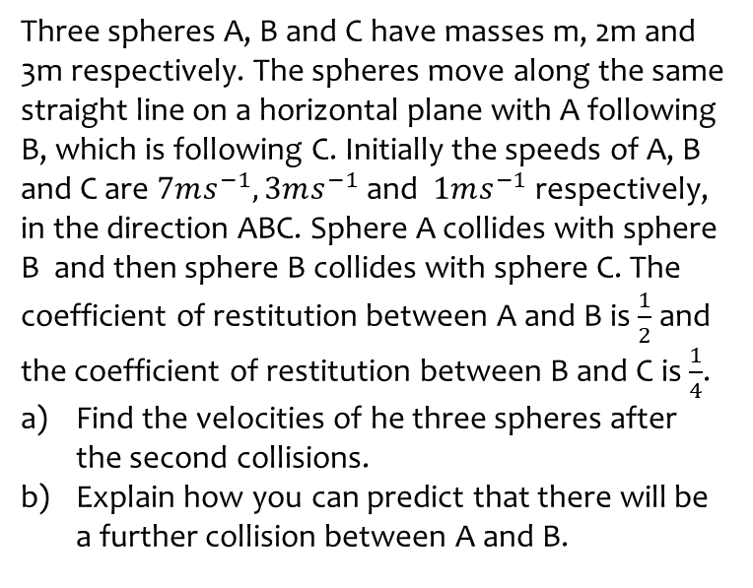
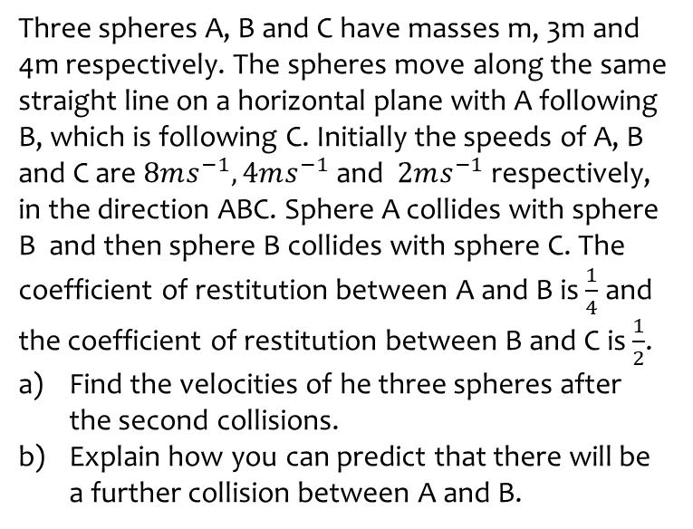
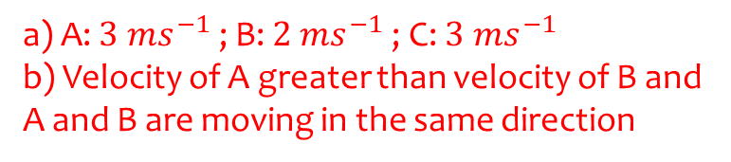
Worked example
Your turn
Three spheres A, B and C have masses m, 3m and 4m respectively. The spheres move along the same straight line on a horizontal plane with A following B, which is following C. Initially the speeds of A, B and C are $8ms^{−1}, 4ms^{−1}$ and $2ms^{−1}$ respectively, in the direction ABC. Sphere A collides with sphere B and then sphere B collides with sphere C. The coefficient of restitution between A and B is $\frac{1}{4}$ and the coefficient of restitution between B and C is $\frac{1}{2}$.
Find the velocities of he three spheres after the second collisions.
Explain how you can predict that there will be a further collision between A and B.
Three spheres A, B and C have masses m, 2m and 3m respectively. The spheres move along the same straight line on a horizontal plane with A following B, which is following C. Initially the speeds of A, B and C are $7ms^{−1}, 3ms^{−1}$ and $1ms^{−1}$ respectively, in the direction ABC. Sphere A collides with sphere B and then sphere B collides with sphere C. The coefficient of restitution between A and B is $\frac{1}{2}$ and the coefficient of restitution between B and C is $\frac{1}{4}$.
Find the velocities of he three spheres after the second collisions.
Explain how you can predict that there will be a further collision between A and B.
a) A: $3 ms^{−1}$ ; B: $2 ms^{−1}$ ; C: $3 ms^{−1}$
b) Velocity of A greater than velocity of B and A and B are moving in the same direction

Slide 3
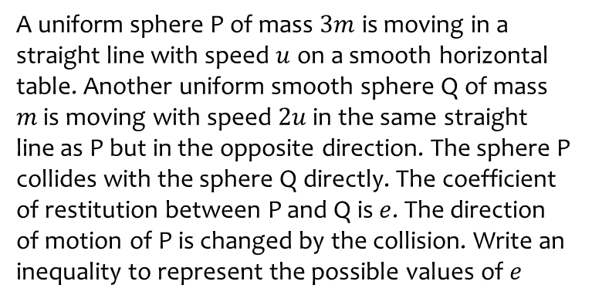
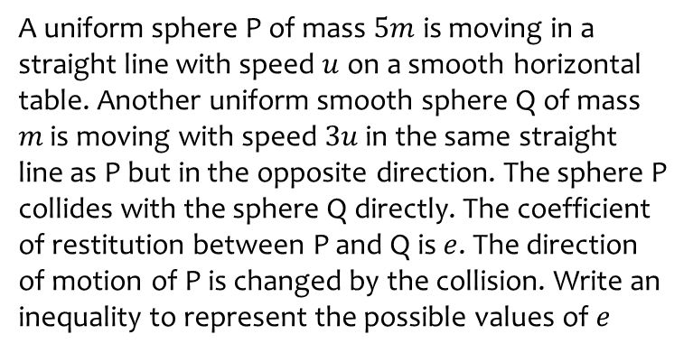

Worked example
Your turn
A uniform sphere P of mass $5m$ is moving in a straight line with speed $u$ on a smooth horizontal table. Another uniform smooth sphere Q of mass $m$ is moving with speed $3u$ in the same straight line as P but in the opposite direction. The sphere P collides with the sphere Q directly. The coefficient of restitution between P and Q is $e$. The direction of motion of P is changed by the collision. Write an inequality to represent the possible values of $e$
A uniform sphere P of mass $3m$ is moving in a straight line with speed $u$ on a smooth horizontal table. Another uniform smooth sphere Q of mass $m$ is moving with speed $2u$ in the same straight line as P but in the opposite direction. The sphere P collides with the sphere Q directly. The coefficient of restitution between P and Q is $e$. The direction of motion of P is changed by the collision. Write an inequality to represent the possible values of $e$
$$e>\frac{1}{3}$$

Slide 4
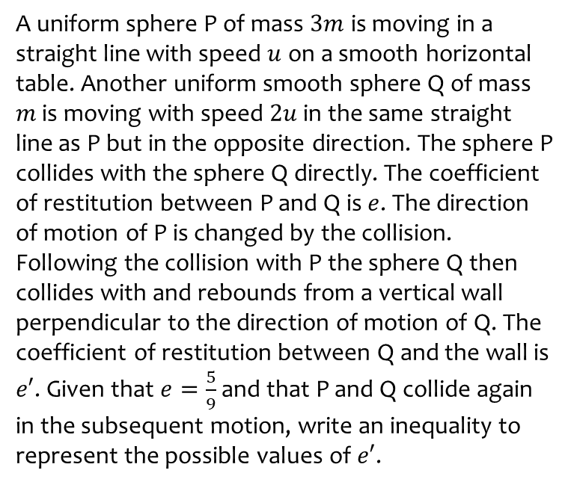
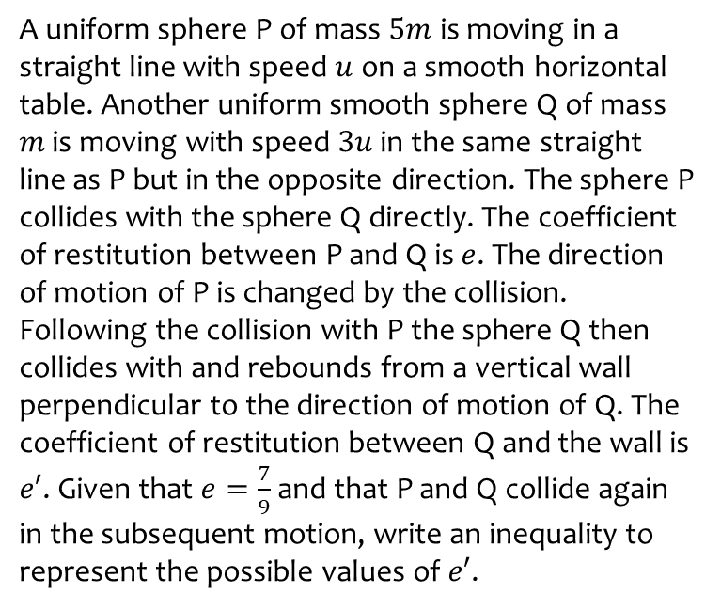

Worked example
Your turn
A uniform sphere P of mass $5m$ is moving in a straight line with speed $u$ on a smooth horizontal table. Another uniform smooth sphere Q of mass $m$ is moving with speed $3u$ in the same straight line as P but in the opposite direction. The sphere P collides with the sphere Q directly. The coefficient of restitution between P and Q is $e$. The direction of motion of P is changed by the collision. Following the collision with P the sphere Q then collides with and rebounds from a vertical wall perpendicular to the direction of motion of Q. The coefficient of restitution between Q and the wall is $e′$. Given that $e=\frac{7}{9}$ and that P and Q collide again in the subsequent motion, write an inequality to represent the possible values of $e′$.
A uniform sphere P of mass $3m$ is moving in a straight line with speed $u$ on a smooth horizontal table. Another uniform smooth sphere Q of mass $m$ is moving with speed $2u$ in the same straight line as P but in the opposite direction. The sphere P collides with the sphere Q directly. The coefficient of restitution between P and Q is $e$. The direction of motion of P is changed by the collision. Following the collision with P the sphere Q then collides with and rebounds from a vertical wall perpendicular to the direction of motion of Q. The coefficient of restitution between Q and the wall is $e′$. Given that $e=\frac{5}{9}$ and that P and Q collide again in the subsequent motion, write an inequality to represent the possible values of $e′$.
$$e′>\frac{1}{9}$$

Slide 5
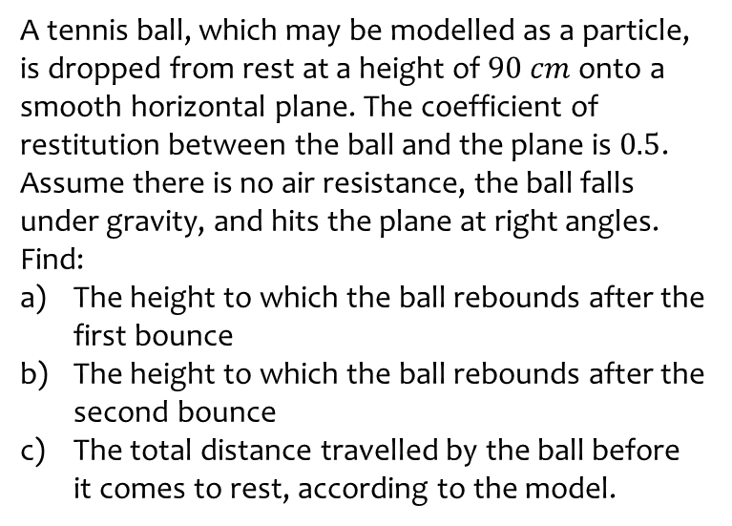
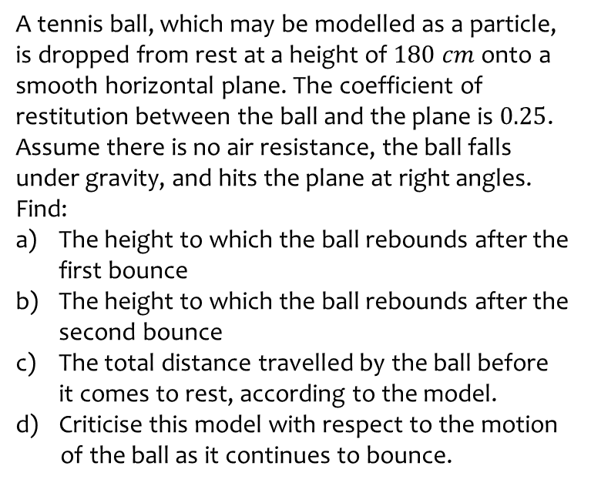
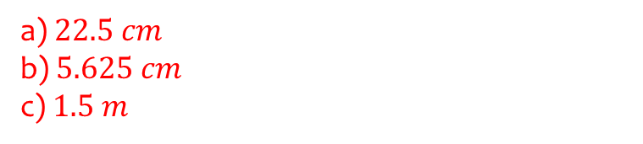
Worked example
Your turn
A tennis ball, which may be modelled as a particle, is dropped from rest at a height of $180 cm$ onto a smooth horizontal plane. The coefficient of restitution between the ball and the plane is $0.25$. Assume there is no air resistance, the ball falls under gravity, and hits the plane at right angles. Find:
The height to which the ball rebounds after the first bounce
The height to which the ball rebounds after the second bounce
The total distance travelled by the ball before it comes to rest, according to the model.
Criticise this model with respect to the motion
of the ball as it continues to bounce.
A tennis ball, which may be modelled as a particle, is dropped from rest at a height of $90 cm$ onto a smooth horizontal plane. The coefficient of restitution between the ball and the plane is $0.5$. Assume there is no air resistance, the ball falls under gravity, and hits the plane at right angles. Find:
The height to which the ball rebounds after the first bounce
The height to which the ball rebounds after the second bounce
The total distance travelled by the ball before it comes to rest, according to the model.
a) $22.5 cm$
b) $5.625 cm$
c) $1.5 m$

Slide 6
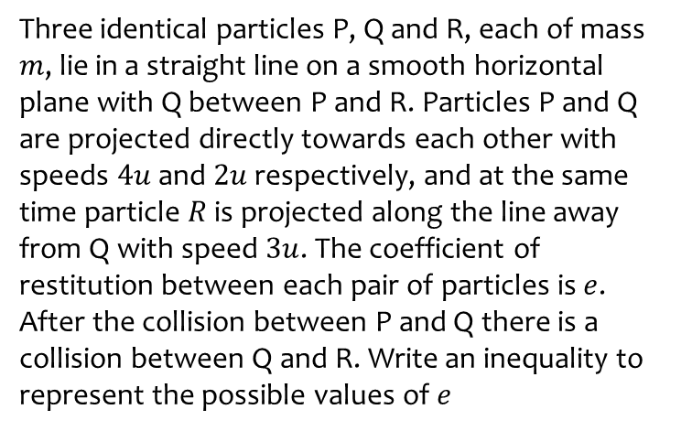
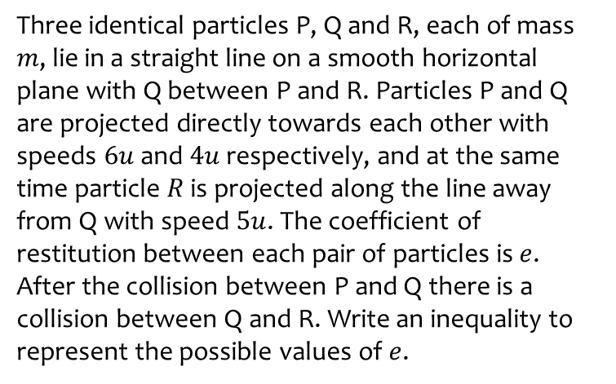

Worked example
Your turn
Three identical particles P, Q and R, each of mass $m$, lie in a straight line on a smooth horizontal plane with Q between P and R. Particles P and Q are projected directly towards each other with speeds $6u$ and $4u$ respectively, and at the same time particle $R$ is projected along the line away from Q with speed $5u$. The coefficient of restitution between each pair of particles is $e$. After the collision between P and Q there is a collision between Q and R. Write an inequality to represent the possible values of $e$.
Three identical particles P, Q and R, each of mass $m$, lie in a straight line on a smooth horizontal plane with Q between P and R. Particles P and Q are projected directly towards each other with speeds $4u$ and $2u$ respectively, and at the same time particle $R$ is projected along the line away from Q with speed $3u$. The coefficient of restitution between each pair of particles is $e$. After the collision between P and Q there is a collision between Q and R. Write an inequality to represent the possible values of $e$
$$e>\frac{2}{3}$$

