Slide 1
4.4) Centres of mass

Slide 2
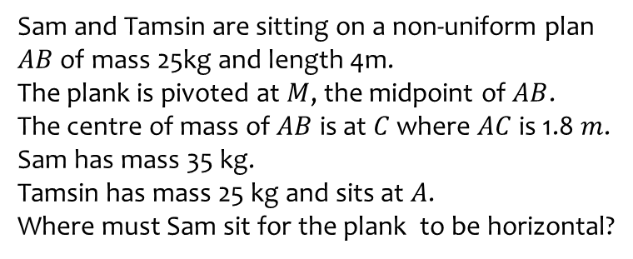
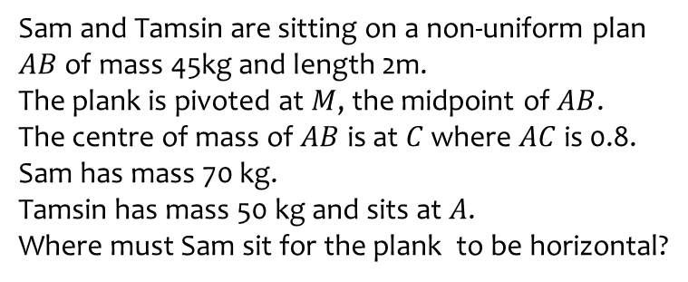
Worked example
Your turn
Sam and Tamsin are sitting on a non-uniform plan $AB$ of mass 45kg and length 2m.
The plank is pivoted at $M$, the midpoint of $AB$.
The centre of mass of $AB$ is at $C$ where $AC$ is 0.8. Sam has mass 70 kg.
Tamsin has mass 50 kg and sits at $A$.
Where must Sam sit for the plank to be horizontal?
Sam and Tamsin are sitting on a non-uniform plan $AB$ of mass 25kg and length 4m.
The plank is pivoted at $M$, the midpoint of $AB$.
The centre of mass of $AB$ is at $C$ where $AC$ is 1.8 $m$. Sam has mass 35 kg.
Tamsin has mass 25 kg and sits at $A$.
Where must Sam sit for the plank to be horizontal?
$3.57 m$ from end $A$

Slide 3
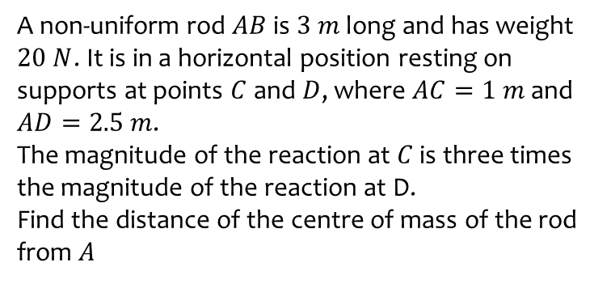
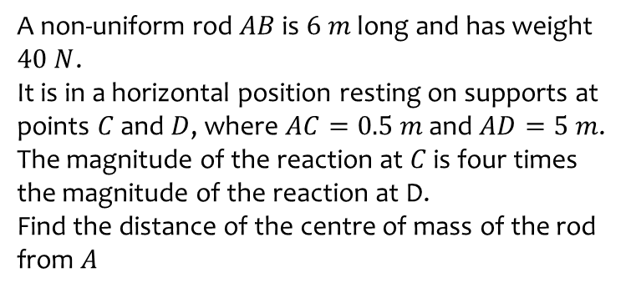
Worked example
Your turn
A non-uniform rod $AB$is $6 m$ long and has weight $40 N$.
It is in a horizontal position resting on supports at points $C$ and $D$, where $AC=0.5 m$ and $AD=5 m$.
The magnitude of the reaction at $C$ is four times the magnitude of the reaction at D.
Find the distance of the centre of mass of the rod from $A$
A non-uniform rod $AB$is $3 m$ long and has weight $20 N$. It is in a horizontal position resting on supports at points $C$ and $D$, where $AC=1 m$ and $AD=2.5 m$.
The magnitude of the reaction at $C$ is three times the magnitude of the reaction at D.
Find the distance of the centre of mass of the rod from $A$
$1.38 m$ (3 sf)

