Slide 1
4.4) Points of intersection

Slide 2
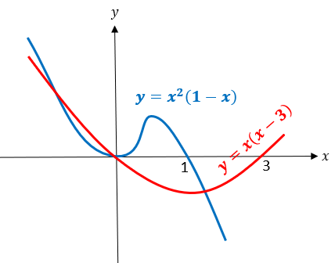
Worked example
Your turn
On the same diagram sketch the curves with equations $y=x(x−2)$ and $y=x^{2}\left(1−x\right)$.
Find the coordinates of their points of intersection.
On the same diagram sketch the curves with equations $y=x(x−3)$ and $y=x^{2}\left(1−x\right)$.
Find the coordinates of their points of intersection.
$$\left(−\sqrt{3}, 3+3\sqrt{3}\right), \\ \left(0,0\right), \\ \left(\sqrt{3}, 3−3\sqrt{3}\right)$$

Slide 3
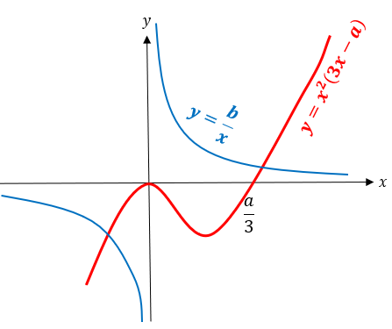
Worked example
Your turn
On the same diagram sketch the curves with equations $y=−x^{2}\left(5x−a\right)$ and $y=−\frac{b}{x}$, where $a,b$ are positive constants.
State, giving a reason, the number of real solutions to the equation $x^{2}\left(5x−a\right)+\frac{b}{x}=0$
On the same diagram sketch the curves with equations $y=x^{2}\left(3x−a\right)$ and $y=\frac{b}{x}$,
where $a,b$ are positive constants.
State, giving a reason, the number of real solutions to the equation $x^{2}\left(3x−a\right)−\frac{b}{x}=0$
$2$ points of intersection where
$$x^{2}\left(3x−a\right)=\frac{b}{x}$$
$$x^{2}\left(3x−a\right)−\frac{b}{x}=0$$
$∴2$ solutions

Slide 4
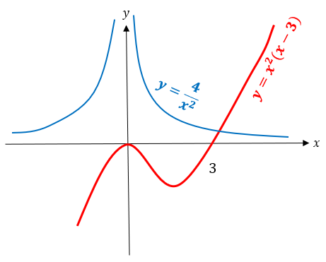
Worked example
Your turn
On the same diagram sketch the curves with equations $y=\frac{3}{x^{2}}$ and $y=x^{2}(x−4)$.
State, giving a reason, the number of real solutions to the equation $x^{4}\left(x−4\right)−3=0$
On the same diagram sketch the curves with equations $y=\frac{4}{x^{2}}$ and $y=x^{2}(x−3)$.
State, giving a reason, the number of real solutions to the equation $x^{4}\left(x−3\right)−4=0$
$1$ point of intersection where
$$x^{2}\left(x−3\right)=\frac{4}{x^{2}}$$
$$x^{4}\left(x−3\right)=4$$
$$x^{4}\left(x−3\right)−4=0$$
$∴1$ real solution

Slide 5
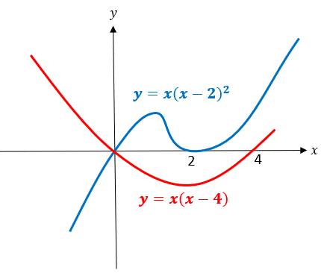
Worked example
Your turn
On the same diagram sketch the curves with equations $y=x(x−5)$ and $y=x{\left(x−3\right)}^{2}$, and hence find the coordinates of any points of intersection.
On the same diagram sketch the curves with equations $y=x(x−4)$ and $y=x{\left(x−2\right)}^{2}$, and hence find the coordinates of any points of intersection.
$(0, 0)$ only as:
$$x{\left(x−2\right)}^{2}=x\left(x−4\right) \\ x\left(x^{2}−4x+4\right)=x^{2}−4x \\ x^{3}−4x^{2}+4x=x^{2}−4x \\ x^{3}−5x^{2}+8x=0 \\ x\left(x^{2}−5x+8\right)=0$$
Discriminant of $x^{2}−5x+8=−7<0$

Slide 6
Worked example
Your turn
Work out the range of values of $a$ such that the graphs of $y=x^{2}+a$ and $3y=x−2$ have two points of intersection
Work out the range of values of $a$ such that the graphs of $y=x^{2}+a$ and $4y=x−3$ have two points of intersection
$$a<−\frac{47}{72}$$

