Slide 1
4.3) Equilibrium

Slide 2
Worked example
Your turn
Person A and Person B are on opposite ends of a uniform seesaw of mass 30kg.
A weighs 60kg and is 5m from the pivot.
B is 4m from the pivot.
The seesaw remains horizontal. Determine:
a) The reaction force at the pivot of the seesaw
b) The mass of B
Person A and Person B are on opposite ends of a uniform seesaw of mass 20kg.
A weighs 70kg and is 10m from the pivot.
B is 8m from the pivot.
The seesaw remains horizontal. Determine:
a) The reaction force at the pivot of the seesaw
b) The mass of B
a) $1764 N$
b) $90 kg$

Slide 3
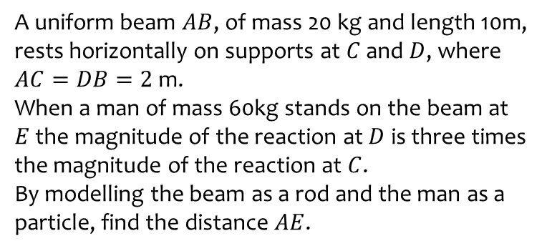
Worked example
Your turn
A uniform beam $AB$, of mass 20 kg and length 10m, rests horizontally on supports at $C$ and $D$, where $AC=DB=2$ m.
When a man of mass 60kg stands on the beam at $E$ the magnitude of the reaction at $D$ is three times the magnitude of the reaction at $C$.
By modelling the beam as a rod and the man as a particle, find the distance $AE$.
A uniform beam $AB$, of mass 40 kg and length 5m, rests horizontally on supports at $C$ and $D$, where $AC=DB=1$ m.
When a man of mass 80kg stands on the beam at $E$ the magnitude of the reaction at $D$ is twice the magnitude of the reaction at $C$.
By modelling the beam as a rod and the man as a particle, find the distance $AE$.
$$3.25 m$$

Slide 4
Worked example
Your turn
A uniform rod $AB$has length $5 m$ and mass $20 kg$.
The rod is in equilibrium in a horizontal position, resting on two smooth supports at $C$ and $D$, where $AC=0.4$ metres and $DB=x$ metres.
Given that the magnitude of the reaction on the rod at D is three times the magnitude of the reaction on the rod at C, find the value of $x$
A uniform rod $AB$has length $2 m$ and mass $50 kg$.
The rod is in equilibrium in a horizontal position, resting on two smooth supports at $C$ and $D$, where $AC=0.2$ metres and $DB=x$ metres.
Given that the magnitude of the reaction on the rod at D is twice the magnitude of the reaction on the rod at C, find the value of $x$
$$x=0.6$$

Slide 5
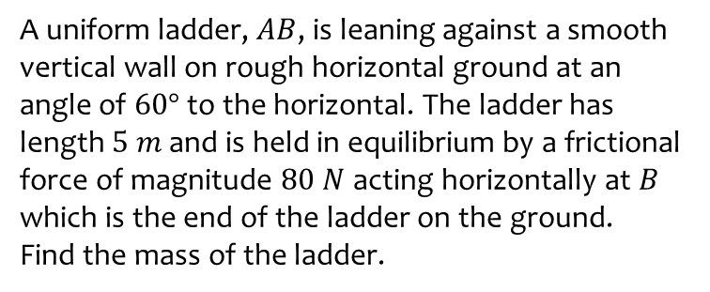
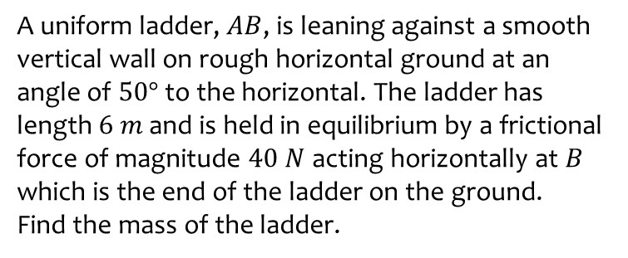
Worked example
Your turn
A uniform ladder, $AB$, is leaning against a smooth vertical wall on rough horizontal ground at an angle of $50°$ to the horizontal. The ladder has length $6 m$ and is held in equilibrium by a frictional force of magnitude $40 N$ acting horizontally at $B$ which is the end of the ladder on the ground.
Find the mass of the ladder.
A uniform ladder, $AB$, is leaning against a smooth vertical wall on rough horizontal ground at an angle of $60°$ to the horizontal. The ladder has length $5 m$ and is held in equilibrium by a frictional force of magnitude $80 N$ acting horizontally at $B$ which is the end of the ladder on the ground.
Find the mass of the ladder.
$28.3 kg$ (3 sf)

