Slide 1
4.3) Reciprocal graphs

Slide 2
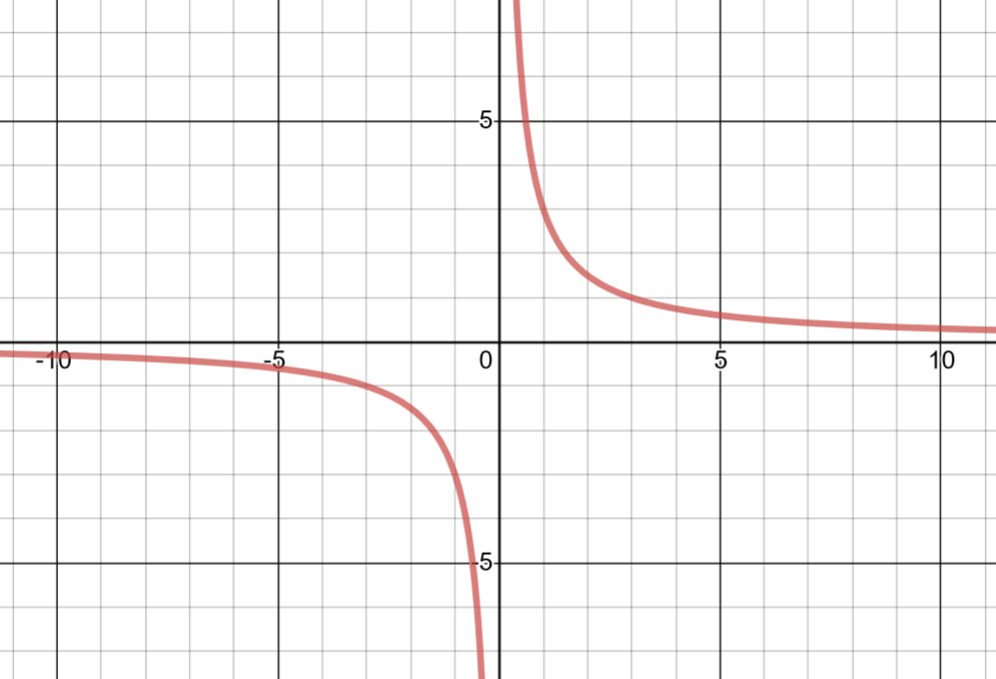
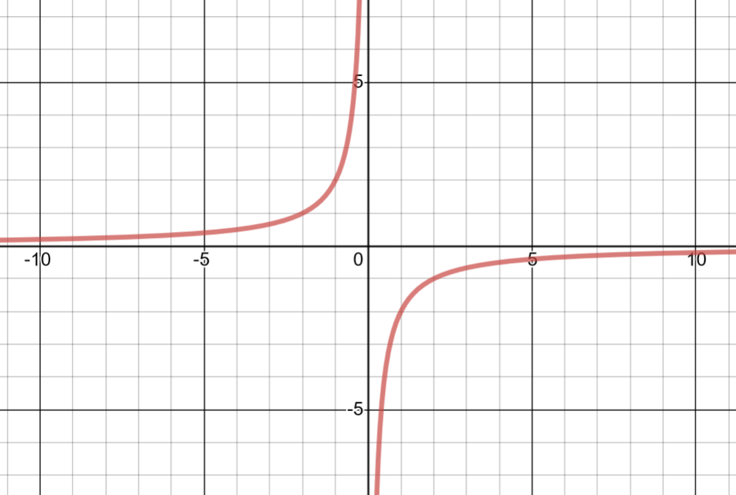
Worked example
Your turn
Sketch the graph of $y=\frac{a}{x}, a>0$
Sketch the graph of $y=\frac{a}{x}, a<0$
Sketch the graph of $y=\frac{3}{x}$
Sketch the graph of $y=\frac{−2}{x}$
Graphs used with permission from DESMOS: https://www.desmos.com/

Slide 3
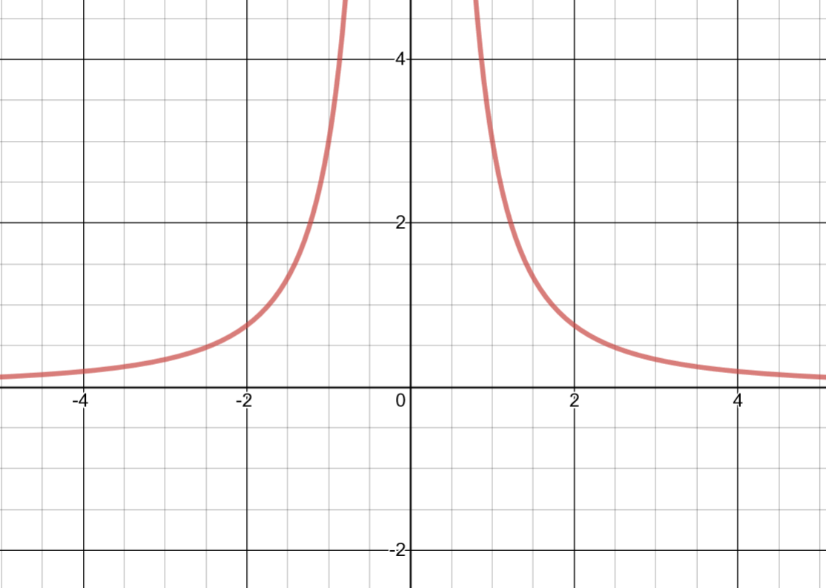
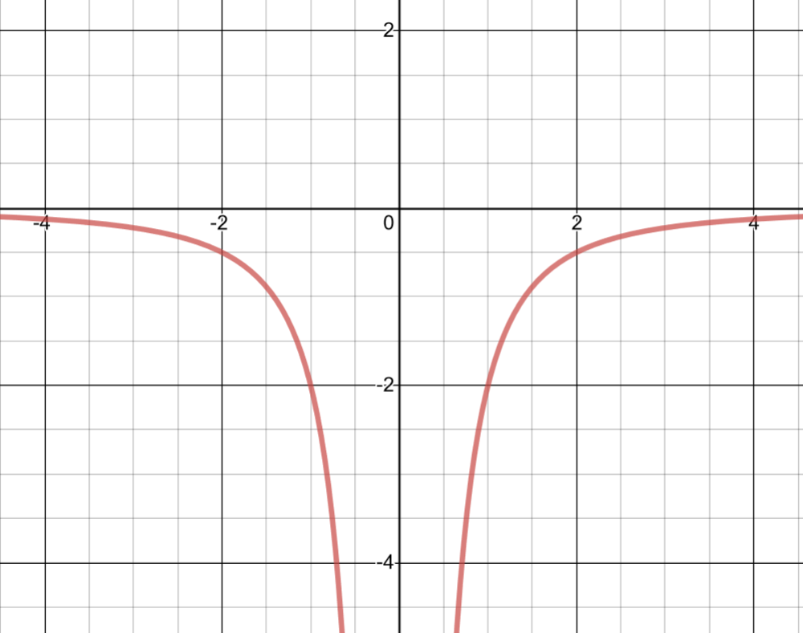
Worked example
Your turn
Sketch the graph of $y=\frac{a}{x^{2}}, a>0$
Sketch the graph of $y=\frac{a}{x^{2}}, a<0$
Sketch the graph of $y=\frac{3}{x^{2}}$
Sketch the graph of $y=\frac{−2}{x^{2}}$
Graphs used with permission from DESMOS: https://www.desmos.com/

Slide 4
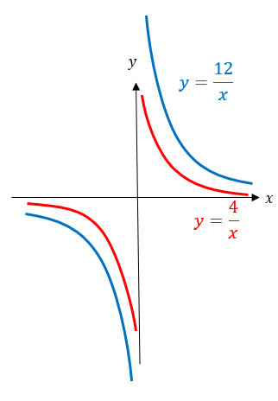
Worked example
Your turn
Sketch on the same diagram:
$y=\frac{2}{x}$ and $y=\frac{8}{x}$
Sketch on the same diagram:
$y=\frac{4}{x}$ and $y=\frac{12}{x}$

Slide 5
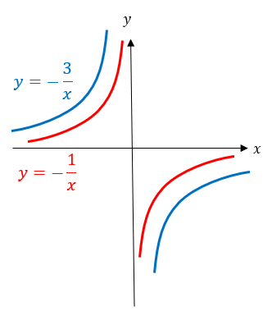
Worked example
Your turn
Sketch on the same diagram:
$y=−\frac{2}{x}$ and $y=−\frac{8}{x}$
Sketch on the same diagram:
$y=−\frac{1}{x}$ and $y=−\frac{3}{x}$

Slide 6
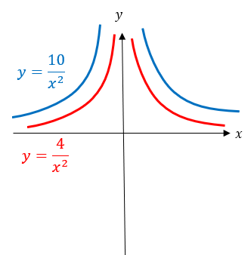
Worked example
Your turn
Sketch on the same diagram:
$y=\frac{2}{x^{2}}$ and $y=\frac{7}{x^{2}}$
Sketch on the same diagram:
$y=\frac{4}{x^{2}}$ and $y=\frac{10}{x^{2}}$

