Slide 1
4.3) Using partial fractions

Slide 2
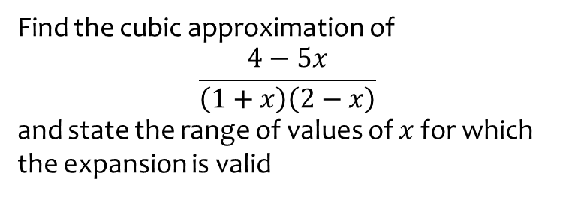
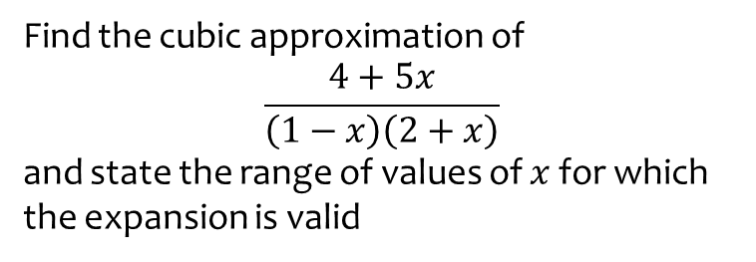

Worked example
Your turn
Find the cubic approximation of
$$\frac{4+5x}{\left(1−x\right)\left(2+x\right)}$$
and state the range of values of $x$ for which the expansion is valid
Find the cubic approximation of
$$\frac{4−5x}{\left(1+x\right)\left(2−x\right)}$$
and state the range of values of $x$ for which the expansion is valid
$$2−\frac{7}{2}x+\frac{11}{4}x^{2}−\frac{25}{8}x^{3}$$
Valid for $\left|x\right|<1$

Slide 3
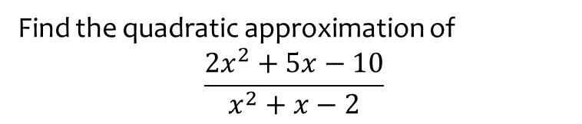


Worked example
Your turn
Find the quadratic approximation of
$$\frac{2x^{2}−5x−10}{x^{2}−x−2}$$
Find the quadratic approximation of
$$\frac{2x^{2}+5x−10}{x^{2}+x−2}$$
$$5+\frac{3}{2}x^{2}+…$$

Slide 4


Worked example
Your turn
Find the quadratic approximation of
$$\frac{40x^{2}−37x+9}{{\left(4x−1\right)}^{2}(x+2)}$$
Find the quadratic approximation of
$$\frac{8x^{2}−13x+6}{{\left(2x−1\right)}^{2}(x+1)}$$
$$6+5x+23x^{2}$$

