Slide 1
4.3) Loss of kinetic energy

Slide 2
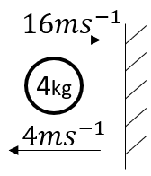
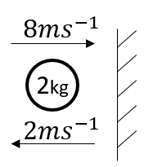
Worked example
Your turn
Find the loss in kinetic energy
Find the loss in kinetic energy
$$60 J$$
Diagrams used with permission from DrFrostMaths: https://www.drfrostmaths.com/

Slide 3
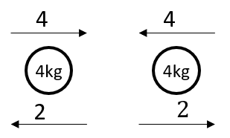
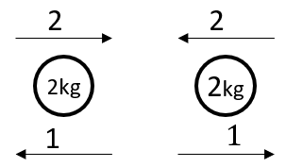
Worked example
Your turn
Find the total loss in kinetic energy
Find the total loss in kinetic energy
$$6 J$$
Diagrams used with permission from DrFrostMaths: https://www.drfrostmaths.com/

Slide 4
Worked example
Your turn
Find the percentage of kinetic energy lost in the collision.
Find the percentage of kinetic energy lost in the collision.
$$75\%$$
Diagrams used with permission from DrFrostMaths: https://www.drfrostmaths.com/

Slide 5
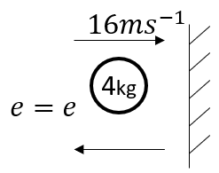
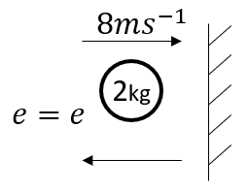
Worked example
Your turn
Find the loss in kinetic energy, in terms of $e$
Find the loss in kinetic energy, in terms of $e$
$$64(1−e^{2})$$
Diagrams used with permission from DrFrostMaths: https://www.drfrostmaths.com/

Slide 6
Worked example
Your turn
Two spheres A and B have massed $6 kg$ and $10 kg$ respectively. A and B move towards each other in opposite directions along the same straight line on a smooth horizontal surface with speeds $6 ms^{−1}$ and $4 ms^{−1}$ respectively.
Given that the coefficient of restitution is $\frac{2}{5}$, find:
The velocities of the spheres after the collision
The loss of kinetic energy due to the impact
Two spheres A and B have massed $3 kg$ and $5 kg$ respectively. A and B move towards each other in opposite directions along the same straight line on a smooth horizontal surface with speeds $3 ms^{−1}$ and $2 ms^{−1}$ respectively.
Given that the coefficient of restitution is $\frac{3}{5}$, find:
The velocities of the spheres after the collision
The loss of kinetic energy due to the impact
a) A: Direction reversed and speed $2 ms^{−1}$
B: Direction reversed and speed $1 ms^{−1}$
b) $15 J$

Slide 7
Worked example
Your turn
A gun of mass 1200 kg fires a shell of mass 24 kg with speed $400 ms^{−1}$.
Find the velocity of the gun after firing
Find the total kinetic energy generated on firing
Show that the ratio of the energy of the gun to the energy of the shell is equal to the ratio of the speed of the gun to the speed of the shell after firing
A gun of mass 600 kg fires a shell of mass 12 kg with speed $200 ms^{−1}$.
Find the velocity of the gun after firing
Find the total kinetic energy generated on firing
Show that the ratio of the energy of the gun to the energy of the shell is equal to the ratio of the speed of the gun to the speed of the shell after firing
Direction of gun reversed and speed $4 ms^{−1}$
$244800 J$
Shown. Both ratios $1:50$

Slide 8
Worked example
Your turn
Two particles A and B, of masses 400g and 600g respectively, are connected by a light inextensible string. The particles are side by side at rest on a smooth floor and A is projected with speed $12ms^{−1}$ directly away from B. When the string becomes taut, particle B is jerked into motion and A and B then move with a common speed in the direction of the projection of A. Find:
the common speed of the particles after the string becomes taut
The loss in kinetic energy due to the jerk
Two particles A and B, of masses 200g and 300g respectively, are connected by a light inextensible string. The particles are side by side at rest on a smooth floor and A is projected with speed $6ms^{−1}$ directly away from B. When the string becomes taut, particle B is jerked into motion and A and B then move with a common speed in the direction of the projection of A. Find:
the common speed of the particles after the string becomes taut
The loss in kinetic energy due to the jerk
a) $2.4 ms^{−1}$
b) $2.16 J$

