Slide 1
4.2) Quartic graphs

Slide 2
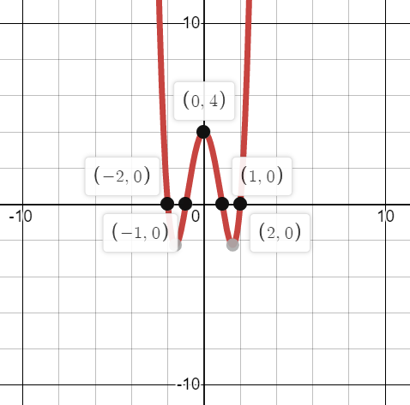
Worked example
Your turn
Sketch the graph of:
$$y=(x+3)(x+4)(x−3)(x−4)$$
Sketch the graph of:
$$y=(x+1)(x+2)(x−1)(x−2)$$

Slide 3
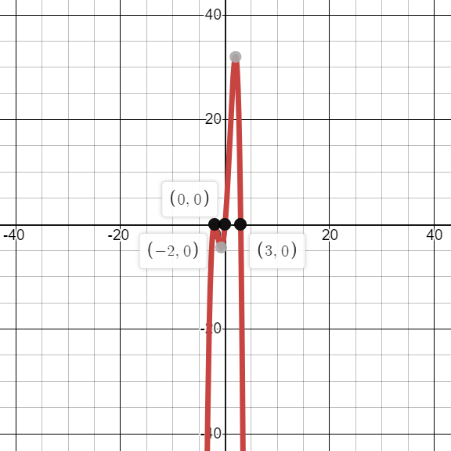
Worked example
Your turn
Sketch the graph of:
$$y=x{\left(x−3\right)}^{2}(2−x)$$
Sketch the graph of:
$$y=x{\left(x+2\right)}^{2}(3−x)$$

Slide 4
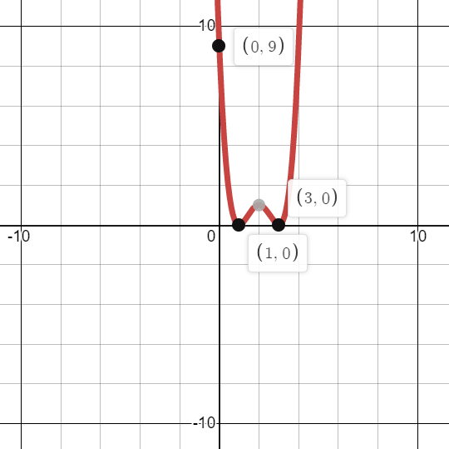
Worked example
Your turn
Sketch the graph of:
$$y={\left(x+2\right)}^{2}{\left(x−4\right)}^{2}$$
Sketch the graph of:
$$y={\left(x−1\right)}^{2}{\left(x−3\right)}^{2}$$

Slide 5
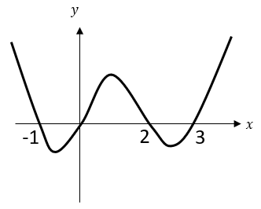
Worked example
Your turn
Sketch the graph of:
$$y=x(x−4)(x+5)(x+6)$$
Sketch the graph of:
$$y=x(x+1)(x−2)(x−3)$$

Slide 6
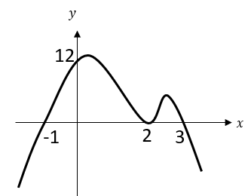
Worked example
Your turn
Sketch the graph of:
$$y={\left(x+4\right)}^{2}(x−5)(6−x)$$
Sketch the graph of:
$$y={\left(x−2\right)}^{2}(x+1)(3−x)$$

Slide 7
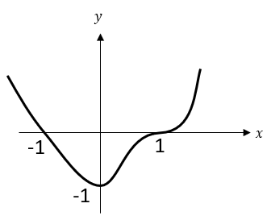
Worked example
Your turn
Sketch the graph of:
$$y=\left(x−2\right){\left(x+2\right)}^{3}$$
Sketch the graph of:
$$y=\left(x+1\right){\left(x−1\right)}^{3}$$

Slide 8
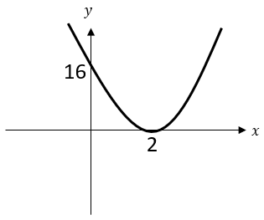
Worked example
Your turn
Sketch the graph of:
$$y={\left(x+3\right)}^{4}$$
Sketch the graph of:
$$y={\left(x−2\right)}^{4}$$

Slide 9
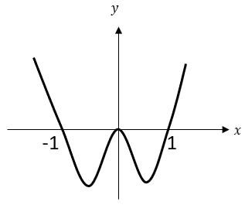
Worked example
Your turn
Sketch the graph of:
$$y=x^{2}\left(x+2\right)\left(x−2\right)$$
Sketch the graph of:
$$y=x^{2}\left(x+1\right)\left(x−1\right)$$

Slide 10
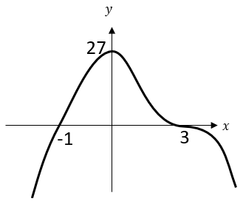
Worked example
Your turn
Sketch the graph of:
$$y=−(x−4){\left(x+2\right)}^{3}$$
Sketch the graph of:
$$y=−(x+1){\left(x−3\right)}^{3}$$

