Slide 1
4.2) Resultant moments

Slide 2
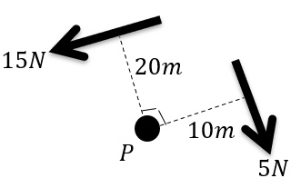
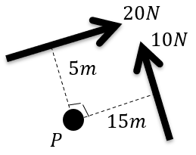
Worked example
Your turn
Calculate the resultant moment acting about $P$
Calculate the resultant moment acting about $P$
$50 Nm$ anticlockwise
Diagrams/Graphs used with permission from DrFrostMaths: https://www.drfrostmaths.com/

Slide 3
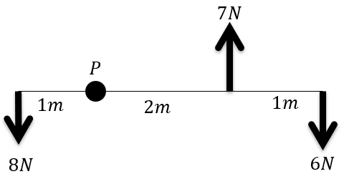
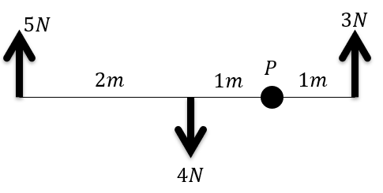
Worked example
Your turn
The rod is light. Calculate the resultant moment acting about $P$.
The rod is light. Calculate the resultant moment acting about $P$.
$8 Nm$clockwise
Diagrams/Graphs used with permission from DrFrostMaths: https://www.drfrostmaths.com/

Slide 4
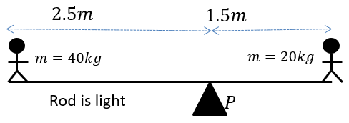
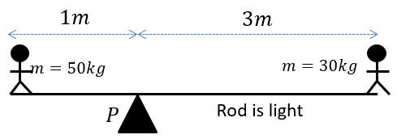
Worked example
Your turn
Find the resultant moment acting about $P$
Find the resultant moment acting about $P$
$40g Nm=392 Nm$ clockwise
Diagrams/Graphs used with permission from DrFrostMaths: https://www.drfrostmaths.com/

Slide 5
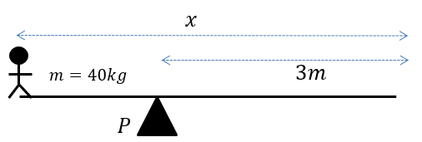
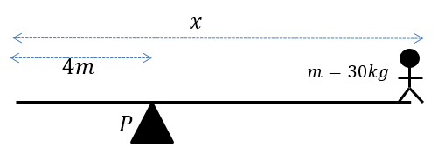
Worked example
Your turn
The rod is light. Calculate the resultant moment acting about $P$.
The rod is light. Calculate the resultant moment acting about $P$.
$30g\left(x−4\right) Nm$ clockwise
Diagrams/Graphs used with permission from DrFrostMaths: https://www.drfrostmaths.com/

Slide 6
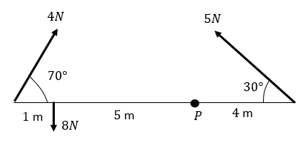
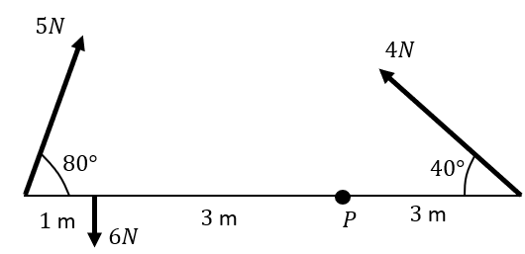
Worked example
Your turn
The rod is light. Calculate the resultant moment acting about $P$.
The rod is light. Calculate the resultant moment acting about $P$.
$6.02 Nm$ anticlockwise (3 sf)
Diagrams/Graphs used with permission from DrFrostMaths: https://www.drfrostmaths.com/

Slide 7
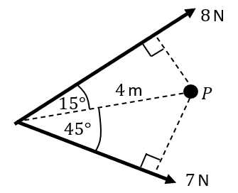
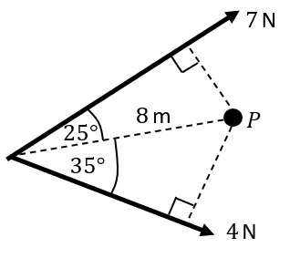
Worked example
Your turn
The rod is light. Calculate the resultant moment acting about $P$
Two forces act on a lamina. Calculate the resultant moment about the point $P$.
$5.31 Nm$ clockwise (3 sf)
Diagrams/Graphs used with permission from DrFrostMaths: https://www.drfrostmaths.com/

Slide 8
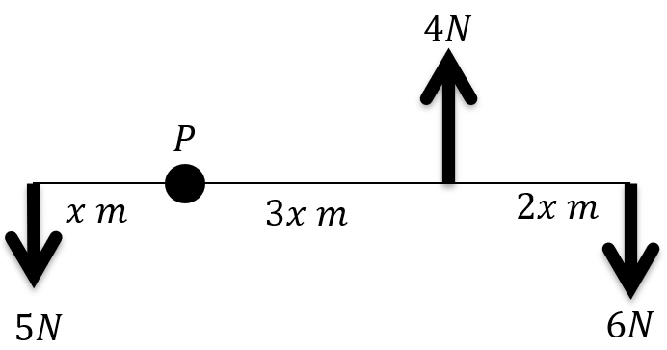
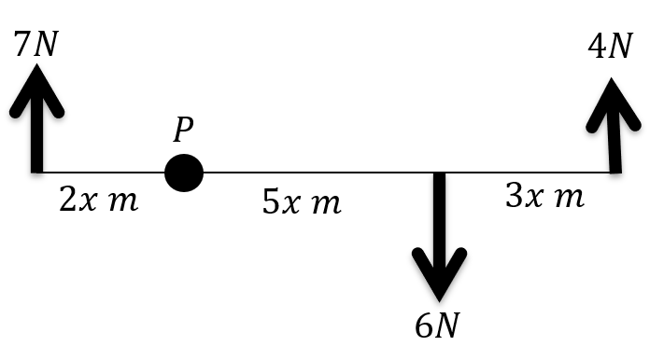
Worked example
Your turn
A set of forces act on a light rod.
The resultant moment of P is $26 Nm$ clockwise. Find the value of $x$
A set of forces act on a light rod.
The resultant moment of P is $48 Nm$ clockwise. Find the value of $x$
$$x=4$$
Diagrams/Graphs used with permission from DrFrostMaths: https://www.drfrostmaths.com/

