Slide 1
4.2) Linear regression

Slide 2
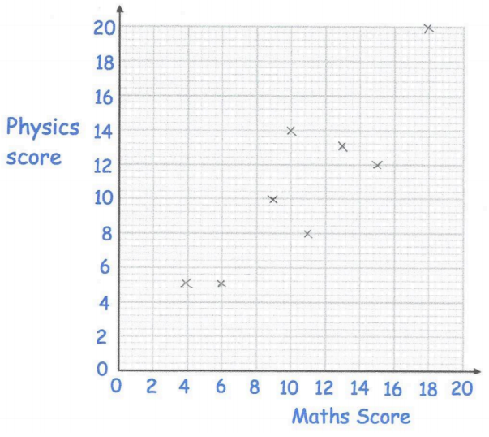
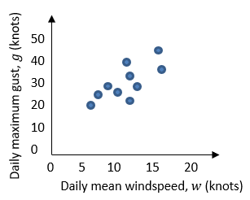
Worked example
Your turn
The following data was plotted on a scatter diagram.
The equation of the regression line of $y$ on $x$ for these 8 students is $y=0.54+0.96x$
Draw the regression line on your diagram.
Give an interpretation of the value of the gradient.
Justify the use of a linear regression line in this instance.
From the large data set, the daily mean windspeed, $w$ knots, and the daily maximum gust, $g$ knots, were recorded for the first 15 days in May in Camborne in 2015.
The data was plotted on a scatter diagram.
The equation of the regression line of $g$ on $w$ for these 15 days is $g=7.23+1.82w$
Draw the regression line on your diagram.
Give an interpretation of the value of the gradient.
Justify the use of a linear regression line in this instance.
Maths score ($x$) | $$9$$ | $$13$$ | $$6$$ | $$18$$ | $$11$$ | $$4$$ | $$15$$ | $$10$$
Physics score ($y$) | $$10$$ | $$13$$ | $$5$$ | $$20$$ | $$8$$ | $$5$$ | $$12$$ | $$14$$
Drawn
Gradient $=1.82$. If the daily mean windspeed increases by 10 knots the daily maximum gust increases by approximately 18 knots.
The correlation suggests that there is a linear relationship
between $g$ and $w$ so a linear regression line is a suitable model.
Questions used with permission from Corbettmaths (https://corbettmaths.com/) and Drfrostmaths (https://www.drfrostmaths.com/)

Slide 3
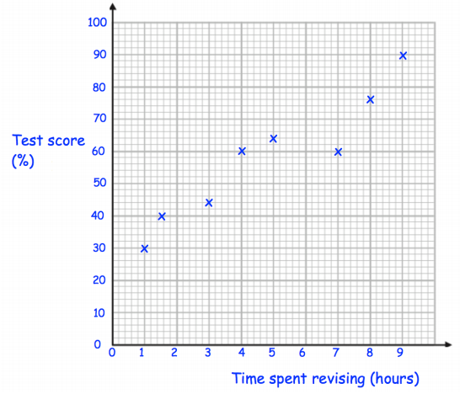
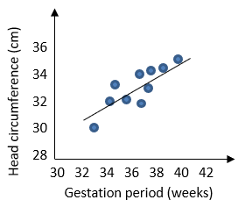

Worked example
Your turn
The test score, $y\%$, and time spent revising, $x$ hours, for a random sample of eight new students are recorded.
The scatter graph shows the results.
The equation of the regression line of $y$ on $x$ is $y=27.9+6.25x$.
The regression equation is used to estimate the test score of a student who revised for $5.5$ hours and a student who revised for $15.5$ hours.
Comment on the reliability of these estimates.
A teacher wants to estimate the time spent revising for a student who achieved a test score of $35\%$.
(b) Explain why the regression equation given above is not suitable for this estimate.
The head circumference, $y$ cm, and gestation period, $x$ weeks, for a random sample of eight new born babies at a clinic are recorded.
The scatter graph shows the results.
The equation of the regression line of $y$ on $x$ is $y=8.91+0.624x$.
The regression equation is used to estimate the head circumference of a baby born at 39 weeks and a baby born at 30 weeks.
Comment on the reliability of these estimates.
A nurse wants to estimate the gestation period for a baby born with a head circumference of 31.6cm.
(b) Explain why the regression equation given above is not suitable for this estimate.
The prediction for 39 weeks is within the range of the data (interpolation) so is more likely to be correct.
The prediction for 30 weeks is outside the range of the data (extrapolation) so is less likely to be accurate.
The independent variable in this model is the gestation period, $x$. You should not use this model to predict a value of $x$ for a given value of $y$.
Questions used with permission from Corbettmaths (https://corbettmaths.com/) and Drfrostmaths (https://www.drfrostmaths.com/)

