Slide 1
4.2) Direct collision with a smooth plane

Slide 2
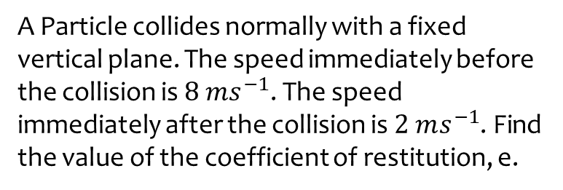
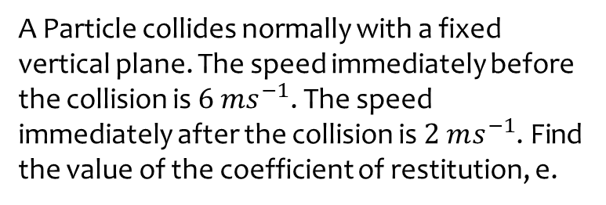
Worked example
Your turn
A Particle collides normally with a fixed vertical plane. The speed immediately before the collision is $6 ms^{−1}$. The speed immediately after the collision is $2 ms^{−1}$. Find the value of the coefficient of restitution, e.
A Particle collides normally with a fixed vertical plane. The speed immediately before the collision is $8 ms^{−1}$. The speed immediately after the collision is $2 ms^{−1}$. Find the value of the coefficient of restitution, e.
$$\frac{1}{4}$$

Slide 3
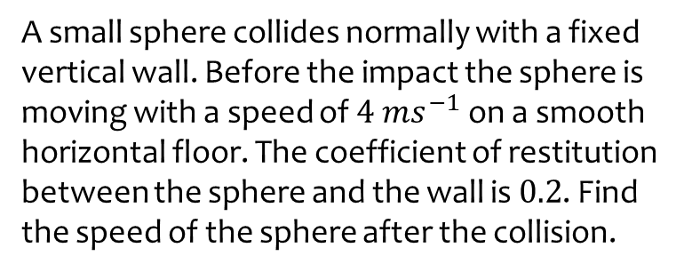
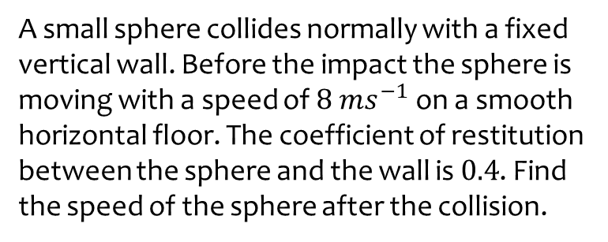
Worked example
Your turn
A small sphere collides normally with a fixed vertical wall. Before the impact the sphere is moving with a speed of $8 ms^{−1}$ on a smooth horizontal floor. The coefficient of restitution between the sphere and the wall is $0.4$. Find the speed of the sphere after the collision.
A small sphere collides normally with a fixed vertical wall. Before the impact the sphere is moving with a speed of $4 ms^{−1}$ on a smooth horizontal floor. The coefficient of restitution between the sphere and the wall is $0.2$. Find the speed of the sphere after the collision.
$$0.8 ms^{−1}$$

Slide 4
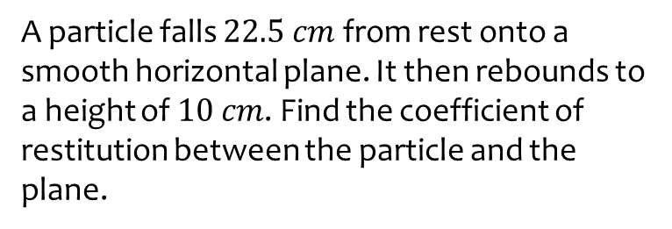
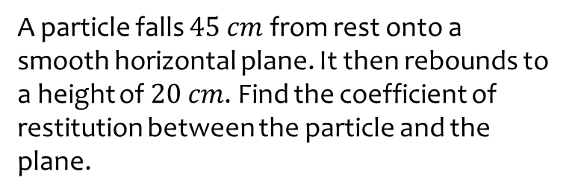
Worked example
Your turn
A particle falls $45 cm$ from rest onto a smooth horizontal plane. It then rebounds to a height of $20 cm$. Find the coefficient of restitution between the particle and the plane.
A particle falls $22.5 cm$ from rest onto a smooth horizontal plane. It then rebounds to a height of $10 cm$. Find the coefficient of restitution between the particle and the plane.
$0.667$ (3 sf)

Slide 5
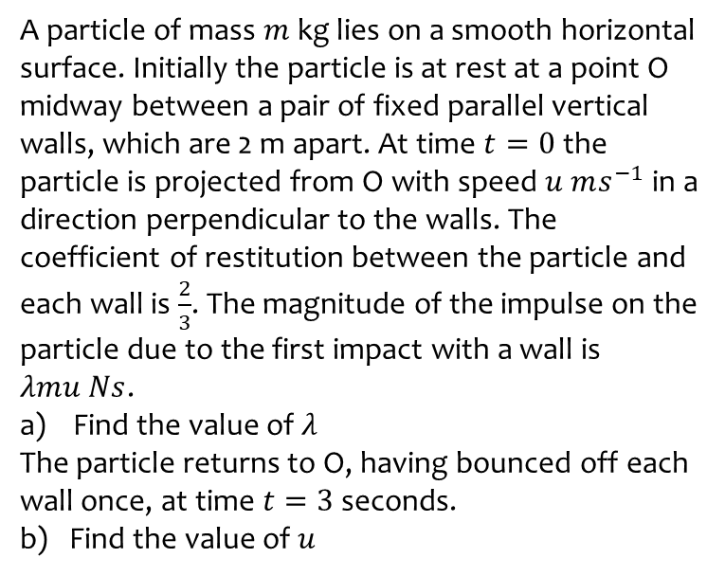
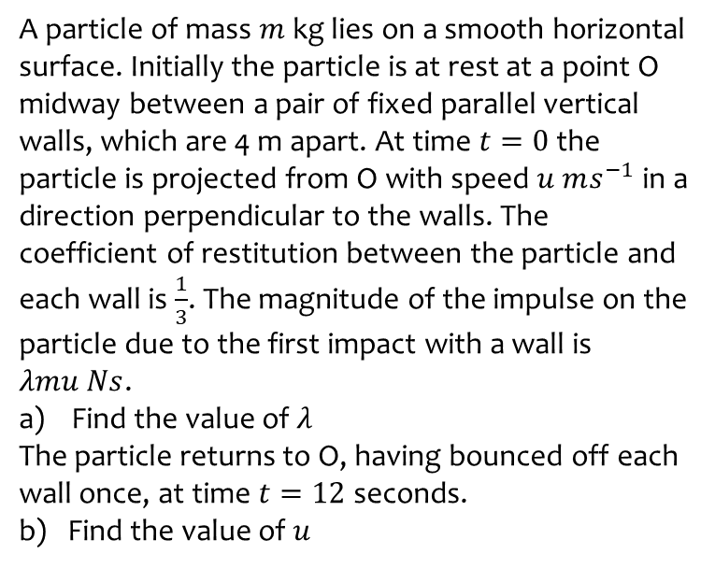
Worked example
Your turn
A particle of mass $m$ kg lies on a smooth horizontal surface. Initially the particle is at rest at a point O midway between a pair of fixed parallel vertical walls, which are 4 m apart. At time $t=0$ the particle is projected from O with speed $u ms^{−1}$ in a direction perpendicular to the walls. The coefficient of restitution between the particle and each wall is $\frac{1}{3}$. The magnitude of the impulse on the particle due to the first impact with a wall is $λmu Ns$.
Find the value of $λ$
The particle returns to O, having bounced off each wall once, at time $t=12$ seconds.
b) Find the value of $u$
A particle of mass $m$ kg lies on a smooth horizontal surface. Initially the particle is at rest at a point O midway between a pair of fixed parallel vertical walls, which are 2 m apart. At time $t=0$ the particle is projected from O with speed $u ms^{−1}$ in a direction perpendicular to the walls. The coefficient of restitution between the particle and each wall is $\frac{2}{3}$. The magnitude of the impulse on the particle due to the first impact with a wall is $λmu Ns$.
Find the value of $λ$
The particle returns to O, having bounced off each wall once, at time $t=3$ seconds.
b) Find the value of $u$
a) $λ=\frac{5}{3}$
b) $u=\frac{25}{12}$

Slide 6
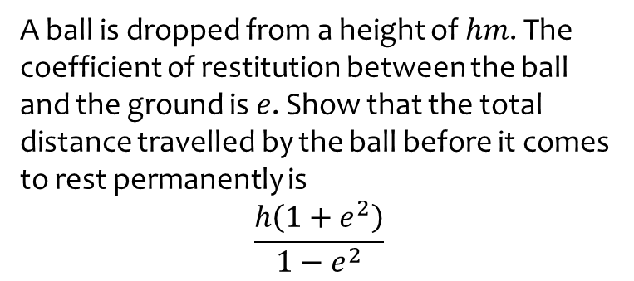
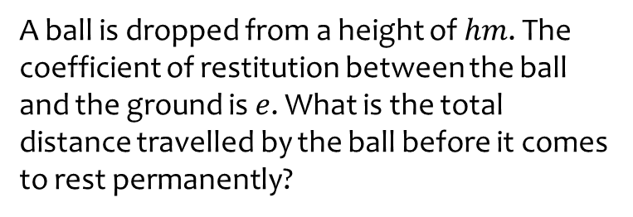
Worked example
Your turn
A ball is dropped from a height of $hm$. The coefficient of restitution between the ball and the ground is $e$. What is the total distance travelled by the ball before it comes to rest permanently?
A ball is dropped from a height of $hm$. The coefficient of restitution between the ball and the ground is $e$. Show that the total distance travelled by the ball before it comes to rest permanently is
$$\frac{h\left(1+e^{2}\right)}{1−e^{2}}$$
Shown

