Slide 1
4.1) Cubic graphs

Slide 2
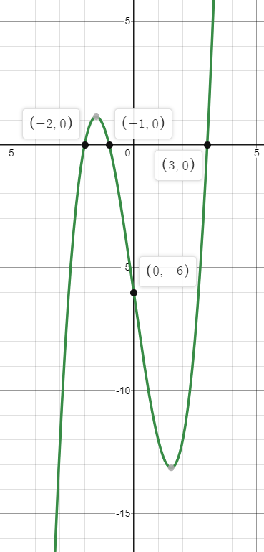

Worked example
Your turn
Sketch the graph of:
$$y=\left(x+1\right)\left(x+2\right)\left(x+3\right)$$
$$y=(x+1)(x−2)(x+3)$$
Sketch the graph of:
$$y=\left(x+1\right)\left(x+2\right)\left(x−3\right)$$

Slide 3
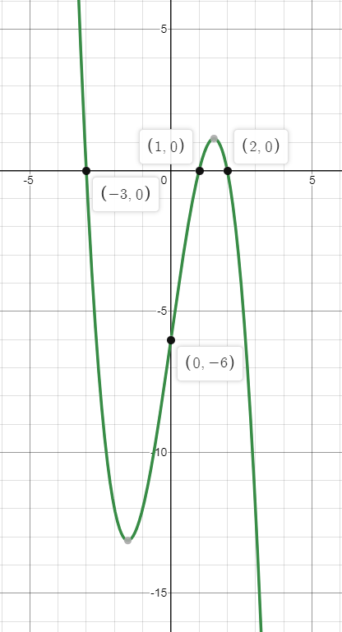

Worked example
Your turn
Sketch the graph of:
$$y=(x+1)(x−2)(3−x)$$
$$y=(x−1)(x−2)(3−x)$$
Sketch the graph of:
$$y=(x−1)(x+3)(2−x)$$

Slide 4
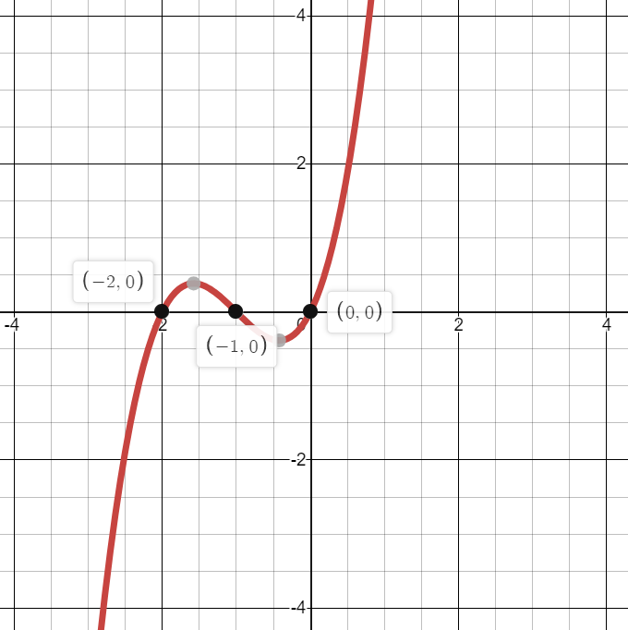
Worked example
Your turn
Sketch the graph of:
$$y=x\left(x+3\right)(x+4)$$
Sketch the graph of:
$$y=x\left(x+1\right)(x+2)$$

Slide 5
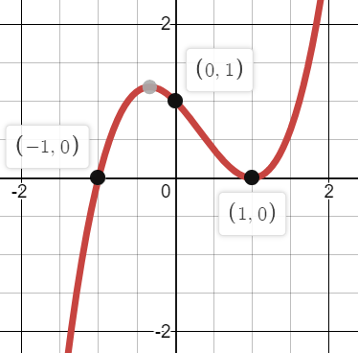
Worked example
Your turn
Sketch the graph of:
$$y={\left(x+2\right)}^{2}(x−2)$$
Sketch the graph of:
$$y={\left(x−1\right)}^{2}(x+1)$$

Slide 6
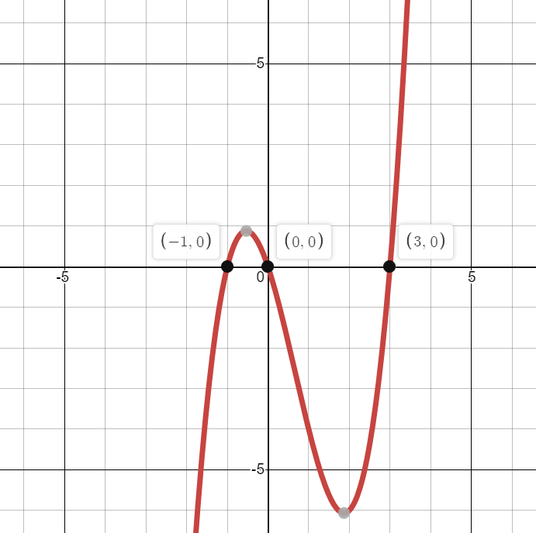
Worked example
Your turn
Sketch the graph of:
$$y=x^{2}−4x^{2}−5x$$
Sketch the graph of:
$$y=x^{3}−2x^{2}−3x$$

Slide 7
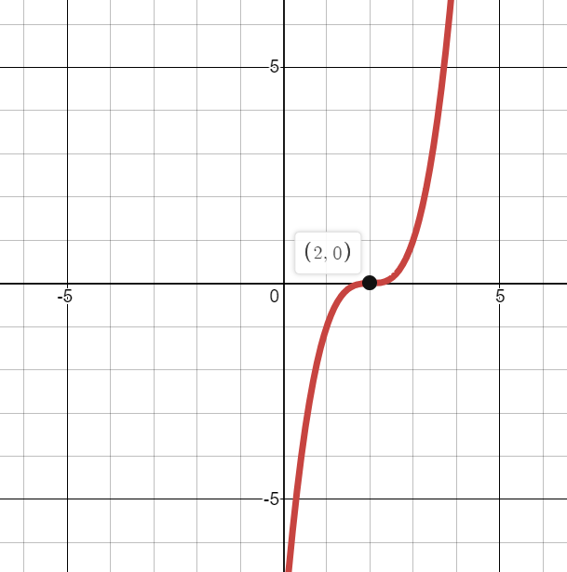
Worked example
Your turn
Sketch the graph of:
$$y={\left(x+4\right)}^{3}$$
Sketch the graph of:
$$y={\left(x−2\right)}^{3}$$

Slide 8
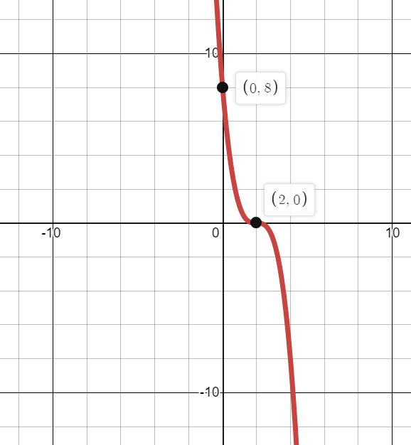
Worked example
Your turn
Sketch the graph of:
$$y={−\left(x+4\right)}^{3}$$
Sketch the graph of:
$$y=−{\left(x−2\right)}^{3}$$

Slide 9
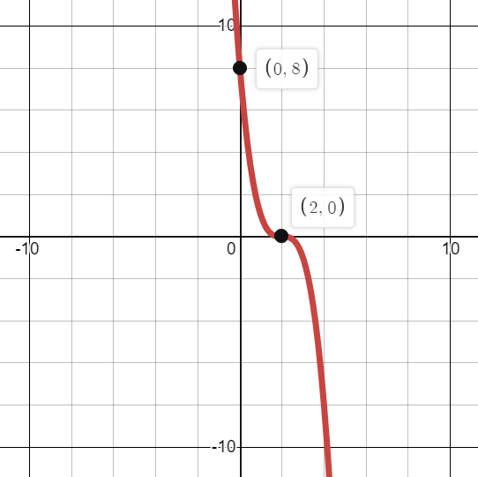
Worked example
Your turn
Sketch the graph of:
$$y={\left(4−x\right)}^{3}$$
Sketch the graph of:
$$y={\left(2−x\right)}^{3}$$

Slide 10
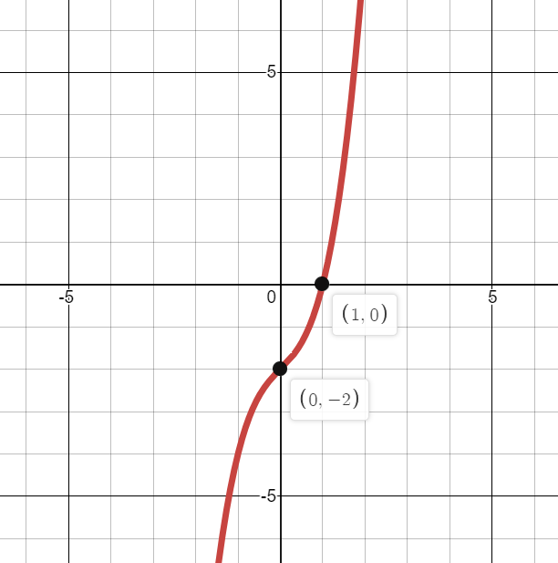
Worked example
Your turn
Sketch the graph of:
$$y=(x+2)(x^{2}+2x+4)$$
Sketch the graph of:
$$y=(x−1)(x^{2}+x+2)$$

Slide 11
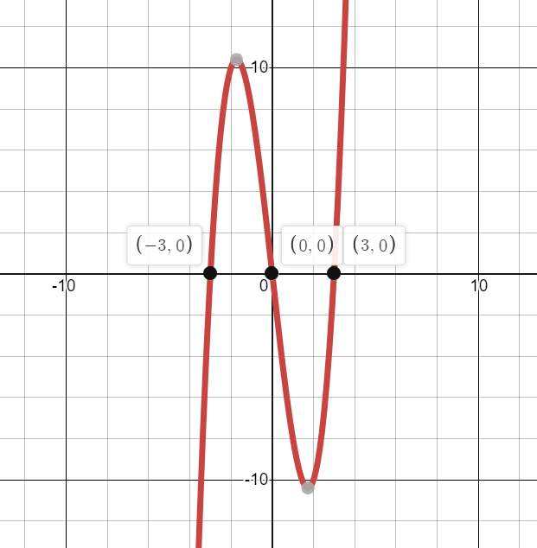
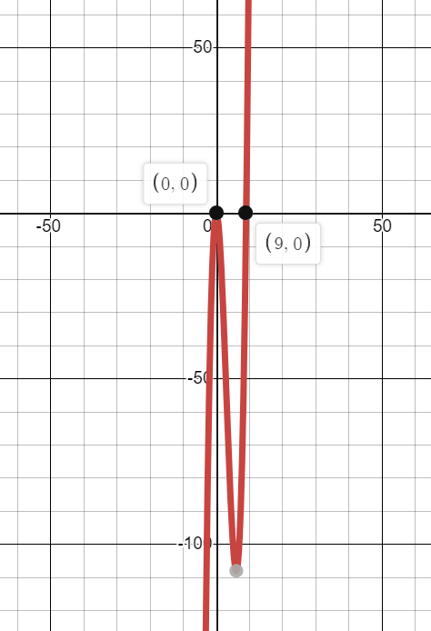
Worked example
Your turn
Sketch the graphs of:
$$y=x^{3}−16x$$
$$y=x^{3}−16x^{2}$$
Sketch the graphs of:
$$y=x^{3}−9x$$
$$y=x^{3}−9x^{2}$$

Slide 12
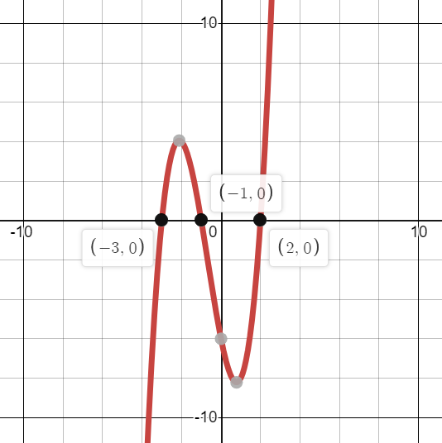
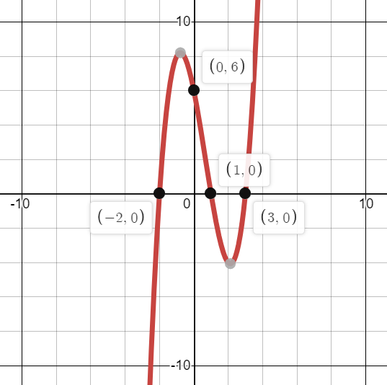
Worked example
Your turn
The graph of $y=ax^{3}+bx^{2}+cx+d$ is shown where $a, b, c, d∈ℝ$.
Find the value of $a, b, c$ and $d$
The graph of $y=ax^{3}+bx^{2}+cx+d$ is shown where $a, b, c, d∈ℝ$.
Find the value of $a, b, c$ and $d$
$$a=1, b=−2, c=−5, d=6$$

Slide 13
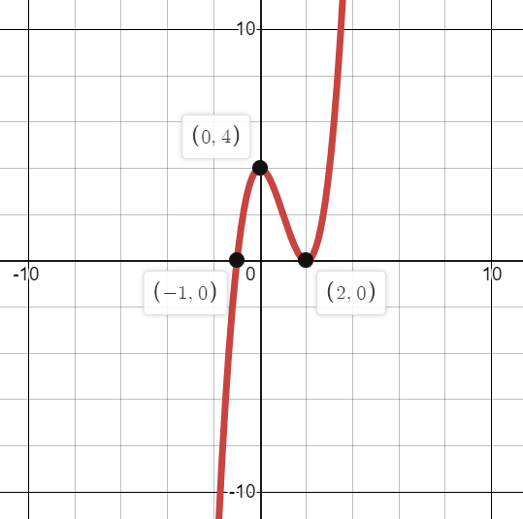
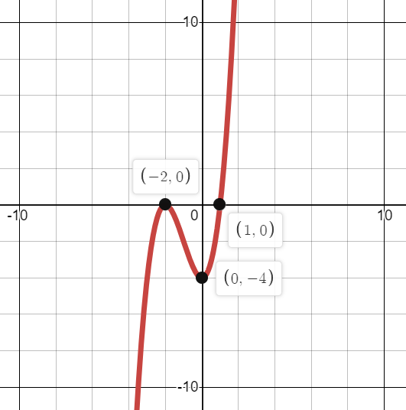
Worked example
Your turn
The graph of $y=ax^{3}+bx^{2}+cx+d$ is shown where $a, b, c, d∈ℝ$.
Find the value of $a, b, c$ and $d$
The graph of $y=ax^{3}+bx^{2}+cx+d$ is shown where $a, b, c, d∈ℝ$.
Find the value of $a, b, c$ and $d$
$$a=1, b=3, c=0, d=−4$$

Slide 14
Worked example
Your turn
A curve is a positive cubic, touches the $x$-axis at $3$ and crosses the $x$-axis at $−2$. Write a possible equation for the curve.
A curve is a positive cubic, touches the $x$-axis at $3$ and crosses the $x$-axis at $−2$. Write a possible equation for the curve.
$$y={\left(x−3\right)}^{2}(x+2)$$

