Slide 1
4.1) Moments

Slide 2
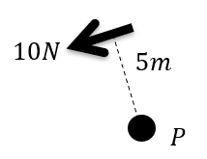
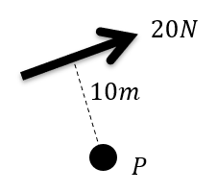
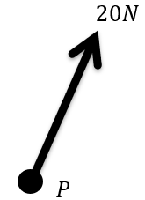
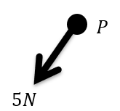
Worked example
Your turn
Calculate the moment of the force about the point $P$
Calculate the moment of the force about the point $P$
$200 Nm$ clockwise
$$0 Nm$$
Diagrams/Graphs used with permission from DrFrostMaths: https://www.drfrostmaths.com/

Slide 3
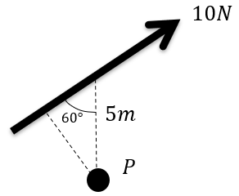
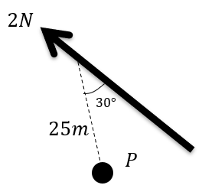
Worked example
Your turn
Calculate the moment of the force about the point $P$
Calculate the moment of the force about the point $P$
$$50\sin{30°}Nm=25 Nm$$
Diagrams/Graphs used with permission from DrFrostMaths: https://www.drfrostmaths.com/

Slide 4
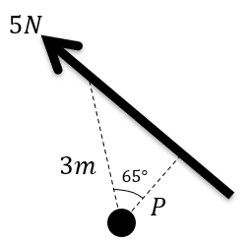
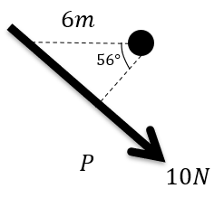
Worked example
Your turn
Calculate the moment of the force about the point $P$
Calculate the moment of the force about the point $P$
$33.6 Nm$ (3 sf) clockwise
Diagrams/Graphs used with permission from DrFrostMaths: https://www.drfrostmaths.com/

Slide 5
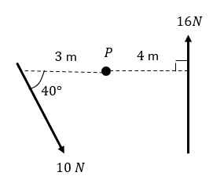
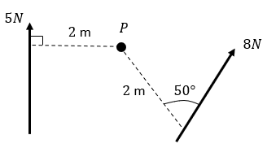
Worked example
Your turn
Two forces act on a lamina. Find the moment of each of the forces about the point $P$.
Two forces act on a lamina. Find the moment of each of the forces about the point $P$.
$$\text{Moment} \text{of}\text{ 5}\text{N} \text{force} =10 \text{Nm} \text{clockwise}$$
$$\text{Moment} \text{of}\text{ 8}\text{N} \text{force}=12.3 \text{Nm} \text{anticlockwise}\text{ (3 }\text{sf}\text{)}$$
Diagrams/Graphs used with permission from DrFrostMaths: https://www.drfrostmaths.com/

