Slide 1
4.1) Direct impact and Newton’s law of restitution

Slide 2
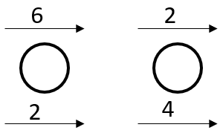
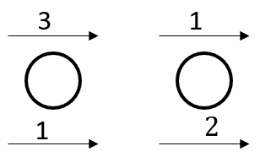
Worked example
Your turn
Calculate the value of the coefficient of restitution, $e$, in the isolated system:
Calculate the value of the coefficient of restitution, $e$, in the isolated system:
$$e=\frac{1}{2}$$
Diagrams used with permission from DrFrostMaths: https://www.drfrostmaths.com/

Slide 3
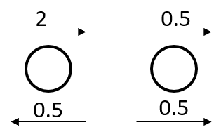
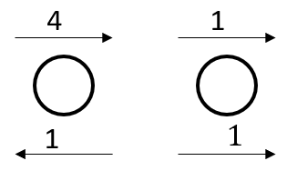
Worked example
Your turn
Calculate the value of the coefficient of restitution, $e$, in the isolated system:
Calculate the value of the coefficient of restitution, $e$, in the isolated system:
$$e=\frac{2}{3}$$
Diagrams used with permission from DrFrostMaths: https://www.drfrostmaths.com/

Slide 4
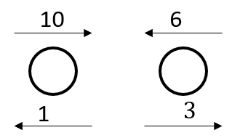
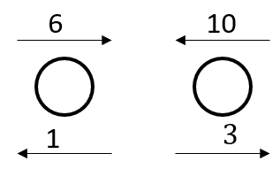
Worked example
Your turn
Calculate the value of the coefficient of restitution, $e$, in the isolated system:
Calculate the value of the coefficient of restitution, $e$, in the isolated system:
$$e=\frac{1}{4}$$
Diagrams used with permission from DrFrostMaths: https://www.drfrostmaths.com/

Slide 5
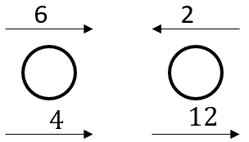
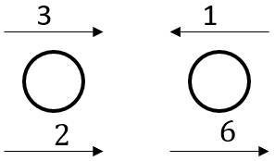
Worked example
Your turn
Calculate the value of the coefficient of restitution, $e$, in the isolated system:
Calculate the value of the coefficient of restitution, $e$, in the isolated system:
$e=1$ ; Perfectly elastic
Diagrams used with permission from DrFrostMaths: https://www.drfrostmaths.com/

Slide 6
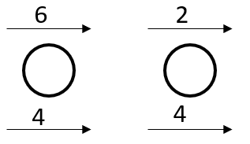
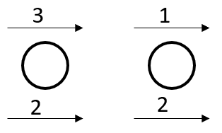
Worked example
Your turn
Calculate the value of the coefficient of restitution, $e$, in the isolated system:
Calculate the value of the coefficient of restitution, $e$, in the isolated system:
$e=0$ ; Totally inelastic ; Particles coalesce
Diagrams used with permission from DrFrostMaths: https://www.drfrostmaths.com/

Slide 7
Worked example
Your turn
Two particles A and B are travelling in the same direction on a smooth surface with speeds $8 ms^{−1}$ and $6 ms^{−1}$ respectively.
They collide directly, and immediately after the collision continue to travel in the same direction with speeds $4 ms^{−1}$ and $v ms^{−1}$ respectively.
Given that the coefficient of restitution between A and B is $\frac{2}{3}$, find $v$
Two particles A and B are travelling in the same direction on a smooth surface with speeds $4 ms^{−1}$ and $3 ms^{−1}$ respectively.
They collide directly, and immediately after the collision continue to travel in the same direction with speeds $2 ms^{−1}$ and $v ms^{−1}$ respectively.
Given that the coefficient of restitution between A and B is $\frac{1}{3}$, find $v$
$v=2.33$(3 sf)

Slide 8
Worked example
Your turn
Two particles A and B of masses 400g and 200g respectively are travelling in opposite directions towards each other on a smooth surface with speeds of $10ms^{−1}$ and $8ms^{−1}$ respectively.
They collide directly, and immediately after their collision have velocities $v_{1} ms^{−1}$ and $v_{2} ms^{−1}$respectively, measured in the direction of the motion of A before the collision.
Given that the coefficient of restitution between A and B is $\frac{1}{4}$, find $v_{1}$and $v_{2}$
Two particles A and B of masses 200g and 400g respectively are travelling in opposite directions towards each other on a smooth surface with speeds of $5ms^{−1}$ and $4ms^{−1}$ respectively.
They collide directly, and immediately after their collision have velocities $v_{1} ms^{−1}$ and $v_{2} ms^{−1}$respectively, measured in the direction of the motion of A before the collision.
Given that the coefficient of restitution between A and B is $\frac{1}{2}$, find $v_{1}$and $v_{2}$
$v_{1}=−4$ and $v_{2}=0.5$

Slide 9
Worked example
Your turn
A particle $A$ of mass $m$ is moving with speed $4u$ on a smooth horizontal table.
The particle collides directly with a particle $B$ of mass $2m$ moving with speed $u$ in the same direction as $A$.
The coefficient of restitution between $A$ and $B$ is $\frac{1}{4}$.
Find the speed of B after the collision
Find the speed of A after the collision
A particle $A$ of mass $2m$ is moving with speed $2u$ on a smooth horizontal table.
The particle collides directly with a particle $B$ of mass $4m$ moving with speed $u$ in the same direction as $A$.
The coefficient of restitution between $A$ and $B$ is $\frac{1}{2}$.
Find the speed of B after the collision
Find the speed of A after the collision
a) $\frac{3u}{2}$
b) $u$

Slide 10
Worked example
Your turn
A uniform sphere A of mass $m$ is moving with speed $u$ on a smooth horizontal table when it collides directly with another uniform sphere B of mass $4m$ which is at rest on the table.
The spheres are of equal radius and the coefficient of restitution between them is $e$.
The direction of motion of A is unchanged by the collision.
Find the speeds of A and B immediately after the collision
Find the range of possible values of $e$
A uniform sphere A of mass $m$ is moving with speed $u$ on a smooth horizontal table when it collides directly with another uniform sphere B of mass $2m$ which is at rest on the table.
The spheres are of equal radius and the coefficient of restitution between them is $e$.
The direction of motion of A is unchanged by the collision.
Find the speeds of A and B immediately after the collision
Find the range of possible values of $e$
a) $v_{A}=\frac{u}{3}\left(1−2e\right) ; v_{B}=\frac{u}{3}(1+e)$
b) $e<\frac{1}{2}$

Slide 11
Worked example
Your turn
Two balls P and Q have massed $6m$ and $8m$ respectively. They are moving in opposite directions towards each other along the same straight line on a smooth level floor.
Immediately before they collide, P has speed $6u$ and Q has speed $4u$.
The coefficient of restitution between P and Q is $e$.
By modelling the balls as smooth spheres and the floor as a smooth horizontal plane,
Find the speed of Q after the collision
Given that the direction of motion of P is unchanged, find the range of possible values of $e$
Given that the magnitude of the impulse of P on Q is $\frac{320mu}{9}$, find the value of $e$
Two balls P and Q have massed $3m$ and $4m$ respectively. They are moving in opposite directions towards each other along the same straight line on a smooth level floor.
Immediately before they collide, P has speed $3u$ and Q has speed $2u$.
The coefficient of restitution between P and Q is $e$.
By modelling the balls as smooth spheres and the floor as a smooth horizontal plane,
Find the speed of Q after the collision
Given that the direction of motion of P is unchanged, find the range of possible values of $e$
Given that the magnitude of the impulse of P on Q is $\frac{80mu}{9}$, find the value of $e$
a) $\frac{u}{7}\left(15e+1\right)$
b) $0≤e<\frac{1}{20}$
c) $e=\frac{1}{27}$

