Slide 1
4.1) Correlation

Slide 2
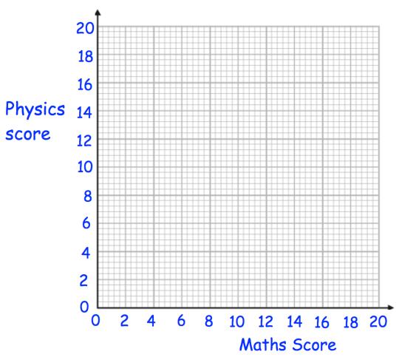
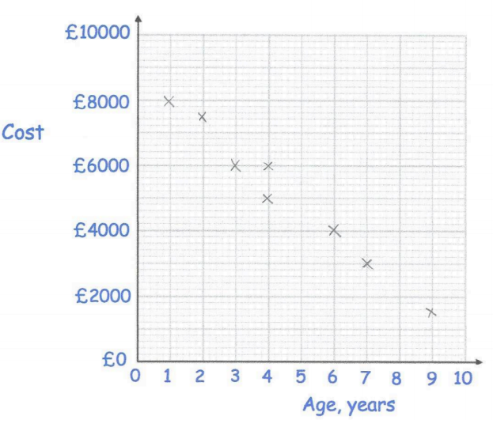
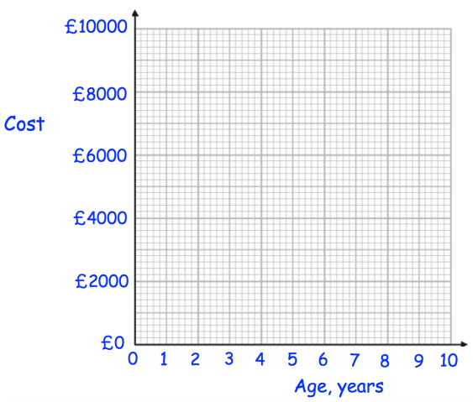
Worked example
Your turn
Plot a scatter diagram to represent this data:
Plot a scatter diagram to represent this data:
Maths score ($x$) | $$9$$ | $$13$$ | $$6$$ | $$18$$ | $$11$$ | $$4$$ | $$15$$ | $$10$$
Physics score ($y$) | $$10$$ | $$13$$ | $$5$$ | $$20$$ | $$8$$ | $$5$$ | $$12$$ | $$14$$
Age, years $(x)$ | $$4$$ | $$7$$ | $$2$$ | $$4$$ | $$1$$ | $$9$$ | $$3$$ | $$6$$
Cost, $£$ ($y$) | $$6000$$ | $$3000$$ | $$7500$$ | $$5000$$ | $$8000$$ | $$1500$$ | $$6000$$ | $$4000$$
Questions used with permission from Corbettmaths: https://corbettmaths.com/

Slide 3
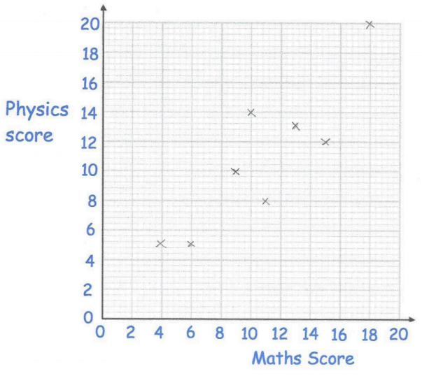
Worked example
Your turn
Use the scatter diagram to:
Describe the correlation
Interpret the correlation
Use the scatter diagram to:
Describe the correlation
Interpret the correlation
a) Strong negative correlation
b) As the age (of an object) increases, its cost decreases
Questions used with permission from Corbettmaths: https://corbettmaths.com/

Slide 4
Worked example
Your turn
A student was interested to see if there as a relationship between the value of a house and the speed of its internet connection.
A scatter diagram was drawn with a weak negative correlation.
He says his data supports the conclusion that a slower internet connection reduces the value of a house.
Give one reason why his conclusion may not be valid.
A student was interested to see if there was a relationship between what people earn and the age which they left education or training.
A scatter diagram was drawn with a weak negative correlation.
She says her data supports the conclusion that more education causes people to earn a lower hourly rate of pay.
Give one reason why her conclusion might not be valid.
Respondents who left education later would have significantly less work experience than those who left education earlier. This could be the cause of the reduced income shown in her results.
Small opportunistic sample used

