Slide 1
4) Moments
4.1) Moments
4.2) Resultant moments
4.3) Equilibrium
4.4) Centres of mass
4.5) Tilting

Slide 2
4.1) Moments
Chapter CONTENTS

Slide 3
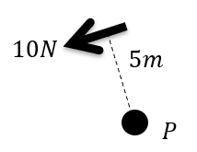
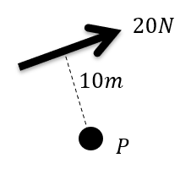
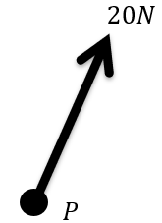
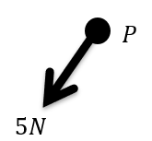
Worked example
Your turn
Calculate the moment of the force about the point $P$
Calculate the moment of the force about the point $P$
$200 Nm$ clockwise
$$0 Nm$$
Diagrams/Graphs used with permission from DrFrostMaths: https://www.drfrostmaths.com/

Slide 4
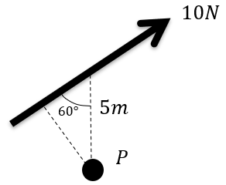
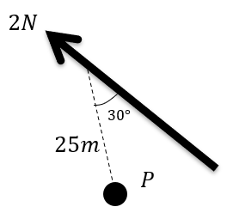
Worked example
Your turn
Calculate the moment of the force about the point $P$
Calculate the moment of the force about the point $P$
$$50\sin{30°}Nm=25 Nm$$
Diagrams/Graphs used with permission from DrFrostMaths: https://www.drfrostmaths.com/

Slide 5
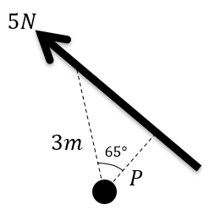
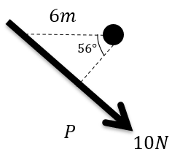
Worked example
Your turn
Calculate the moment of the force about the point $P$
Calculate the moment of the force about the point $P$
$33.6 Nm$ (3 sf) clockwise
Diagrams/Graphs used with permission from DrFrostMaths: https://www.drfrostmaths.com/

Slide 6
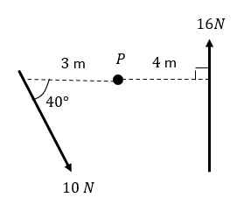
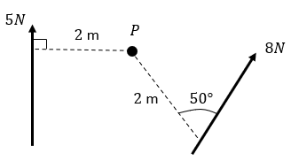
Worked example
Your turn
Two forces act on a lamina. Find the moment of each of the forces about the point $P$.
Two forces act on a lamina. Find the moment of each of the forces about the point $P$.
$$\text{Moment} \text{of}\text{ 5}\text{N} \text{force} =10 \text{Nm} \text{clockwise}$$
$$\text{Moment} \text{of}\text{ 8}\text{N} \text{force}=12.3 \text{Nm} \text{anticlockwise}\text{ (3 }\text{sf}\text{)}$$
Diagrams/Graphs used with permission from DrFrostMaths: https://www.drfrostmaths.com/

Slide 7
4.2) Resultant moments
Chapter CONTENTS

Slide 8
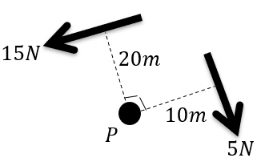
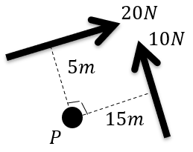
Worked example
Your turn
Calculate the resultant moment acting about $P$
Calculate the resultant moment acting about $P$
$50 Nm$ anticlockwise
Diagrams/Graphs used with permission from DrFrostMaths: https://www.drfrostmaths.com/

Slide 9
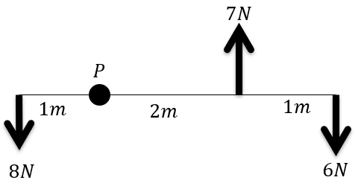
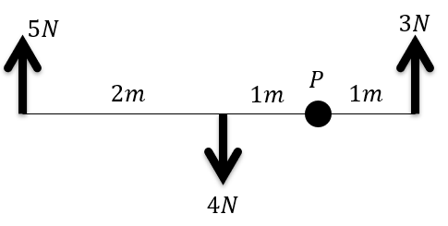
Worked example
Your turn
The rod is light. Calculate the resultant moment acting about $P$.
The rod is light. Calculate the resultant moment acting about $P$.
$8 Nm$clockwise
Diagrams/Graphs used with permission from DrFrostMaths: https://www.drfrostmaths.com/

Slide 10
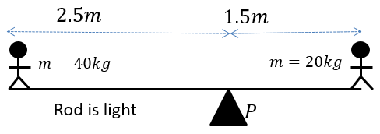
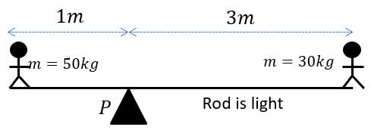
Worked example
Your turn
Find the resultant moment acting about $P$
Find the resultant moment acting about $P$
$40g Nm=392 Nm$ clockwise
Diagrams/Graphs used with permission from DrFrostMaths: https://www.drfrostmaths.com/

Slide 11
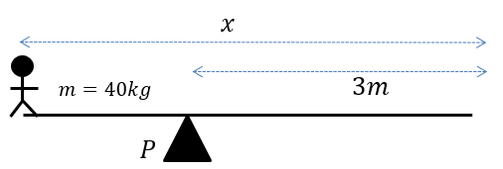
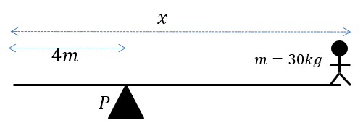
Worked example
Your turn
The rod is light. Calculate the resultant moment acting about $P$.
The rod is light. Calculate the resultant moment acting about $P$.
$30g\left(x−4\right) Nm$ clockwise
Diagrams/Graphs used with permission from DrFrostMaths: https://www.drfrostmaths.com/

Slide 12
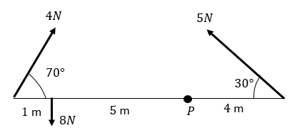
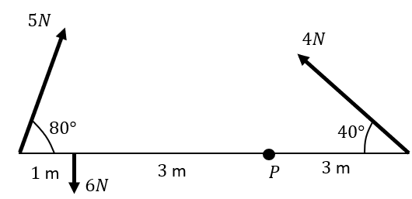
Worked example
Your turn
The rod is light. Calculate the resultant moment acting about $P$.
The rod is light. Calculate the resultant moment acting about $P$.
$6.02 Nm$ anticlockwise (3 sf)
Diagrams/Graphs used with permission from DrFrostMaths: https://www.drfrostmaths.com/

Slide 13
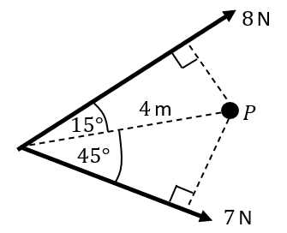
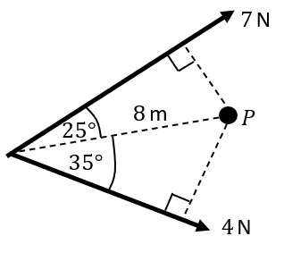
Worked example
Your turn
The rod is light. Calculate the resultant moment acting about $P$
Two forces act on a lamina. Calculate the resultant moment about the point $P$.
$5.31 Nm$ clockwise (3 sf)
Diagrams/Graphs used with permission from DrFrostMaths: https://www.drfrostmaths.com/

Slide 14
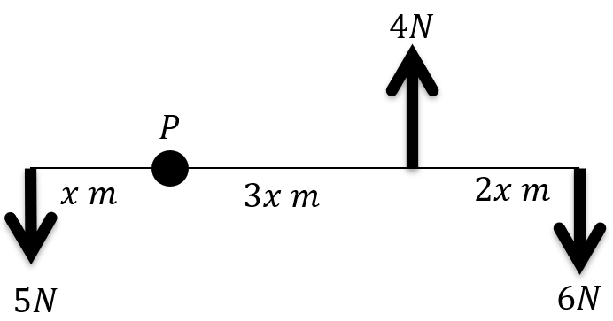
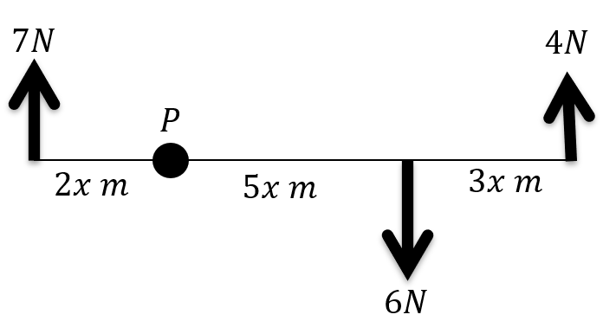
Worked example
Your turn
A set of forces act on a light rod.
The resultant moment of P is $26 Nm$ clockwise. Find the value of $x$
A set of forces act on a light rod.
The resultant moment of P is $48 Nm$ clockwise. Find the value of $x$
$$x=4$$
Diagrams/Graphs used with permission from DrFrostMaths: https://www.drfrostmaths.com/

Slide 15
4.3) Equilibrium
Chapter CONTENTS

Slide 16
Worked example
Your turn
Person A and Person B are on opposite ends of a uniform seesaw of mass 30kg.
A weighs 60kg and is 5m from the pivot.
B is 4m from the pivot.
The seesaw remains horizontal. Determine:
a) The reaction force at the pivot of the seesaw
b) The mass of B
Person A and Person B are on opposite ends of a uniform seesaw of mass 20kg.
A weighs 70kg and is 10m from the pivot.
B is 8m from the pivot.
The seesaw remains horizontal. Determine:
a) The reaction force at the pivot of the seesaw
b) The mass of B
a) $1764 N$
b) $90 kg$

Slide 17
Worked example
Your turn
A uniform beam $AB$, of mass 20 kg and length 10m, rests horizontally on supports at $C$ and $D$, where $AC=DB=2$ m.
When a man of mass 60kg stands on the beam at $E$ the magnitude of the reaction at $D$ is three times the magnitude of the reaction at $C$.
By modelling the beam as a rod and the man as a particle, find the distance $AE$.
A uniform beam $AB$, of mass 40 kg and length 5m, rests horizontally on supports at $C$ and $D$, where $AC=DB=1$ m.
When a man of mass 80kg stands on the beam at $E$ the magnitude of the reaction at $D$ is twice the magnitude of the reaction at $C$.
By modelling the beam as a rod and the man as a particle, find the distance $AE$.
$$3.25 m$$

Slide 18
Worked example
Your turn
A uniform rod $AB$has length $5 m$ and mass $20 kg$.
The rod is in equilibrium in a horizontal position, resting on two smooth supports at $C$ and $D$, where $AC=0.4$ metres and $DB=x$ metres.
Given that the magnitude of the reaction on the rod at D is three times the magnitude of the reaction on the rod at C, find the value of $x$
A uniform rod $AB$has length $2 m$ and mass $50 kg$.
The rod is in equilibrium in a horizontal position, resting on two smooth supports at $C$ and $D$, where $AC=0.2$ metres and $DB=x$ metres.
Given that the magnitude of the reaction on the rod at D is twice the magnitude of the reaction on the rod at C, find the value of $x$
$$x=0.6$$

Slide 19
Worked example
Your turn
A uniform ladder, $AB$, is leaning against a smooth vertical wall on rough horizontal ground at an angle of $50°$ to the horizontal. The ladder has length $6 m$ and is held in equilibrium by a frictional force of magnitude $40 N$ acting horizontally at $B$ which is the end of the ladder on the ground.
Find the mass of the ladder.
A uniform ladder, $AB$, is leaning against a smooth vertical wall on rough horizontal ground at an angle of $60°$ to the horizontal. The ladder has length $5 m$ and is held in equilibrium by a frictional force of magnitude $80 N$ acting horizontally at $B$ which is the end of the ladder on the ground.
Find the mass of the ladder.
$28.3 kg$ (3 sf)

Slide 20
4.4) Centres of mass
Chapter CONTENTS

Slide 21
Worked example
Your turn
Sam and Tamsin are sitting on a non-uniform plan $AB$ of mass 45kg and length 2m.
The plank is pivoted at $M$, the midpoint of $AB$.
The centre of mass of $AB$ is at $C$ where $AC$ is 0.8. Sam has mass 70 kg.
Tamsin has mass 50 kg and sits at $A$.
Where must Sam sit for the plank to be horizontal?
Sam and Tamsin are sitting on a non-uniform plan $AB$ of mass 25kg and length 4m.
The plank is pivoted at $M$, the midpoint of $AB$.
The centre of mass of $AB$ is at $C$ where $AC$ is 1.8 $m$. Sam has mass 35 kg.
Tamsin has mass 25 kg and sits at $A$.
Where must Sam sit for the plank to be horizontal?
$3.57 m$ from end $A$

Slide 22
Worked example
Your turn
A non-uniform rod $AB$is $6 m$ long and has weight $40 N$.
It is in a horizontal position resting on supports at points $C$ and $D$, where $AC=0.5 m$ and $AD=5 m$.
The magnitude of the reaction at $C$ is four times the magnitude of the reaction at D.
Find the distance of the centre of mass of the rod from $A$
A non-uniform rod $AB$is $3 m$ long and has weight $20 N$. It is in a horizontal position resting on supports at points $C$ and $D$, where $AC=1 m$ and $AD=2.5 m$.
The magnitude of the reaction at $C$ is three times the magnitude of the reaction at D.
Find the distance of the centre of mass of the rod from $A$
$1.38 m$ (3 sf)

Slide 23
4.5) Tilting
Chapter CONTENTS

Slide 24
Worked example
Your turn
A uniform beam beam $AB$, of mass 54kg and length 8m, rests horizontally on supports $C$ and $D$ where $AC=2$ m and $CD=7$ m.
When an object is placed at $A$, the beam is on the point of tilting about $C$.
Determine the mass of the object.
A uniform beam beam $AB$, of mass 45kg and length 16m, rests horizontally on supports $C$ and $D$ where $AC=5$ m and $CD=9$ m.
When an object is placed at $A$, the beam is on the point of tilting about $C$.
Determine the mass of the object.
$$27 kg$$

Slide 25
Worked example
Your turn
A non-uniform rod $AB$, of length 5 m and weight 80 N, is suspended from a pair of light cables attached to $C$ and $D$ where $AC=2$ m and $BD=1$ m.
When a weight of 50 N is hung from $A$ the rod is on the point of rotating.
Find the distance of the centre of mass of the rod from $A$.
A non-uniform rod $AB$, of length 10 m and weight 40 N, is suspended from a pair of light cables attached to $C$ and $D$ where $AC=3$ m and $BD=2$ m.
When a weight of 25 N is hung from $A$ the rod is on the point of rotating.
Find the distance of the centre of mass of the rod from $A$.
$$4.875 m$$

Slide 26
Worked example
Your turn
A beam $AB$has length $25 m$. The beam rests horizontally in equilibrium on two smooth supports at the points $P$ and $Q$, where $AP=4 m$ and $QB=5 m$.
When an adult of mass $60 kg$ stands on the beam at $A$, the beam remains in equilibrium and is on the point of tilting about $P$.
When the same child stands on the beam at $B$, the beam remains in equilibrium and is on the point of tilting about $Q$.
The child is modelled as a particle and the beam is modelled as a non-uniform rod.
Find the mass of the beam
Find the distance of the centre of mass of the beam from $A$
A beam $AB$has length $15 m$. The beam rests horizontally in equilibrium on two smooth supports at the points $P$ and $Q$, where $AP=2 m$ and $QB=3 m$.
When a child of mass $50 kg$ stands on the beam at $A$, the beam remains in equilibrium and is on the point of tilting about $P$.
When the same child stands on the beam at $B$, the beam remains in equilibrium and is on the point of tilting about $Q$.
The child is modelled as a particle and the beam is modelled as a non-uniform rod.
Find the mass of the beam
Find the distance of the centre of mass of the beam from $A$
a) $25 kg$
b) $6 m$

