Slide 1
4) Graphs and transformations
4.1) Cubic graphs
4.2) Quartic graphs
4.3) Reciprocal graphs
4.4) Points of intersection
4.5) Translating graphs
4.6) Stretching graphs
4.7) Transforming functions

Slide 2
4.1) Cubic graphs
Chapter CONTENTS

Slide 3
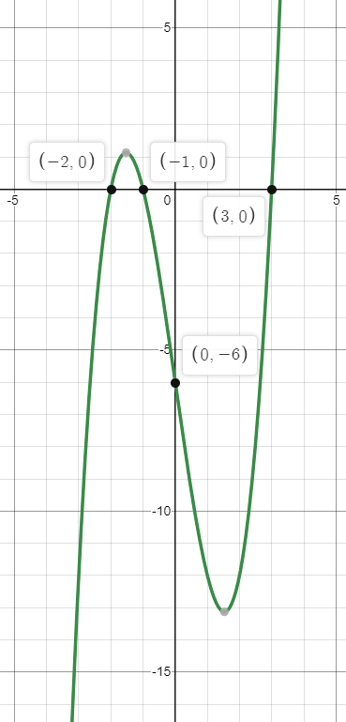
Worked example
Your turn
Sketch the graph of:
$$y=\left(x+1\right)\left(x+2\right)\left(x+3\right)$$
$$y=(x+1)(x−2)(x+3)$$
Sketch the graph of:
$$y=\left(x+1\right)\left(x+2\right)\left(x−3\right)$$

Slide 4
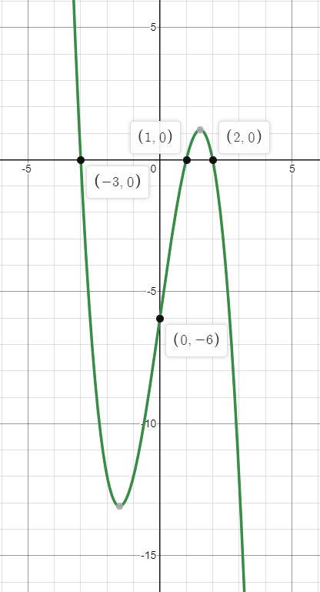
Worked example
Your turn
Sketch the graph of:
$$y=(x+1)(x−2)(3−x)$$
$$y=(x−1)(x−2)(3−x)$$
Sketch the graph of:
$$y=(x−1)(x+3)(2−x)$$

Slide 5
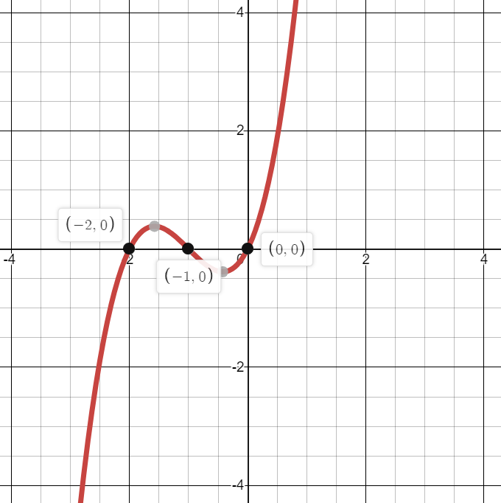
Worked example
Your turn
Sketch the graph of:
$$y=x\left(x+3\right)(x+4)$$
Sketch the graph of:
$$y=x\left(x+1\right)(x+2)$$

Slide 6
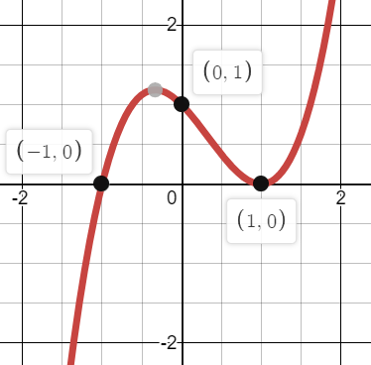
Worked example
Your turn
Sketch the graph of:
$$y={\left(x+2\right)}^{2}(x−2)$$
Sketch the graph of:
$$y={\left(x−1\right)}^{2}(x+1)$$

Slide 7
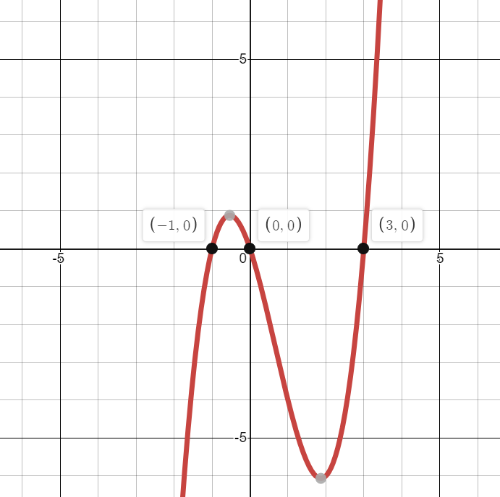
Worked example
Your turn
Sketch the graph of:
$$y=x^{2}−4x^{2}−5x$$
Sketch the graph of:
$$y=x^{3}−2x^{2}−3x$$

Slide 8
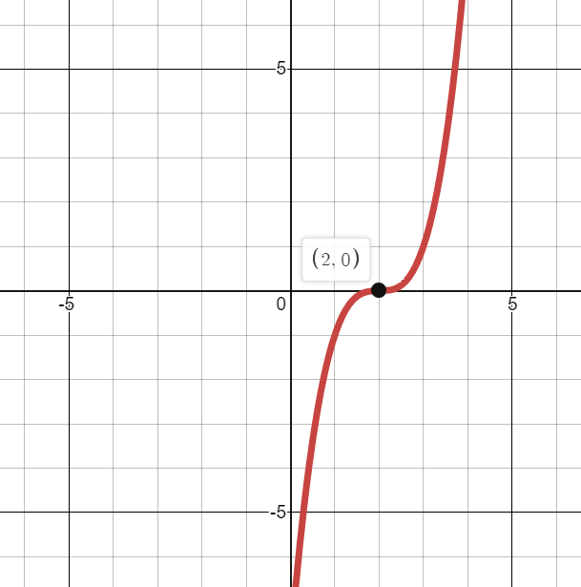
Worked example
Your turn
Sketch the graph of:
$$y={\left(x+4\right)}^{3}$$
Sketch the graph of:
$$y={\left(x−2\right)}^{3}$$

Slide 9
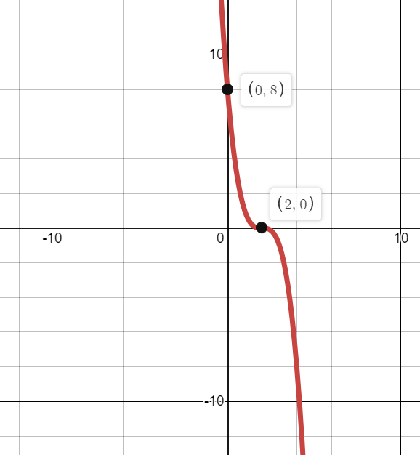
Worked example
Your turn
Sketch the graph of:
$$y={−\left(x+4\right)}^{3}$$
Sketch the graph of:
$$y=−{\left(x−2\right)}^{3}$$

Slide 10
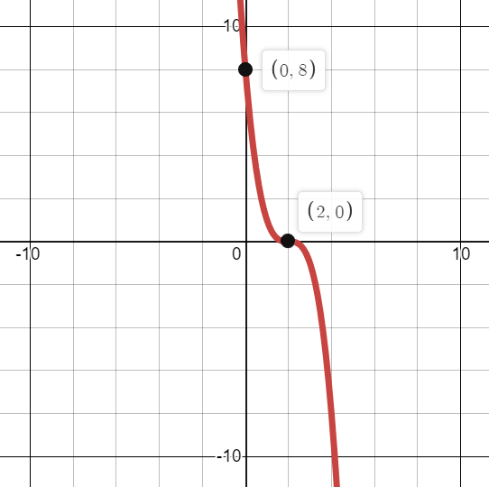
Worked example
Your turn
Sketch the graph of:
$$y={\left(4−x\right)}^{3}$$
Sketch the graph of:
$$y={\left(2−x\right)}^{3}$$

Slide 11
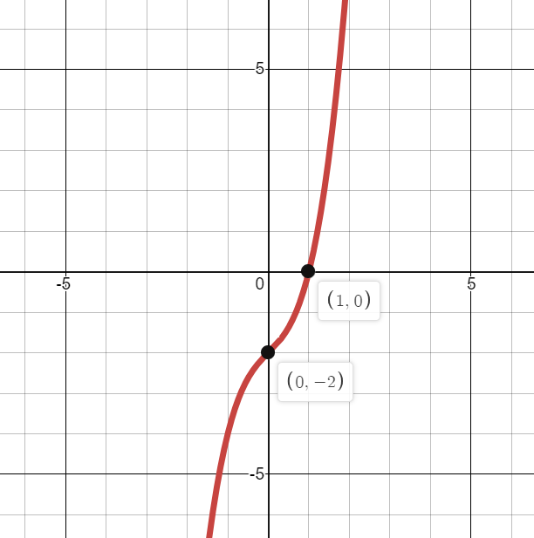
Worked example
Your turn
Sketch the graph of:
$$y=(x+2)(x^{2}+2x+4)$$
Sketch the graph of:
$$y=(x−1)(x^{2}+x+2)$$

Slide 12
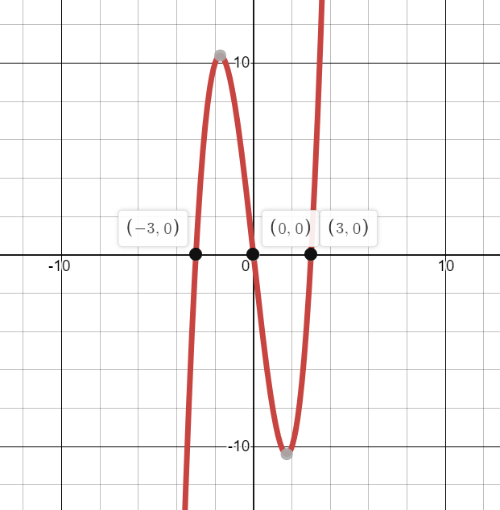
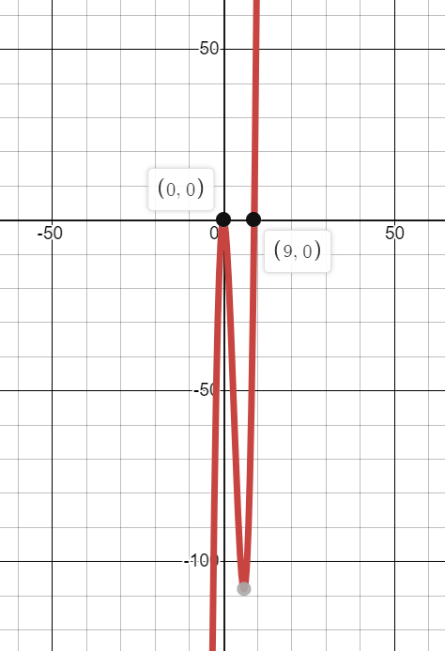
Worked example
Your turn
Sketch the graphs of:
$$y=x^{3}−16x$$
$$y=x^{3}−16x^{2}$$
Sketch the graphs of:
$$y=x^{3}−9x$$
$$y=x^{3}−9x^{2}$$

Slide 13
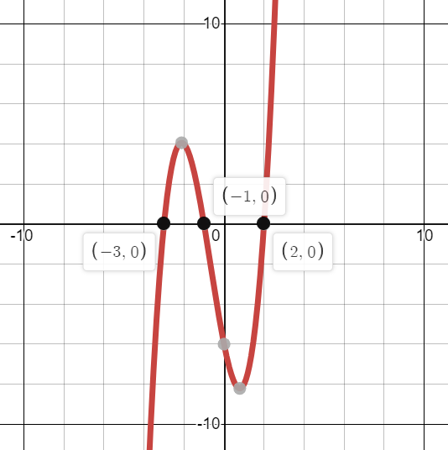
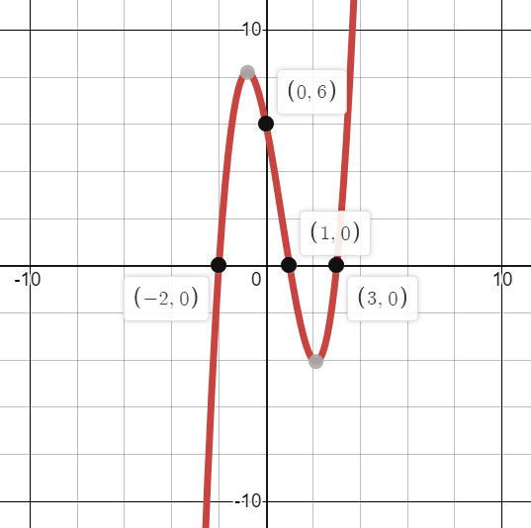
Worked example
Your turn
The graph of $y=ax^{3}+bx^{2}+cx+d$ is shown where $a, b, c, d∈ℝ$.
Find the value of $a, b, c$ and $d$
The graph of $y=ax^{3}+bx^{2}+cx+d$ is shown where $a, b, c, d∈ℝ$.
Find the value of $a, b, c$ and $d$
$$a=1, b=−2, c=−5, d=6$$

Slide 14
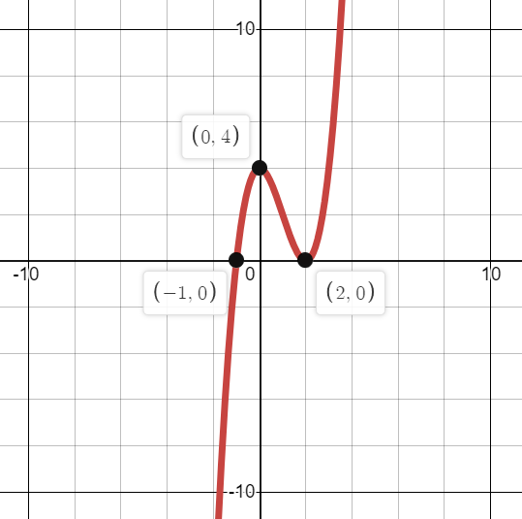
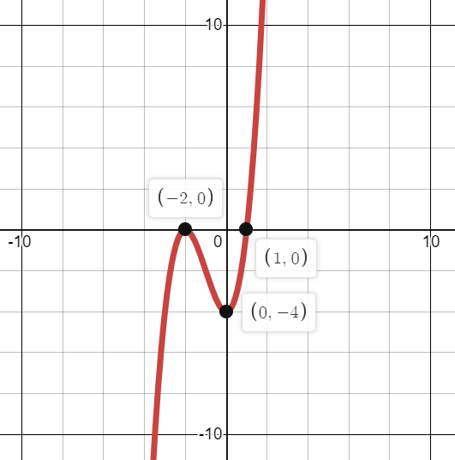
Worked example
Your turn
The graph of $y=ax^{3}+bx^{2}+cx+d$ is shown where $a, b, c, d∈ℝ$.
Find the value of $a, b, c$ and $d$
The graph of $y=ax^{3}+bx^{2}+cx+d$ is shown where $a, b, c, d∈ℝ$.
Find the value of $a, b, c$ and $d$
$$a=1, b=3, c=0, d=−4$$

Slide 15
Worked example
Your turn
A curve is a positive cubic, touches the $x$-axis at $3$ and crosses the $x$-axis at $−2$. Write a possible equation for the curve.
A curve is a positive cubic, touches the $x$-axis at $3$ and crosses the $x$-axis at $−2$. Write a possible equation for the curve.
$$y={\left(x−3\right)}^{2}(x+2)$$

Slide 16
4.2) Quartic graphs
Chapter CONTENTS

Slide 17
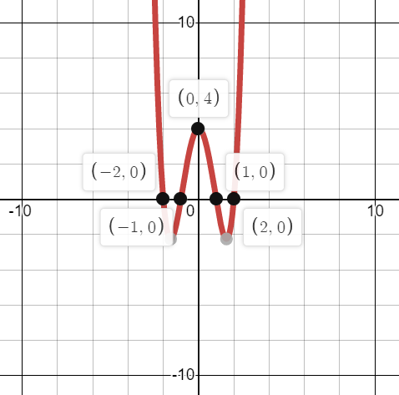
Worked example
Your turn
Sketch the graph of:
$$y=(x+3)(x+4)(x−3)(x−4)$$
Sketch the graph of:
$$y=(x+1)(x+2)(x−1)(x−2)$$

Slide 18
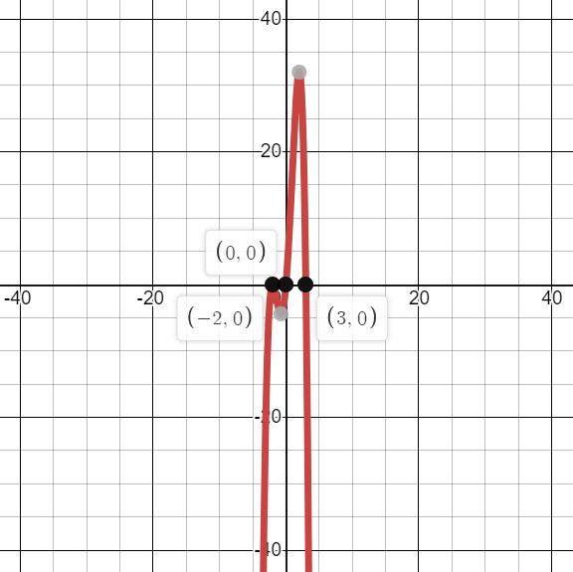
Worked example
Your turn
Sketch the graph of:
$$y=x{\left(x−3\right)}^{2}(2−x)$$
Sketch the graph of:
$$y=x{\left(x+2\right)}^{2}(3−x)$$

Slide 19
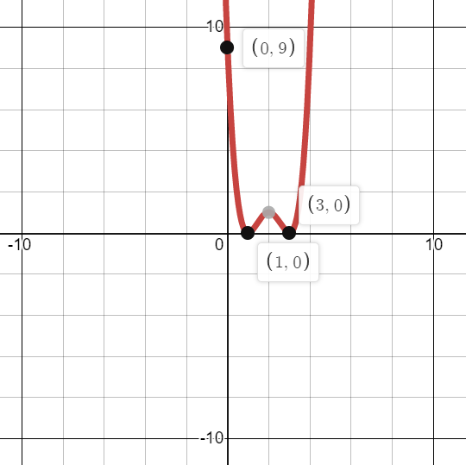
Worked example
Your turn
Sketch the graph of:
$$y={\left(x+2\right)}^{2}{\left(x−4\right)}^{2}$$
Sketch the graph of:
$$y={\left(x−1\right)}^{2}{\left(x−3\right)}^{2}$$

Slide 20
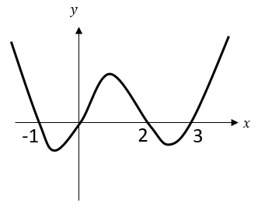
Worked example
Your turn
Sketch the graph of:
$$y=x(x−4)(x+5)(x+6)$$
Sketch the graph of:
$$y=x(x+1)(x−2)(x−3)$$

Slide 21
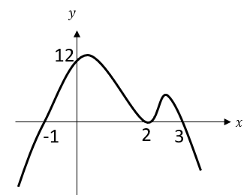
Worked example
Your turn
Sketch the graph of:
$$y={\left(x+4\right)}^{2}(x−5)(6−x)$$
Sketch the graph of:
$$y={\left(x−2\right)}^{2}(x+1)(3−x)$$

Slide 22
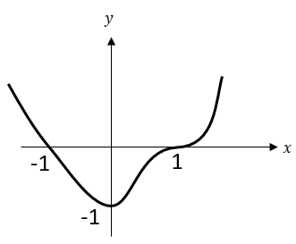
Worked example
Your turn
Sketch the graph of:
$$y=\left(x−2\right){\left(x+2\right)}^{3}$$
Sketch the graph of:
$$y=\left(x+1\right){\left(x−1\right)}^{3}$$

Slide 23
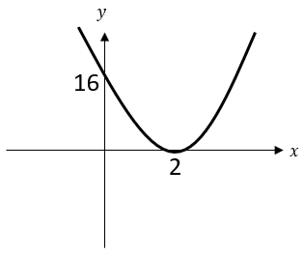
Worked example
Your turn
Sketch the graph of:
$$y={\left(x+3\right)}^{4}$$
Sketch the graph of:
$$y={\left(x−2\right)}^{4}$$

Slide 24
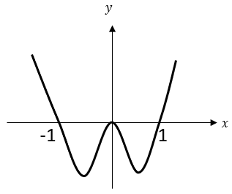
Worked example
Your turn
Sketch the graph of:
$$y=x^{2}\left(x+2\right)\left(x−2\right)$$
Sketch the graph of:
$$y=x^{2}\left(x+1\right)\left(x−1\right)$$

Slide 25
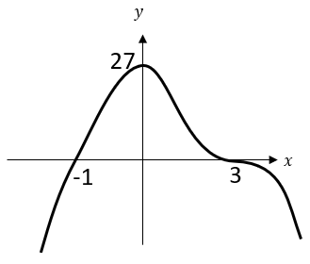
Worked example
Your turn
Sketch the graph of:
$$y=−(x−4){\left(x+2\right)}^{3}$$
Sketch the graph of:
$$y=−(x+1){\left(x−3\right)}^{3}$$

Slide 26
4.3) Reciprocal graphs
Chapter CONTENTS

Slide 27
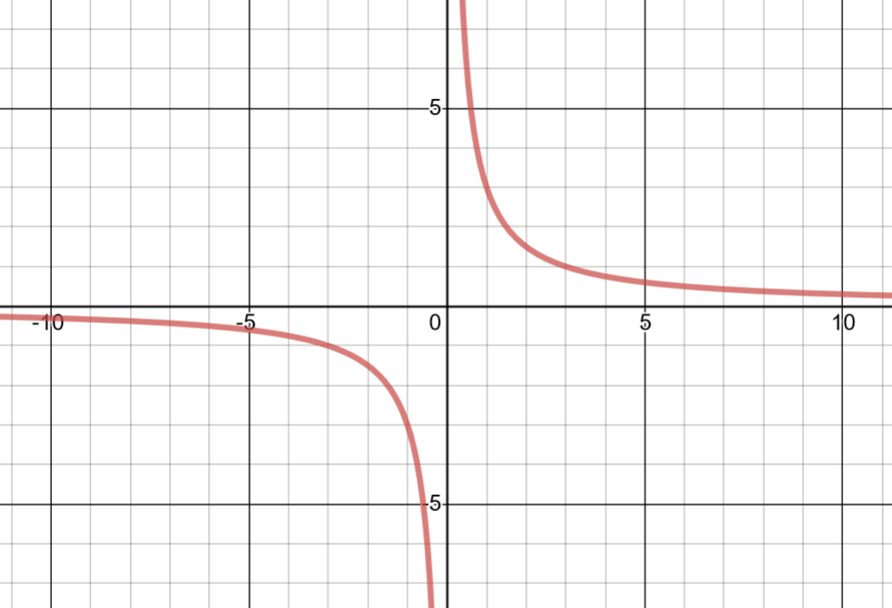
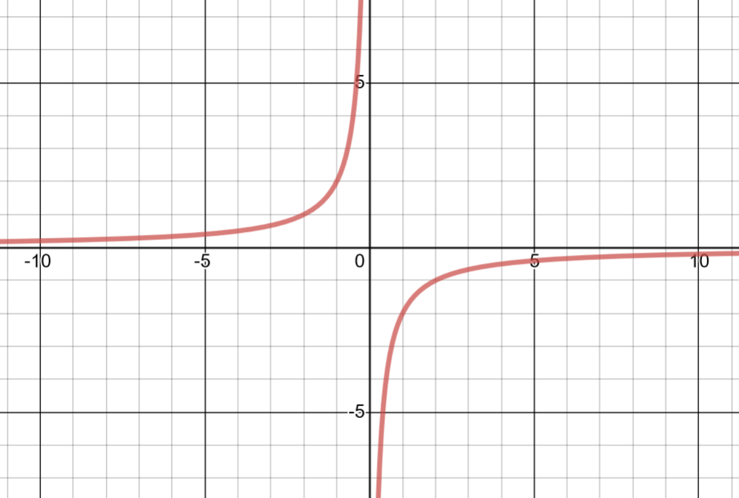
Worked example
Your turn
Sketch the graph of $y=\frac{a}{x}, a>0$
Sketch the graph of $y=\frac{a}{x}, a<0$
Sketch the graph of $y=\frac{3}{x}$
Sketch the graph of $y=\frac{−2}{x}$
Graphs used with permission from DESMOS: https://www.desmos.com/

Slide 28
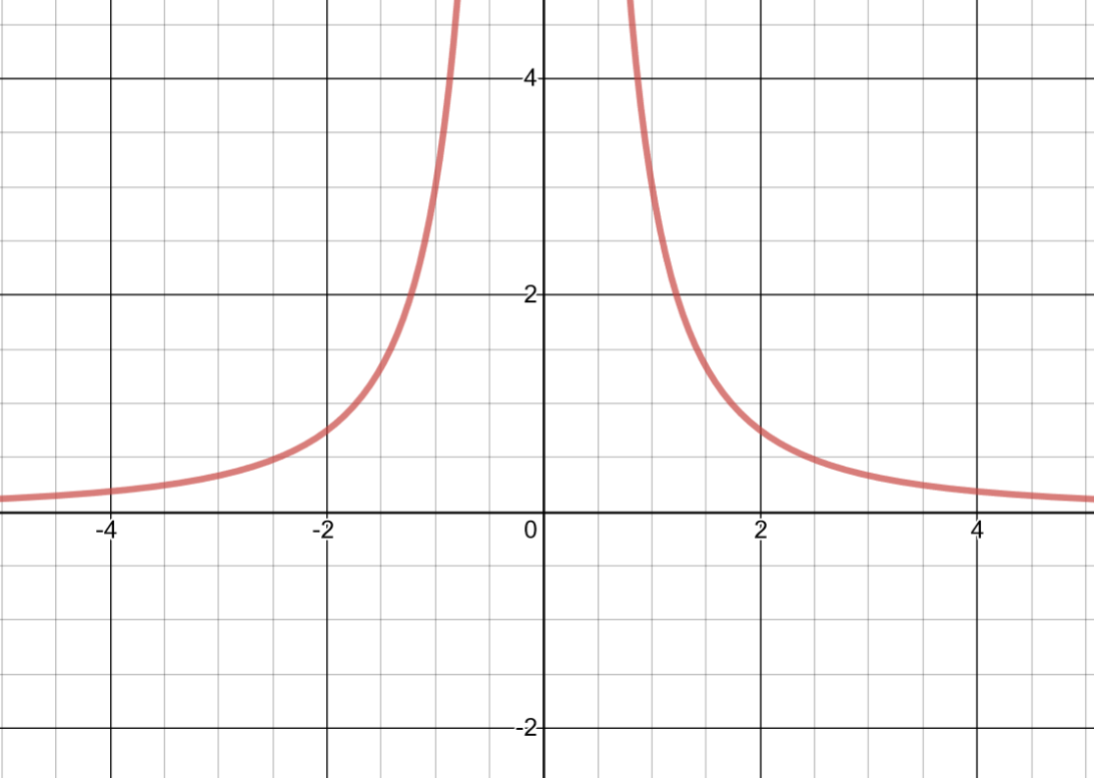
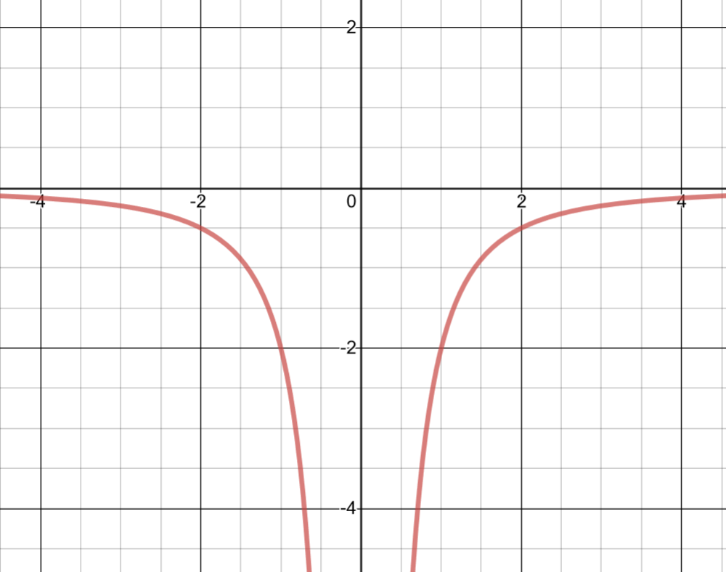
Worked example
Your turn
Sketch the graph of $y=\frac{a}{x^{2}}, a>0$
Sketch the graph of $y=\frac{a}{x^{2}}, a<0$
Sketch the graph of $y=\frac{3}{x^{2}}$
Sketch the graph of $y=\frac{−2}{x^{2}}$
Graphs used with permission from DESMOS: https://www.desmos.com/

Slide 29
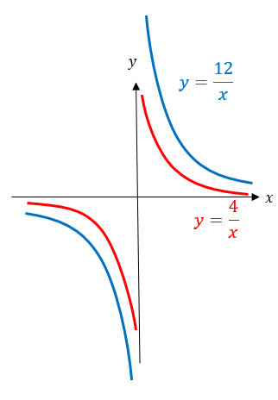
Worked example
Your turn
Sketch on the same diagram:
$y=\frac{2}{x}$ and $y=\frac{8}{x}$
Sketch on the same diagram:
$y=\frac{4}{x}$ and $y=\frac{12}{x}$

Slide 30
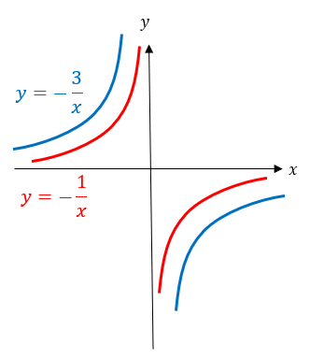
Worked example
Your turn
Sketch on the same diagram:
$y=−\frac{2}{x}$ and $y=−\frac{8}{x}$
Sketch on the same diagram:
$y=−\frac{1}{x}$ and $y=−\frac{3}{x}$

Slide 31
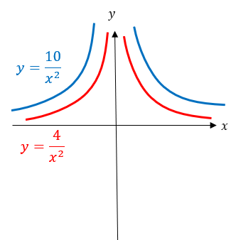
Worked example
Your turn
Sketch on the same diagram:
$y=\frac{2}{x^{2}}$ and $y=\frac{7}{x^{2}}$
Sketch on the same diagram:
$y=\frac{4}{x^{2}}$ and $y=\frac{10}{x^{2}}$

Slide 32
4.4) Points of intersection
Chapter CONTENTS

Slide 33
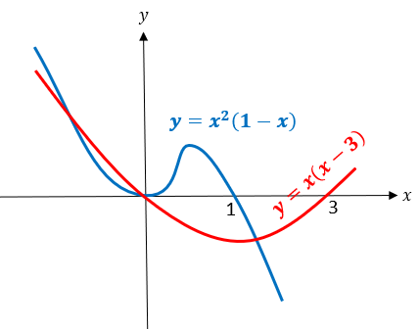
Worked example
Your turn
On the same diagram sketch the curves with equations $y=x(x−2)$ and $y=x^{2}\left(1−x\right)$.
Find the coordinates of their points of intersection.
On the same diagram sketch the curves with equations $y=x(x−3)$ and $y=x^{2}\left(1−x\right)$.
Find the coordinates of their points of intersection.
$$\left(−\sqrt{3}, 3+3\sqrt{3}\right), \\ \left(0,0\right), \\ \left(\sqrt{3}, 3−3\sqrt{3}\right)$$

Slide 34
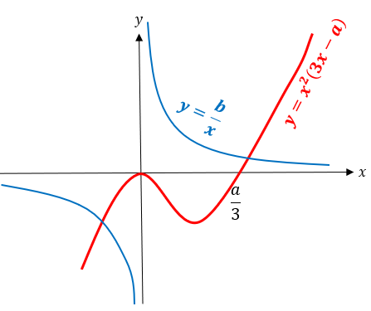
Worked example
Your turn
On the same diagram sketch the curves with equations $y=−x^{2}\left(5x−a\right)$ and $y=−\frac{b}{x}$, where $a,b$ are positive constants.
State, giving a reason, the number of real solutions to the equation $x^{2}\left(5x−a\right)+\frac{b}{x}=0$
On the same diagram sketch the curves with equations $y=x^{2}\left(3x−a\right)$ and $y=\frac{b}{x}$,
where $a,b$ are positive constants.
State, giving a reason, the number of real solutions to the equation $x^{2}\left(3x−a\right)−\frac{b}{x}=0$
$2$ points of intersection where
$$x^{2}\left(3x−a\right)=\frac{b}{x}$$
$$x^{2}\left(3x−a\right)−\frac{b}{x}=0$$
$∴2$ solutions

Slide 35
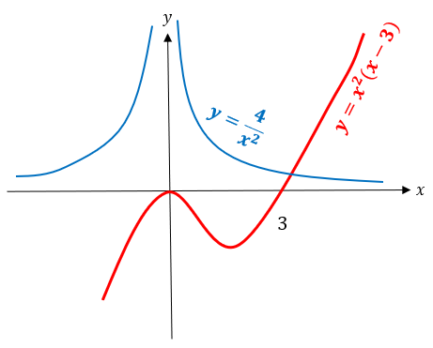
Worked example
Your turn
On the same diagram sketch the curves with equations $y=\frac{3}{x^{2}}$ and $y=x^{2}(x−4)$.
State, giving a reason, the number of real solutions to the equation $x^{4}\left(x−4\right)−3=0$
On the same diagram sketch the curves with equations $y=\frac{4}{x^{2}}$ and $y=x^{2}(x−3)$.
State, giving a reason, the number of real solutions to the equation $x^{4}\left(x−3\right)−4=0$
$1$ point of intersection where
$$x^{2}\left(x−3\right)=\frac{4}{x^{2}}$$
$$x^{4}\left(x−3\right)=4$$
$$x^{4}\left(x−3\right)−4=0$$
$∴1$ real solution

Slide 36
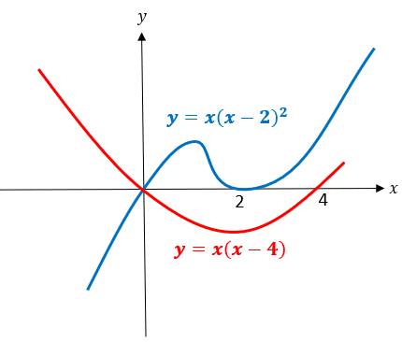
Worked example
Your turn
On the same diagram sketch the curves with equations $y=x(x−5)$ and $y=x{\left(x−3\right)}^{2}$, and hence find the coordinates of any points of intersection.
On the same diagram sketch the curves with equations $y=x(x−4)$ and $y=x{\left(x−2\right)}^{2}$, and hence find the coordinates of any points of intersection.
$(0, 0)$ only as:
$$x{\left(x−2\right)}^{2}=x\left(x−4\right) \\ x\left(x^{2}−4x+4\right)=x^{2}−4x \\ x^{3}−4x^{2}+4x=x^{2}−4x \\ x^{3}−5x^{2}+8x=0 \\ x\left(x^{2}−5x+8\right)=0$$
Discriminant of $x^{2}−5x+8=−7<0$

Slide 37
Worked example
Your turn
Work out the range of values of $a$ such that the graphs of $y=x^{2}+a$ and $3y=x−2$ have two points of intersection
Work out the range of values of $a$ such that the graphs of $y=x^{2}+a$ and $4y=x−3$ have two points of intersection
$$a<−\frac{47}{72}$$

Slide 38
4.5) Translating graphs
Chapter CONTENTS

Slide 39
Worked example
Your turn
Describe the effect on the graph of $y=f(x)$ of:
$$f(x+9)$$
$$f(x−8)$$
$$f\left(x\right)+7$$
$$f\left(x\right)−6$$
Describe the effect on the graph of $y=f(x)$ of:
$$f(x+2)$$
$$f(x−3)$$
$$f\left(x\right)+4$$
$$f\left(x\right)−5$$
Translation by vector $\left(\begin{matrix}−2 \\ 0\end{matrix}\right)$
Translation by vector $\left(\begin{matrix}3 \\ 0\end{matrix}\right)$
Translation by vector $\left(\begin{matrix}0 \\ 4\end{matrix}\right)$
Translation by vector $\left(\begin{matrix}0 \\ −5\end{matrix}\right)$

Slide 40
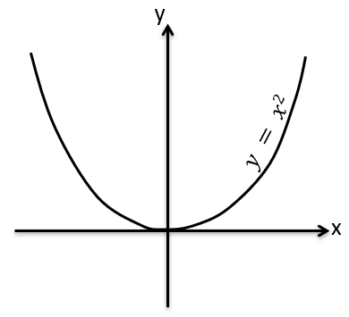
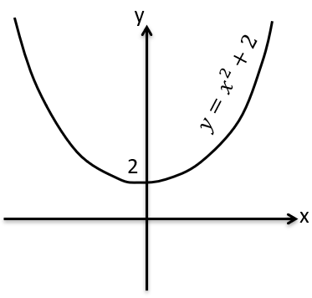
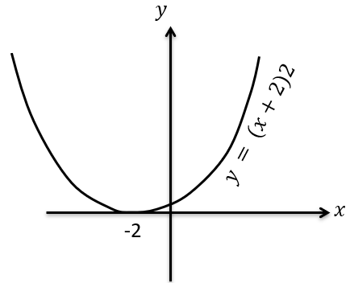
Worked example
Your turn
Sketch:
$$y=−x^{2}$$
$$y=−x^{2}−3$$
$$y=−{\left(x−3\right)}^{2}$$
Sketch:
$$y=x^{2}$$
$$y=x^{2}+2$$
$$y={\left(x+2\right)}^{2}$$

Slide 41
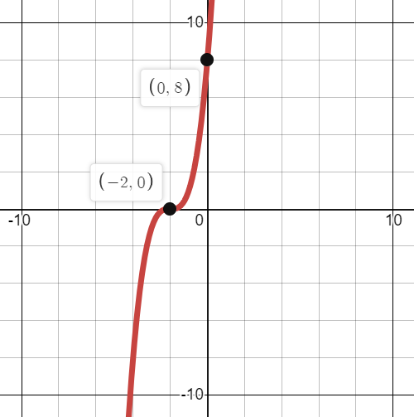
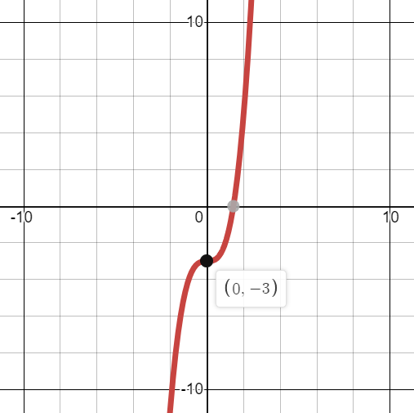
Worked example
Your turn
$$f\left(x\right)=−x^{3}$$
Sketch:
$$f(x−3)$$
$$f\left(x\right)+2$$
$$g\left(x\right)=x^{3}$$
Sketch:
$$g(x+2)$$
$$g\left(x\right)−3$$

Slide 42
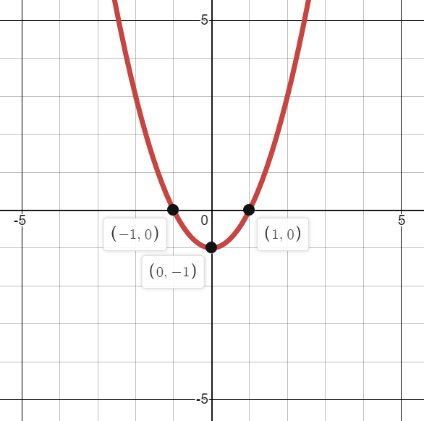
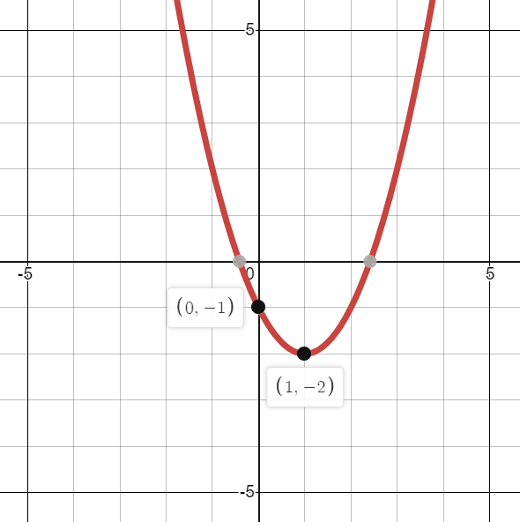
Worked example
Your turn
$$f\left(x\right)=x(x+3)$$
Sketch:
$$f(x−3)$$
$$f\left(x\right)+2$$
$$g\left(x\right)=x(x−2)$$
Sketch:
$$g(x+1)$$
$$g\left(x\right)−1$$

Slide 43
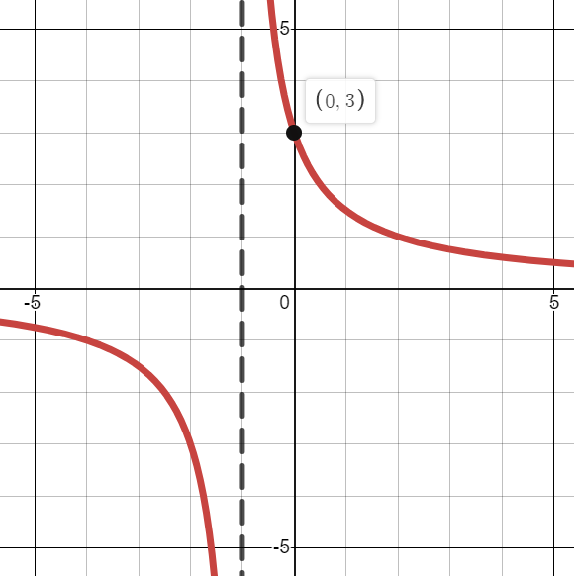
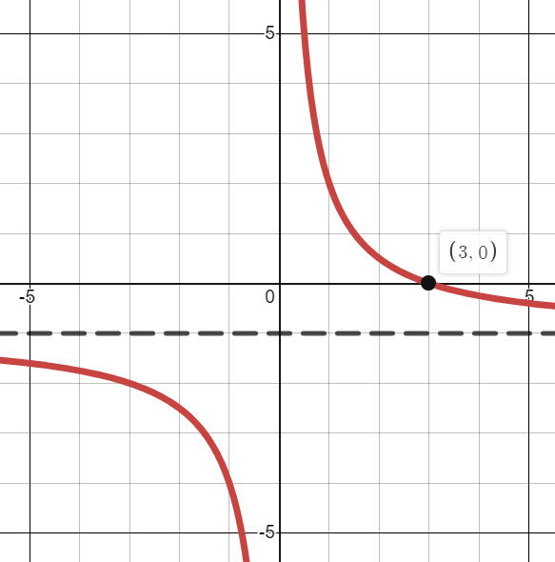
Worked example
Your turn
$$f\left(x\right)=−\frac{2}{x}$$
Sketch:
$$f(x−3)$$
$$f\left(x\right)+2$$
$$g\left(x\right)=\frac{3}{x}$$
Sketch:
$$g(x+1)$$
$$g\left(x\right)−1$$

Slide 44
Worked example
Your turn
The point with coordinates $(−1.5, 0)$ lies on the curve with equation
$$y={\left(x+a\right)}^{3}+6{\left(x+a\right)}^{2}+9(x+a)$$
where $a$ is a constant. Find the two possible values of $a$
The point with coordinates $(−2, 0)$ lies on the curve with equation
$$y={\left(x+a\right)}^{3}+8{\left(x+a\right)}^{2}+16(x+a)$$
where $a$ is a constant. Find the two possible values of $a$
$$a=±2$$

Slide 45
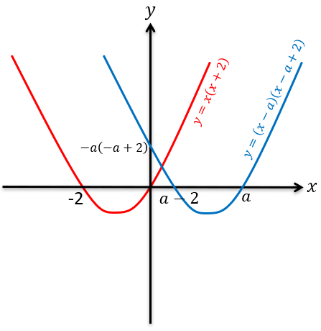
Worked example
Your turn
Sketch $y=x(x−3)$. On the same axes, sketch $y=\left(x+a\right)\left(x+a−3\right)$, where $a>3$.
Sketch $y=x(x+2)$. On the same axes, sketch $y=\left(x−a\right)\left(x−a+2\right)$, where $a>2$.

Slide 46
4.6) Stretching graphs
Chapter CONTENTS

Slide 47
Worked example
Your turn
Describe the effect on the graph of $y=f(x)$ of:
$$f(9x)$$
$$f(\frac{1}{8}x)$$
$$7f\left(x\right)$$
$$\frac{1}{6}f\left(x\right)$$
Describe the effect on the graph of $y=f(x)$ of:
$$f(2x)$$
$$f(\frac{1}{3}x)$$
$$4f\left(x\right)$$
$$\frac{1}{5}f\left(x\right)$$
Stretch, scale factor $\frac{1}{2}$, in the $x$-direction
Stretch, scale factor $3$, in the $x$-direction
Stretch, scale factor $4$, in the $y$-direction
Stretch, scale factor $\frac{1}{5}$, in the $y$-direction

Slide 48
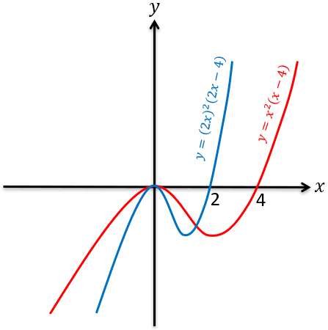
Worked example
Your turn
Sketch $y=x^{2}\left(x+8\right)$. On the same axes, sketch the graph with equation
$$y={\left(4x\right)}^{2}\left(4x+8\right)$$
Sketch $y=x^{2}\left(x−4\right)$. On the same axes, sketch the graph with equation
$$y={\left(2x\right)}^{2}\left(2x−4\right)$$

Slide 49
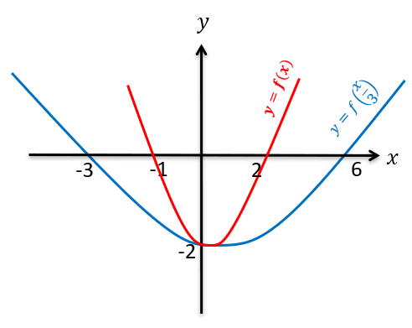
Worked example
Your turn
If $y=(x+2)(x−1)$, sketch $y=f(x)$ and $y=f(\frac{x}{4})$ on the same axes.
If $y=(x+1)(x−2)$, sketch $y=f(x)$ and $y=f(\frac{x}{3})$ on the same axes.

Slide 50
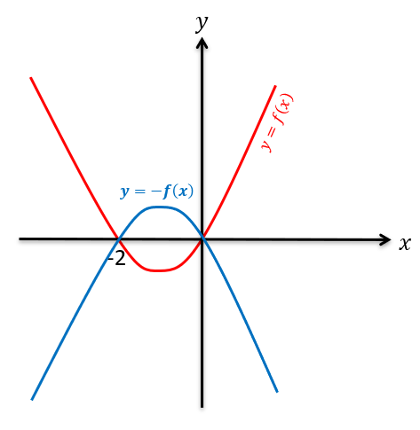
Worked example
Your turn
If $y=x(x−3)$, sketch
$y=f(x)$ and $y=−f(x)$ on the same axes.
If $y=x(x+2)$, sketch
$y=f(x)$ and $y=−f(x)$ on the same axes.

Slide 51
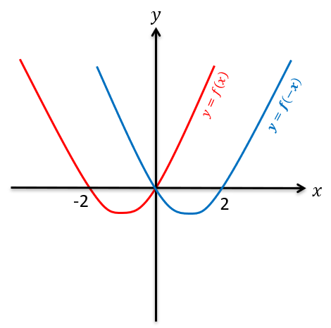
Worked example
Your turn
If $y=x(x−3)$, sketch
$y=f(x)$ and $y=f(−x)$ on the same axes.
If $y=x(x+2)$, sketch
$y=f(x)$ and $y=f(−x)$ on the same axes.

Slide 52
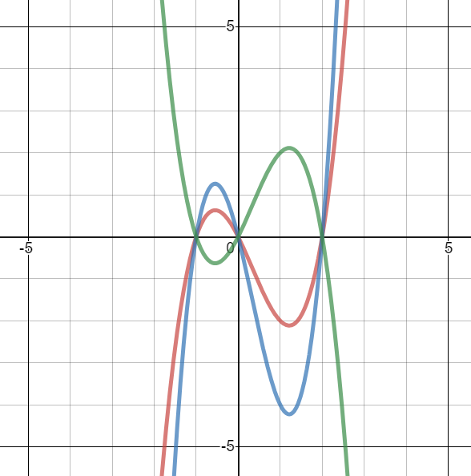
Worked example
Your turn
On the same axes, sketch:
$$y=x(x+2)(x−1)$$
$$y=4x\left(4x+2\right)(4x−1)$$
$$y=−x(x+2)(x−1)$$
On the same axes, sketch:
$$y=x(x−2)(x+1)$$
$$y=2x\left(2x−2\right)(2x+1)$$
$$y=−x(x−2)(x+1)$$

Slide 53
4.7) Transforming functions
Chapter CONTENTS

Slide 54
Worked example
Your turn
A sketch of the curve $y=f(x)$ is shown.
Sketch:
$$y=f(x−3)$$
A sketch of the curve $y=f(x)$ is shown.
Sketch:
$$y=f(x+2)$$

Slide 55
Worked example
Your turn
A sketch of the curve $y=f(x)$ is shown.
Sketch:
$$y=f\left(x\right)−3$$
A sketch of the curve $y=f(x)$ is shown.
Sketch:
$$y=f\left(x\right)+2$$

Slide 56
Worked example
Your turn
A sketch of the curve $y=f(x)$ is shown.
Sketch:
$$y=f\left(4x\right)$$
A sketch of the curve $y=f(x)$ is shown.
Sketch:
$$y=f\left(2x\right)$$

Slide 57
Worked example
Your turn
A sketch of the curve $y=f(x)$ is shown.
Sketch:
$$y=f\left(\frac{x}{4}\right)$$
A sketch of the curve $y=f(x)$ is shown.
Sketch:
$$y=f\left(\frac{x}{3}\right)$$

Slide 58
Worked example
Your turn
A sketch of the curve $y=f(x)$ is shown.
Sketch:
$$y=f\left(−x\right)$$
A sketch of the curve $y=f(x)$ is shown.
Sketch:
$$y=−f\left(x\right)$$

Slide 59
Worked example
Your turn
Find the new coordinates under the transformations
Find the new coordinates under the transformations
$$y=f(x)$$ | $$(−6, 4)$$ | $$(0, 1)$$
$$y=f(x+2)$$
$$y=f\left(x\right)−2$$
$$y=f(3x)$$
$$y=4f(x)$$
$$y=f\left(\frac{x}{5}\right)$$
$$y=6f(x)$$
$$y=−f(x)$$
$$y=f(−x)$$
$$y=f(x)$$ | $$(6, −4)$$ | $$(1, 0)$$
$$y=f(x+1)$$
$$y=f\left(x\right)−1$$
$$y=f(2x)$$
$$y=3f(x)$$
$$y=f\left(\frac{x}{4}\right)$$
$$y=\frac{1}{5}f(x)$$
$$y=−f(x)$$
$$y=f(−x)$$

Slide 60
Worked example
Your turn
The point $A(2, 5)$is the minimum of the curve with equation $y=f\left(x\right)$. Write the new coordinates of the new minimum of the curve:
$$y=2f\left(x\right)+3$$
$$y=3f\left(x\right)−2$$
The point $A(3, 4)$is on the graph of $y=f\left(x\right)$. Write the new coordinates of $A$ after the transformation:
$$y=5f\left(x\right)−6$$
$$(3, 14)$$

Slide 61
Worked example
Your turn
The point $A(2, 5)$is the minimum of the curve with equation $y=f\left(x\right)$. Write the new coordinates of the new minimum of the curve:
$$y=f\left(2x\right)+3$$
$$y=f\left(3x\right)−2$$
The point $A(3, 4)$is on the graph of $y=f\left(x\right)$. Write the new coordinates of $A$ after the transformation:
$$y=f\left(5x\right)−6$$
$$(\frac{3}{5}, −2)$$

Slide 62
Worked example
Your turn
The point $A(2, 5)$is the minimum of the curve with equation $y=f\left(x\right)$. Write the new coordinates of the new minimum of the curve:
$$y=−f\left(x\right)+3$$
$$y=−f\left(x\right)−2$$
The point $A(3, 4)$is on the graph of $y=f\left(x\right)$. Write the new coordinates of $A$ after the transformation:
$$y=−f\left(x\right)−6$$
$$(3, −10)$$

Slide 63
Worked example
Your turn
The point $A(2, 5)$is the minimum of the curve with equation $y=f\left(x\right)$. Write the new coordinates of the new minimum of the curve:
$$y=f\left(−x\right)+3$$
$$y=f\left(−x\right)−2$$
The point $A(3, 4)$is on the graph of $y=f\left(x\right)$. Write the new coordinates of $A$ after the transformation:
$$y=−f\left(−x\right)−6$$
$$(−3, −10)$$

Slide 64
Worked example
Your turn
The point $A(2, 5)$is the minimum of the curve with equation $y=f\left(x\right)$. Write the new coordinates of the new minimum of the curve:
$$y=−2f\left(x\right)+3$$
$$y=−3f\left(x\right)−2$$
The point $A(3, 4)$is on the graph of $y=f\left(x\right)$. Write the new coordinates of $A$ after the transformation:
$$y=−5f\left(x\right)−6$$
$$(3, −26)$$

Slide 65
Worked example
Your turn
The point $A(2, 5)$is the minimum of the curve with equation $y=f\left(x\right)$. Write the new coordinates of the new minimum of the curve:
$$y=2f\left(−x\right)+3$$
$$y=3f\left(−x\right)−2$$
The point $A(3, 4)$is on the graph of $y=f\left(x\right)$. Write the new coordinates of $A$ after the transformation:
$$y=5f\left(−x\right)−6$$
$$(−3, 14)$$

Slide 66
Worked example
Your turn
The point $A(2, 5)$is the minimum of the curve with equation $y=f\left(x\right)$. Write the new coordinates of the new minimum of the curve:
$$y=−2f\left(−x\right)+3$$
$$y=−3f\left(−x\right)−2$$
The point $A(3, 4)$is on the graph of $y=f\left(x\right)$. Write the new coordinates of $A$ after the transformation:
$$y=−5f\left(−x\right)−6$$
$$(−3, −26)$$

Slide 67
Worked example
Your turn
The point $A(2, 5)$is the minimum of the curve with equation $y=f\left(x\right)$. Write the new coordinates of the new minimum of the curve:
$$y=3f\left(2x\right)+7$$
$$y=7f\left(5x\right)−2$$
The point $A(3, 4)$is on the graph of $y=f\left(x\right)$. Write the new coordinates of $A$ after the transformation:
$$y=5f\left(3x\right)−7$$
$$(1, 13)$$

Slide 68
Worked example
Your turn
The point $A(2, 5)$is the minimum of the curve with equation $y=f\left(x\right)$. Write the new coordinates of the new minimum of the curve:
$$y=−3f\left(2x\right)+7$$
$$y=−7f\left(5x\right)−2$$
The point $A(3, 4)$is on the graph of $y=f\left(x\right)$. Write the new coordinates of $A$ after the transformation:
$$y=−5f\left(3x\right)−7$$
$$(1, −27)$$

Slide 69
Worked example
Your turn
The point $A(2, 5)$is the minimum of the curve with equation $y=f\left(x\right)$. Write the new coordinates of the new minimum of the curve:
$$y=−3f\left(−2x\right)+7$$
$$y=−7f\left(−5x\right)−2$$
The point $A(3, 4)$is on the graph of $y=f\left(x\right)$. Write the new coordinates of $A$ after the transformation:
$$y=−5f\left(−3x\right)−7$$
$$(−1, −27)$$

