Slide 1
4) Elastic collisions in one dimension
4.1) Direct impact and Newton’s law of restitution
4.2) Direct collision with a smooth plane
4.3) Loss of kinetic energy
4.4) Successive direct impacts

Slide 2
4.1) Direct impact and Newton’s law of restitution
Chapter CONTENTS

Slide 3
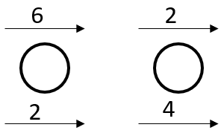
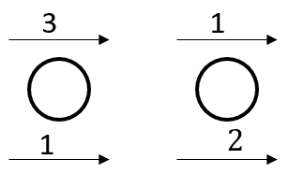
Worked example
Your turn
Calculate the value of the coefficient of restitution, $e$, in the isolated system:
Calculate the value of the coefficient of restitution, $e$, in the isolated system:
$$e=\frac{1}{2}$$
Diagrams used with permission from DrFrostMaths: https://www.drfrostmaths.com/

Slide 4
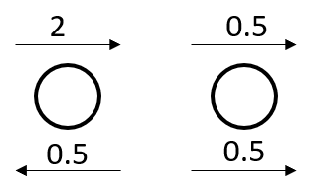
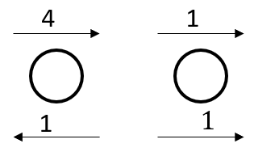
Worked example
Your turn
Calculate the value of the coefficient of restitution, $e$, in the isolated system:
Calculate the value of the coefficient of restitution, $e$, in the isolated system:
$$e=\frac{2}{3}$$
Diagrams used with permission from DrFrostMaths: https://www.drfrostmaths.com/

Slide 5
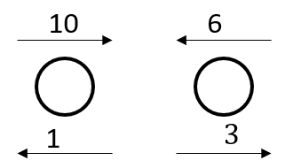
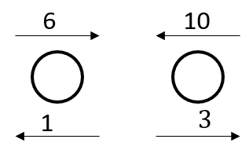
Worked example
Your turn
Calculate the value of the coefficient of restitution, $e$, in the isolated system:
Calculate the value of the coefficient of restitution, $e$, in the isolated system:
$$e=\frac{1}{4}$$
Diagrams used with permission from DrFrostMaths: https://www.drfrostmaths.com/

Slide 6
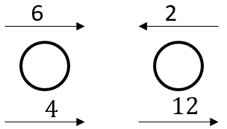
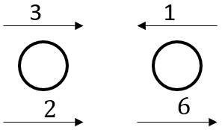
Worked example
Your turn
Calculate the value of the coefficient of restitution, $e$, in the isolated system:
Calculate the value of the coefficient of restitution, $e$, in the isolated system:
$e=1$ ; Perfectly elastic
Diagrams used with permission from DrFrostMaths: https://www.drfrostmaths.com/

Slide 7
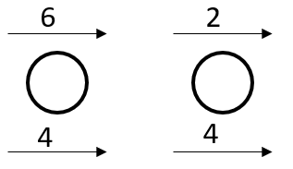
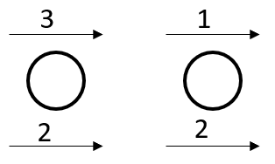
Worked example
Your turn
Calculate the value of the coefficient of restitution, $e$, in the isolated system:
Calculate the value of the coefficient of restitution, $e$, in the isolated system:
$e=0$ ; Totally inelastic ; Particles coalesce
Diagrams used with permission from DrFrostMaths: https://www.drfrostmaths.com/

Slide 8
Worked example
Your turn
Two particles A and B are travelling in the same direction on a smooth surface with speeds $8 ms^{−1}$ and $6 ms^{−1}$ respectively.
They collide directly, and immediately after the collision continue to travel in the same direction with speeds $4 ms^{−1}$ and $v ms^{−1}$ respectively.
Given that the coefficient of restitution between A and B is $\frac{2}{3}$, find $v$
Two particles A and B are travelling in the same direction on a smooth surface with speeds $4 ms^{−1}$ and $3 ms^{−1}$ respectively.
They collide directly, and immediately after the collision continue to travel in the same direction with speeds $2 ms^{−1}$ and $v ms^{−1}$ respectively.
Given that the coefficient of restitution between A and B is $\frac{1}{3}$, find $v$
$v=2.33$(3 sf)

Slide 9
Worked example
Your turn
Two particles A and B of masses 400g and 200g respectively are travelling in opposite directions towards each other on a smooth surface with speeds of $10ms^{−1}$ and $8ms^{−1}$ respectively.
They collide directly, and immediately after their collision have velocities $v_{1} ms^{−1}$ and $v_{2} ms^{−1}$respectively, measured in the direction of the motion of A before the collision.
Given that the coefficient of restitution between A and B is $\frac{1}{4}$, find $v_{1}$and $v_{2}$
Two particles A and B of masses 200g and 400g respectively are travelling in opposite directions towards each other on a smooth surface with speeds of $5ms^{−1}$ and $4ms^{−1}$ respectively.
They collide directly, and immediately after their collision have velocities $v_{1} ms^{−1}$ and $v_{2} ms^{−1}$respectively, measured in the direction of the motion of A before the collision.
Given that the coefficient of restitution between A and B is $\frac{1}{2}$, find $v_{1}$and $v_{2}$
$v_{1}=−4$ and $v_{2}=0.5$

Slide 10
Worked example
Your turn
A particle $A$ of mass $m$ is moving with speed $4u$ on a smooth horizontal table.
The particle collides directly with a particle $B$ of mass $2m$ moving with speed $u$ in the same direction as $A$.
The coefficient of restitution between $A$ and $B$ is $\frac{1}{4}$.
Find the speed of B after the collision
Find the speed of A after the collision
A particle $A$ of mass $2m$ is moving with speed $2u$ on a smooth horizontal table.
The particle collides directly with a particle $B$ of mass $4m$ moving with speed $u$ in the same direction as $A$.
The coefficient of restitution between $A$ and $B$ is $\frac{1}{2}$.
Find the speed of B after the collision
Find the speed of A after the collision
a) $\frac{3u}{2}$
b) $u$

Slide 11
Worked example
Your turn
A uniform sphere A of mass $m$ is moving with speed $u$ on a smooth horizontal table when it collides directly with another uniform sphere B of mass $4m$ which is at rest on the table.
The spheres are of equal radius and the coefficient of restitution between them is $e$.
The direction of motion of A is unchanged by the collision.
Find the speeds of A and B immediately after the collision
Find the range of possible values of $e$
A uniform sphere A of mass $m$ is moving with speed $u$ on a smooth horizontal table when it collides directly with another uniform sphere B of mass $2m$ which is at rest on the table.
The spheres are of equal radius and the coefficient of restitution between them is $e$.
The direction of motion of A is unchanged by the collision.
Find the speeds of A and B immediately after the collision
Find the range of possible values of $e$
a) $v_{A}=\frac{u}{3}\left(1−2e\right) ; v_{B}=\frac{u}{3}(1+e)$
b) $e<\frac{1}{2}$

Slide 12
Worked example
Your turn
Two balls P and Q have massed $6m$ and $8m$ respectively. They are moving in opposite directions towards each other along the same straight line on a smooth level floor.
Immediately before they collide, P has speed $6u$ and Q has speed $4u$.
The coefficient of restitution between P and Q is $e$.
By modelling the balls as smooth spheres and the floor as a smooth horizontal plane,
Find the speed of Q after the collision
Given that the direction of motion of P is unchanged, find the range of possible values of $e$
Given that the magnitude of the impulse of P on Q is $\frac{320mu}{9}$, find the value of $e$
Two balls P and Q have massed $3m$ and $4m$ respectively. They are moving in opposite directions towards each other along the same straight line on a smooth level floor.
Immediately before they collide, P has speed $3u$ and Q has speed $2u$.
The coefficient of restitution between P and Q is $e$.
By modelling the balls as smooth spheres and the floor as a smooth horizontal plane,
Find the speed of Q after the collision
Given that the direction of motion of P is unchanged, find the range of possible values of $e$
Given that the magnitude of the impulse of P on Q is $\frac{80mu}{9}$, find the value of $e$
a) $\frac{u}{7}\left(15e+1\right)$
b) $0≤e<\frac{1}{20}$
c) $e=\frac{1}{27}$

Slide 13
4.2) Direct collision with a smooth plane
Chapter CONTENTS

Slide 14
Worked example
Your turn
A Particle collides normally with a fixed vertical plane. The speed immediately before the collision is $6 ms^{−1}$. The speed immediately after the collision is $2 ms^{−1}$. Find the value of the coefficient of restitution, e.
A Particle collides normally with a fixed vertical plane. The speed immediately before the collision is $8 ms^{−1}$. The speed immediately after the collision is $2 ms^{−1}$. Find the value of the coefficient of restitution, e.
$$\frac{1}{4}$$

Slide 15
Worked example
Your turn
A small sphere collides normally with a fixed vertical wall. Before the impact the sphere is moving with a speed of $8 ms^{−1}$ on a smooth horizontal floor. The coefficient of restitution between the sphere and the wall is $0.4$. Find the speed of the sphere after the collision.
A small sphere collides normally with a fixed vertical wall. Before the impact the sphere is moving with a speed of $4 ms^{−1}$ on a smooth horizontal floor. The coefficient of restitution between the sphere and the wall is $0.2$. Find the speed of the sphere after the collision.
$$0.8 ms^{−1}$$

Slide 16
Worked example
Your turn
A particle falls $45 cm$ from rest onto a smooth horizontal plane. It then rebounds to a height of $20 cm$. Find the coefficient of restitution between the particle and the plane.
A particle falls $22.5 cm$ from rest onto a smooth horizontal plane. It then rebounds to a height of $10 cm$. Find the coefficient of restitution between the particle and the plane.
$0.667$ (3 sf)

Slide 17
Worked example
Your turn
A particle of mass $m$ kg lies on a smooth horizontal surface. Initially the particle is at rest at a point O midway between a pair of fixed parallel vertical walls, which are 4 m apart. At time $t=0$ the particle is projected from O with speed $u ms^{−1}$ in a direction perpendicular to the walls. The coefficient of restitution between the particle and each wall is $\frac{1}{3}$. The magnitude of the impulse on the particle due to the first impact with a wall is $λmu Ns$.
Find the value of $λ$
The particle returns to O, having bounced off each wall once, at time $t=12$ seconds.
b) Find the value of $u$
A particle of mass $m$ kg lies on a smooth horizontal surface. Initially the particle is at rest at a point O midway between a pair of fixed parallel vertical walls, which are 2 m apart. At time $t=0$ the particle is projected from O with speed $u ms^{−1}$ in a direction perpendicular to the walls. The coefficient of restitution between the particle and each wall is $\frac{2}{3}$. The magnitude of the impulse on the particle due to the first impact with a wall is $λmu Ns$.
Find the value of $λ$
The particle returns to O, having bounced off each wall once, at time $t=3$ seconds.
b) Find the value of $u$
a) $λ=\frac{5}{3}$
b) $u=\frac{25}{12}$

Slide 18
Worked example
Your turn
A ball is dropped from a height of $hm$. The coefficient of restitution between the ball and the ground is $e$. What is the total distance travelled by the ball before it comes to rest permanently?
A ball is dropped from a height of $hm$. The coefficient of restitution between the ball and the ground is $e$. Show that the total distance travelled by the ball before it comes to rest permanently is
$$\frac{h\left(1+e^{2}\right)}{1−e^{2}}$$
Shown

Slide 19
4.3) Loss of kinetic energy
Chapter CONTENTS

Slide 20
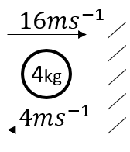
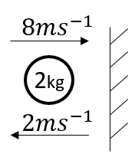
Worked example
Your turn
Find the loss in kinetic energy
Find the loss in kinetic energy
$$60 J$$
Diagrams used with permission from DrFrostMaths: https://www.drfrostmaths.com/

Slide 21
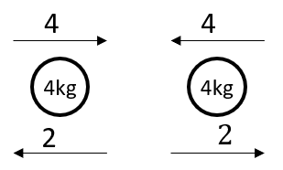
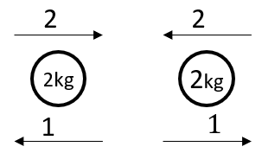
Worked example
Your turn
Find the total loss in kinetic energy
Find the total loss in kinetic energy
$$6 J$$
Diagrams used with permission from DrFrostMaths: https://www.drfrostmaths.com/

Slide 22
Worked example
Your turn
Find the percentage of kinetic energy lost in the collision.
Find the percentage of kinetic energy lost in the collision.
$$75\%$$
Diagrams used with permission from DrFrostMaths: https://www.drfrostmaths.com/

Slide 23
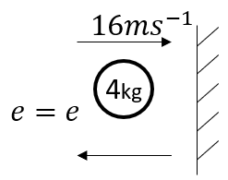
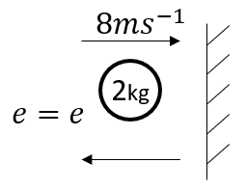
Worked example
Your turn
Find the loss in kinetic energy, in terms of $e$
Find the loss in kinetic energy, in terms of $e$
$$64(1−e^{2})$$
Diagrams used with permission from DrFrostMaths: https://www.drfrostmaths.com/

Slide 24
Worked example
Your turn
Two spheres A and B have massed $6 kg$ and $10 kg$ respectively. A and B move towards each other in opposite directions along the same straight line on a smooth horizontal surface with speeds $6 ms^{−1}$ and $4 ms^{−1}$ respectively.
Given that the coefficient of restitution is $\frac{2}{5}$, find:
The velocities of the spheres after the collision
The loss of kinetic energy due to the impact
Two spheres A and B have massed $3 kg$ and $5 kg$ respectively. A and B move towards each other in opposite directions along the same straight line on a smooth horizontal surface with speeds $3 ms^{−1}$ and $2 ms^{−1}$ respectively.
Given that the coefficient of restitution is $\frac{3}{5}$, find:
The velocities of the spheres after the collision
The loss of kinetic energy due to the impact
a) A: Direction reversed and speed $2 ms^{−1}$
B: Direction reversed and speed $1 ms^{−1}$
b) $15 J$

Slide 25
Worked example
Your turn
A gun of mass 1200 kg fires a shell of mass 24 kg with speed $400 ms^{−1}$.
Find the velocity of the gun after firing
Find the total kinetic energy generated on firing
Show that the ratio of the energy of the gun to the energy of the shell is equal to the ratio of the speed of the gun to the speed of the shell after firing
A gun of mass 600 kg fires a shell of mass 12 kg with speed $200 ms^{−1}$.
Find the velocity of the gun after firing
Find the total kinetic energy generated on firing
Show that the ratio of the energy of the gun to the energy of the shell is equal to the ratio of the speed of the gun to the speed of the shell after firing
Direction of gun reversed and speed $4 ms^{−1}$
$244800 J$
Shown. Both ratios $1:50$

Slide 26
Worked example
Your turn
Two particles A and B, of masses 400g and 600g respectively, are connected by a light inextensible string. The particles are side by side at rest on a smooth floor and A is projected with speed $12ms^{−1}$ directly away from B. When the string becomes taut, particle B is jerked into motion and A and B then move with a common speed in the direction of the projection of A. Find:
the common speed of the particles after the string becomes taut
The loss in kinetic energy due to the jerk
Two particles A and B, of masses 200g and 300g respectively, are connected by a light inextensible string. The particles are side by side at rest on a smooth floor and A is projected with speed $6ms^{−1}$ directly away from B. When the string becomes taut, particle B is jerked into motion and A and B then move with a common speed in the direction of the projection of A. Find:
the common speed of the particles after the string becomes taut
The loss in kinetic energy due to the jerk
a) $2.4 ms^{−1}$
b) $2.16 J$

Slide 27
4.4) Successive direct impacts
Chapter CONTENTS

Slide 28
Worked example
Your turn
Three spheres A, B and C have masses m, 3m and 4m respectively. The spheres move along the same straight line on a horizontal plane with A following B, which is following C. Initially the speeds of A, B and C are $8ms^{−1}, 4ms^{−1}$ and $2ms^{−1}$ respectively, in the direction ABC. Sphere A collides with sphere B and then sphere B collides with sphere C. The coefficient of restitution between A and B is $\frac{1}{4}$ and the coefficient of restitution between B and C is $\frac{1}{2}$.
Find the velocities of he three spheres after the second collisions.
Explain how you can predict that there will be a further collision between A and B.
Three spheres A, B and C have masses m, 2m and 3m respectively. The spheres move along the same straight line on a horizontal plane with A following B, which is following C. Initially the speeds of A, B and C are $7ms^{−1}, 3ms^{−1}$ and $1ms^{−1}$ respectively, in the direction ABC. Sphere A collides with sphere B and then sphere B collides with sphere C. The coefficient of restitution between A and B is $\frac{1}{2}$ and the coefficient of restitution between B and C is $\frac{1}{4}$.
Find the velocities of he three spheres after the second collisions.
Explain how you can predict that there will be a further collision between A and B.
a) A: $3 ms^{−1}$ ; B: $2 ms^{−1}$ ; C: $3 ms^{−1}$
b) Velocity of A greater than velocity of B and A and B are moving in the same direction

Slide 29
Worked example
Your turn
A uniform sphere P of mass $5m$ is moving in a straight line with speed $u$ on a smooth horizontal table. Another uniform smooth sphere Q of mass $m$ is moving with speed $3u$ in the same straight line as P but in the opposite direction. The sphere P collides with the sphere Q directly. The coefficient of restitution between P and Q is $e$. The direction of motion of P is changed by the collision. Write an inequality to represent the possible values of $e$
A uniform sphere P of mass $3m$ is moving in a straight line with speed $u$ on a smooth horizontal table. Another uniform smooth sphere Q of mass $m$ is moving with speed $2u$ in the same straight line as P but in the opposite direction. The sphere P collides with the sphere Q directly. The coefficient of restitution between P and Q is $e$. The direction of motion of P is changed by the collision. Write an inequality to represent the possible values of $e$
$$e>\frac{1}{3}$$

Slide 30
Worked example
Your turn
A uniform sphere P of mass $5m$ is moving in a straight line with speed $u$ on a smooth horizontal table. Another uniform smooth sphere Q of mass $m$ is moving with speed $3u$ in the same straight line as P but in the opposite direction. The sphere P collides with the sphere Q directly. The coefficient of restitution between P and Q is $e$. The direction of motion of P is changed by the collision. Following the collision with P the sphere Q then collides with and rebounds from a vertical wall perpendicular to the direction of motion of Q. The coefficient of restitution between Q and the wall is $e′$. Given that $e=\frac{7}{9}$ and that P and Q collide again in the subsequent motion, write an inequality to represent the possible values of $e′$.
A uniform sphere P of mass $3m$ is moving in a straight line with speed $u$ on a smooth horizontal table. Another uniform smooth sphere Q of mass $m$ is moving with speed $2u$ in the same straight line as P but in the opposite direction. The sphere P collides with the sphere Q directly. The coefficient of restitution between P and Q is $e$. The direction of motion of P is changed by the collision. Following the collision with P the sphere Q then collides with and rebounds from a vertical wall perpendicular to the direction of motion of Q. The coefficient of restitution between Q and the wall is $e′$. Given that $e=\frac{5}{9}$ and that P and Q collide again in the subsequent motion, write an inequality to represent the possible values of $e′$.
$$e′>\frac{1}{9}$$

Slide 31
Worked example
Your turn
A tennis ball, which may be modelled as a particle, is dropped from rest at a height of $180 cm$ onto a smooth horizontal plane. The coefficient of restitution between the ball and the plane is $0.25$. Assume there is no air resistance, the ball falls under gravity, and hits the plane at right angles. Find:
The height to which the ball rebounds after the first bounce
The height to which the ball rebounds after the second bounce
The total distance travelled by the ball before it comes to rest, according to the model.
Criticise this model with respect to the motion
of the ball as it continues to bounce.
A tennis ball, which may be modelled as a particle, is dropped from rest at a height of $90 cm$ onto a smooth horizontal plane. The coefficient of restitution between the ball and the plane is $0.5$. Assume there is no air resistance, the ball falls under gravity, and hits the plane at right angles. Find:
The height to which the ball rebounds after the first bounce
The height to which the ball rebounds after the second bounce
The total distance travelled by the ball before it comes to rest, according to the model.
a) $22.5 cm$
b) $5.625 cm$
c) $1.5 m$

Slide 32
Worked example
Your turn
Three identical particles P, Q and R, each of mass $m$, lie in a straight line on a smooth horizontal plane with Q between P and R. Particles P and Q are projected directly towards each other with speeds $6u$ and $4u$ respectively, and at the same time particle $R$ is projected along the line away from Q with speed $5u$. The coefficient of restitution between each pair of particles is $e$. After the collision between P and Q there is a collision between Q and R. Write an inequality to represent the possible values of $e$.
Three identical particles P, Q and R, each of mass $m$, lie in a straight line on a smooth horizontal plane with Q between P and R. Particles P and Q are projected directly towards each other with speeds $4u$ and $2u$ respectively, and at the same time particle $R$ is projected along the line away from Q with speed $3u$. The coefficient of restitution between each pair of particles is $e$. After the collision between P and Q there is a collision between Q and R. Write an inequality to represent the possible values of $e$
$$e>\frac{2}{3}$$

