Slide 1
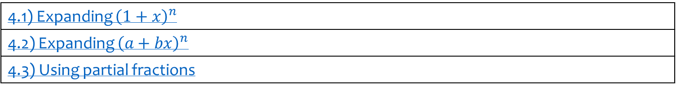
4) Binomial expansion
4.1) Expanding ${\left(1+x\right)}^{n}$
4.2) Expanding ${\left(a+bx\right)}^{n}$
4.3) Using partial fractions

Slide 2
4.1) Expanding ${\left(1+x\right)}^{n}$
Chapter CONTENTS

Slide 3


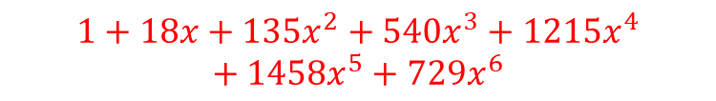
Worked example
Your turn
Find the binomial expansion of:
$${\left(1+x\right)}^{4}$$
$${\left(1−2x\right)}^{5}$$
Find the binomial expansion of:
$${\left(1+3x\right)}^{6}$$
$$1+18x+135x^{2}+540x^{3}+1215x^{4}+1458x^{5}+729x^{6}$$

Slide 4
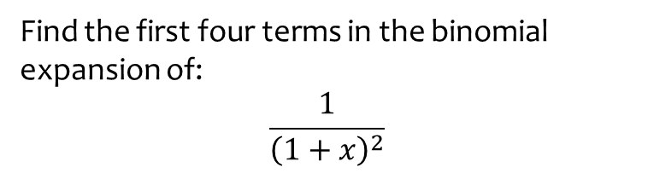

Worked example
Your turn
Find the first four terms in the binomial expansion of:
$$\frac{1}{1+x}$$
$$\frac{1}{{\left(1−x\right)}^{3}}$$
Find the first four terms in the binomial expansion of:
$$\frac{1}{{\left(1+x\right)}^{2}}$$
$$1−2x+3x^{2}−4x^{3}+…$$

Slide 5
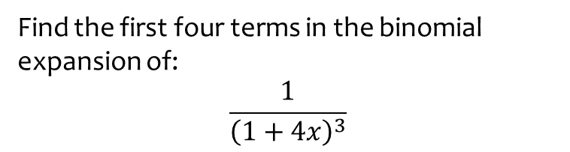

Worked example
Your turn
Find the first four terms in the binomial expansion of:
$$\frac{1}{1+2x}$$
$$\frac{1}{{\left(1−3x\right)}^{4}}$$
Find the first four terms in the binomial expansion of:
$$\frac{1}{{\left(1+4x\right)}^{3}}$$
$$1−12x+96x^{2}−640x^{3}+…$$

Slide 6
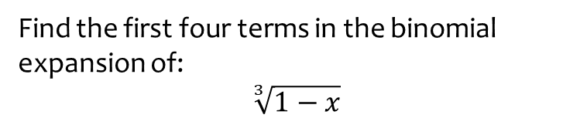


Worked example
Your turn
Find the first four terms in the binomial expansion of:
$$\sqrt{1+x}$$
$$\sqrt[4]{1−x}$$
Find the first four terms in the binomial expansion of:
$$\sqrt[3]{1−x}$$
$$1−\frac{1}{3}x−\frac{1}{9}x^{2}−\frac{5}{81}x^{3}+…$$

Slide 7
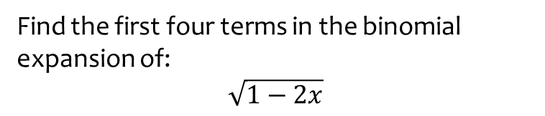


Worked example
Your turn
Find the first four terms in the binomial expansion of:
$$\sqrt{1+6x}$$
$$\sqrt{1−4x}$$
Find the first four terms in the binomial expansion of:
$$\sqrt{1−2x}$$
$$1−x−\frac{x^{2}}{2}−\frac{x^{3}}{2}+…$$

Slide 8


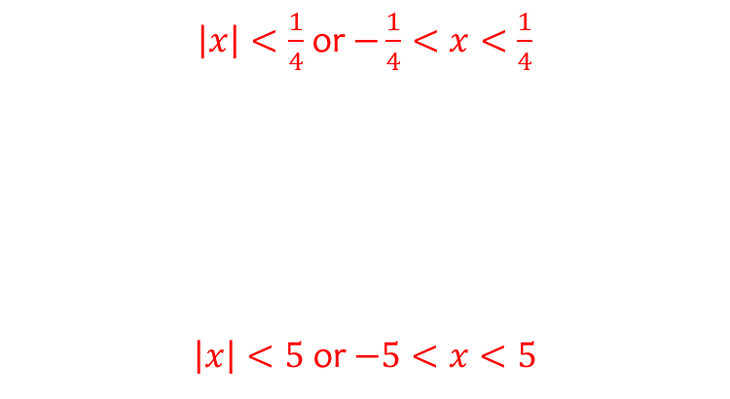
Worked example
Your turn
State when the binomial expansion is valid:
$$\frac{1}{1+2x}$$
$$\frac{1}{{\left(1−3x\right)}^{4}}$$
$${\left(1+5x\right)}^{\frac{3}{2}}$$
$$\frac{1}{\sqrt{1+\frac{x}{7}}}$$
State when the binomial expansion is valid:
$$\frac{1}{{\left(1+4x\right)}^{3}}$$
$$\sqrt{1−\frac{x}{5}}$$
$\left|x\right|<\frac{1}{4}$ or $−\frac{1}{4}<x<\frac{1}{4}$
$\left|x\right|<5$ or $−5<x<5$

Slide 9



Worked example
Your turn
State when the binomial expansion is valid:
$$\frac{2−x}{\sqrt{1+3x}}$$
$$\frac{5+x}{{\left(1−2x\right)}^{4}}$$
$${\left(1+5x\right)}^{\frac{3}{2}}\sqrt{1−\frac{x}{4}}$$
State when the binomial expansion is valid:
$$\frac{2+x}{\sqrt{1+5x}}$$
$${\left(1−3x\right)}^{\frac{5}{3}}\sqrt[4]{1+\frac{x}{2}}$$
$\left|x\right|<\frac{1}{5}$ or $−\frac{1}{5}<x<\frac{1}{5}$
$\left|x\right|<\frac{1}{3}$ or $−\frac{1}{3}<x<\frac{1}{3}$

Slide 10
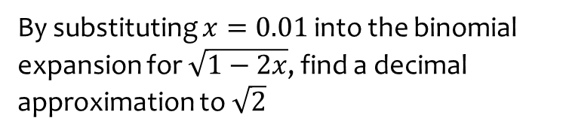
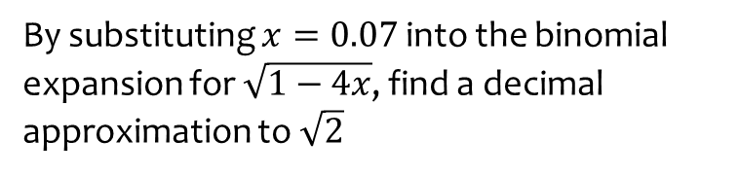
Worked example
Your turn
By substituting $x=0.07$ into the binomial expansion for $\sqrt{1−4x}$, find a decimal approximation to $\sqrt{2}$
By substituting $x=0.01$ into the binomial expansion for $\sqrt{1−2x}$, find a decimal approximation to $\sqrt{2}$
$$1.414213571…$$

Slide 11
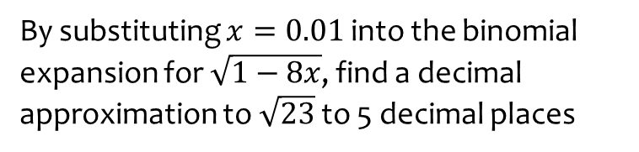
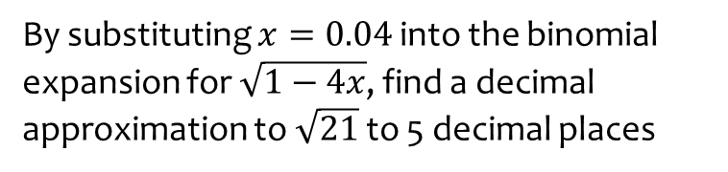
Worked example
Your turn
By substituting $x=0.04$ into the binomial expansion for $\sqrt{1−4x}$, find a decimal approximation to $\sqrt{21}$ to 5 decimal places
By substituting $x=0.01$ into the binomial expansion for $\sqrt{1−8x}$, find a decimal approximation to $\sqrt{23}$ to 5 decimal places
$$4.79584$$

Slide 12
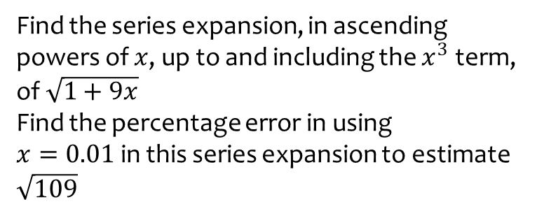
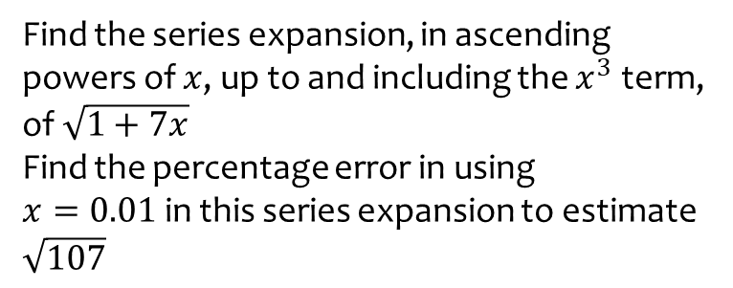

Worked example
Your turn
Find the series expansion, in ascending powers of $x$, up to and including the $x^{3}$ term, of $\sqrt{1+7x}$
Find the percentage error in using
$x=0.01$in this series expansion to estimate $\sqrt{107}$
Find the series expansion, in ascending powers of $x$, up to and including the $x^{3}$ term, of $\sqrt{1+9x}$
Find the percentage error in using
$x=0.01$in this series expansion to estimate $\sqrt{109}$
$0.003\%$ (3 dp)

Slide 13
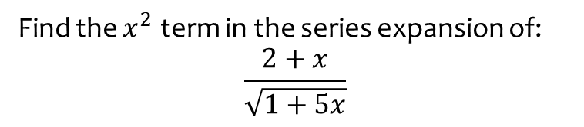
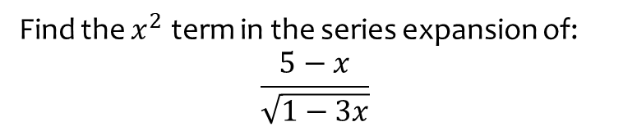

Worked example
Your turn
Find the $x^{2}$ term in the series expansion of:
$$\frac{5−x}{\sqrt{1−3x}}$$
Find the $x^{2}$ term in the series expansion of:
$$\frac{2+x}{\sqrt{1+5x}}$$
$$\frac{65}{4}x^{2}$$

Slide 14
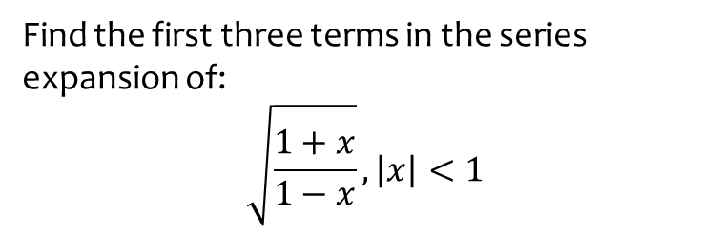
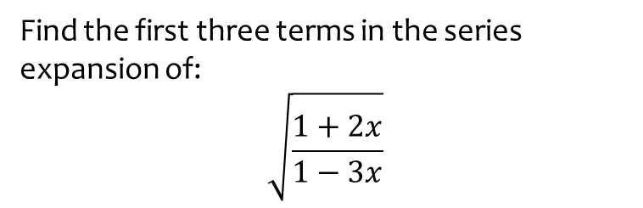

Worked example
Your turn
Find the first three terms in the series expansion of:
$$\sqrt{\frac{1+2x}{1−3x}}$$
Find the first three terms in the series expansion of:
$$\sqrt{\frac{1+x}{1−x}}, \left|x\right|<1$$
$$1+x+\frac{1}{2}x^{2}$$

Slide 15
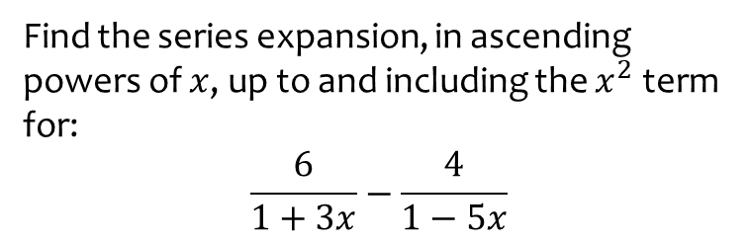
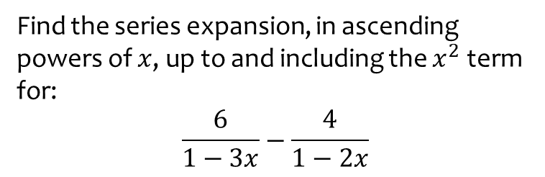
Worked example
Your turn
Find the series expansion, in ascending powers of $x$, up to and including the $x^{2}$ term for:
$$\frac{6}{1−3x}−\frac{4}{1−2x}$$
Find the series expansion, in ascending powers of $x$, up to and including the $x^{2}$ term for:
$$\frac{6}{1+3x}−\frac{4}{1−5x}$$
$$2−38x−46x^{2}$$

Slide 16


Worked example
Your turn
In the expansion of ${\left(1+kx\right)}^{−3}$ the coefficient of $x$ is $12$. Find $k$
In the expansion of ${\left(1+kx\right)}^{−3}$ the coefficient of $x^{2}$ is $4$and $k>0$. Find $k$
In the expansion of ${\left(1+kx\right)}^{−4}$ the coefficient of $x$ is $20$. Find $k$
$$k=−5$$

Slide 17
4.2) Expanding ${\left(a+bx\right)}^{n}$
Chapter CONTENTS

Slide 18
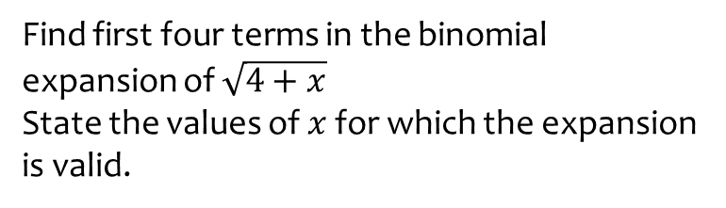
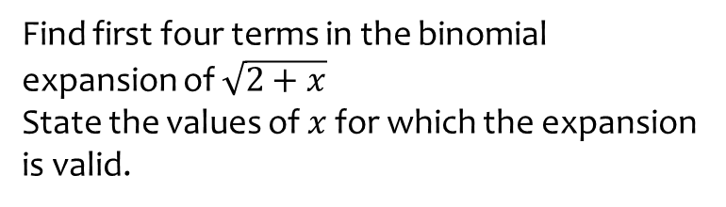
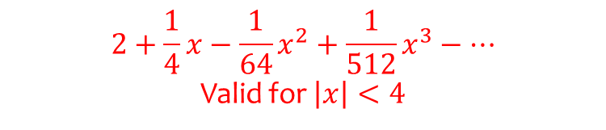
Worked example
Your turn
Find first four terms in the binomial expansion of $\sqrt{2+x}$
State the values of $x$ for which the expansion is valid.
Find first four terms in the binomial expansion of $\sqrt{4+x}$
State the values of $x$ for which the expansion is valid.
$$2+\frac{1}{4}x−\frac{1}{64}x^{2}+\frac{1}{512}x^{3}−…$$
Valid for $\left|x\right|<4$

Slide 19
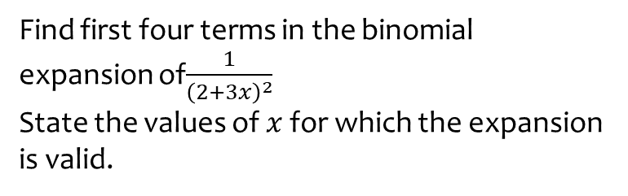
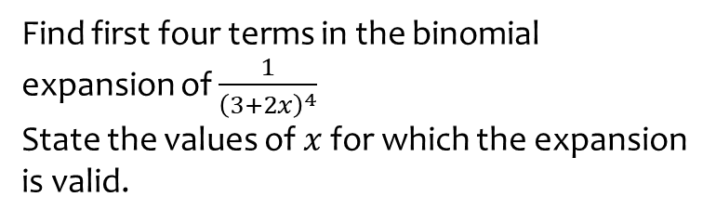
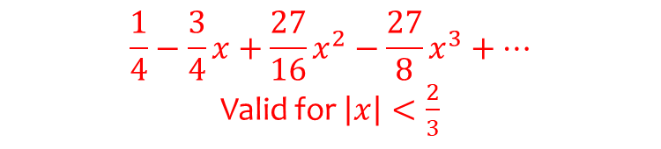
Worked example
Your turn
Find first four terms in the binomial expansion of $\frac{1}{{\left(3+2x\right)}^{4}}$
State the values of $x$ for which the expansion is valid.
Find first four terms in the binomial expansion of$\frac{1}{{\left(2+3x\right)}^{2}}$
State the values of $x$ for which the expansion is valid.
$$\frac{1}{4}−\frac{3}{4}x+\frac{27}{16}x^{2}−\frac{27}{8}x^{3}+…$$
Valid for $\left|x\right|<\frac{2}{3}$

Slide 20
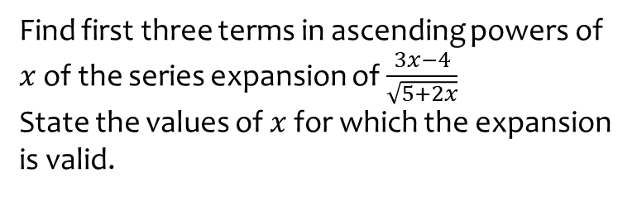
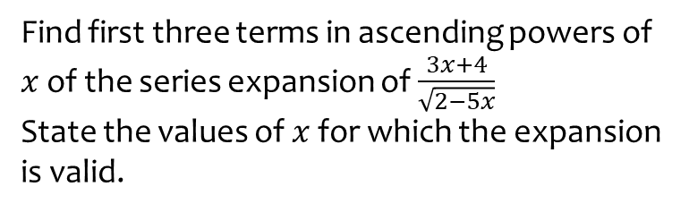
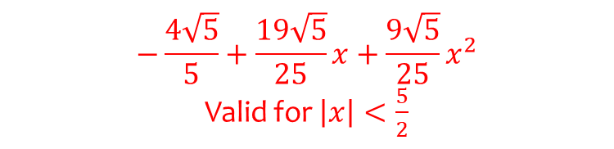
Worked example
Your turn
Find first three terms in ascending powers of $x$ of the series expansion of $\frac{3x+4}{\sqrt{2−5x}}$
State the values of $x$ for which the expansion is valid.
Find first three terms in ascending powers of $x$ of the series expansion of $\frac{3x−4}{\sqrt{5+2x}}$
State the values of $x$ for which the expansion is valid.
$$−\frac{4\sqrt{5}}{5}+\frac{19\sqrt{5}}{25}x+\frac{9\sqrt{5}}{25}x^{2}$$
Valid for $\left|x\right|<\frac{5}{2}$

Slide 21
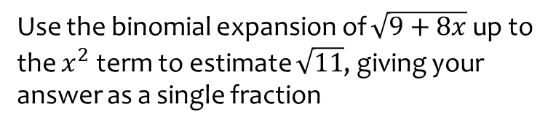
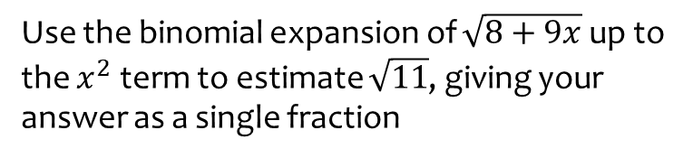

Worked example
Your turn
Use the binomial expansion of $\sqrt{8+9x}$ up to the $x^{2}$ term to estimate $\sqrt{11}$, giving your answer as a single fraction
Use the binomial expansion of $\sqrt{9+8x}$ up to the $x^{2}$ term to estimate $\sqrt{11}$, giving your answer as a single fraction
$$\frac{179}{54}$$

Slide 22
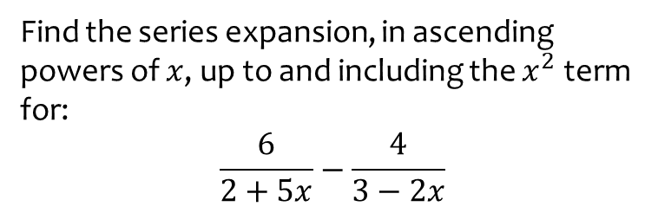
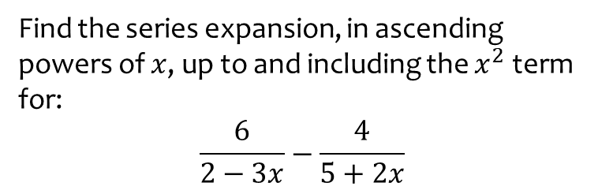

Worked example
Your turn
Find the series expansion, in ascending powers of $x$, up to and including the $x^{2}$ term for:
$$\frac{6}{2−3x}−\frac{4}{5+2x}$$
Find the series expansion, in ascending powers of $x$, up to and including the $x^{2}$ term for:
$$\frac{6}{2+5x}−\frac{4}{3−2x}$$
$$\frac{5}{3}−\frac{151}{18}x+\frac{1961}{108}x^{2}$$

Slide 23
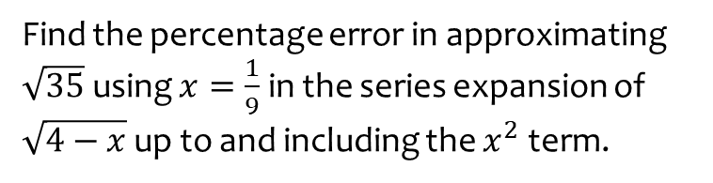
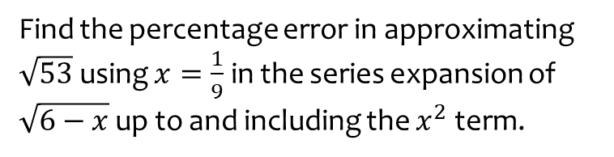
Worked example
Your turn
Find the percentage error in approximating $\sqrt{53}$using $x=\frac{1}{9}$ in the series expansion of $\sqrt{6−x}$ up to and including the $x^{2}$ term.
Find the percentage error in approximating $\sqrt{35}$using $x=\frac{1}{9}$ in the series expansion of $\sqrt{4−x}$ up to and including the $x^{2}$ term.
$$0.000138\%$$

Slide 24
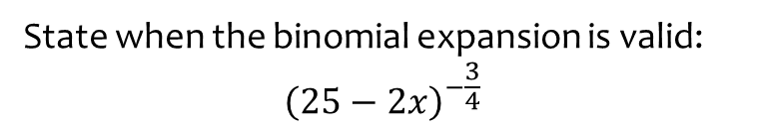


Worked example
Your turn
State when the binomial expansion is valid:
$${\left(2+x\right)}^{−3}$$
$${\left(9+2x\right)}^{\frac{1}{2}}$$
$${\left(8−x\right)}^{\frac{1}{3}}$$
$${\left(5−2x\right)}^{−3}$$
$${\left(16+3x\right)}^{−\frac{1}{2}}$$
State when the binomial expansion is valid:
$${\left(25−2x\right)}^{−\frac{3}{4}}$$
$$\left|x\right|<\frac{25}{2}$$

Slide 25
4.3) Using partial fractions
Chapter CONTENTS

Slide 26
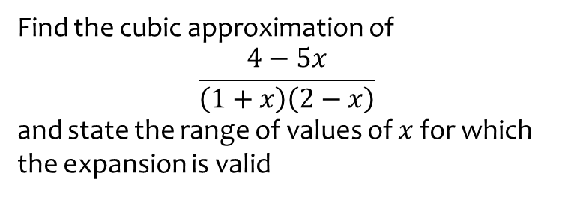
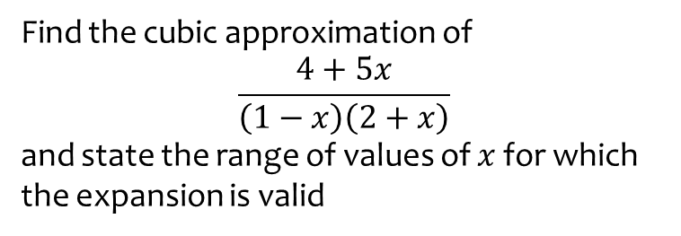

Worked example
Your turn
Find the cubic approximation of
$$\frac{4+5x}{\left(1−x\right)\left(2+x\right)}$$
and state the range of values of $x$ for which the expansion is valid
Find the cubic approximation of
$$\frac{4−5x}{\left(1+x\right)\left(2−x\right)}$$
and state the range of values of $x$ for which the expansion is valid
$$2−\frac{7}{2}x+\frac{11}{4}x^{2}−\frac{25}{8}x^{3}$$
Valid for $\left|x\right|<1$

Slide 27



Worked example
Your turn
Find the quadratic approximation of
$$\frac{2x^{2}−5x−10}{x^{2}−x−2}$$
Find the quadratic approximation of
$$\frac{2x^{2}+5x−10}{x^{2}+x−2}$$
$$5+\frac{3}{2}x^{2}+…$$

Slide 28


Worked example
Your turn
Find the quadratic approximation of
$$\frac{40x^{2}−37x+9}{{\left(4x−1\right)}^{2}(x+2)}$$
Find the quadratic approximation of
$$\frac{8x^{2}−13x+6}{{\left(2x−1\right)}^{2}(x+1)}$$
$$6+5x+23x^{2}$$

