Slide 1
3.x) Conditional probabilities

Slide 2
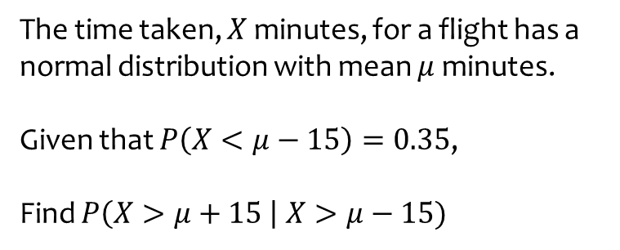
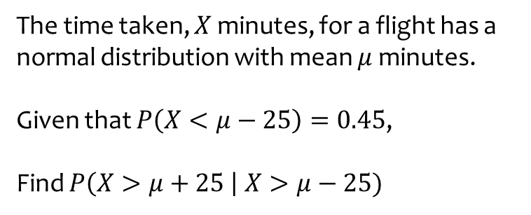

Worked example
Your turn
The time taken, $X$ minutes, for a flight has a normal distribution with mean $μ$ minutes.
Given that $P\left(X<μ−25\right)=0.45$,
Find $P\left(X>μ+25 \right| X>μ−25)$
The time taken, $X$ minutes, for a flight has a normal distribution with mean $μ$ minutes.
Given that $P\left(X<μ−15\right)=0.35$,
Find $P\left(X>μ+15 \right| X>μ−15)$
$$\frac{7}{13}$$

Slide 3
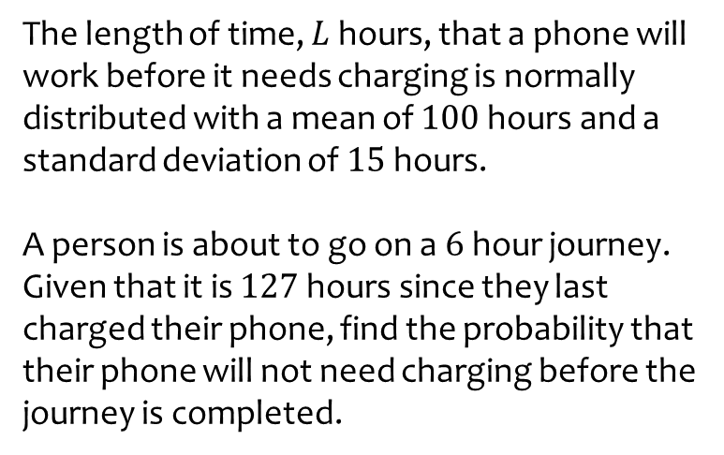
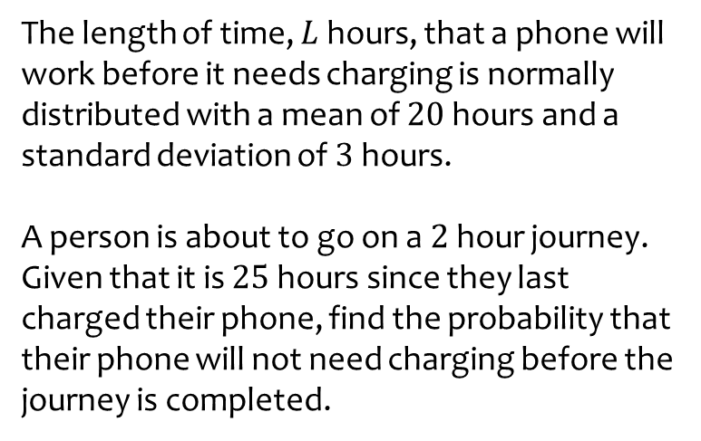

Worked example
Your turn
The length of time, $L$ hours, that a phone will work before it needs charging is normally distributed with a mean of $20$ hours and a standard deviation of $3$ hours.
A person is about to go on a $2$ hour journey.
Given that it is $25$ hours since they last charged their phone, find the probability that their phone will not need charging before the journey is completed.
The length of time, $L$ hours, that a phone will work before it needs charging is normally distributed with a mean of $100$ hours and a standard deviation of $15$ hours.
A person is about to go on a $6$ hour journey.
Given that it is $127$ hours since they last charged their phone, find the probability that their phone will not need charging before the journey is completed.
$0.39$ (2 sf)

