Slide 1
3.8) Modelling with series

Slide 2
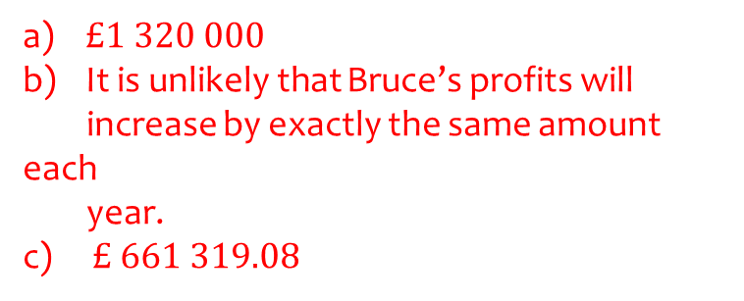
Worked example
Your turn
Bruce starts a new company. In year 1 his profits will be £10 000. He predicts his profits to increase by £5000 each year, so that his profits in year 2 are modelled to be £15 000, in year 3, £20 000 and so on. He predicts this will continue until he reaches annual profits of £50 000. He then models his annual profits to remain at £50 000.
Calculate the profits for Bruce’s business in the first 20 years.
State one reason why this may not be a suitable model.
Bruce’s financial advisor says the yearly profits are likely to increase by 2.5% per annum. Using this model, calculate the profits for Bruce’s business in the first 20 years.
Jenny starts a new company. In year 1 her profits will be £20 000. She predicts her profits to increase by £5000 each year, so that her profits in year 2 are modelled to be £25 000, in year 3, £30 000 and so on. She predicts this will continue until she reaches annual profits of
£100 000. She then models her annual profits to remain at £100 000.
Calculate the profits for Jenny’s business in the first 20 years.
State one reason why this may not be a suitable model.
Jenny’s financial advisor says the yearly profits are likely to increase by 5% per annum. Using this model, calculate the profits for Jenny’s business in the first 20 years.
$£1 320 000$
It is unlikely that Bruce’s profits will
increase by exactly the same amount each
year.
c) $£ 661 319.08$

Slide 3
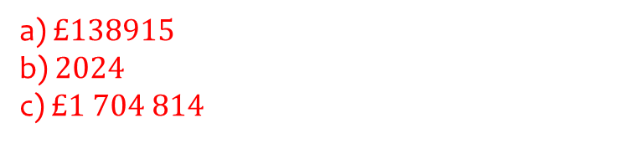
Worked example
Your turn
A company predicts a yearly profit of £210 000 in the year 2031. The company predicts that the yearly profit will rise each year by 4%.
Find the predicted profit in the year 2035
Find the first year in which the yearly predicted profit exceeds £300 000
Find the total predicted profit for the years 2031 to 2042 inclusive, giving your answer to the nearest pound.
A company predicts a yearly profit of £120 000 in the year 2013. The company predicts that the yearly profit will rise each year by 5%.
Find the predicted profit in the year 2016
Find the first year in which the yearly predicted profit exceeds £200 000
Find the total predicted profit for the years 2013 to 2023 inclusive, giving your answer to the nearest pound.
a) $£138915$
b) $2024$
c) $£1 704 814$

