Slide 1
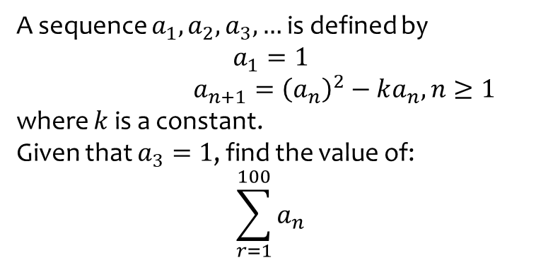
Worked example
Your turn
A sequence $a_{1},a_{2},a_{3}, …$ is defined by
$$a_{1}=1$$
$a_{n+1}={\left(a_{n}\right)}^{2}−ka_{n},n≥1$
where $k$ is a constant.
Given that $a_{3}=1$, find the value of:
$$\sum_{r=1}^{100}{a_{n}}$$
A sequence $a_{1},a_{2},a_{3}, …$ is defined by
$$a_{1}=1$$
$a_{n+1}=ka_{n}+5, n≥1$
where $a$ is a positive constant.
Given that $a_{3}=41$, find the value of:
$$\sum_{r=1}^{5}{a_{n}}$$
$$901$$

Slide 2
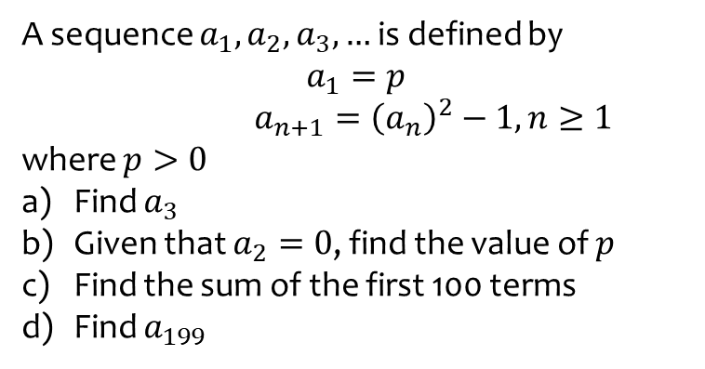
Worked example
Your turn
A sequence $a_{1},a_{2},a_{3}, …$ is defined by
$$a_{1}=2$$
$a_{n+1}={\left(a_{n}\right)}^{2}−2, n≥2$
where $p>0$
Find $a_{3}$
Given that $a_{2}=2$, find the value of $p$
Find the sum of the first 100 terms
Find $a_{199}$
A sequence $a_{1},a_{2},a_{3}, …$ is defined by
$$a_{1}=p$$
$a_{n+1}={\left(a_{n}\right)}^{2}−1, n≥1$
where $p>0$
Find $a_{3}$
Given that $a_{2}=0$, find the value of $p$
Find the sum of the first 100 terms
Find $a_{199}$
a) $p^{4}−2p^{2}$
b) $p=−1$
c) $−100$
d) $−1$

Slide 3
Worked example
Your turn
For each sequence:
State whether the sequence is increasing, decreasing or periodic.
If the sequence is periodic, write down its order.
$u_{n+1}=u_{n}−3, u_{1}=7$
$u_{n+1}={\left(u_{n}\right)}^{3}, u_{1}=2$
$u_{n+1}=\cos\left(45n°\right)$
For each sequence:
State whether the sequence is increasing, decreasing or periodic.
If the sequence is periodic, write down its order.
$u_{n+1}=u_{n}+3, u_{1}=7$
$u_{n+1}={\left(u_{n}\right)}^{2}, u_{1}=\frac{1}{2}$
$u_{n+1}=\sin\left(90n°\right)$
Increasing
Decreasing
Periodic, order $4$

