Slide 1
3.7) Regions

Slide 2
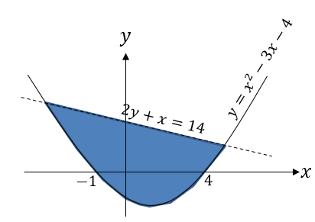
Worked example
Your turn
Shade the region that satisfies the inequalities:
$$4y+x≤12 \\ y>x^{2}−5x−6$$
Shade the region that satisfies the inequalities:
$$2y+x<14 \\ y≥x^{2}−3x−4$$

Slide 3
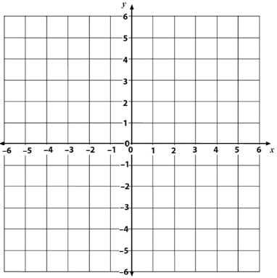
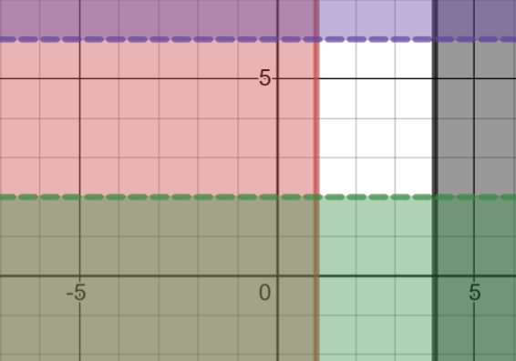
Worked example
Your turn
Shade the region which satisfies the inequalities. Label it R.
$2≤x≤5$ and $1<y<3$
Shade the region which satisfies the inequalities. Label it R
$1≤x≤4$ and $2<y<6$
$$R$$
Graphs used with permission from DESMOS: https://www.desmos.com/

Slide 4
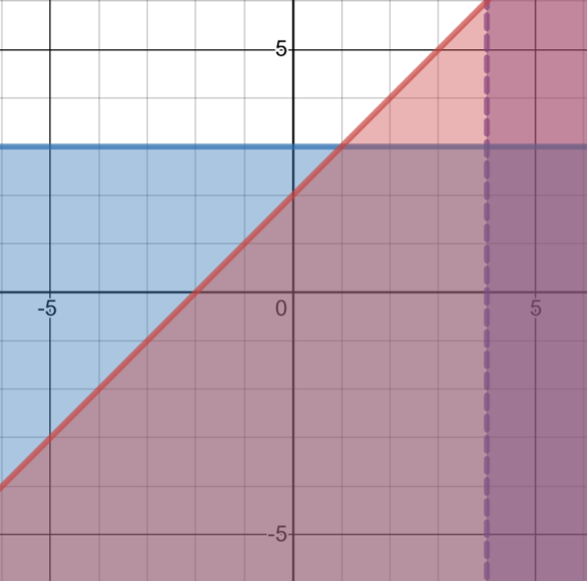
Worked example
Your turn
Shade the region which satisfies the inequalities. Label it R
$x≤3$, $y>1$ and $y≥x+3$
Shade the region which satisfies the inequalities. Label it R.
$$x<4,y≥3,y≥x+2$$
$$R$$
Graphs used with permission from DESMOS: https://www.desmos.com/

Slide 5
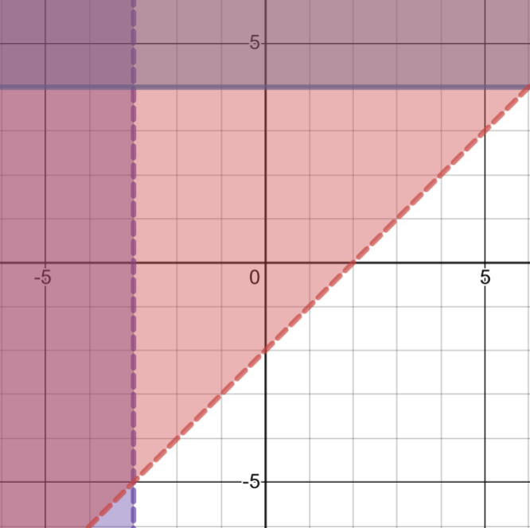
Worked example
Your turn
Shade the region which satisfies the inequalities:
$x≥−2$, $y<1$ and $y<x−1$
Shade the region which satisfies the inequalities. Label it R.
$$x>−3,y≤4 \text{and} y<x−2$$
$$R$$
Graphs used with permission from DESMOS: https://www.desmos.com/

Slide 6
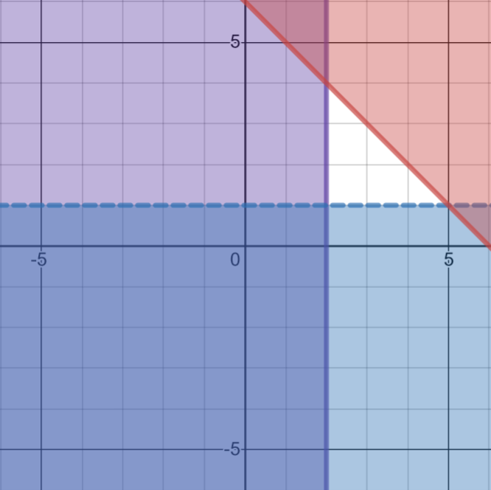
Worked example
Your turn
Shade the region which satisfies the inequalities:
$x≥2,y>−1$ and $x+y≤5$
Shade the region which satisfies the inequalities. Label it R.
$x≥2,y>1$ and $x+y≤6$
$$R$$
Graphs used with permission from DESMOS: https://www.desmos.com/

