Slide 1
3.7) Recurrence relations

Slide 2
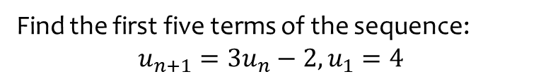
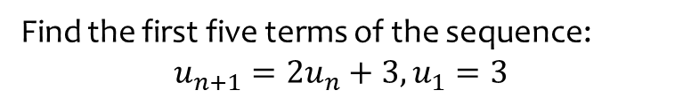
Worked example
Your turn
Find the first five terms of the sequence:
$$u_{n+1}=2u_{n}+3, u_{1}=3$$
Find the first five terms of the sequence:
$$u_{n+1}=3u_{n}−2, u_{1}=4$$
$$4, 10, 28, 82, 244$$

Slide 3
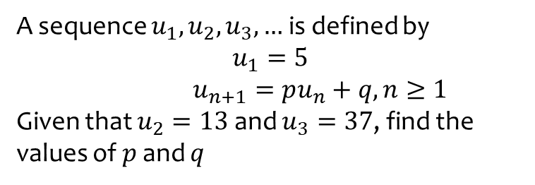
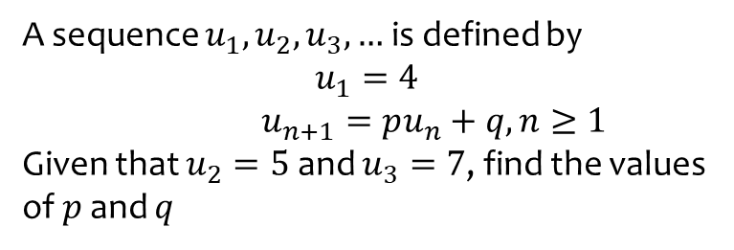
Worked example
Your turn
A sequence $u_{1},u_{2},u_{3}, …$ is defined by
$$u_{1}=4$$
$u_{n+1}=pu_{n}+q, n≥1$
Given that $u_{2}=5$ and $u_{3}=7$, find the values of $p$ and $q$
A sequence $u_{1},u_{2},u_{3}, …$ is defined by
$$u_{1}=5$$
$u_{n+1}=pu_{n}+q, n≥1$
Given that $u_{2}=13$ and $u_{3}=37$, find the values of $p$ and $q$
$$p=3, q=−2$$

