Slide 1
3.7) Hypothesis testing with the normal distribution

Slide 2
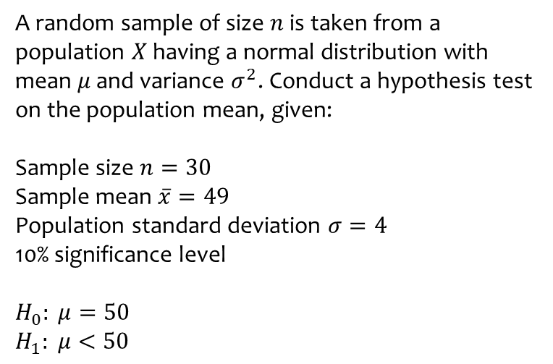
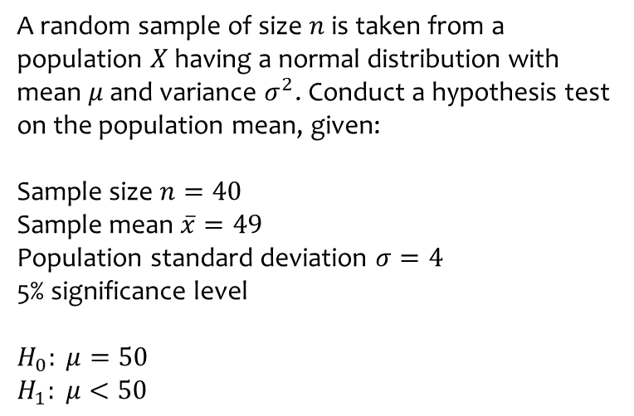
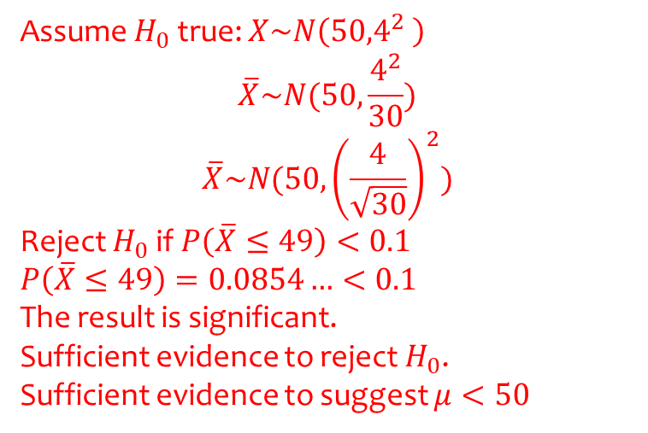
Worked example
Your turn
A random sample of size $n$ is taken from a population $X$ having a normal distribution with mean $μ$ and variance $σ^{2}$. Conduct a hypothesis test on the population mean, given:
Sample size $n=40$
Sample mean $\overline{x}=49$
Population standard deviation $σ=4$
5% significance level
$$H_{0}: μ=50$$
$$H_{1}: μ<50$$
A random sample of size $n$ is taken from a population $X$ having a normal distribution with mean $μ$ and variance $σ^{2}$. Conduct a hypothesis test on the population mean, given:
Sample size $n=30$
Sample mean $\overline{x}=49$
Population standard deviation $σ=4$
10% significance level
$$H_{0}: μ=50$$
$$H_{1}: μ<50$$
Assume $H_{0}$ true: $X\sim N\left({50,4}^{2} \right)$
$$\overline{X}\sim N(50,\frac{4^{2}}{30})$$
$$\overline{X}\sim N(50,{\left(\frac{4}{\sqrt{30}}\right)}^{2})$$
Reject $H_{0}$ if $P\left(\overline{X}≤49\right)<0.1$
$$P\left(\overline{X}≤49\right)=0.0854…<0.1$$
The result is significant.
Sufficient evidence to reject $H_{0}$.
Sufficient evidence to suggest $μ<50$

Slide 3
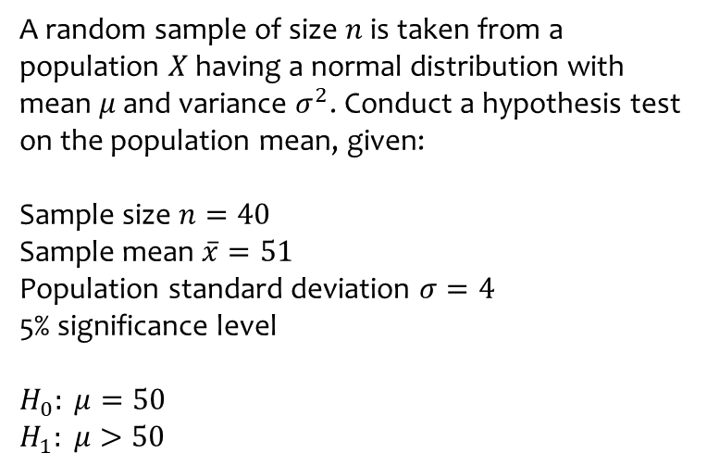
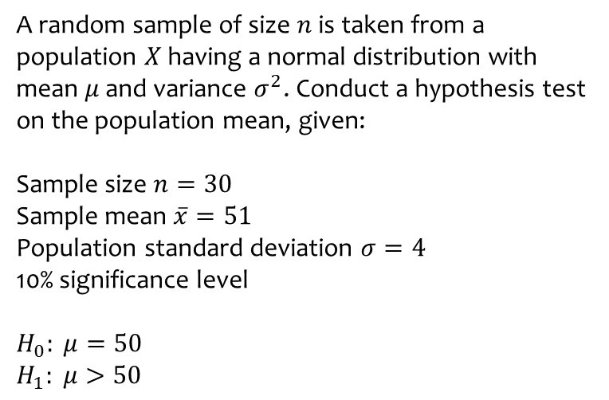
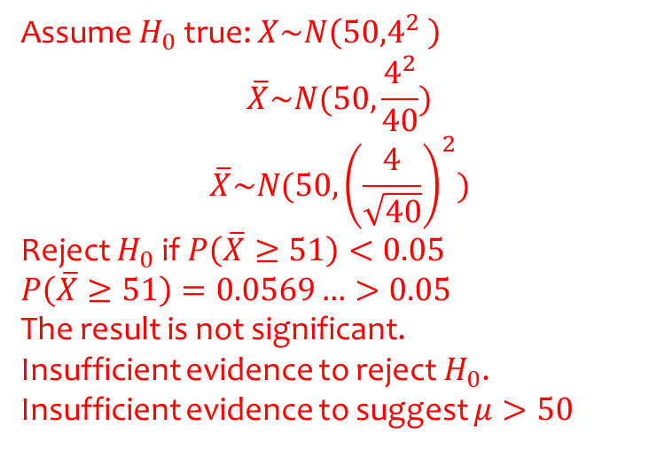
Worked example
Your turn
A random sample of size $n$ is taken from a population $X$ having a normal distribution with mean $μ$ and variance $σ^{2}$. Conduct a hypothesis test on the population mean, given:
Sample size $n=30$
Sample mean $\overline{x}=51$
Population standard deviation $σ=4$
10% significance level
$$H_{0}: μ=50$$
$$H_{1}: μ>50$$
A random sample of size $n$ is taken from a population $X$ having a normal distribution with mean $μ$ and variance $σ^{2}$. Conduct a hypothesis test on the population mean, given:
Sample size $n=40$
Sample mean $\overline{x}=51$
Population standard deviation $σ=4$
5% significance level
$$H_{0}: μ=50$$
$$H_{1}: μ>50$$
Assume $H_{0}$ true: $X\sim N\left({50,4}^{2} \right)$
$$\overline{X}\sim N(50,\frac{4^{2}}{40})$$
$$\overline{X}\sim N(50,{\left(\frac{4}{\sqrt{40}}\right)}^{2})$$
Reject $H_{0}$ if $P\left(\overline{X}≥51\right)<0.05$
$$P\left(\overline{X}≥51\right)=0.0569…>0.05$$
The result is not significant.
Insufficient evidence to reject $H_{0}$.
Insufficient evidence to suggest $μ>50$

Slide 4
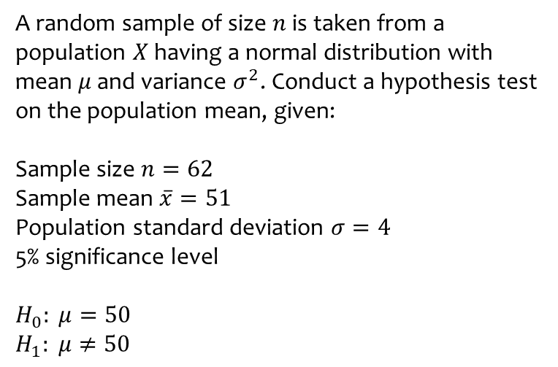
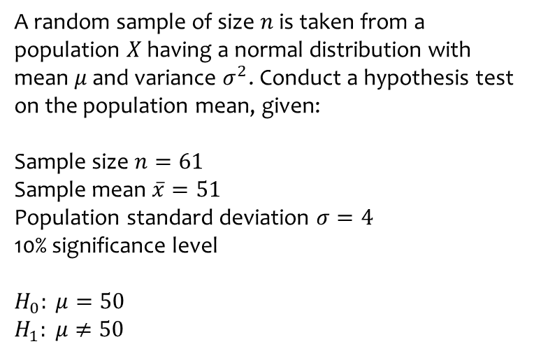
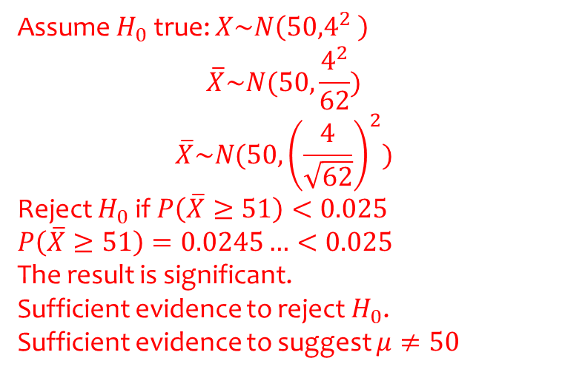
Worked example
Your turn
A random sample of size $n$ is taken from a population $X$ having a normal distribution with mean $μ$ and variance $σ^{2}$. Conduct a hypothesis test on the population mean, given:
Sample size $n=61$
Sample mean $\overline{x}=51$
Population standard deviation $σ=4$
10% significance level
$$H_{0}: μ=50$$
$$H_{1}: μ≠50$$
A random sample of size $n$ is taken from a population $X$ having a normal distribution with mean $μ$ and variance $σ^{2}$. Conduct a hypothesis test on the population mean, given:
Sample size $n=62$
Sample mean $\overline{x}=51$
Population standard deviation $σ=4$
5% significance level
$$H_{0}: μ=50$$
$$H_{1}: μ≠50$$
Assume $H_{0}$ true: $X\sim N\left({50,4}^{2} \right)$
$$\overline{X}\sim N(50,\frac{4^{2}}{62})$$
$$\overline{X}\sim N(50,{\left(\frac{4}{\sqrt{62}}\right)}^{2})$$
Reject $H_{0}$ if $P\left(\overline{X}≥51\right)<0.025$
$$P\left(\overline{X}≥51\right)=0.0245…<0.025$$
The result is significant.
Sufficient evidence to reject $H_{0}$.
Sufficient evidence to suggest $μ≠50$

Slide 5
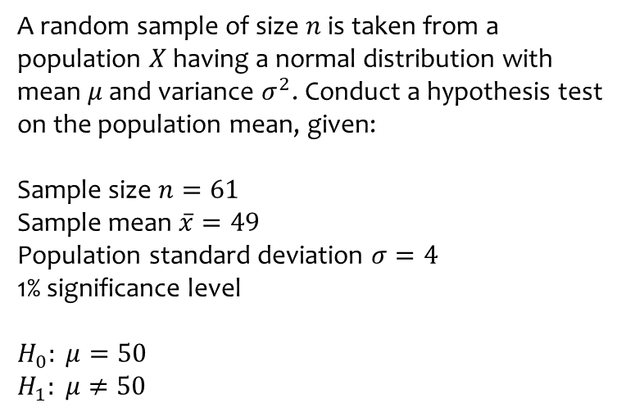
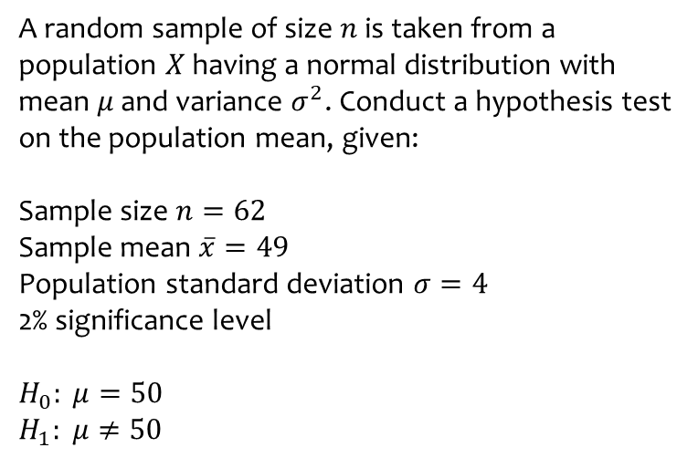
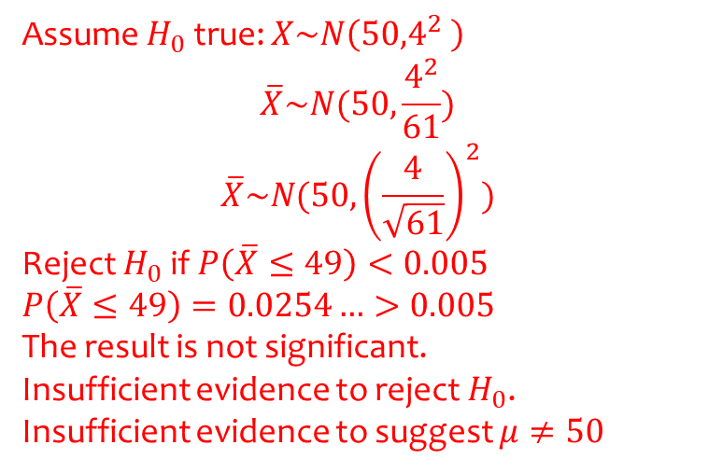
Worked example
Your turn
A random sample of size $n$ is taken from a population $X$ having a normal distribution with mean $μ$ and variance $σ^{2}$. Conduct a hypothesis test on the population mean, given:
Sample size $n=62$
Sample mean $\overline{x}=49$
Population standard deviation $σ=4$
2% significance level
$$H_{0}: μ=50$$
$$H_{1}: μ≠50$$
A random sample of size $n$ is taken from a population $X$ having a normal distribution with mean $μ$ and variance $σ^{2}$. Conduct a hypothesis test on the population mean, given:
Sample size $n=61$
Sample mean $\overline{x}=49$
Population standard deviation $σ=4$
1% significance level
$$H_{0}: μ=50$$
$$H_{1}: μ≠50$$
Assume $H_{0}$ true: $X\sim N\left({50,4}^{2} \right)$
$$\overline{X}\sim N(50,\frac{4^{2}}{61})$$
$$\overline{X}\sim N(50,{\left(\frac{4}{\sqrt{61}}\right)}^{2})$$
Reject $H_{0}$ if $P\left(\overline{X}≤49\right)<0.005$
$$P\left(\overline{X}≤49\right)=0.0254…>0.005$$
The result is not significant.
Insufficient evidence to reject $H_{0}$.
Insufficient evidence to suggest $μ≠50$

Slide 6
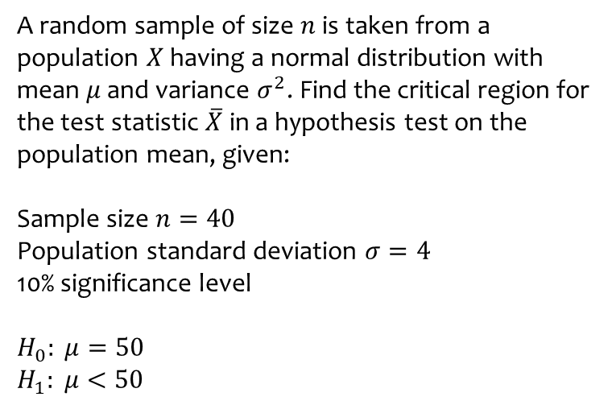
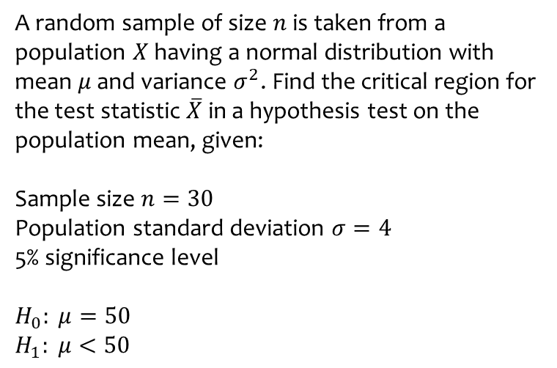
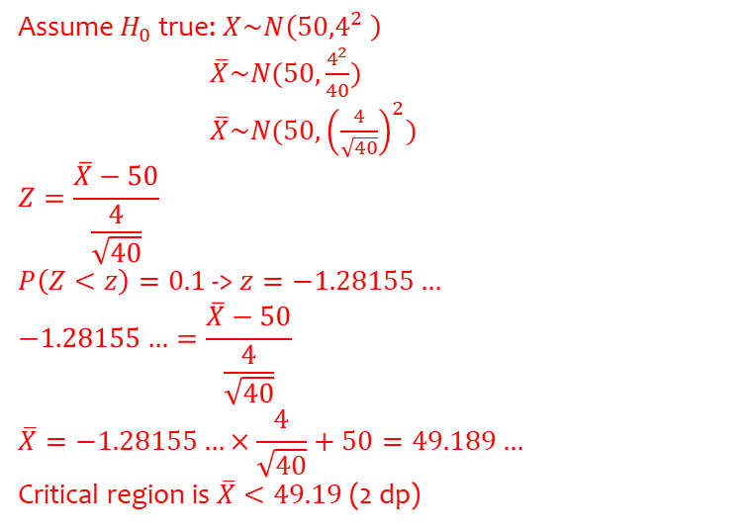
Worked example
Your turn
A random sample of size $n$ is taken from a population $X$ having a normal distribution with mean $μ$ and variance $σ^{2}$. Find the critical region for the test statistic $\overline{X}$ in a hypothesis test on the population mean, given:
Sample size $n=30$
Population standard deviation $σ=4$
5% significance level
$$H_{0}: μ=50$$
$$H_{1}: μ<50$$
A random sample of size $n$ is taken from a population $X$ having a normal distribution with mean $μ$ and variance $σ^{2}$. Find the critical region for the test statistic $\overline{X}$ in a hypothesis test on the population mean, given:
Sample size $n=40$
Population standard deviation $σ=4$
10% significance level
$$H_{0}: μ=50$$
$$H_{1}: μ<50$$
Assume $H_{0}$ true: $X\sim N\left({50,4}^{2} \right)$
$\overline{X}\sim N(50,\frac{4^{2}}{40})$
$\overline{X}\sim N(50,{\left(\frac{4}{\sqrt{40}}\right)}^{2})$
$$Z=\frac{\overline{X}−50}{\frac{4}{\sqrt{40}}}$$
$P\left(Z<z\right)=0.1$ -> $z=−1.28155…$
$$−1.28155…=\frac{\overline{X}−50}{\frac{4}{\sqrt{40}}}$$
$$\overline{X}=−1.28155…×\frac{4}{\sqrt{40}}+50=49.189…$$
Critical region is $\overline{X}<49.19$ (2 dp)

Slide 7
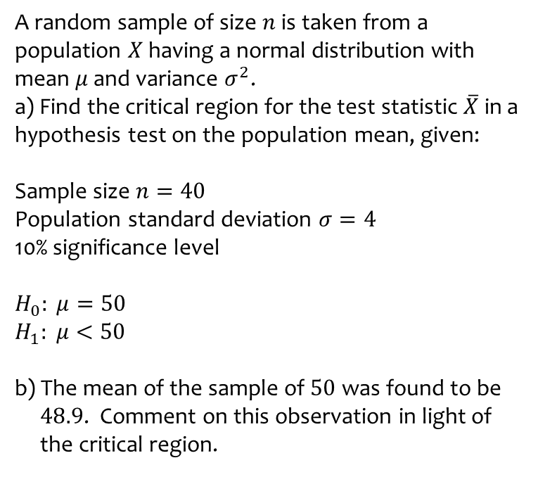
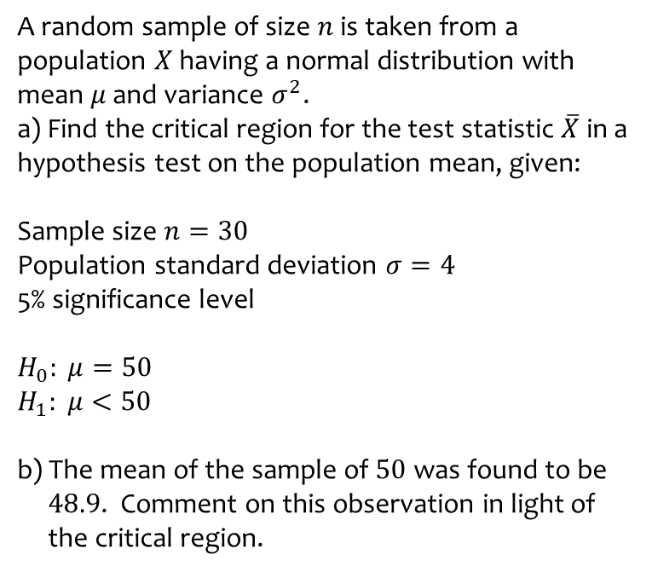
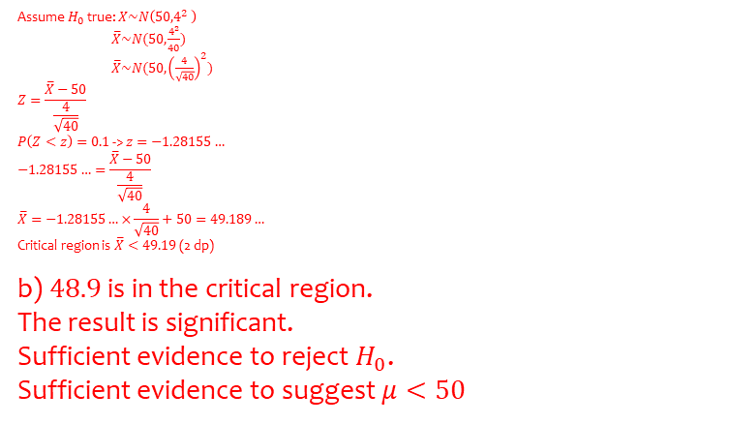
Worked example
Your turn
A random sample of size $n$ is taken from a population $X$ having a normal distribution with mean $μ$ and variance $σ^{2}$.
a) Find the critical region for the test statistic $\overline{X}$ in a hypothesis test on the population mean, given:
Sample size $n=30$
Population standard deviation $σ=4$
5% significance level
$$H_{0}: μ=50$$
$$H_{1}: μ<50$$
b) The mean of the sample of $50$ was found to be
$48.9$. Comment on this observation in light of
the critical region.
A random sample of size $n$ is taken from a population $X$ having a normal distribution with mean $μ$ and variance $σ^{2}$.
a) Find the critical region for the test statistic $\overline{X}$ in a hypothesis test on the population mean, given:
Sample size $n=40$
Population standard deviation $σ=4$
10% significance level
$$H_{0}: μ=50$$
$$H_{1}: μ<50$$
b) The mean of the sample of $50$ was found to be
$48.9$. Comment on this observation in light of
the critical region.
Assume $H_{0}$ true: $X\sim N\left({50,4}^{2} \right)$
$\overline{X}\sim N(50,\frac{4^{2}}{40})$
$\overline{X}\sim N(50,{\left(\frac{4}{\sqrt{40}}\right)}^{2})$
$$Z=\frac{\overline{X}−50}{\frac{4}{\sqrt{40}}}$$
$P\left(Z<z\right)=0.1$ -> $z=−1.28155…$
$$−1.28155…=\frac{\overline{X}−50}{\frac{4}{\sqrt{40}}}$$
$$\overline{X}=−1.28155…×\frac{4}{\sqrt{40}}+50=49.189…$$
Critical region is $\overline{X}<49.19$ (2 dp)
b) $48.9$ is in the critical region.
The result is significant.
Sufficient evidence to reject $H_{0}$.
Sufficient evidence to suggest $μ<50$

Slide 8
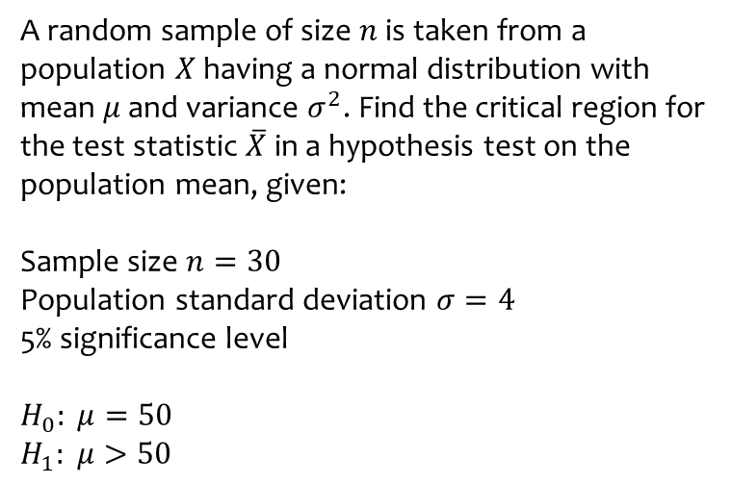
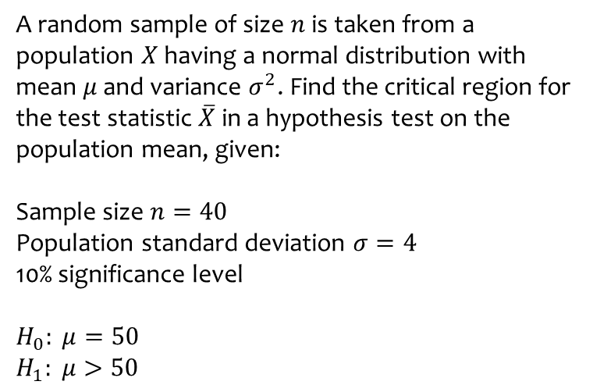
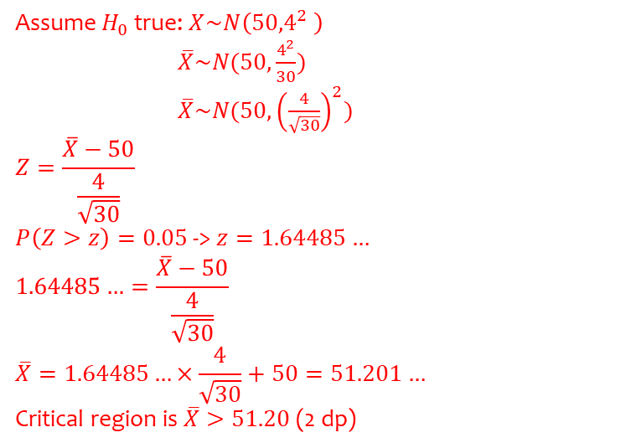
Worked example
Your turn
A random sample of size $n$ is taken from a population $X$ having a normal distribution with mean $μ$ and variance $σ^{2}$. Find the critical region for the test statistic $\overline{X}$ in a hypothesis test on the population mean, given:
Sample size $n=40$
Population standard deviation $σ=4$
10% significance level
$$H_{0}: μ=50$$
$$H_{1}: μ>50$$
A random sample of size $n$ is taken from a population $X$ having a normal distribution with mean $μ$ and variance $σ^{2}$. Find the critical region for the test statistic $\overline{X}$ in a hypothesis test on the population mean, given:
Sample size $n=30$
Population standard deviation $σ=4$
5% significance level
$$H_{0}: μ=50$$
$$H_{1}: μ>50$$
Assume $H_{0}$ true: $X\sim N\left({50,4}^{2} \right)$
$\overline{X}\sim N(50,\frac{4^{2}}{30})$
$\overline{X}\sim N(50,{\left(\frac{4}{\sqrt{30}}\right)}^{2})$
$$Z=\frac{\overline{X}−50}{\frac{4}{\sqrt{30}}}$$
$P\left(Z>z\right)=0.05$ -> $z=1.64485…$
$$1.64485…=\frac{\overline{X}−50}{\frac{4}{\sqrt{30}}}$$
$$\overline{X}=1.64485…×\frac{4}{\sqrt{30}}+50=51.201…$$
Critical region is $\overline{X}>51.20$ (2 dp)

Slide 9
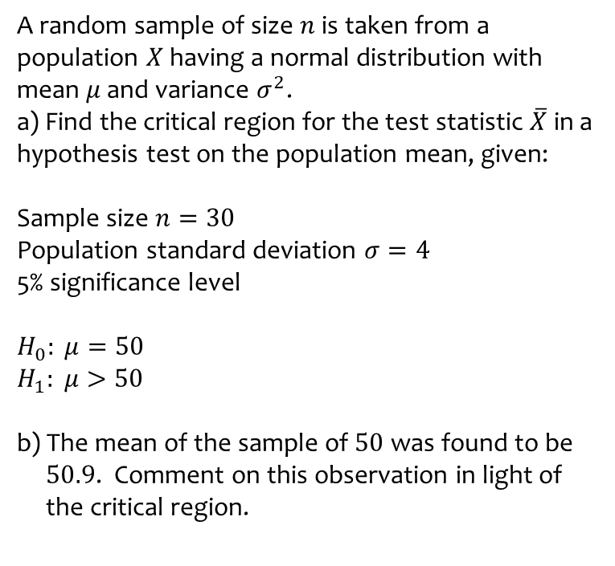
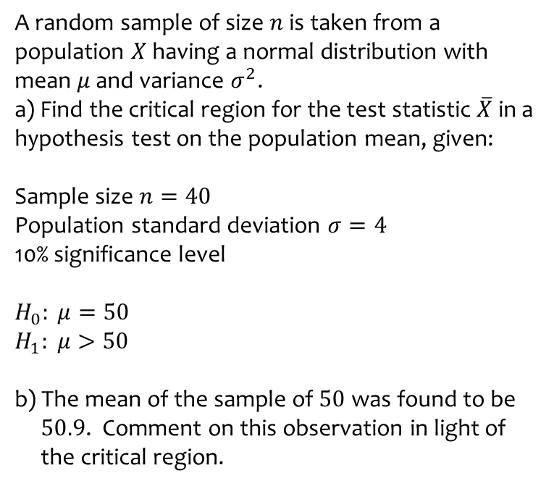
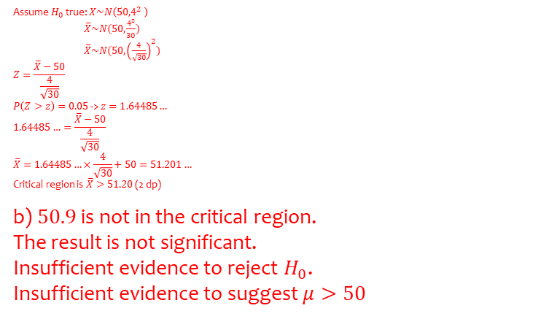
Worked example
Your turn
A random sample of size $n$ is taken from a population $X$ having a normal distribution with mean $μ$ and variance $σ^{2}$.
a) Find the critical region for the test statistic $\overline{X}$ in a hypothesis test on the population mean, given:
Sample size $n=40$
Population standard deviation $σ=4$
10% significance level
$$H_{0}: μ=50$$
$$H_{1}: μ>50$$
b) The mean of the sample of $50$ was found to be
$50.9$. Comment on this observation in light of
the critical region.
A random sample of size $n$ is taken from a population $X$ having a normal distribution with mean $μ$ and variance $σ^{2}$.
a) Find the critical region for the test statistic $\overline{X}$ in a hypothesis test on the population mean, given:
Sample size $n=30$
Population standard deviation $σ=4$
5% significance level
$$H_{0}: μ=50$$
$$H_{1}: μ>50$$
b) The mean of the sample of $50$ was found to be
$50.9$. Comment on this observation in light of
the critical region.
Assume $H_{0}$ true: $X\sim N\left({50,4}^{2} \right)$
$\overline{X}\sim N(50,\frac{4^{2}}{30})$
$\overline{X}\sim N(50,{\left(\frac{4}{\sqrt{30}}\right)}^{2})$
$$Z=\frac{\overline{X}−50}{\frac{4}{\sqrt{30}}}$$
$P\left(Z>z\right)=0.05$ -> $z=1.64485…$
$$1.64485…=\frac{\overline{X}−50}{\frac{4}{\sqrt{30}}}$$
$$\overline{X}=1.64485…×\frac{4}{\sqrt{30}}+50=51.201…$$
Critical region is $\overline{X}>51.20$ (2 dp)
b) $50.9$ is not in the critical region.
The result is not significant.
Insufficient evidence to reject $H_{0}$.
Insufficient evidence to suggest $μ>50$

Slide 10
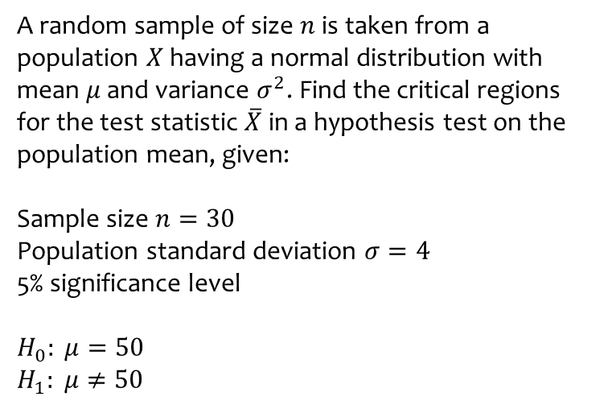
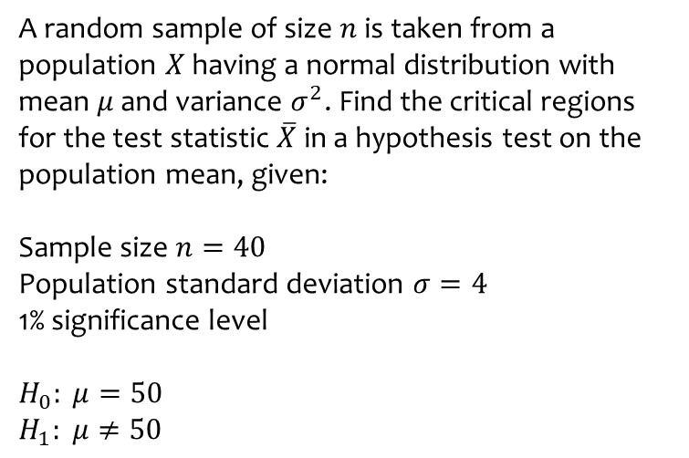
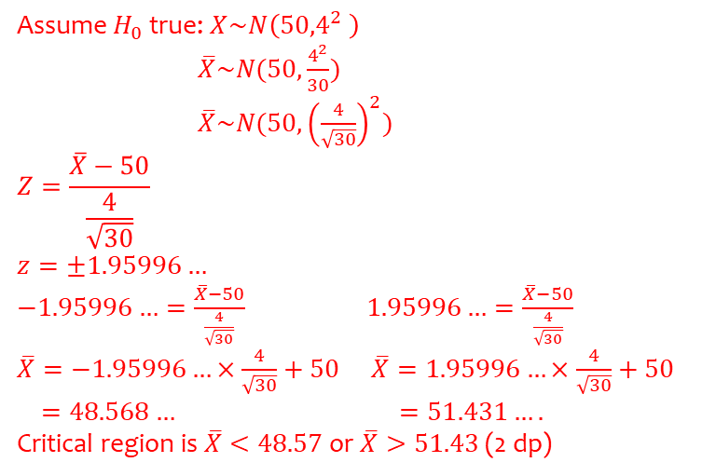
Worked example
Your turn
A random sample of size $n$ is taken from a population $X$ having a normal distribution with mean $μ$ and variance $σ^{2}$. Find the critical regions for the test statistic $\overline{X}$ in a hypothesis test on the population mean, given:
Sample size $n=40$
Population standard deviation $σ=4$
1% significance level
$$H_{0}: μ=50$$
$$H_{1}: μ≠50$$
A random sample of size $n$ is taken from a population $X$ having a normal distribution with mean $μ$ and variance $σ^{2}$. Find the critical regions for the test statistic $\overline{X}$ in a hypothesis test on the population mean, given:
Sample size $n=30$
Population standard deviation $σ=4$
5% significance level
$$H_{0}: μ=50$$
$$H_{1}: μ≠50$$
Assume $H_{0}$ true: $X\sim N\left({50,4}^{2} \right)$
$\overline{X}\sim N(50,\frac{4^{2}}{30})$
$\overline{X}\sim N(50,{\left(\frac{4}{\sqrt{30}}\right)}^{2})$
$$Z=\frac{\overline{X}−50}{\frac{4}{\sqrt{30}}}$$
$$z=±1.95996…$$
$−1.95996…=\frac{\overline{X}−50}{\frac{4}{\sqrt{30}}}$ $1.95996…=\frac{\overline{X}−50}{\frac{4}{\sqrt{30}}}$
$\overline{X}=−1.95996…×\frac{4}{\sqrt{30}}+50$ $\overline{X}=1.95996…×\frac{4}{\sqrt{30}}+50$
$=48.568…$ $=51.431….$
Critical region is $\overline{X}<48.57$ or $\overline{X}>51.43$ (2 dp)

Slide 11
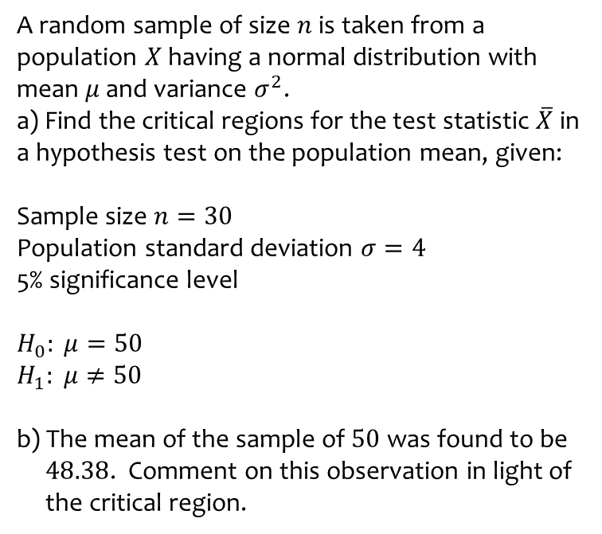
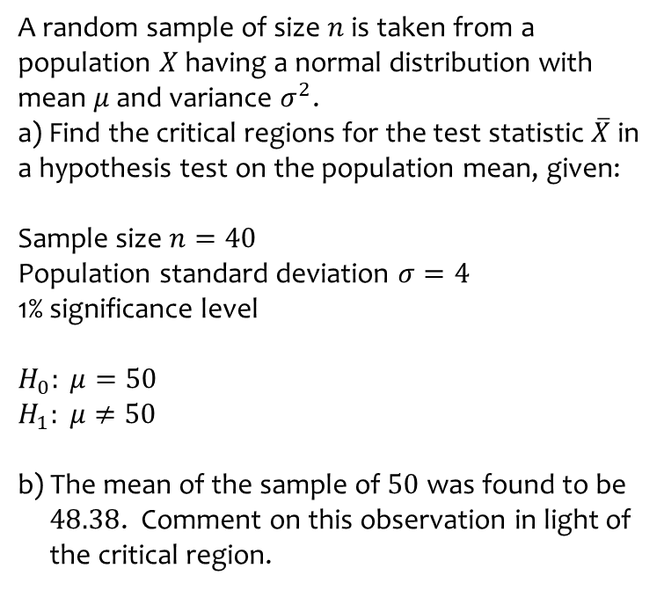
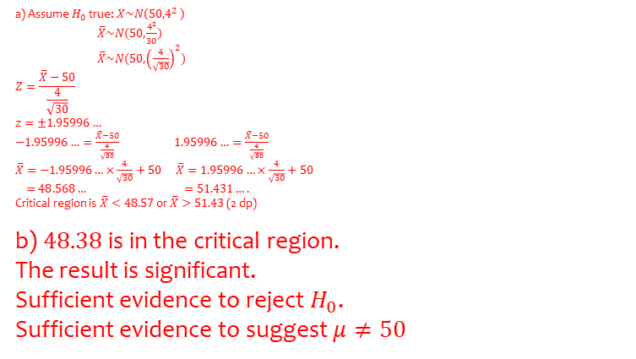
Worked example
Your turn
A random sample of size $n$ is taken from a population $X$ having a normal distribution with mean $μ$ and variance $σ^{2}$.
a) Find the critical regions for the test statistic $\overline{X}$ in a hypothesis test on the population mean, given:
Sample size $n=40$
Population standard deviation $σ=4$
1% significance level
$$H_{0}: μ=50$$
$$H_{1}: μ≠50$$
b) The mean of the sample of $50$ was found to be
$48.38$. Comment on this observation in light of
the critical region.
A random sample of size $n$ is taken from a population $X$ having a normal distribution with mean $μ$ and variance $σ^{2}$.
a) Find the critical regions for the test statistic $\overline{X}$ in a hypothesis test on the population mean, given:
Sample size $n=30$
Population standard deviation $σ=4$
5% significance level
$$H_{0}: μ=50$$
$$H_{1}: μ≠50$$
b) The mean of the sample of $50$ was found to be
$48.38$. Comment on this observation in light of
the critical region.
a) Assume $H_{0}$ true: $X\sim N\left({50,4}^{2} \right)$
$\overline{X}\sim N(50,\frac{4^{2}}{30})$
$\overline{X}\sim N(50,{\left(\frac{4}{\sqrt{30}}\right)}^{2})$
$$Z=\frac{\overline{X}−50}{\frac{4}{\sqrt{30}}}$$
$$z=±1.95996…$$
$−1.95996…=\frac{\overline{X}−50}{\frac{4}{\sqrt{30}}}$ $1.95996…=\frac{\overline{X}−50}{\frac{4}{\sqrt{30}}}$
$\overline{X}=−1.95996…×\frac{4}{\sqrt{30}}+50$ $\overline{X}=1.95996…×\frac{4}{\sqrt{30}}+50$
$=48.568…$ $=51.431….$
Critical region is $\overline{X}<48.57$ or $\overline{X}>51.43$ (2 dp)
b) $48.38$ is in the critical region.
The result is significant.
Sufficient evidence to reject $H_{0}$.
Sufficient evidence to suggest $μ≠50$

Slide 12
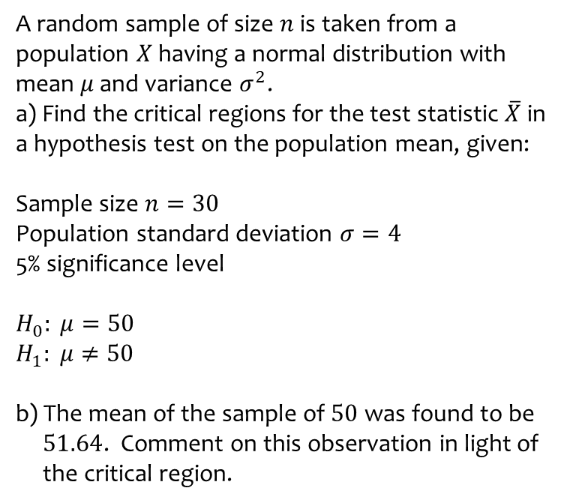
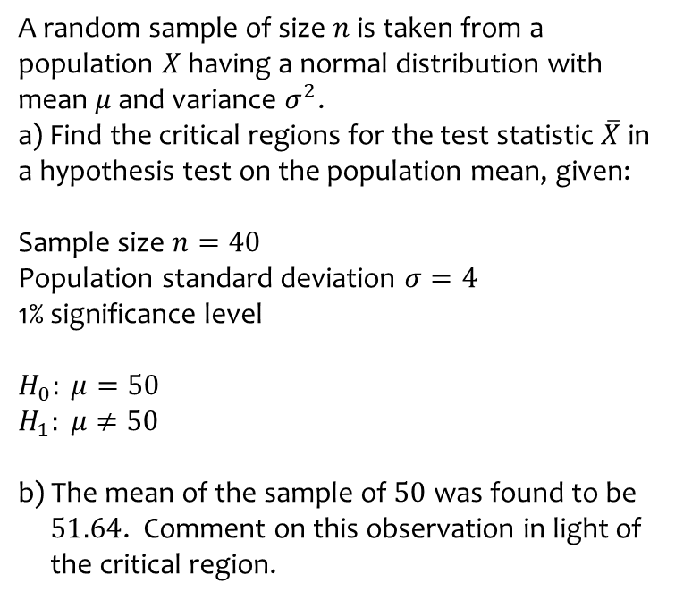
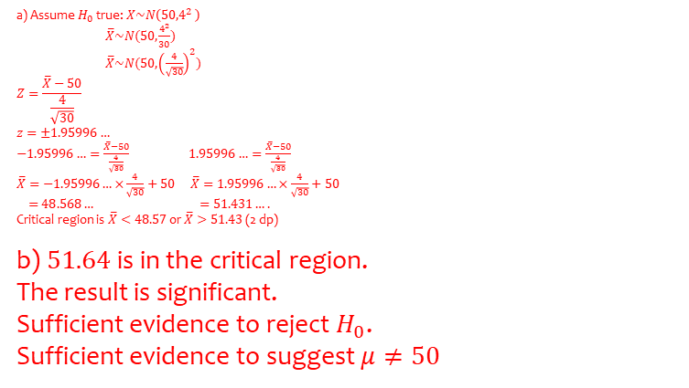
Worked example
Your turn
A random sample of size $n$ is taken from a population $X$ having a normal distribution with mean $μ$ and variance $σ^{2}$.
a) Find the critical regions for the test statistic $\overline{X}$ in a hypothesis test on the population mean, given:
Sample size $n=40$
Population standard deviation $σ=4$
1% significance level
$$H_{0}: μ=50$$
$$H_{1}: μ≠50$$
b) The mean of the sample of $50$ was found to be
$51.64$. Comment on this observation in light of
the critical region.
A random sample of size $n$ is taken from a population $X$ having a normal distribution with mean $μ$ and variance $σ^{2}$.
a) Find the critical regions for the test statistic $\overline{X}$ in a hypothesis test on the population mean, given:
Sample size $n=30$
Population standard deviation $σ=4$
5% significance level
$$H_{0}: μ=50$$
$$H_{1}: μ≠50$$
b) The mean of the sample of $50$ was found to be
$51.64$. Comment on this observation in light of
the critical region.
a) Assume $H_{0}$ true: $X\sim N\left({50,4}^{2} \right)$
$\overline{X}\sim N(50,\frac{4^{2}}{30})$
$\overline{X}\sim N(50,{\left(\frac{4}{\sqrt{30}}\right)}^{2})$
$$Z=\frac{\overline{X}−50}{\frac{4}{\sqrt{30}}}$$
$$z=±1.95996…$$
$−1.95996…=\frac{\overline{X}−50}{\frac{4}{\sqrt{30}}}$ $1.95996…=\frac{\overline{X}−50}{\frac{4}{\sqrt{30}}}$
$\overline{X}=−1.95996…×\frac{4}{\sqrt{30}}+50$ $\overline{X}=1.95996…×\frac{4}{\sqrt{30}}+50$
$=48.568…$ $=51.431….$
Critical region is $\overline{X}<48.57$ or $\overline{X}>51.43$ (2 dp)
b) $51.64$ is in the critical region.
The result is significant.
Sufficient evidence to reject $H_{0}$.
Sufficient evidence to suggest $μ≠50$

Slide 13
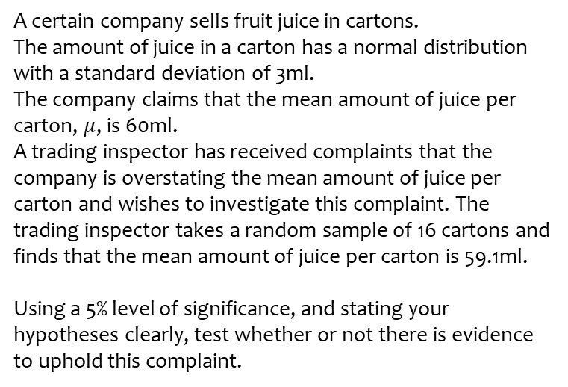
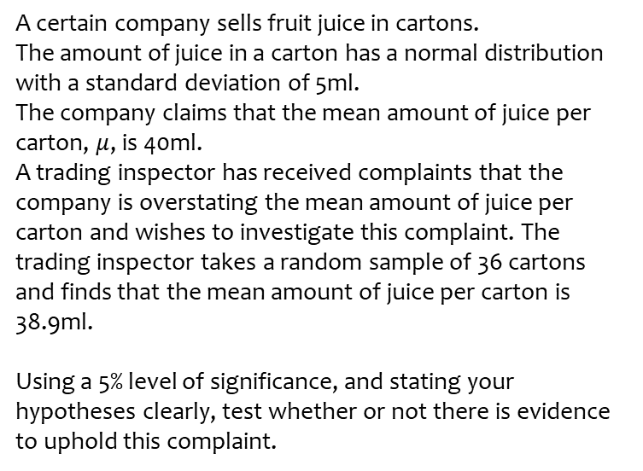
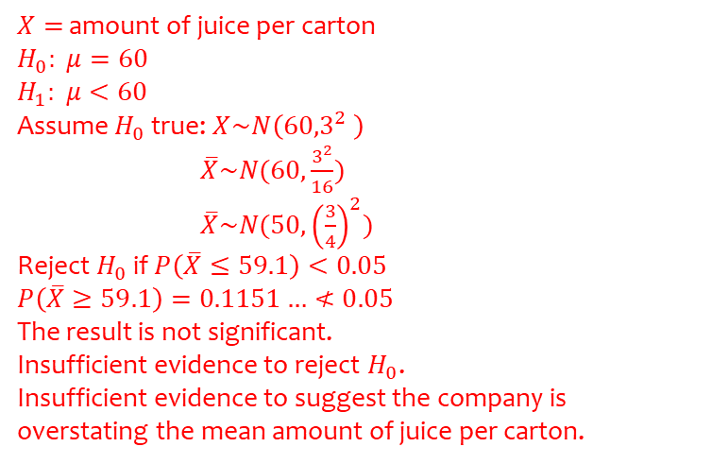
Worked example
Your turn
A certain company sells fruit juice in cartons.
The amount of juice in a carton has a normal distribution with a standard deviation of 5ml.
The company claims that the mean amount of juice per carton, $μ$, is 40ml.
A trading inspector has received complaints that the company is overstating the mean amount of juice per carton and wishes to investigate this complaint. The trading inspector takes a random sample of 36 cartons and finds that the mean amount of juice per carton is 38.9ml.
Using a 5% level of significance, and stating your hypotheses clearly, test whether or not there is evidence to uphold this complaint.
A certain company sells fruit juice in cartons.
The amount of juice in a carton has a normal distribution with a standard deviation of 3ml.
The company claims that the mean amount of juice per carton, $μ$, is 60ml.
A trading inspector has received complaints that the company is overstating the mean amount of juice per carton and wishes to investigate this complaint. The trading inspector takes a random sample of 16 cartons and finds that the mean amount of juice per carton is 59.1ml.
Using a 5% level of significance, and stating your hypotheses clearly, test whether or not there is evidence to uphold this complaint.
$X=$ amount of juice per carton
$$H_{0}: μ=60$$
$$H_{1}: μ<60$$
Assume $H_{0}$ true: $X\sim N\left({60,3}^{2} \right)$
$\overline{X}\sim N(60,\frac{3^{2}}{16})$
$\overline{X}\sim N(50,{\left(\frac{3}{4}\right)}^{2})$
Reject $H_{0}$ if $P\left(\overline{X}≤59.1\right)<0.05$
$$P\left(\overline{X}≥59.1\right)=0.1151…≮0.05$$
The result is not significant.
Insufficient evidence to reject $H_{0}$.
Insufficient evidence to suggest the company is overstating the mean amount of juice per carton.

Slide 14
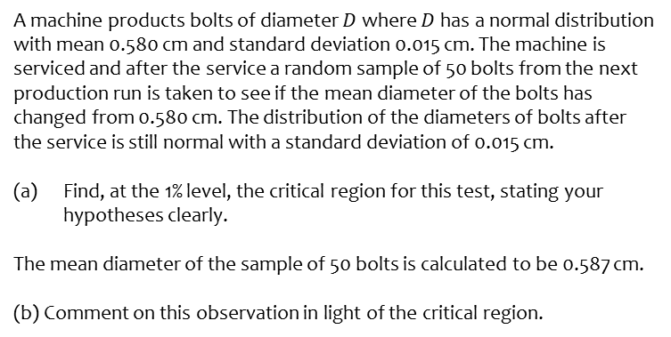
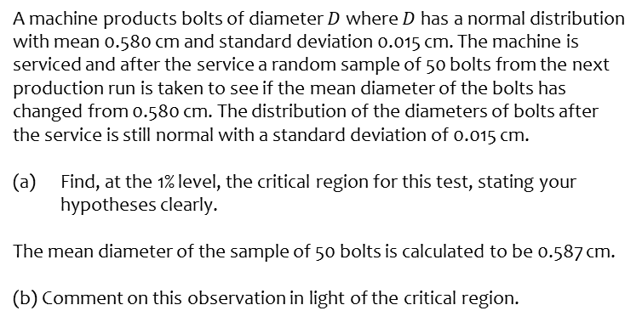
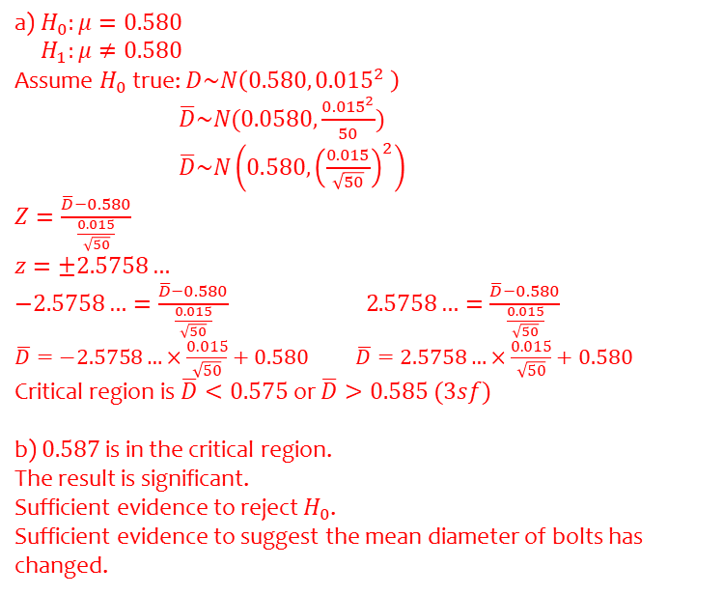
Worked example
Your turn
A machine products bolts of diameter $D$ where $D$ has a normal distribution with mean 0.580 cm and standard deviation 0.015 cm. The machine is serviced and after the service a random sample of 50 bolts from the next production run is taken to see if the mean diameter of the bolts has changed from 0.580 cm. The distribution of the diameters of bolts after the service is still normal with a standard deviation of 0.015 cm.
Find, at the 1% level, the critical region for this test, stating your hypotheses clearly.
The mean diameter of the sample of 50 bolts is calculated to be 0.587 cm.
(b) Comment on this observation in light of the critical region.
A machine products bolts of diameter $D$ where $D$ has a normal distribution with mean 0.580 cm and standard deviation 0.015 cm. The machine is serviced and after the service a random sample of 50 bolts from the next production run is taken to see if the mean diameter of the bolts has changed from 0.580 cm. The distribution of the diameters of bolts after the service is still normal with a standard deviation of 0.015 cm.
Find, at the 1% level, the critical region for this test, stating your hypotheses clearly.
The mean diameter of the sample of 50 bolts is calculated to be 0.587 cm.
(b) Comment on this observation in light of the critical region.
a) $H_{0}:μ=0.580$
$H_{1}:μ≠0.580$
Assume $H_{0}$ true: $D\sim N\left({0.580, 0.015}^{2} \right)$
$\overline{D}\sim N(0.0580,\frac{{0.015}^{2}}{50})$
$\overline{D}\sim N\left(0.580, {\left(\frac{0.015}{\sqrt{50}}\right)}^{2}\right)$
$Z=\frac{\overline{D}−0.580}{\frac{0.015}{\sqrt{50}}}$
$$z=±2.5758…$$
$−2.5758…=\frac{\overline{D}−0.580}{\frac{0.015}{\sqrt{50}}} 2.5758…=\frac{\overline{D}−0.580}{\frac{0.015}{\sqrt{50}}}$
$\overline{D}=−2.5758…×\frac{0.015}{\sqrt{50}}+0.580$ $\overline{D}=2.5758…×\frac{0.015}{\sqrt{50}}+0.580$
Critical region is $\overline{D}<0.575$ or $\overline{D}>0.585 (3sf)$
b) $0.587$ is in the critical region.
The result is significant.
Sufficient evidence to reject $H_{0}$.
Sufficient evidence to suggest the mean diameter of bolts has changed.

