Slide 1
3.6) Sigma notation

Slide 2
Worked example
Your turn
Write out the terms in the series:
$$\sum_{r=1}^{10}{(3r+5)}$$
$$\sum_{n=7}^{13}{(2−3n)}$$
Write out the terms in the series:
$$\sum_{k=4}^{8}{(2k+1)}$$
$$9+11+13+15+17=65$$

Slide 3

Worked example
Your turn
Find the value of $a, d$ and $n$:
$$\sum_{r=1}^{10}{(3r+5)}$$
$$\sum_{n=7}^{13}{(2−3n)}$$
Find the value of $a, d$ and $n$:
$$\sum_{k=4}^{8}{(2k+1)}$$
$$a=9, d=2, n=5$$

Slide 4
Worked example
Your turn
Write in sigma notation:
$$8+13+18+23+28+33+38+43+48+53$$
$$−11+−13+−15+−17+−19+ −21+−23$$
Write in sigma notation:
$$6+7+8+9+10$$
$$\sum_{k=4}^{8}{(k+2)}$$

Slide 5
Worked example
Your turn
Write out the terms in the series:
$$\sum_{r=1}^{10}{5×3^{r−1}}$$
$$\sum_{n=7}^{13}{2×5^{n−1}}$$
Write out the terms in the series:
$$\sum_{k=4}^{8}{3×2^{k−1}}$$
$$24+48+96+192+384=744$$

Slide 6

Worked example
Your turn
Find the value of $a, r$ and $n$:
$$\sum_{r=1}^{10}{5×3^{r−1}}$$
$$\sum_{n=7}^{13}{2×5^{n−1}}$$
Find the value of $a, r$ and $n$:
$$\sum_{k=4}^{8}{3×2^{k−1}}$$
$$a=24, r=2, n=5$$

Slide 7

Worked example
Your turn
Write in sigma notation:
$$3+15+75+375+1875+9375+46875+234375+1171876+5859375$$
$$320+640+1280+2560+5120+10240+20480$$
Write in sigma notation:
$$54+162+486+1458+4374$$
$$\sum_{k=4}^{8}{2×3^{k−1}}$$

Slide 8
Worked example
Your turn
Evaluate:
$$\sum_{n=9}^{30}{(2+7n)}$$
Evaluate:
$$\sum_{r=10}^{30}{(7+2r)}$$
$$987$$

Slide 9
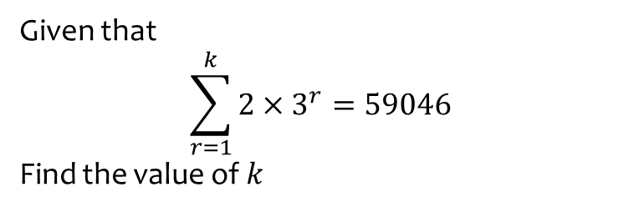
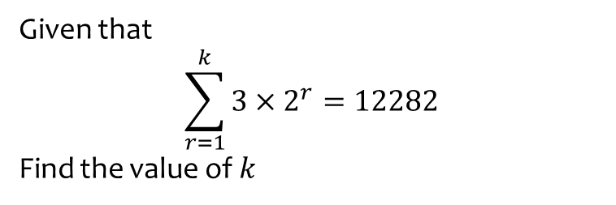
Worked example
Your turn
Given that
$$\sum_{r=1}^{k}{3×2^{r}}=12282$$
Find the value of $k$
Given that
$$\sum_{r=1}^{k}{2×3^{r}}=59046$$
Find the value of $k$
$$k=9$$

Slide 10
Worked example
Your turn
A convergent geometric series is given by
$$1+2x+4x^{2}+8x^{3}$$
Find the range of possible values of $x$
Given that
$$\sum_{r=1}^{∞}{{\left(2x\right)}^{r−1}}=2$$
find the value of $x$
A convergent geometric series is given by
$$1+4x+16x^{2}+64x^{3}$$
Find the range of possible values of $x$
Given that
$$\sum_{r=1}^{∞}{{\left(4x\right)}^{r−1}}=2$$
find the value of $x$
a) $−\frac{1}{4}<x<\frac{1}{4}$
b) $x=\frac{1}{8}$

