Slide 1
3.6) Inequalities on graphs

Slide 2
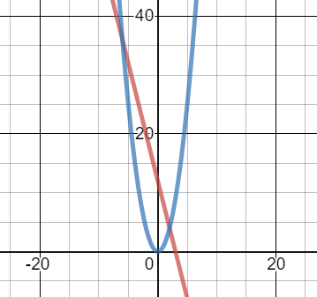
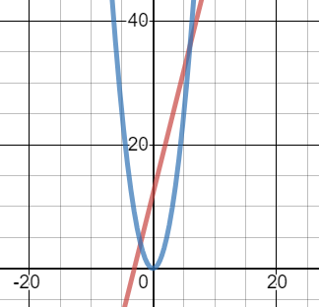
Worked example
Your turn
$L_{1}$ has equation $y=12−4x$.
$L_{2}$ has equation $y=x^{2}$.
The diagram shows a sketch of $L_{1}$ and $L_{2}$ on the same axes.
Find the coordinates of the points of intersection.
Hence write down the solution to the inequality $12−4x>x^{2}$
$L_{1}$ has equation $y=12+4x$.
$L_{2}$ has equation $y=x^{2}$.
The diagram shows a sketch of $L_{1}$ and $L_{2}$ on the same axes.
Find the coordinates of the points of intersection.
Hence write down the solution to the inequality $12+4x>x^{2}$
a) $(6, 36)$ and $(−2, 4)$
b) $−2<x<6$

