Slide 1
3.6) Approximating a binomial distribution

Slide 2
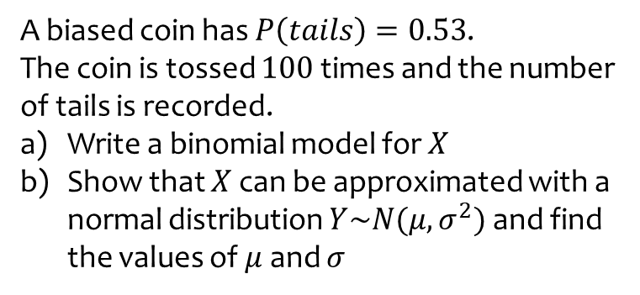
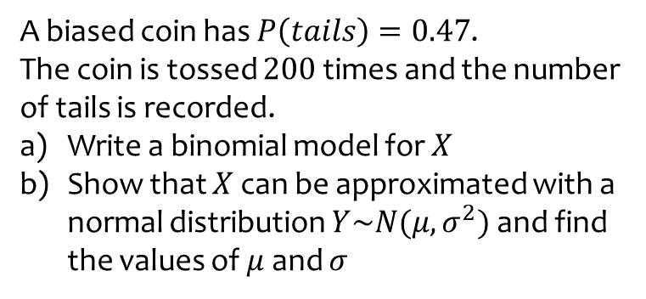
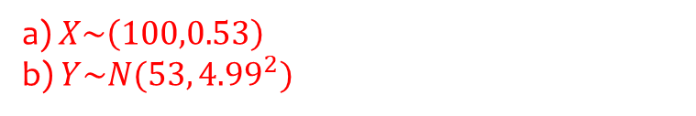
Worked example
Your turn
A biased coin has $P\left(tails\right)=0.47$.
The coin is tossed $200$ times and the number of tails is recorded.
Write a binomial model for $X$
Show that $X$ can be approximated with a normal distribution $Y\sim N(μ, σ^{2})$ and find the values of $μ$ and $σ$
A biased coin has $P\left(tails\right)=0.53$.
The coin is tossed $100$ times and the number of tails is recorded.
Write a binomial model for $X$
Show that $X$ can be approximated with a normal distribution $Y\sim N(μ, σ^{2})$ and find the values of $μ$ and $σ$
a) $X\sim \left(100,0.53\right)$
b) $Y\sim N(53, {4.99}^{2})$

Slide 3
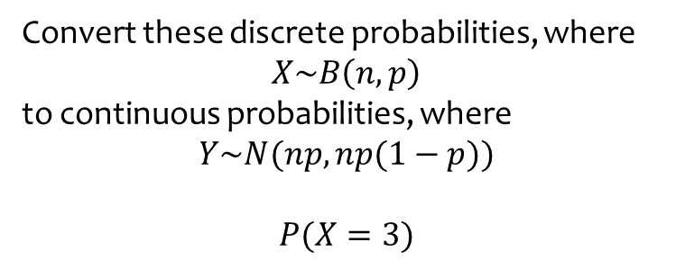
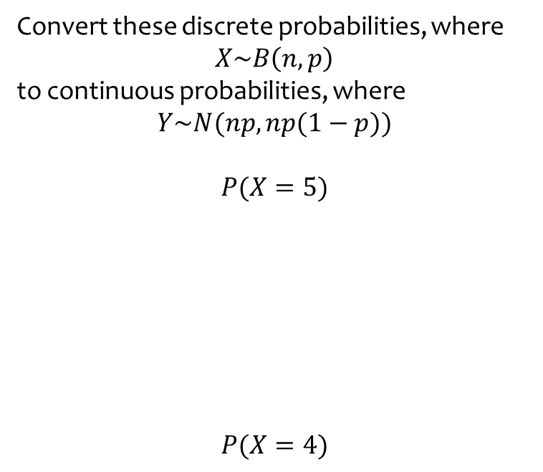
Worked example
Your turn
Convert these discrete probabilities, where
$$X\sim B\left(n, p\right)$$
to continuous probabilities, where
$$Y\sim N(np,np(1−p))$$
$$P(X=5)$$
$$P(X=4)$$
Convert these discrete probabilities, where
$$X\sim B\left(n, p\right)$$
to continuous probabilities, where
$$Y\sim N(np,np(1−p))$$
$$P(X=3)$$
$$≈P\left(2.5≤Y≤3.5\right)$$

Slide 4
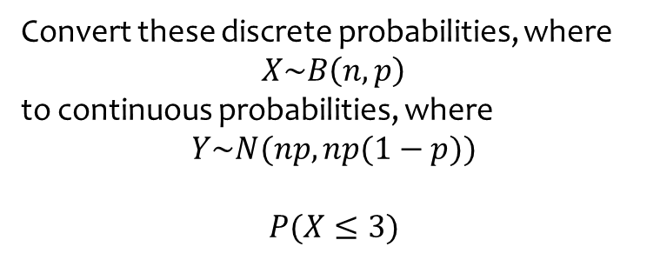
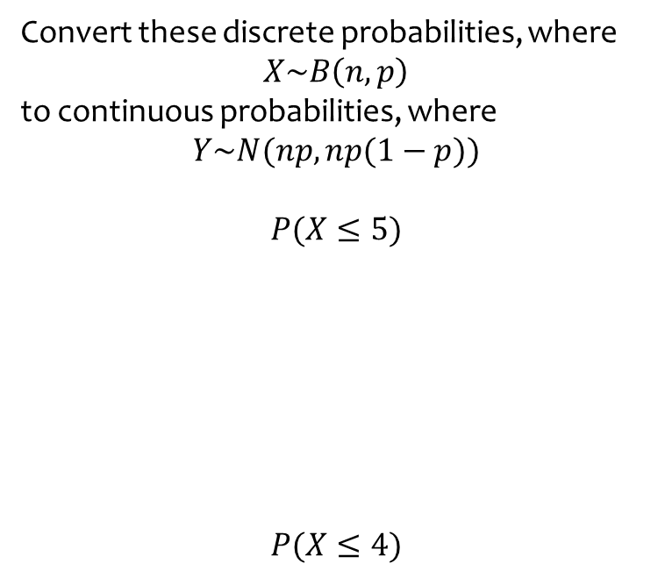
Worked example
Your turn
Convert these discrete probabilities, where
$$X\sim B\left(n, p\right)$$
to continuous probabilities, where
$$Y\sim N(np,np(1−p))$$
$$P(X≤5)$$
$$P(X≤4)$$
Convert these discrete probabilities, where
$$X\sim B\left(n, p\right)$$
to continuous probabilities, where
$$Y\sim N(np,np(1−p))$$
$$P(X≤3)$$
$$≈P\left(Y≤3.5\right)$$

Slide 5
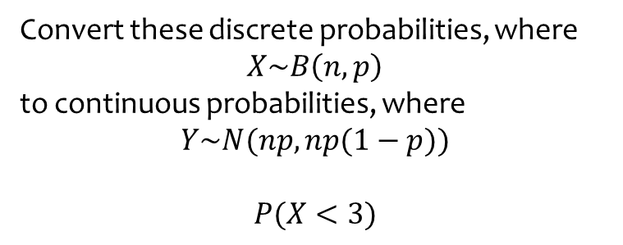
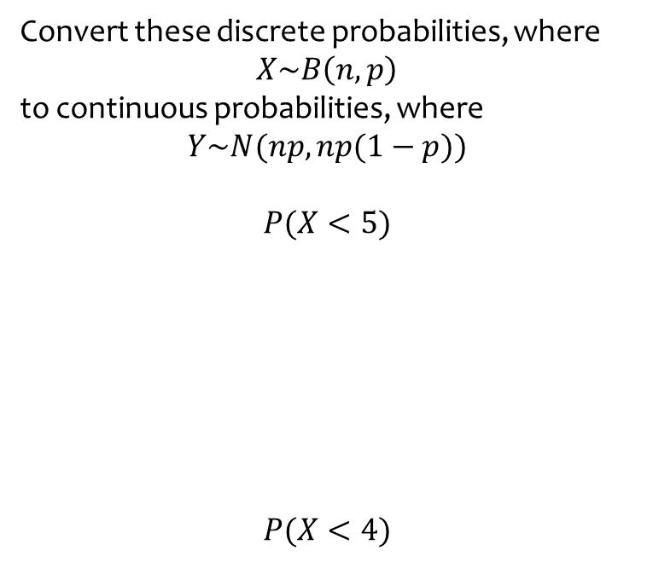
Worked example
Your turn
Convert these discrete probabilities, where
$$X\sim B\left(n, p\right)$$
to continuous probabilities, where
$$Y\sim N(np,np(1−p))$$
$$P(X<5)$$
$$P(X<4)$$
Convert these discrete probabilities, where
$$X\sim B\left(n, p\right)$$
to continuous probabilities, where
$$Y\sim N(np,np(1−p))$$
$$P(X<3)$$
$$≈P\left(Y≤2.5\right)$$

Slide 6
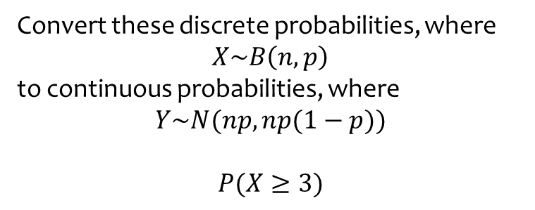
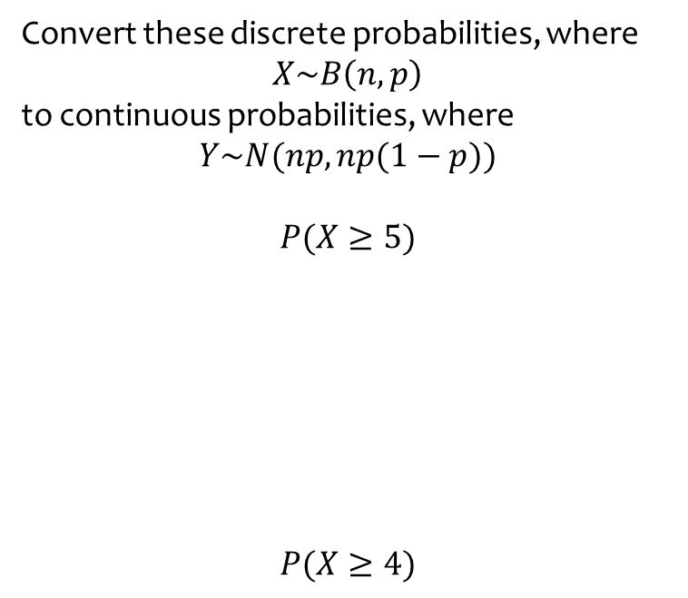
Worked example
Your turn
Convert these discrete probabilities, where
$$X\sim B\left(n, p\right)$$
to continuous probabilities, where
$$Y\sim N(np,np(1−p))$$
$$P(X≥5)$$
$$P(X≥4)$$
Convert these discrete probabilities, where
$$X\sim B\left(n, p\right)$$
to continuous probabilities, where
$$Y\sim N(np,np(1−p))$$
$$P(X≥3)$$
$$≈P\left(Y≥2.5\right)$$

Slide 7
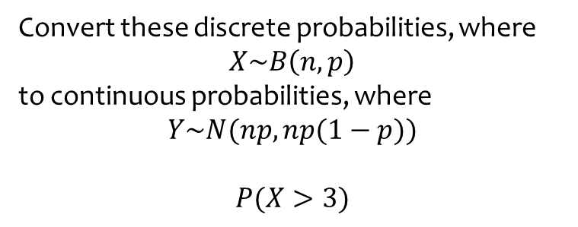
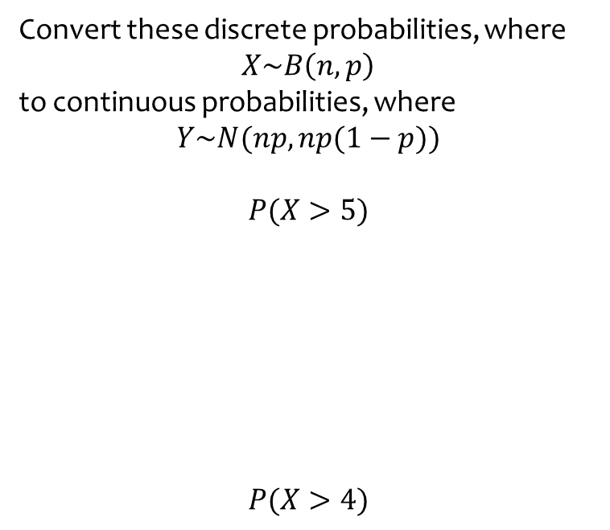
Worked example
Your turn
Convert these discrete probabilities, where
$$X\sim B\left(n, p\right)$$
to continuous probabilities, where
$$Y\sim N(np,np(1−p))$$
$$P(X>5)$$
$$P(X>4)$$
Convert these discrete probabilities, where
$$X\sim B\left(n, p\right)$$
to continuous probabilities, where
$$Y\sim N(np,np(1−p))$$
$$P(X>3)$$
$$≈P\left(Y≥3.5\right)$$

Slide 8
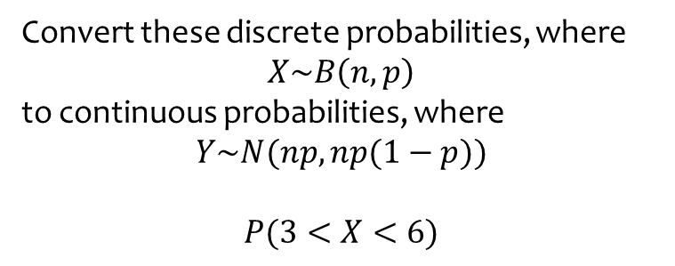
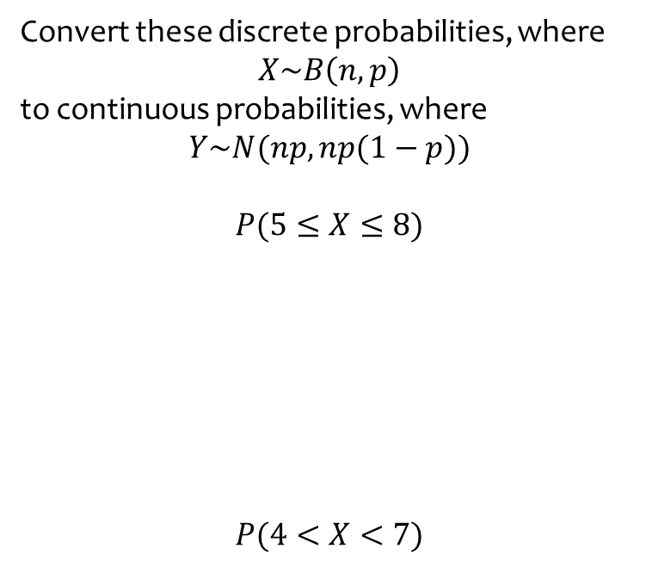
Worked example
Your turn
Convert these discrete probabilities, where
$$X\sim B\left(n, p\right)$$
to continuous probabilities, where
$$Y\sim N(np,np(1−p))$$
$$P(5≤X≤8)$$
$$P(4<X<7)$$
Convert these discrete probabilities, where
$$X\sim B\left(n, p\right)$$
to continuous probabilities, where
$$Y\sim N(np,np(1−p))$$
$$P(3<X<6)$$
$$≈P\left(3.5≤Y≤5.5\right)$$

Slide 9
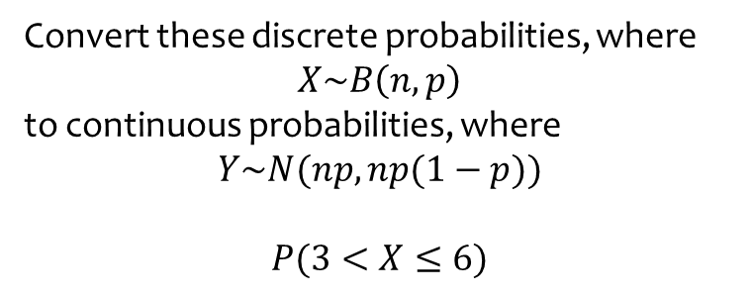
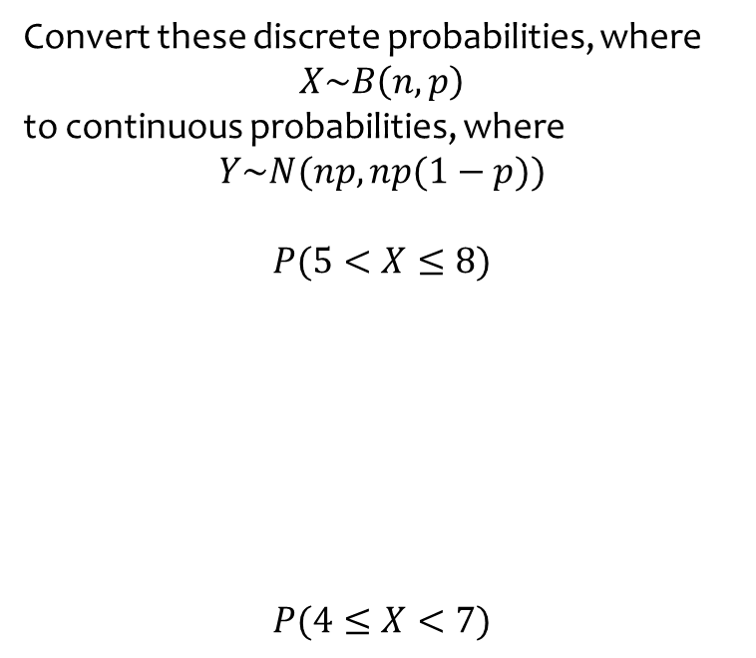
Worked example
Your turn
Convert these discrete probabilities, where
$$X\sim B\left(n, p\right)$$
to continuous probabilities, where
$$Y\sim N(np,np(1−p))$$
$$P(5<X≤8)$$
$$P(4≤X<7)$$
Convert these discrete probabilities, where
$$X\sim B\left(n, p\right)$$
to continuous probabilities, where
$$Y\sim N(np,np(1−p))$$
$$P(3<X≤6)$$
$$≈P\left(3.5≤Y≤6.5\right)$$

Slide 10
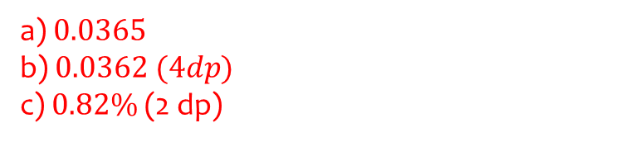
Worked example
Your turn
For a particular type of flower bulbs, 44% will produce red flowers. A random sample of 160 bulbs is planted.
Calculate the actual probability that there are exactly 70 red flowers.
Use a normal approximation to find a estimate that there are exactly 70 red flowers.
Hence determine the percentage error of the normal approximation for 70 red flowers.
For a particular type of flower bulbs, 55% will produce yellow flowers. A random sample of 80 bulbs is planted.
Calculate the actual probability that there are exactly 50 yellow flowers.
Use a normal approximation to find a estimate that there are exactly 50 yellow flowers.
Hence determine the percentage error of the normal approximation for 50 yellow flowers.
a) $0.0365$
b) $0.0362 (4dp)$
c) $0.82\%$ (2 dp)

Slide 11



Worked example
Your turn
The random variable
$$X\sim B(100, 0.51)$$
Use a suitable approximation to estimate:
$$P(X=45)$$
$$P(X>54)$$
$$P(X≤43)$$
$$P(47<X≤51)$$
The random variable
$$X\sim B(200, 0.47)$$
Use a suitable approximation to estimate:
$$P(X=87)$$
$$P(X>102)$$
$$P(X≤91)$$
$$P(89≤X<98)$$
$0.0346$ (4 dp)
$0.1142$ (4 dp)
$0.3616$ (4 dp)
$0.4721$ (4 dp)

