Slide 1
3.5) Finding $μ$ and $σ$

Slide 2
Worked example
Your turn
$$X\sim N\left(μ,4^{2}\right)$$
Given that $P\left(X>30\right)=0.1$, find the value of $μ$.
$$X\sim N\left(μ,3^{2}\right)$$
Given that $P\left(X>20\right)=0.2$, find the value of $μ$.
$$μ=17.5 (3sf)$$

Slide 3
Worked example
Your turn
A machine makes metal sheets with width, $X$ cm, modelled as a normal distribution such that
$$X\sim N\left(70,σ^{2}\right)$$
Given that $P\left(X<64\right)=0.02275$, find the value of $σ$.
Find the 80th percentile of the widths.
A machine makes metal sheets with width, $X$ cm, modelled as a normal distribution such that
$$X\sim N\left(50,σ^{2}\right)$$
Given that $P\left(X<46\right)=0.2119$, find the value of $σ$.
Find the 90th percentile of the widths.
a) $σ=5$
b) $56.4 cm (1dp)$

Slide 4
Worked example
Your turn
A random variable
$$X\sim N(μ,σ^{2})$$
Given that $P\left(X<13\right)=0.1964$ and
$P\left(X>51\right)=0.01$, find the values of $μ$ and $σ$
A random variable
$$X\sim N(μ,σ^{2})$$
Given that $P\left(X<15\right)=0.1469$ and
$P\left(X>35\right)=0.025$, find the values of $μ$ and $σ$
$σ=6.64, μ=22.0$ (3 sf)

Slide 5
Worked example
Your turn
The time taken for a journey, $X,$ has a normal distribution with mean $200$ minutes and standard deviation $d$ minutes.
Given that $30\%$ of the journeys take longer than $230$ minutes, find the standard deviation.
The time taken for a journey, $X,$ has a normal distribution with mean $100$ minutes and standard deviation $d$ minutes.
Given that $15\%$ of the journeys take longer than $115$ minutes, find the standard deviation.
$$d=14.5$$

Slide 6
Worked example
Your turn
The time taken for a journey, $X,$ is normally distributed with mean $μ$ days and standard deviation $σ$ days.
$15\%$ of journeys are shorter than $532$ days.
$2.5\%$ are longer than $682$ days.
Find the values between which the middle $95\%$ of journeys lie.
The time taken for a journey, $X,$ is normally distributed with mean $μ$ days and standard deviation $σ$ days.
$2.5\%$ of journeys are shorter than $235$ days.
$15\%$ are longer than $286$ days.
Find the values between which the middle $68\%$ of journeys lie.
$251$ and $285$ (3 sf)

Slide 7
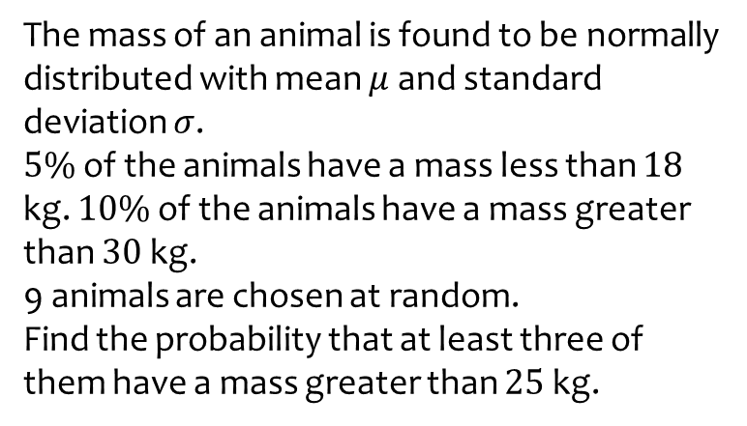
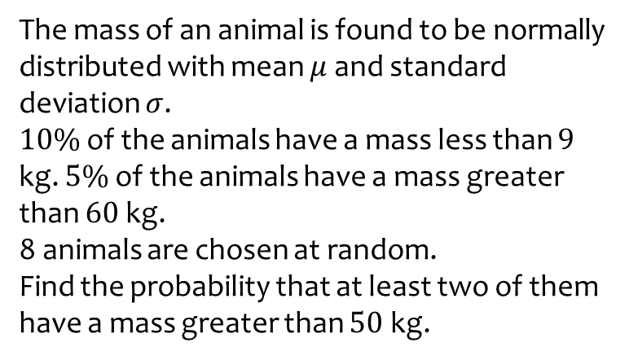
Worked example
Your turn
The mass of an animal is found to be normally distributed with mean $μ$ and standard deviation $σ$.
$10\%$ of the animals have a mass less than $9$ kg. $5\%$ of the animals have a mass greater than $60$ kg.
8 animals are chosen at random.
Find the probability that at least two of them have a mass greater than $50$ kg.
The mass of an animal is found to be normally distributed with mean $μ$ and standard deviation $σ$.
$5\%$ of the animals have a mass less than $18$ kg. $10\%$ of the animals have a mass greater than $30$ kg.
9 animals are chosen at random.
Find the probability that at least three of them have a mass greater than $25$ kg.
$0.8832$ (4 dp)

