Slide 1
3.5) Comparing data

Slide 2
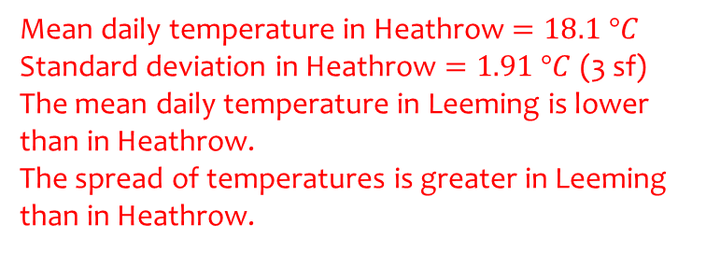
Worked example
Your turn
From the large data set, the daily mean temperature during June 1987 is recorded at Camborne and Leuchars.
For Camborne, $\sum{x}=377.1$ and $\sum{x^{2}}=4939.45$
For Leuchars, the mean temperature was $10.9 °C$ with a standard deviation of $2.10 °C$.
Compare the data for the two locations.
From the large data set, the daily mean temperature during August 2015 is recorded at Heathrow and Leeming.
For Heathrow, $\sum{x}=562.0$ and $\sum{x^{2}}=10301.2$
For Leeming, the mean temperature was $15.6 °C$ with a standard deviation of $2.01 °C$.
Compare the data for the two locations.
Mean daily temperature in Heathrow $=18.1 °C$
Standard deviation in Heathrow $=1.91 °C$ (3 sf)
The mean daily temperature in Leeming is lower than in Heathrow.
The spread of temperatures is greater in Leeming than in Heathrow.

Slide 3
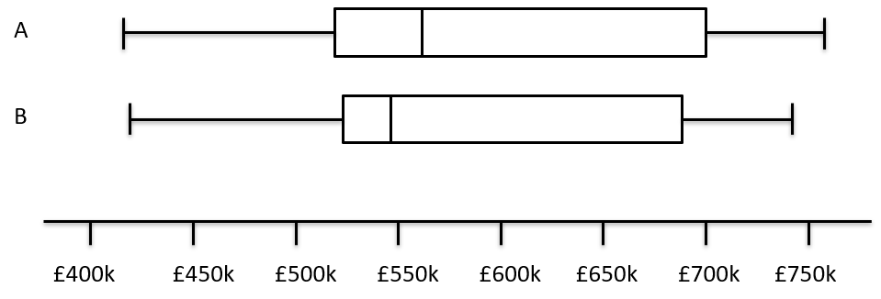
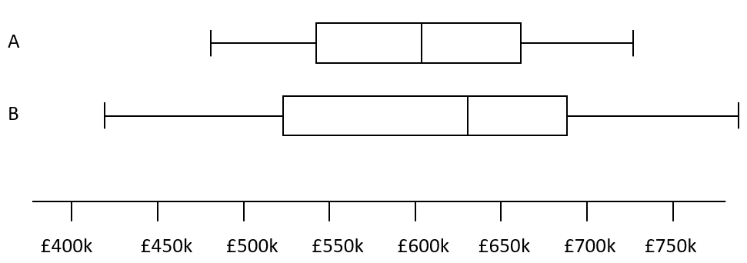
Worked example
Your turn
Compare the house prices of locations A and B
Compare the house prices of locations A and B
The interquartile range of house prices in B is greater than A.
The range of house prices in B is greater than A.
The median house price in Kingston was greater than that in Croydon
Diagrams/Graphs used with permission from DrFrostMaths: https://www.drfrostmaths.com/

