Slide 1
3.4) Problems involving elastic energy

Slide 2
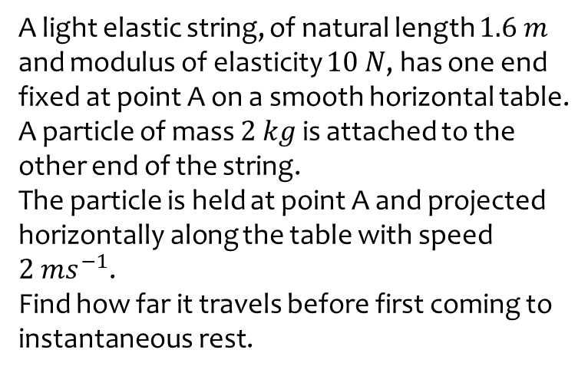
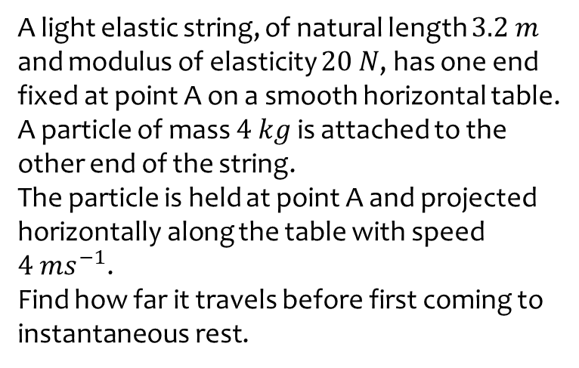

Worked example
Your turn
A light elastic string, of natural length $3.2 m$ and modulus of elasticity $20 N$, has one end fixed at point A on a smooth horizontal table.
A particle of mass $4 kg$ is attached to the other end of the string.
The particle is held at point A and projected horizontally along the table with speed $4 ms^{−1}$.
Find how far it travels before first coming to instantaneous rest.
A light elastic string, of natural length $1.6 m$ and modulus of elasticity $10 N$, has one end fixed at point A on a smooth horizontal table.
A particle of mass $2 kg$ is attached to the other end of the string.
The particle is held at point A and projected horizontally along the table with speed $2 ms^{−1}$.
Find how far it travels before first coming to instantaneous rest.
$2.73 m$ (3 sf)

Slide 3
Worked example
Your turn
A particle of mass 1kg is attached to one end of an elastic string, of natural length 4m and modulus of elasticity 39.2 N.
The other end of the elastic string is attached to a point O.
The particle is released from the point O.
Find the greatest distance it will reach below O.
A particle of mass 0.5kg is attached to one end of an elastic string, of natural length 2m and modulus of elasticity 19.6N.
The other end of the elastic string is attached to a point O.
The particle is released from the point O.
Find the greatest distance it will reach below O.
$$4 m$$

Slide 4
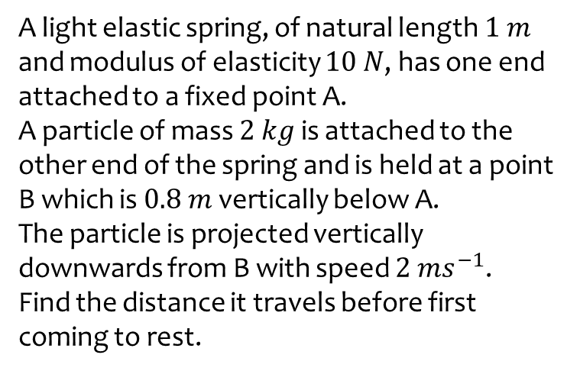
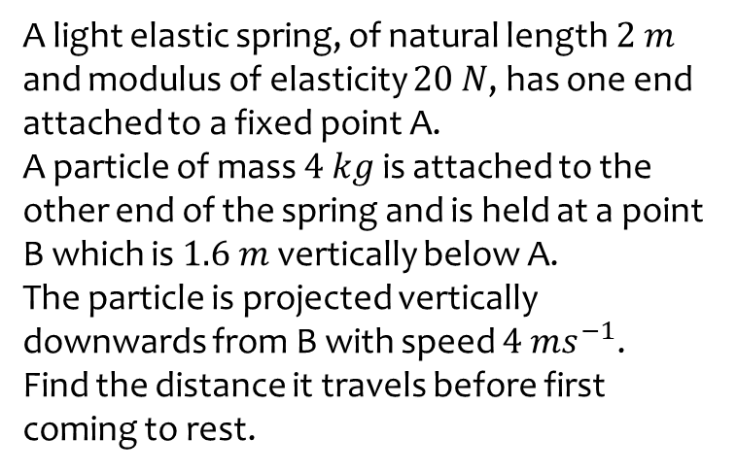

Worked example
Your turn
A light elastic spring, of natural length $2 m$ and modulus of elasticity $20 N$, has one end attached to a fixed point A.
A particle of mass $4 kg$ is attached to the other end of the spring and is held at a point B which is $1.6 m$ vertically below A.
The particle is projected vertically downwards from B with speed $4 ms^{−1}$.
Find the distance it travels before first coming to rest.
A light elastic spring, of natural length $1 m$ and modulus of elasticity $10 N$, has one end attached to a fixed point A.
A particle of mass $2 kg$ is attached to the other end of the spring and is held at a point B which is $0.8 m$ vertically below A.
The particle is projected vertically downwards from B with speed $2 ms^{−1}$.
Find the distance it travels before first coming to rest.
$4.50 m$ (3 sf)

Slide 5
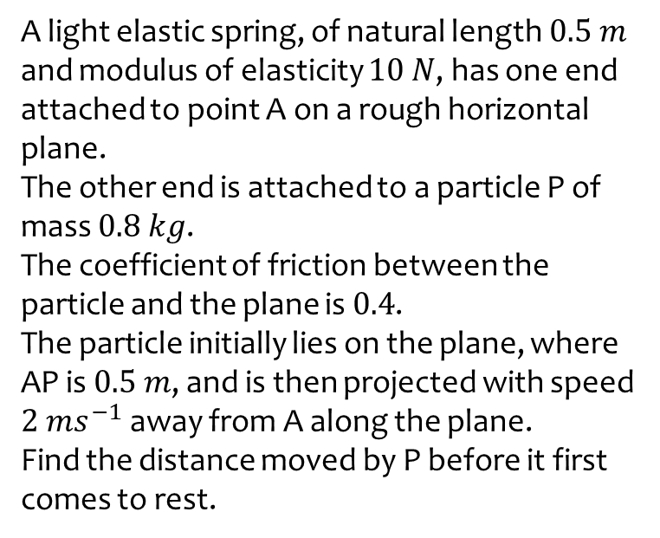
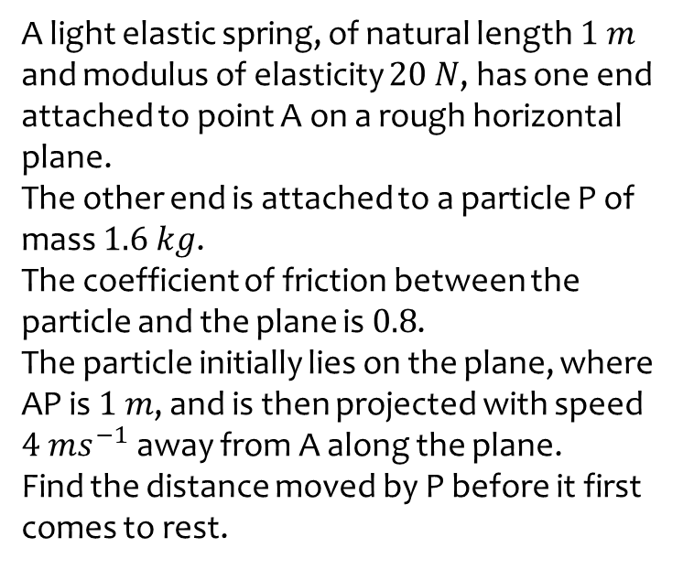

Worked example
Your turn
A light elastic spring, of natural length $1 m$ and modulus of elasticity $20 N$, has one end attached to point A on a rough horizontal plane.
The other end is attached to a particle P of mass $1.6 kg$.
The coefficient of friction between the particle and the plane is $0.8$.
The particle initially lies on the plane, where AP is $1 m$, and is then projected with speed $4 ms^{−1}$ away from A along the plane.
Find the distance moved by P before it first comes to rest.
A light elastic spring, of natural length $0.5 m$ and modulus of elasticity $10 N$, has one end attached to point A on a rough horizontal plane.
The other end is attached to a particle P of mass $0.8 kg$.
The coefficient of friction between the particle and the plane is $0.4$.
The particle initially lies on the plane, where AP is $0.5 m$, and is then projected with speed $2 ms^{−1}$ away from A along the plane.
Find the distance moved by P before it first comes to rest.
$0.273 m$ (3 sf)

Slide 6
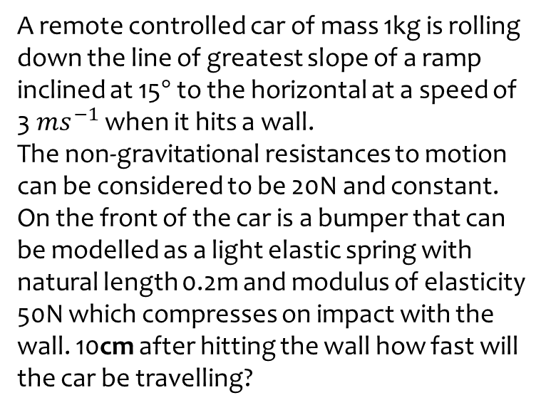
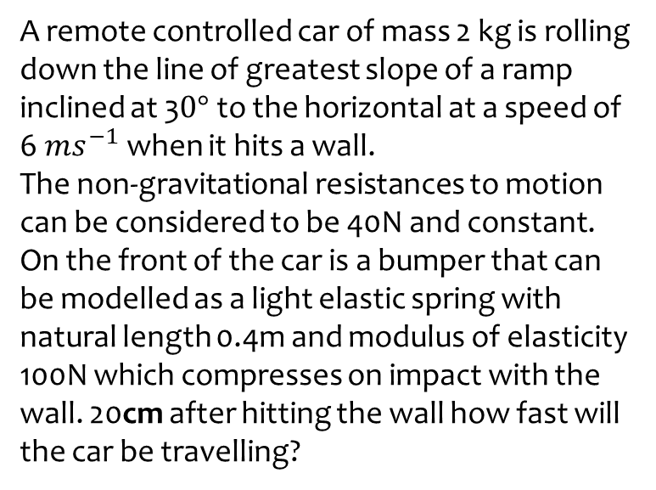

Worked example
Your turn
A remote controlled car of mass 2 kg is rolling down the line of greatest slope of a ramp inclined at 3$0°$ to the horizontal at a speed of 6$ms^{−1}$ when it hits a wall.
The non-gravitational resistances to motion can be considered to be 40N and constant.
On the front of the car is a bumper that can be modelled as a light elastic spring with natural length 0.4m and modulus of elasticity 100N which compresses on impact with the wall. 20cm after hitting the wall how fast will the car be travelling?
A remote controlled car of mass 1kg is rolling down the line of greatest slope of a ramp inclined at 15$°$ to the horizontal at a speed of 3$ms^{−1}$ when it hits a wall.
The non-gravitational resistances to motion can be considered to be 20N and constant.
On the front of the car is a bumper that can be modelled as a light elastic spring with natural length 0.2m and modulus of elasticity 50N which compresses on impact with the wall. 10cm after hitting the wall how fast will the car be travelling?
$1.73 ms^{−1}$ (3 sf)

