Slide 1
3.4) The standard normal distribution

Slide 2



Worked example
Your turn
$Z$ is the number of standard deviations above the mean.
Assume $X\sim N\left({100,15}^{2}\right)$
Find $z$ if
$$X=100$$
$$X=130$$
$$X=62.5$$
$Z$ is the number of standard deviations above the mean.
Assume $X\sim N\left({100,15}^{2}\right)$
Find $Z$ if
$$X=85$$
$$X=165$$
$$Z=−1$$
$$Z=4.3333…$$

Slide 3
Worked example
Your turn
The random variable $X\sim N\left({40, 5}^{2}\right)$.
Write in terms of $Φ\left(z\right)$ for some value of $z$.
(a) $P\left(X≤45\right)$
(b) $P\left(X>43\right)$
The random variable $X\sim N\left({50, 4}^{2}\right)$. Write in terms of $Φ\left(z\right)$ for some value of $z$.
(a) $P\left(X<53\right)$
(b) $P\left(X≥55\right)$
$Φ\left(0.75\right)$
$1−Φ\left(1.25\right)$

Slide 4
Worked example
Your turn
If $X\sim N\left({100,15}^{2}\right)$, determine, in terms of $Φ$:
$P(X>70)$
$P\left(88<X<122.5\right)$
If $X\sim N\left({100,15}^{2}\right)$, determine, in terms of $Φ$:
$P(X>115)$
$P\left(77.5<X<112\right)$
$1−Φ\left(1\right)$
$Φ\left(0.8\right)+Φ\left(1.5\right)−1$

Slide 5
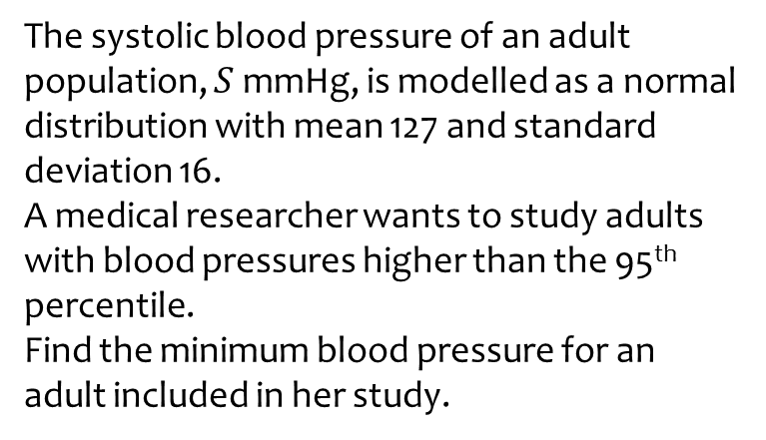
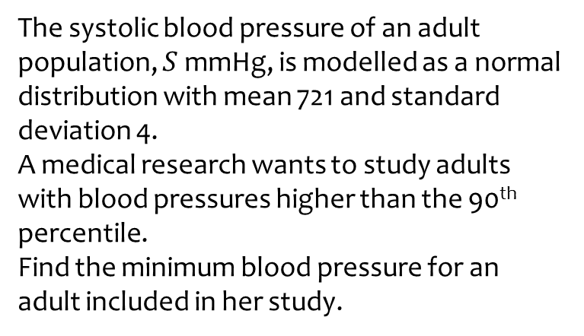
Worked example
Your turn
The systolic blood pressure of an adult population, $S$ mmHg, is modelled as a normal distribution with mean 721 and standard deviation 4.
A medical research wants to study adults with blood pressures higher than the 90th percentile.
Find the minimum blood pressure for an adult included in her study.
The systolic blood pressure of an adult population, $S$ mmHg, is modelled as a normal distribution with mean 127 and standard deviation 16.
A medical researcher wants to study adults with blood pressures higher than the 95th percentile.
Find the minimum blood pressure for an adult included in her study.
$s=153$ (3 sf)

Slide 6

Worked example
Your turn
Determine:
$$P(Z>−1.7)$$
$$P(Z≤−1.5)$$
Determine:
$$P(Z>−1.3)$$
$0.9032$ (4 dp)

Slide 7

Worked example
Your turn
Determine:
$$P\left(−1<Z<0\right)$$
$$P\left(−1.5<Z<0.5\right)$$
Determine:
$$P\left(−2<Z<1\right)$$
$0.8185$ (4 dp)

Slide 8

Worked example
Your turn
Determine $a$ such that:
$$P\left(Z>a\right)=0.3$$
$$P\left(Z<a\right)=0.4$$
Determine $a$ such that:
$$P\left(Z>a\right)=0.7$$
$a=−0.5244$ (4 dp)

Slide 9

Worked example
Your turn
Determine $a$ such that:
$$P\left(−a<Z<a\right)=0.4$$
$$P\left(−a<Z<a\right)=0.5$$
Determine $a$ such that:
$$P\left(−a<Z<a\right)=0.6$$
$a=−0.8416$ (4 dp)

Slide 10
Worked example
Your turn
Use the percentage points table to find values of $z$ which correspond to the $10\%$ to $80\%$ interpercentile range.
Use the percentage points table to find values of $z$ which correspond to the $20\%$ to $90\%$ interpercentile range.
$$−0.8416<z<1.2816$$

