Slide 1
3.4) Histograms

Slide 2
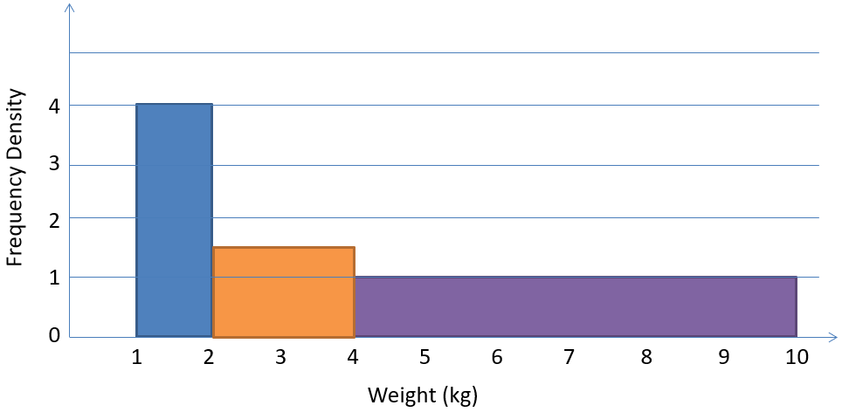
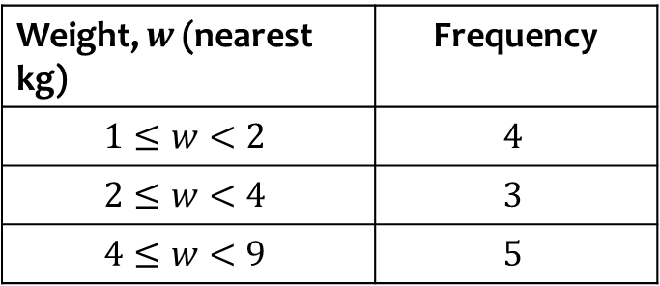
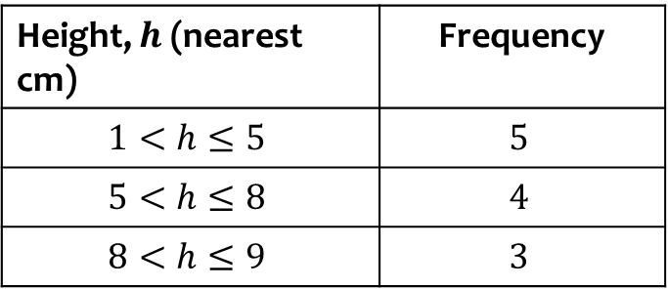
Worked example
Your turn
Plot a histogram for the data:
Plot a histogram for the data:
Height, $h$ (nearest cm) | Frequency
$$1<h≤5$$ | $$5$$
$$5<h≤8$$ | $$4$$
$$8<h≤9$$ | $$3$$
Weight, $w$ (nearest kg) | Frequency
$$1≤w<2$$ | $$4$$
$$2≤w<4$$ | $$3$$
$$4≤w<9$$ | $$5$$

Slide 3
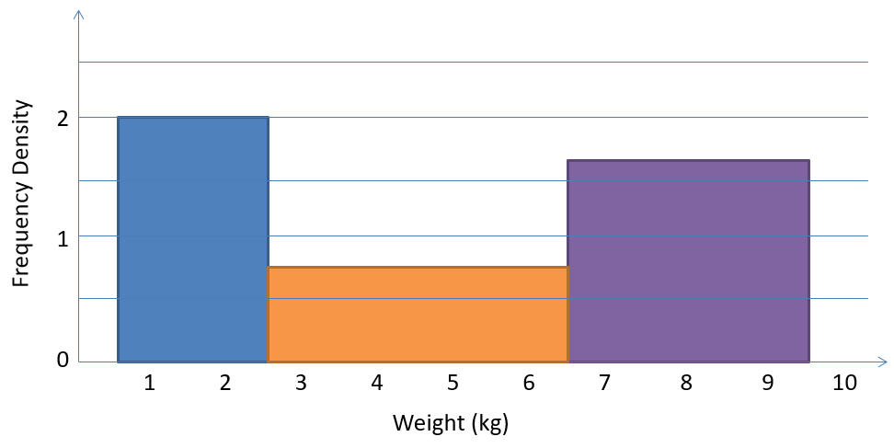
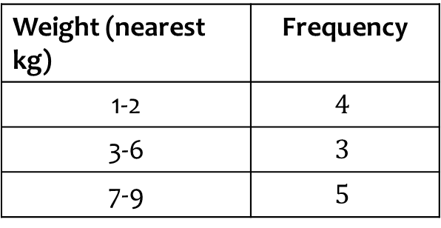
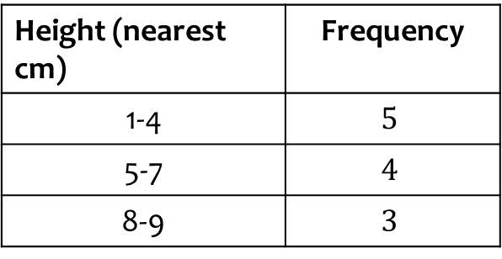
Worked example
Your turn
Plot a histogram for the data:
Plot a histogram for the data:
Height (nearest cm) | Frequency
1-4 | $$5$$
5-7 | $$4$$
8-9 | $$3$$
Weight (nearest kg) | Frequency
1-2 | $$4$$
3-6 | $$3$$
7-9 | $$5$$

Slide 4
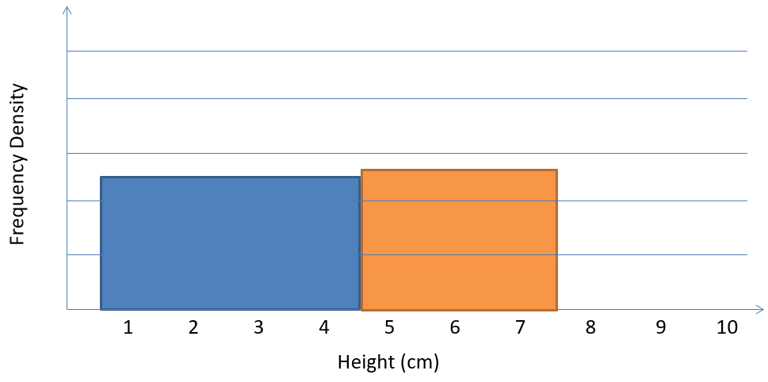
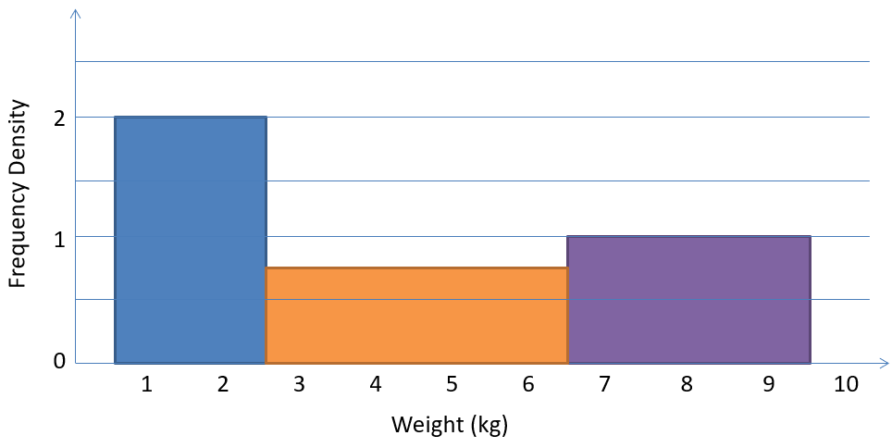
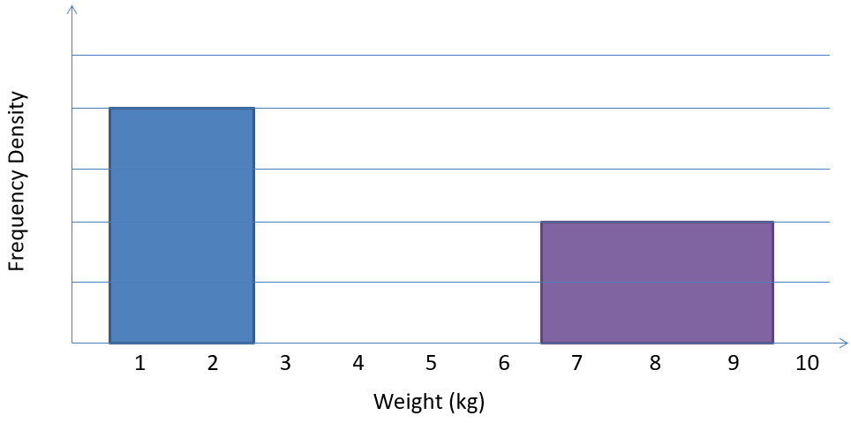
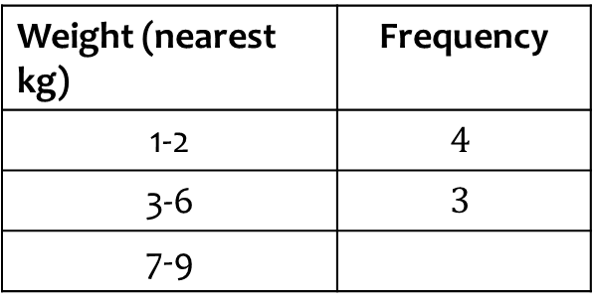

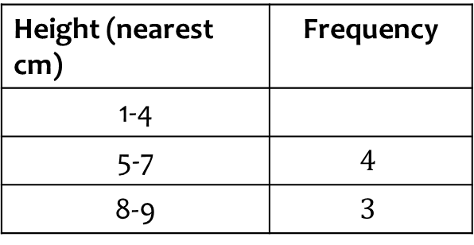
Worked example
Your turn
Complete the table and histogram:
Complete the table and histogram:
Height (nearest cm) | Frequency
1-4
5-7 | $$4$$
8-9 | $$3$$
Weight (nearest kg) | Frequency
1-2 | $$4$$
3-6 | $$3$$
7-9
$$3$$

Slide 5
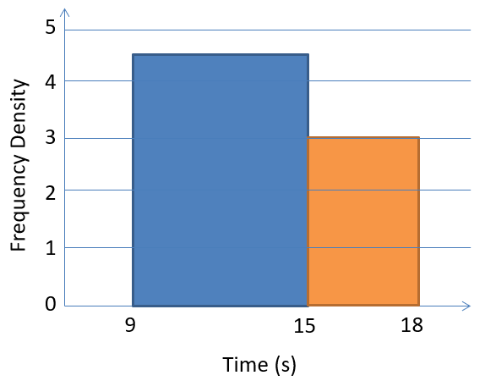
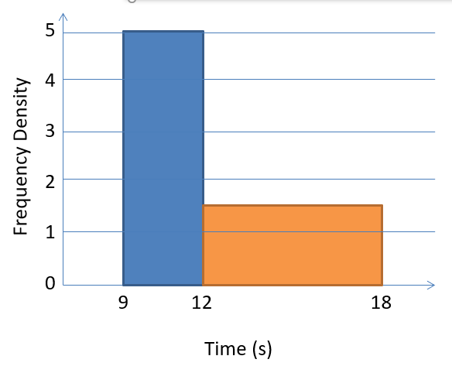
Worked example
Your turn
There were 54 runners in a 100m race.
The following histogram represents their times. Determine the number of runners with times below 13 seconds.
There were 60 runners in a 100m race.
The following histogram represents their times. Determine the number of runners with times above 14 seconds.
$$15$$

Slide 6
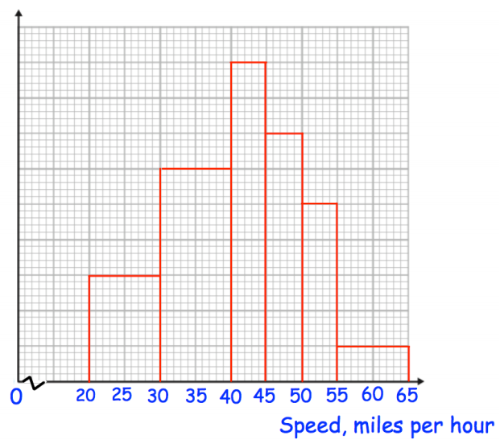
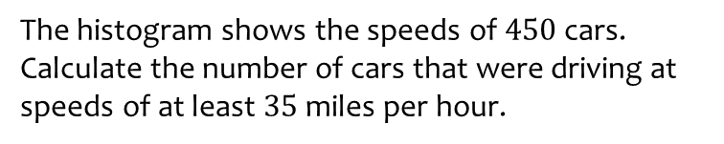
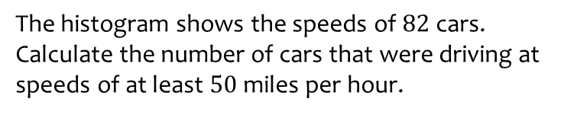
Worked example
Your turn
The histogram shows the speeds of $82$ cars.
Calculate the number of cars that were driving at speeds of at least $50$ miles per hour.
The histogram shows the speeds of $450$ cars.
Calculate the number of cars that were driving at speeds of at least $35$ miles per hour.
$$90$$
Questions used with permission from Corbettmaths (https://corbettmaths.com/) and Drfrostmaths (https://www.drfrostmaths.com/)

Slide 7
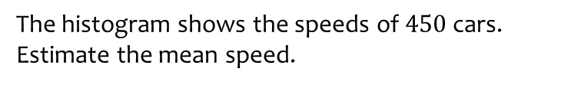
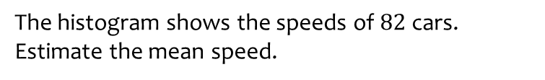

Worked example
Your turn
The histogram shows the speeds of $82$ cars.
Estimate the mean speed.
The histogram shows the speeds of $450$ cars.
Estimate the mean speed.
$28.8$mph
Questions used with permission from Corbettmaths (https://corbettmaths.com/) and Drfrostmaths (https://www.drfrostmaths.com/)

Slide 8
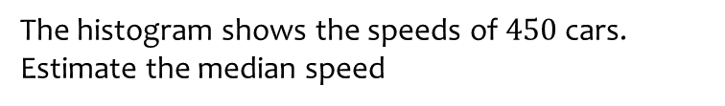
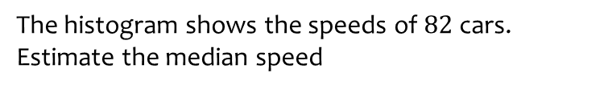

Worked example
Your turn
The histogram shows the speeds of $82$ cars.
Estimate the median speed
The histogram shows the speeds of $450$ cars.
Estimate the median speed
$28.1$ mph (3 sf)
Questions used with permission from Corbettmaths (https://corbettmaths.com/) and Drfrostmaths (https://www.drfrostmaths.com/)

Slide 9
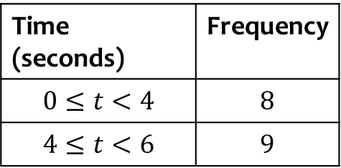

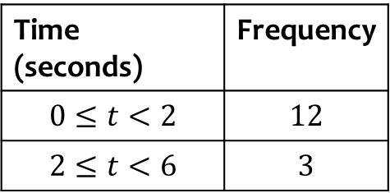
Worked example
Your turn
The frequency table shows some running times.
On a histogram the bar for 0-2 seconds is drawn with width 8cm and height 12cm.
Find the width and height of the bar for 2-6 seconds.
The frequency table shows some running times. On a histogram the bar for 0-4 seconds is drawn with width 6cm and height 8cm. Find the width and height of the bar for 4-6 seconds.
Time (seconds) | Frequency
$$0≤t<2$$ | $$12$$
$$2≤t<6$$ | $$3$$
Time (seconds) | Frequency
$$0≤t<4$$ | $$8$$
$$4≤t<6$$ | $$9$$
Width $=3$ cm
Height $=18$ cm

Slide 10
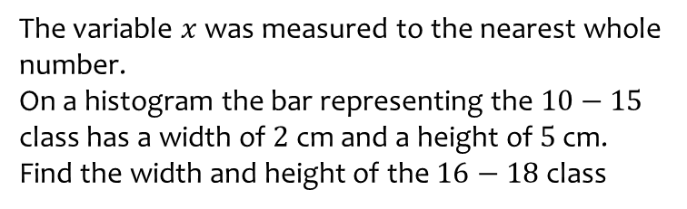
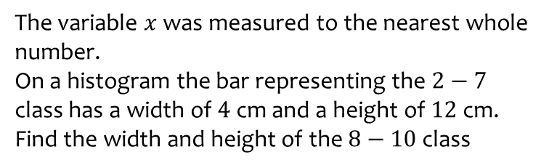
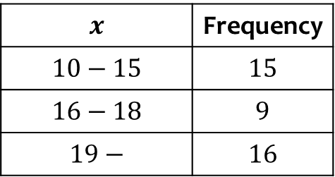
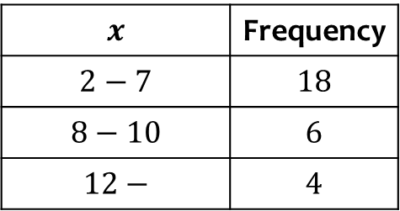

Worked example
Your turn
The variable $x$ was measured to the nearest whole number.
On a histogram the bar representing the $2−7$ class has a width of $4$ cm and a height of $12$ cm.
Find the width and height of the $8−10$ class
The variable $x$ was measured to the nearest whole number.
On a histogram the bar representing the $10−15$ class has a width of $2$ cm and a height of $5$ cm.
Find the width and height of the $16−18$ class
$$x$$ | Frequency
$$2−7$$ | $$18$$
$$8−10$$ | $$6$$
$$12−$$ | $$4$$
$$x$$ | Frequency
$$10−15$$ | $$15$$
$$16−18$$ | $$9$$
$$19−$$ | $$16$$
Width $=1$ cm
Height $=6$ cm

Slide 11
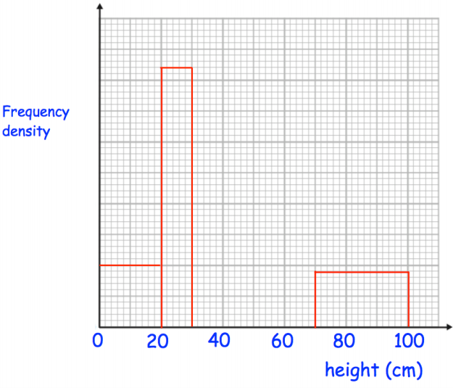
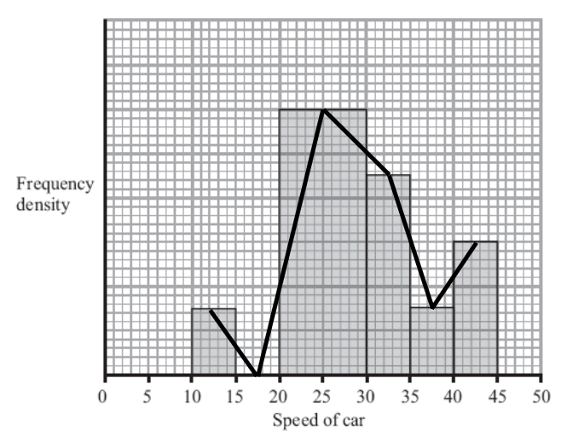
Worked example
Your turn
Draw a frequency polygon.
Draw a frequency polygon.
Questions used with permission from Corbettmaths (https://corbettmaths.com/) and Drfrostmaths (https://www.drfrostmaths.com/)

Slide 12
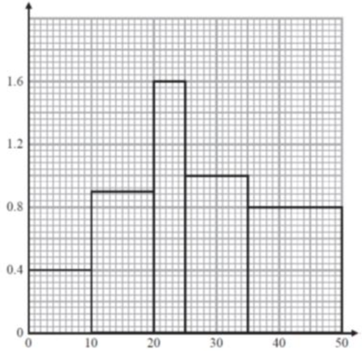
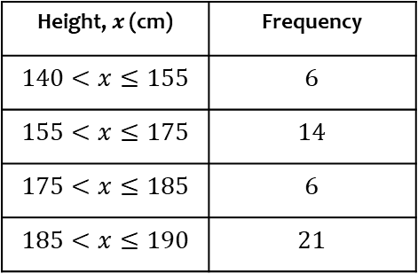
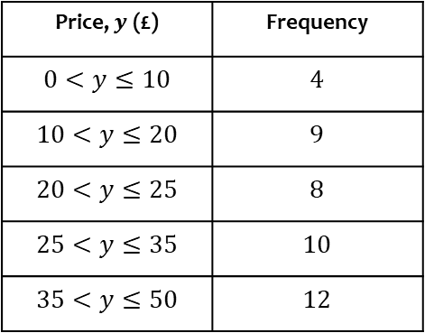
Worked example
Your turn
Plot a histogram
Plot a histogram
Height, $x$ (cm) | Frequency
$$140<x≤155$$ | $$6$$
$$155<x≤175$$ | $$14$$
$$175<x≤185$$ | $$6$$
$$185<x≤190$$ | $$21$$
Price, $y$ (£) | Frequency
$$0<y≤10$$ | $$4$$
$$10<y≤20$$ | $$9$$
$$20<y≤25$$ | $$8$$
$$25<y≤35$$ | $$10$$
$$35<y≤50$$ | $$12$$
Frequency Density
Price (£)
Diagrams/Graphs used with permission from DrFrostMaths: https://www.drfrostmaths.com/

Slide 13
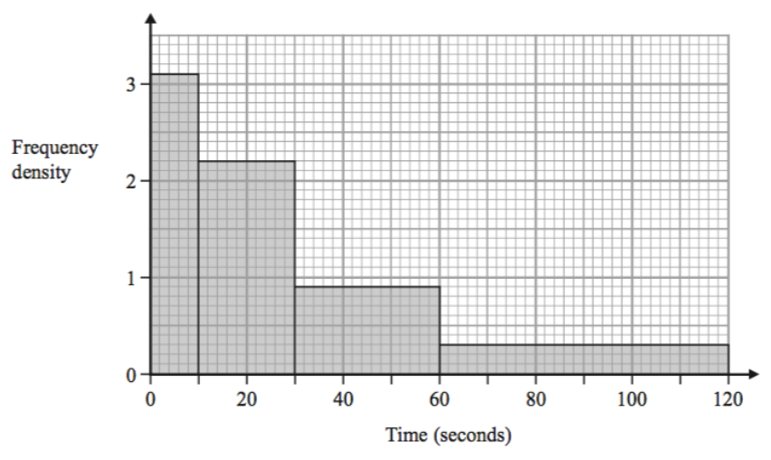
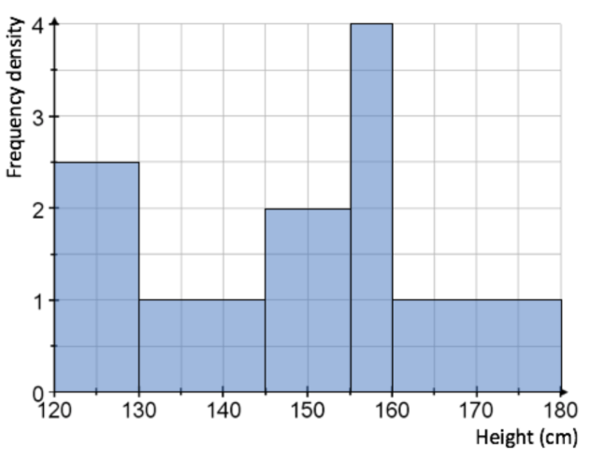
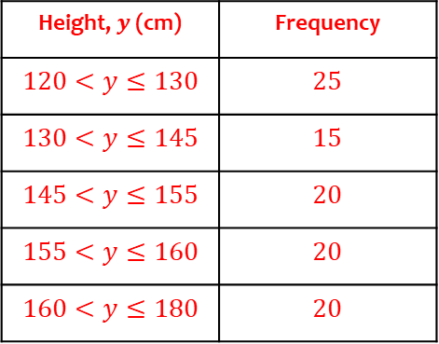
Worked example
Your turn
Draw a frequency table from the histogram
Draw a frequency table from the histogram
Height, $y$(cm) | Frequency
$$120<y≤130$$ | $$25$$
$$130<y≤145$$ | $$15$$
$$145<y≤155$$ | $$20$$
$$155<y≤160$$ | $$20$$
$$160<y≤180$$ | $$20$$

Slide 14
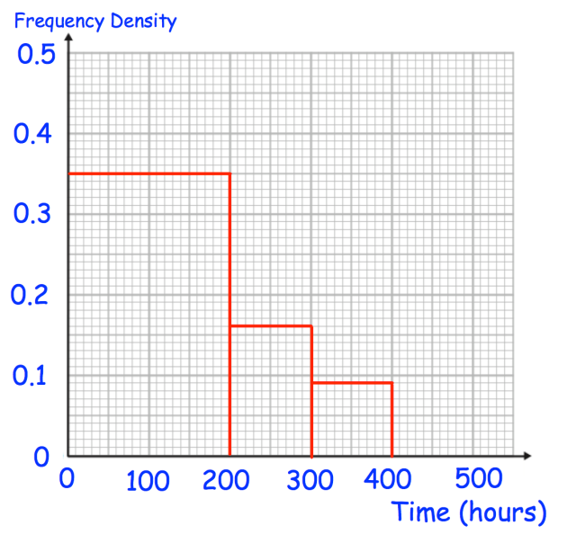
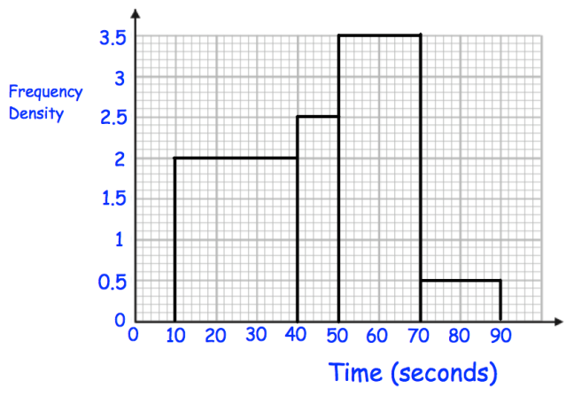

Worked example
Your turn
Estimate the number of pilots who have flown under 350 hours.
Estimate the number of students who took less than 60 seconds to complete the puzzle
$$120$$
Questions used with permission from Corbettmaths: https://corbettmaths.com/

Slide 15
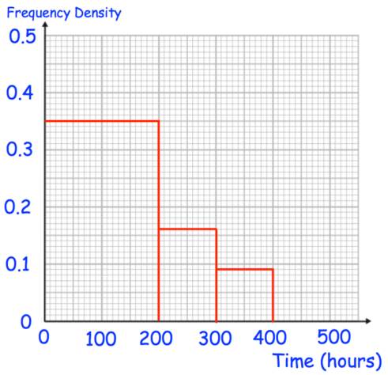
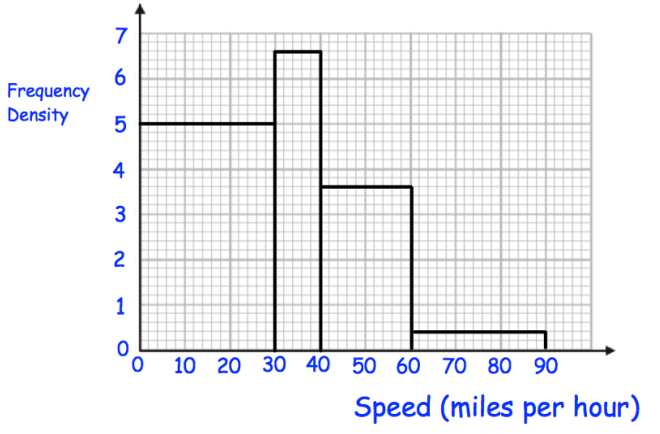
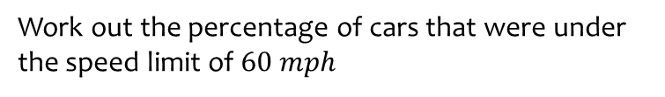

Worked example
Your turn
Work out the percentage of pilots who have flown under 250 hours.
Work out the percentage of cars that were under the speed limit of $60 mph$
$$96\%$$
Questions used with permission from Corbettmaths: https://corbettmaths.com/

Slide 16

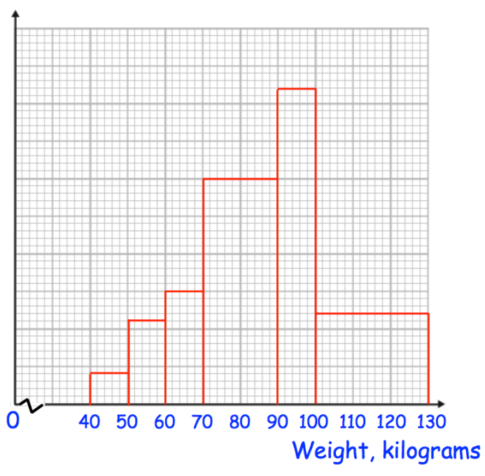
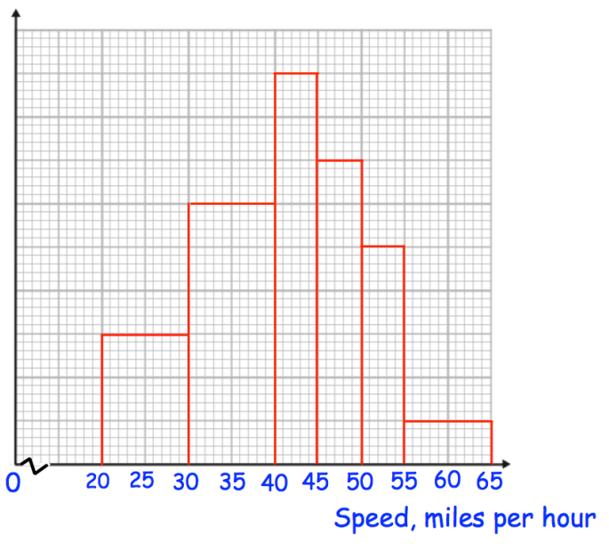
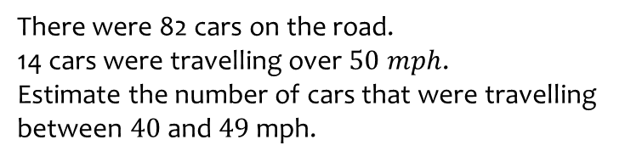

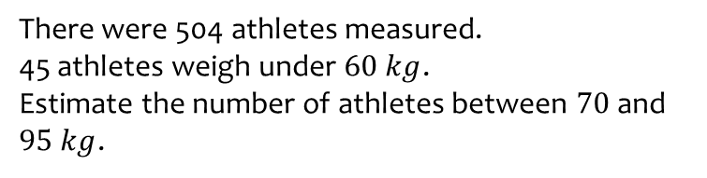
Worked example
Your turn
There were 82 cars on the road.
14 cars were travelling over $50 mph$.
Estimate the number of cars that were travelling between $40$ and $49$ mph.
There were 504 athletes measured.
45 athletes weigh under $60 kg$.
Estimate the number of athletes between $70$ and $95 kg$.
$$243$$
Questions used with permission from Corbettmaths: https://corbettmaths.com/

Slide 17
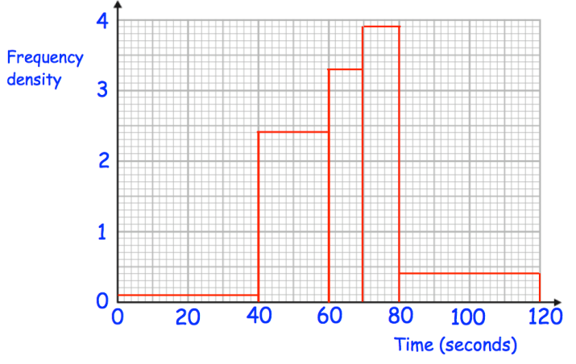
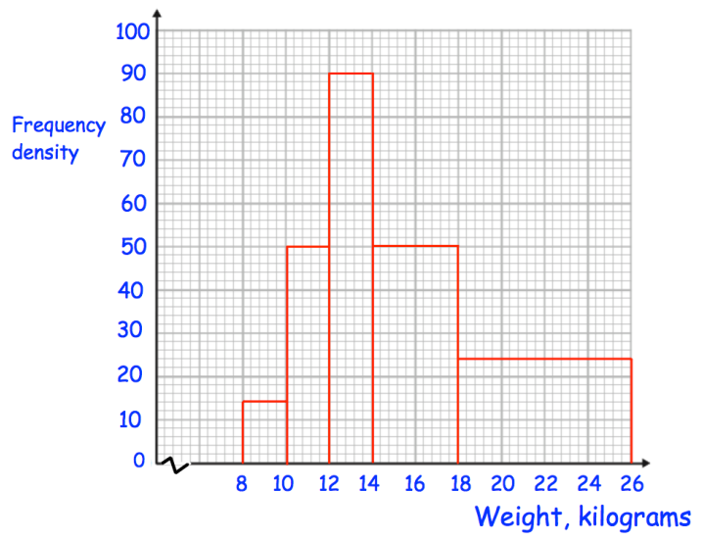

Worked example
Your turn
Estimate the median time
Estimate the median weight
$14.84$(2 dp)
Questions used with permission from Corbettmaths: https://corbettmaths.com/

Slide 18
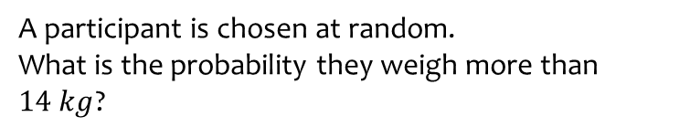

Worked example
Your turn
A participant is chosen at random.
What is the probability they took longer than 60 seconds?
A participant is chosen at random.
What is the probability they weigh more than $14 kg$?
$\frac{14}{25}=0.56$
Questions used with permission from Corbettmaths: https://corbettmaths.com/

