Slide 1
3.3) Simultaneous equations on graphs

Slide 2
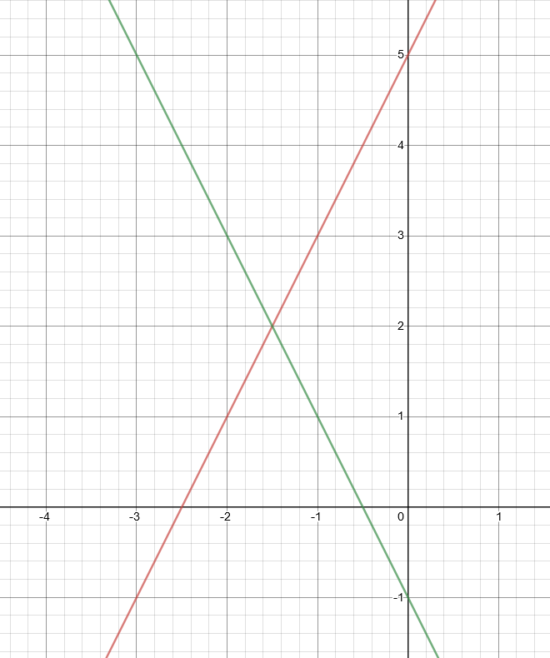
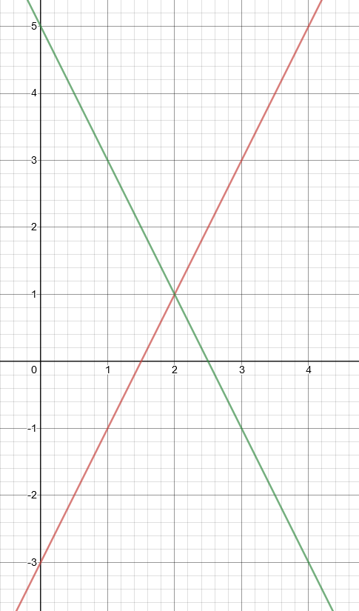
Worked example
Your turn
Solve:
$$y=2x+5$$
$$y=−2x−1$$
Solve:
$$y=2x−3$$
$$y=−2x+5$$
$$x=2, y=1$$

Slide 3
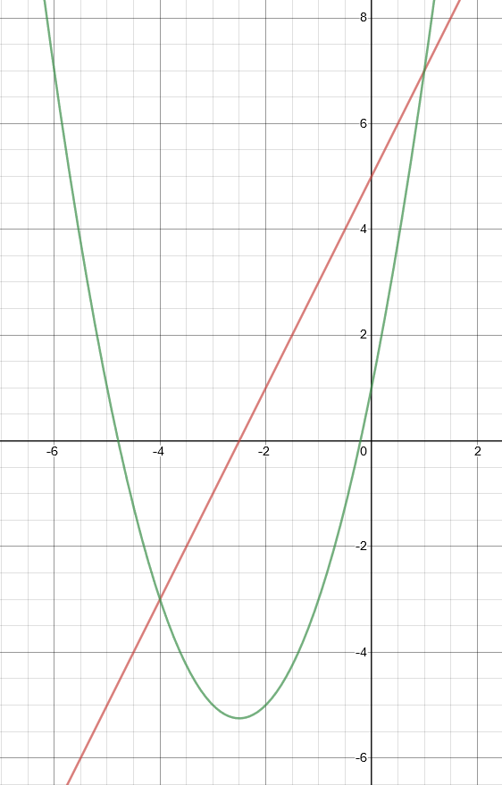
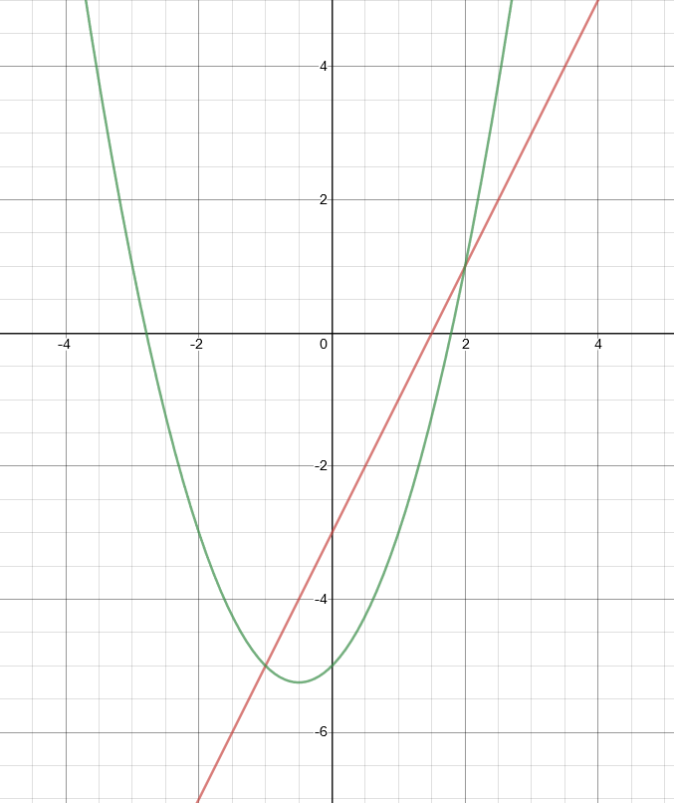
Worked example
Your turn
Solve:
$$y=2x+5$$
$y=x^{2}+5x+1$
Solve:
$y=2x−3$
$y=x^{2}+x−5$
$$x=2, y=1$$
$$x=−1, y=−5$$

Slide 4
Worked example
Your turn
By using the discriminant of a subsequent equation, show that the graphs of
$4x+y=3$ and $y=x^{2}−3x+1$ have two points of intersection
By using the discriminant of a subsequent equation, show that the graphs of
$2x+y=3$ and $y=x^{2}−3x+1$ have two points of intersection
$$x^{2}−x−2=0$$
Discriminant $=9>0$

Slide 5
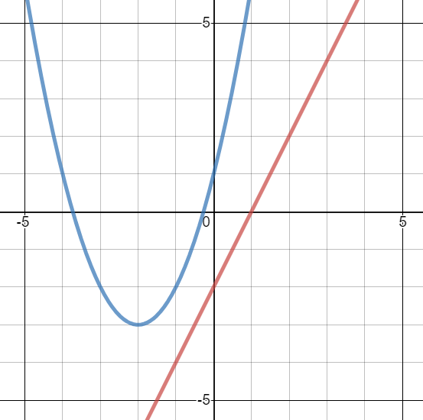
Worked example
Your turn
Prove algebraically, and show graphically, that the lines never meet:
$$y=3x−3$$
$$y=x^{2}+5x+4$$
Prove algebraically, and show graphically, that the lines never meet:
$$y=2x−2$$
$$y=x^{2}+4x+1$$
$$x^{2}+2x+3=0$$
Discriminant $=−8<0$

Slide 6
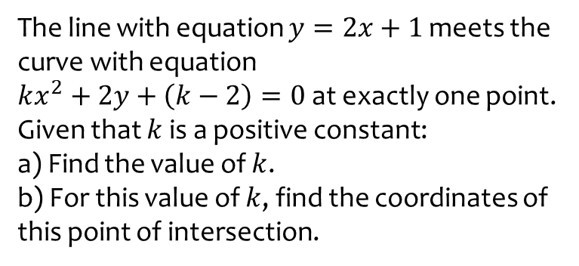
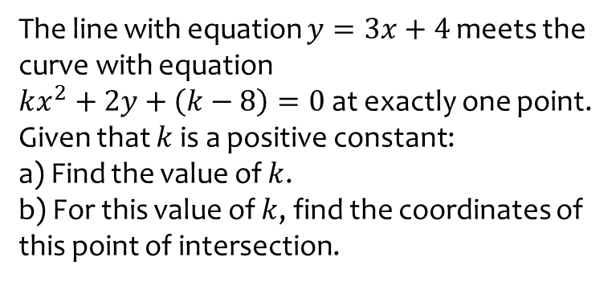
Worked example
Your turn
The line with equation $y=3x+4$ meets the curve with equation
$kx^{2}+2y+\left(k−8\right)=0$ at exactly one point. Given that $k$ is a positive constant:
a) Find the value of $k$.
b) For this value of $k$, find the coordinates of this point of intersection.
The line with equation $y=2x+1$ meets the curve with equation
$kx^{2}+2y+\left(k−2\right)=0$ at exactly one point. Given that $k$ is a positive constant:
a) Find the value of $k$.
b) For this value of $k$, find the coordinates of this point of intersection.
a) $k=2$
b) $(−1, −1)$

