Slide 1
3.3) Geometric sequences

Slide 2
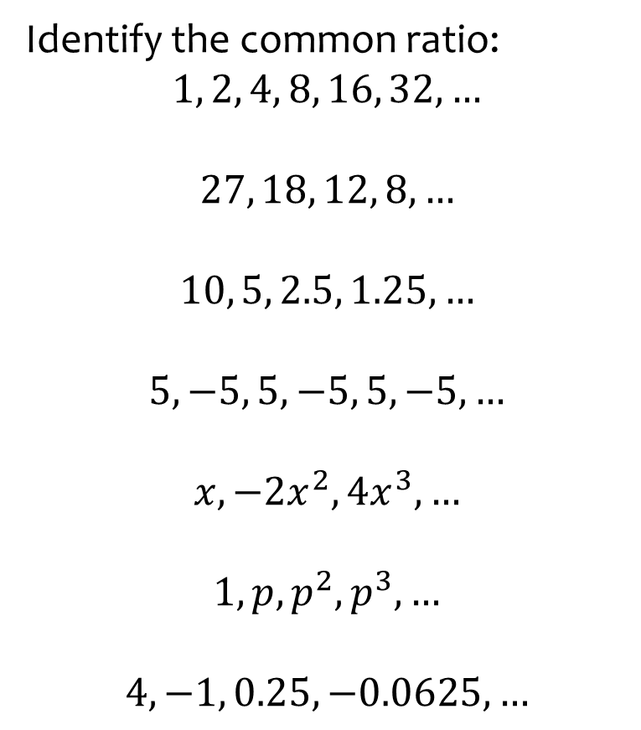
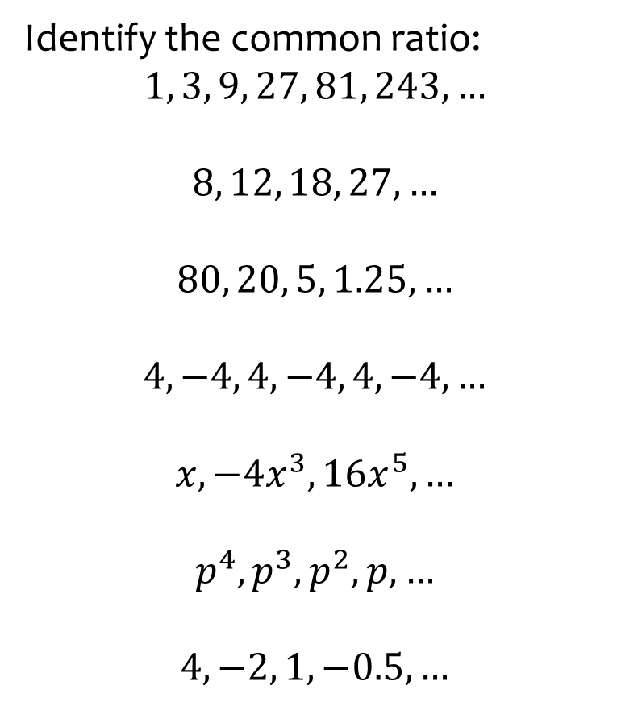

Worked example
Your turn
Identify the common ratio:
$$1, 3, 9, 27, 81, 243, …$$
$$8, 12, 18, 27, …$$
$$80, 20, 5, 1.25, …$$
$$4, −4, 4, −4, 4, −4, …$$
$$x, −4x^{3}, 16x^{5},…$$
$$p^{4}, p^{3}, p^{2}, p, …$$
$$4, −2, 1, −0.5, …$$
Identify the common ratio:
$$1, 2, 4, 8, 16, 32, …$$
$$27, 18, 12, 8, …$$
$$10, 5, 2.5, 1.25, …$$
$$5, −5, 5, −5, 5, −5, …$$
$$x, −2x^{2}, 4x^{3},…$$
$$1, p, p^{2}, p^{3}, …$$
$$4, −1, 0.25, −0.0625, …$$
$$r=2$$
$$r=\frac{2}{3}$$
$$r=\frac{1}{2}$$
$$r=−1$$
$$r=−2x$$
$$r=p$$
$$r=−\frac{1}{4}$$

Slide 3



Worked example
Your turn
Find the n^{th} term of the sequence:
$$3, 6, 12, 24, 48,…$$
$$4, 20, 100, 500, 2500,…$$
Find the n^{th} term of the sequence:
$$2, 6, 18, 54, 162,…$$
$$u_{n}=2×3^{n−1}$$

Slide 4



Worked example
Your turn
Find the 10th term of the sequence:
$$3, 6, 12, 24, 48,…$$
$$4, 20, 100, 500, 2500,…$$
Find the 10th term of the sequence:
$$2, 6, 18, 54, 162,…$$
$$39366$$

Slide 5
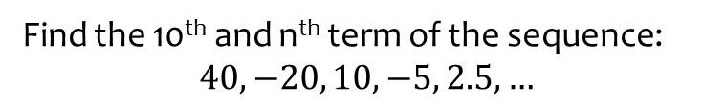

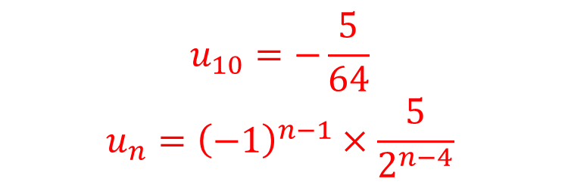
Worked example
Your turn
Find the 10th and n^{th} term of the sequence:
$$80, −20, 5, −1.25, 0.3125,…$$
Find the 10th and n^{th} term of the sequence:
$$40, −20, 10, −5, 2.5, …$$
$$u_{10}=−\frac{5}{64}$$
$$u_{n}={\left(−1\right)}^{n−1}×\frac{5}{2^{n−4}}$$

Slide 6
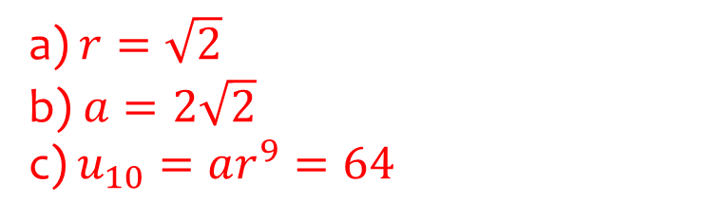
Worked example
Your turn
The second term of a geometric sequence is 6 and the 4th term is 18. The common ratio is positive. Find the exact values of:
The common ratio.
The first term.
The 20th term.
The second term of a geometric sequence is 4 and the 4th term is 8. The common ratio is positive. Find the exact values of:
The common ratio.
The first term.
The 10th term.
a) $r=\sqrt{2}$
b) $a=2\sqrt{2}$
c) $u_{10}=ar^{9}=64$

Slide 7
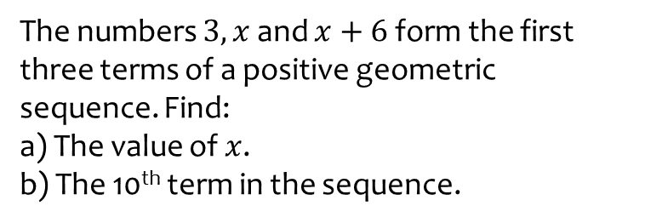
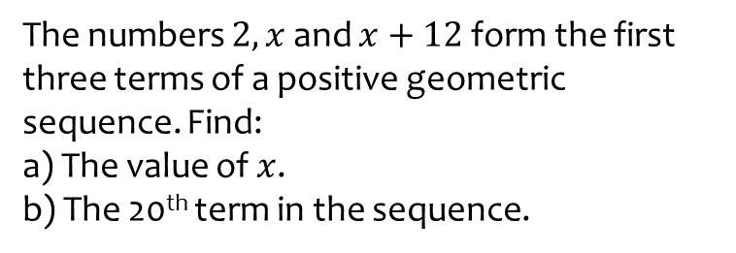
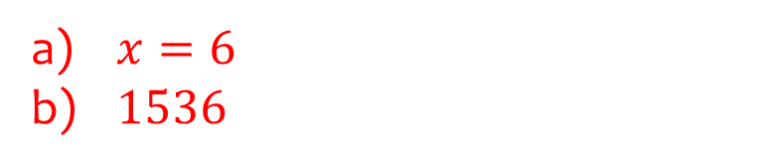
Worked example
Your turn
The numbers $2, x$ and $x+12$ form the first three terms of a positive geometric sequence. Find:
a) The value of $x$.
b) The 20th term in the sequence.
The numbers $3, x$ and $x+6$ form the first three terms of a positive geometric sequence. Find:
a) The value of $x$.
b) The 10th term in the sequence.
$x=6$
$1536$

Slide 8
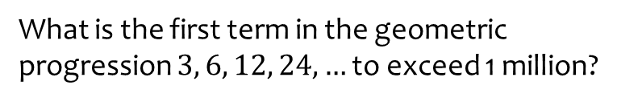
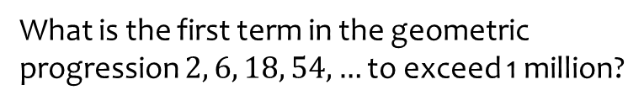

Worked example
Your turn
What is the first term in the geometric progression $2, 6, 18, 54, …$ to exceed 1 million?
What is the first term in the geometric progression $3, 6, 12, 24, …$ to exceed 1 million?
$n=20$ ; $u_{20}=1572864$

Slide 9
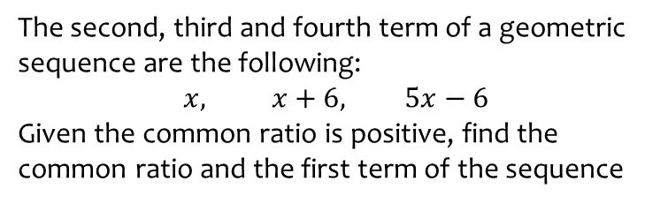
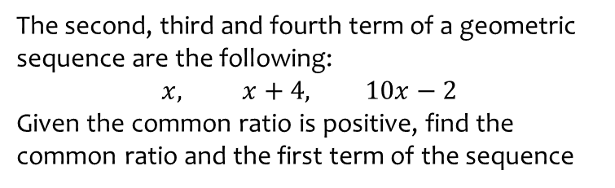

Worked example
Your turn
The second, third and fourth term of a geometric sequence are the following:
$$x, x+4, 10x−2$$
Given the common ratio is positive, find the common ratio and the first term of the sequence
The second, third and fourth term of a geometric sequence are the following:
$$x, x+6, 5x−6$$
Given the common ratio is positive, find the common ratio and the first term of the sequence
$$r=2$$
$$a=3$$

Slide 10
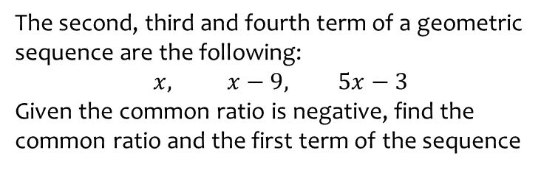
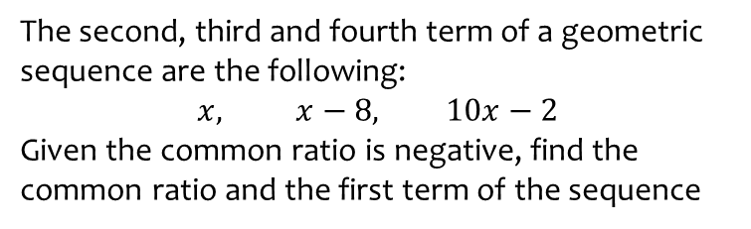

Worked example
Your turn
The second, third and fourth term of a geometric sequence are the following:
$$x, x−8, 10x−2$$
Given the common ratio is negative, find the common ratio and the first term of the sequence
The second, third and fourth term of a geometric sequence are the following:
$$x, x−9, 5x−3$$
Given the common ratio is negative, find the common ratio and the first term of the sequence
$$r=−2$$
$$a=3$$

Slide 11
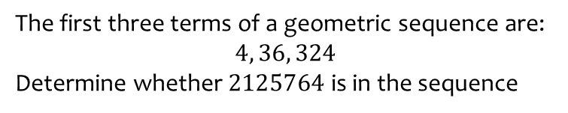
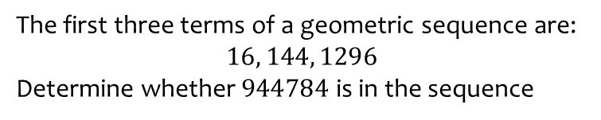
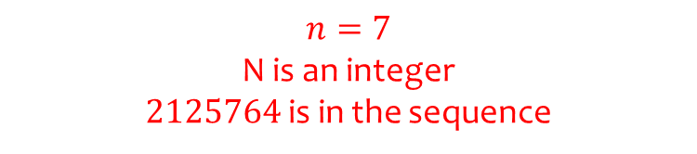
Worked example
Your turn
The first three terms of a geometric sequence are:
$$16, 144, 1296$$
Determine whether $944784$ is in the sequence
The first three terms of a geometric sequence are:
$$4, 36, 324$$
Determine whether $2125764$ is in the sequence
$$n=7$$
N is an integer
$2125764$ is in the sequence

