Slide 1
3.3) The inverse normal distribution function

Slide 2
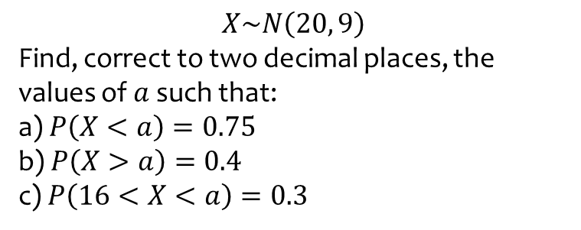
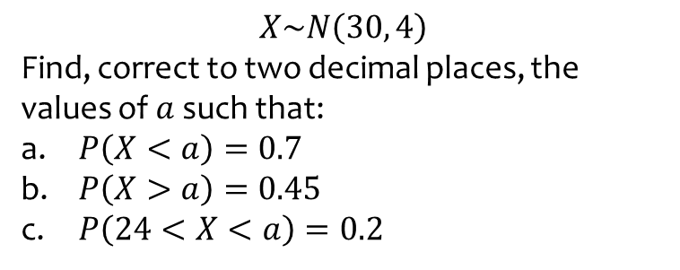
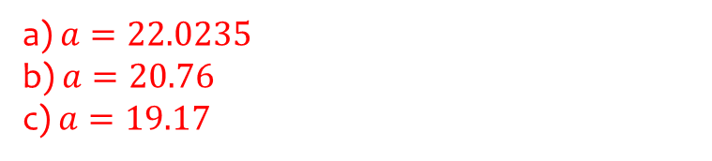
Worked example
Your turn
$$X\sim N\left(30, 4\right)$$
Find, correct to two decimal places, the values of $a$ such that:
$P\left(X<a\right)=0.7$
$P\left(X>a\right)=0.45$
$P\left(24<X<a\right)=0.2$
$$X\sim N\left(20, 9\right)$$
Find, correct to two decimal places, the values of $a$ such that:
a) $P\left(X<a\right)=0.75$
b) $P\left(X>a\right)=0.4$
c) $P\left(16<X<a\right)=0.3$
a) $a=22.0235$
b) $a=20.76$
c) $a=19.17$

Slide 3
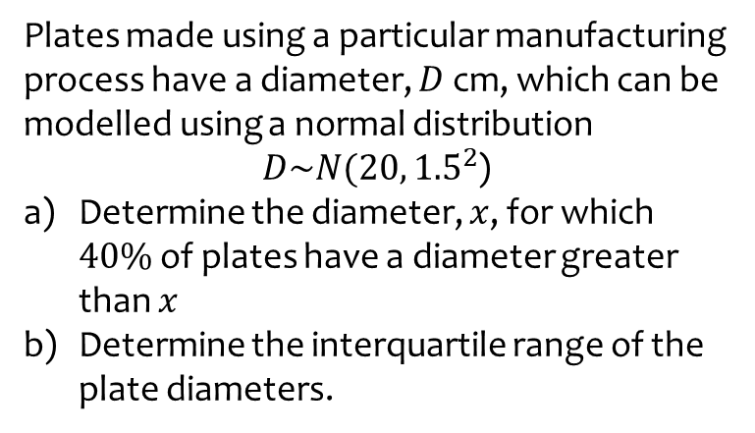
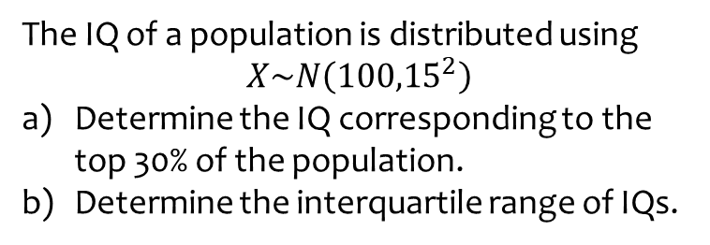
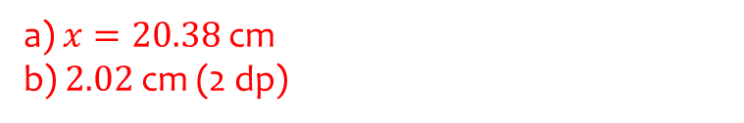
Worked example
Your turn
The IQ of a population is distributed using
$$X\sim N\left({100,15}^{2}\right)$$
Determine the IQ corresponding to the top 30% of the population.
Determine the interquartile range of IQs.
Plates made using a particular manufacturing process have a diameter, $D$ cm, which can be modelled using a normal distribution
$D\sim N(20, {1.5}^{2}$)
Determine the diameter, $x$, for which $40\%$ of plates have a diameter greater than $x$
Determine the interquartile range of the plate diameters.
a) $x=20.38$ cm
b) $2.02$ cm (2 dp)

Slide 4
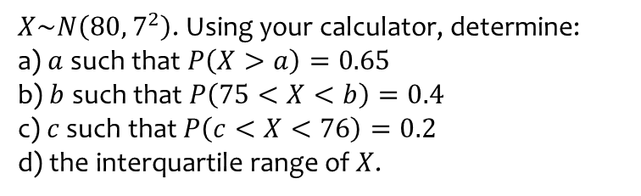
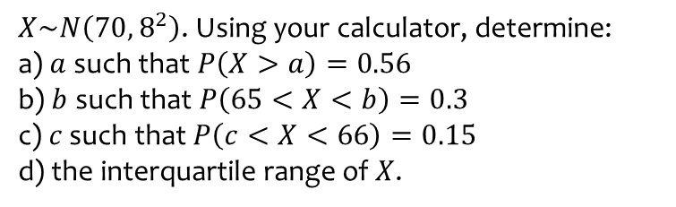
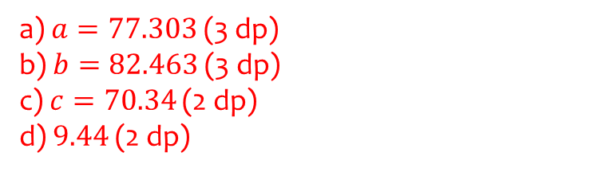
Worked example
Your turn
$X\sim N\left({70, 8}^{2}\right)$. Using your calculator, determine:
a) $a$ such that $P\left(X>a\right)=0.56$
b) $b$ such that $P\left(65<X<b\right)=0.3$
c) $c$ such that $P\left(c<X<66\right)=0.15$
d) the interquartile range of $X$.
$X\sim N\left({80, 7}^{2}\right)$. Using your calculator, determine:
a) $a$ such that $P\left(X>a\right)=0.65$
b) $b$ such that $P\left(75<X<b\right)=0.4$
c) $c$ such that $P\left(c<X<76\right)=0.2$
d) the interquartile range of $X$.
a) $a=77.303$ (3 dp)
b) $b=82.463$ (3 dp)
c) $c=70.34$ (2 dp)
d) $9.44$ (2 dp)

