Slide 1
3.3) Elastic energy

Slide 2

Worked example
Your turn
An elastic string has natural length 1.6m and modulus of elasticity 3N.
Find the energy stored in the string when its length is 1.4m.
An elastic string has natural length 1.4m and modulus of elasticity 6N.
Find the energy stored in the string when its length is 1.6m.
$0.0857 J$ (3 sf)

Slide 3
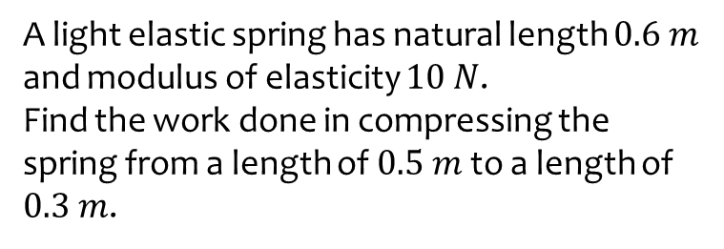
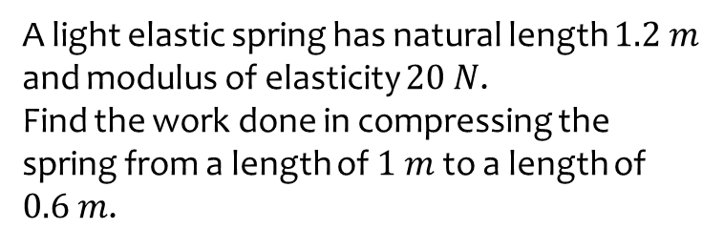

Worked example
Your turn
A light elastic spring has natural length $1.2 m$ and modulus of elasticity $20 N$.
Find the work done in compressing the spring from a length of $1 m$ to a length of $0.6 m$.
A light elastic spring has natural length $0.6 m$ and modulus of elasticity $10 N$.
Find the work done in compressing the spring from a length of $0.5 m$ to a length of $0.3 m$.
$0.667 J$ (3 sf)

