Slide 1
3.3) Cumulative frequency

Slide 2
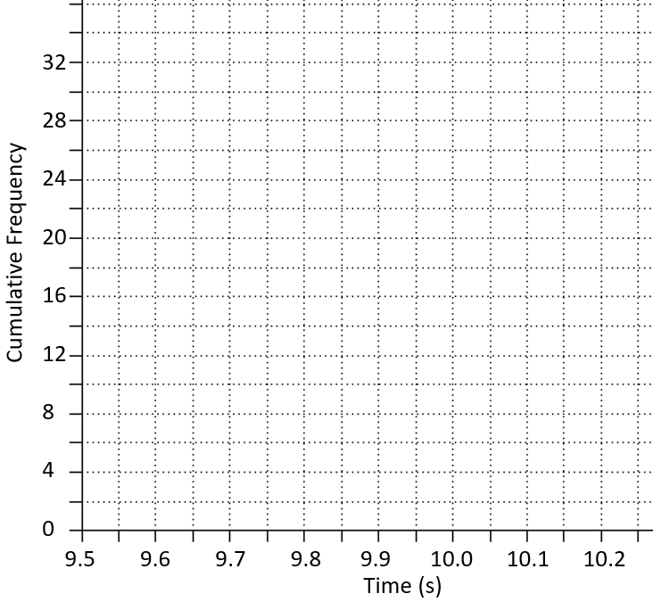
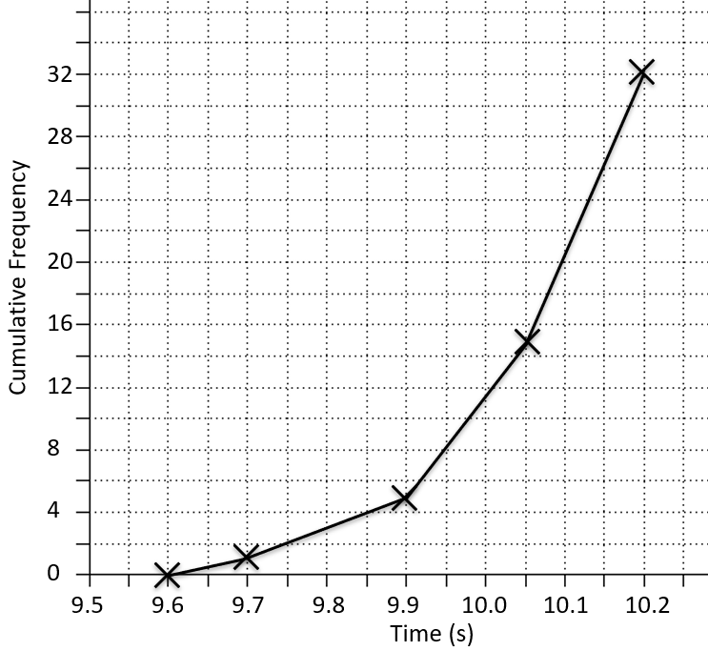
Worked example
Your turn
Draw a cumulative frequency diagram for the data:
Draw a cumulative frequency diagram for the data:
Time (s) | Frequency
$$9.6 < t ≤ 9.8$$ | 3
$$9.8 < t ≤10.05$$ | 7
$$10.05 < t ≤ 10.15$$ | 8
$$10.15 < t ≤ 10.2$$ | 14
Time (s) | Frequency
$$9.6 < t ≤ 9.7$$ | 1
$$9.7 < t ≤ 9.9$$ | 4
$$9.9 < t ≤ 10.05$$ | 10
$$10.05 < t ≤ 10.2$$ | 17
Diagrams/Graphs used with permission from DrFrostMaths: https://www.drfrostmaths.com/

Slide 3
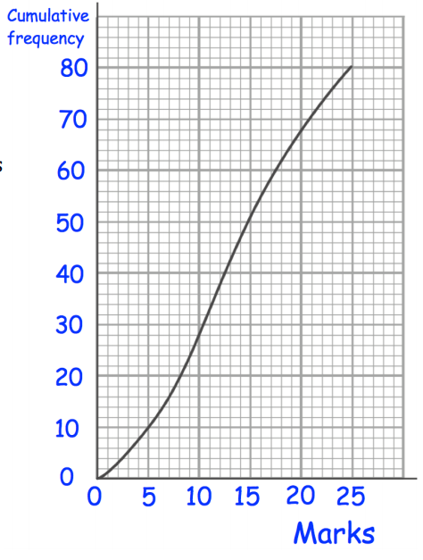
Worked example
Your turn
Use the cumulative frequency diagram to estimate the:
Lower quartile
Median
Upper quartile
60th percentile
Use the cumulative frequency diagram to estimate the:
Lower quartile
Median
Upper quartile
90th percentile
$9.95$ s
$10.07$ s
$10.13$ s
$10.17$ s
Questions used with permission from Corbettmaths (https://corbettmaths.com/) and Drfrostmaths (https://www.drfrostmaths.com/)

Slide 4
Worked example
Your turn
Use the cumulative frequency diagram to estimate the:
Interquartile range
10th – 90th interpercentile range
Use the cumulative frequency diagram to estimate the:
Interquartile range
20th – 80th interpercentile range
$0.18$s
$0.21$ s
Questions used with permission from Corbettmaths (https://corbettmaths.com/) and Drfrostmaths (https://www.drfrostmaths.com/)

Slide 5
Worked example
Your turn
Use the cumulative frequency diagram to estimate the number of students who achieved fewer than $23$ marks.
Use the cumulative frequency diagram to estimate the number of runners who had a time less than $10.15$ seconds.
$$26$$
Questions used with permission from Corbettmaths (https://corbettmaths.com/) and Drfrostmaths (https://www.drfrostmaths.com/)

Slide 6
Worked example
Your turn
Use the cumulative frequency diagram to estimate the number of students who achieved more than $12$ marks.
Use the cumulative frequency diagram to estimate the number of runners who had a time greater than $9.95$ seconds.
$$24$$
Questions used with permission from Corbettmaths (https://corbettmaths.com/) and Drfrostmaths (https://www.drfrostmaths.com/)

Slide 7
Worked example
Your turn
Use the cumulative frequency diagram to estimate the number of students who achieved between $7$ and $21$ marks.
Use the cumulative frequency diagram to estimate the number of runners who had a time between $9.8$ and $10$ seconds.
$$8$$
Questions used with permission from Corbettmaths (https://corbettmaths.com/) and Drfrostmaths (https://www.drfrostmaths.com/)

Slide 8
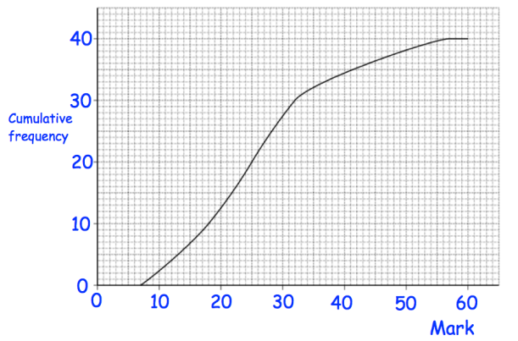
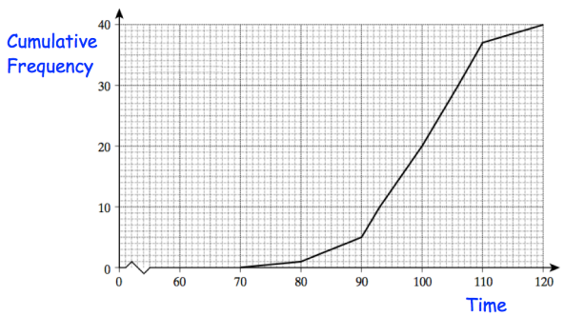
Worked example
Your turn
Use the cumulative frequency diagram to draw a box plot:
Use the cumulative frequency diagram to draw a box plot:
Questions used with permission from Corbettmaths: https://corbettmaths.com/

