Slide 1
3.2) Hooke’s law and dynamics problems

Slide 2
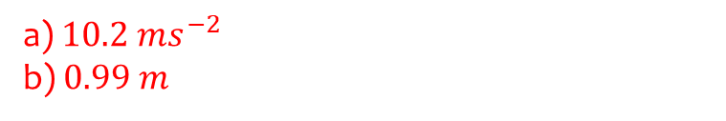
Worked example
Your turn
One end of a light elastic string, of natural length 1m and modulus of elasticity 40N, is attached to a fixed point A.
The other end is attached to a particle of mass 4kg.
The particle is held at a point which is 3m below A and released from rest. Find:
The initial acceleration of the particle
The length of the string when the particle reaches its maximum speed.
One end of a light elastic string, of natural length 0.5m and modulus of elasticity 20N, is attached to a fixed point A.
The other end is attached to a particle of mass 2kg.
The particle is held at a point which is 1.5m below A and released from rest. Find:
The initial acceleration of the particle
The length of the string when the particle reaches its maximum speed.
a) $10.2 ms^{−2}$
b) $0.99 m$

Slide 3
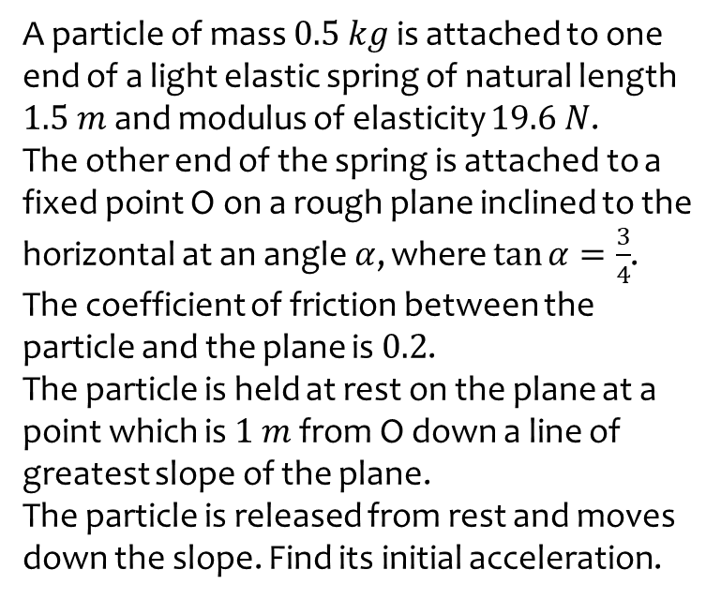
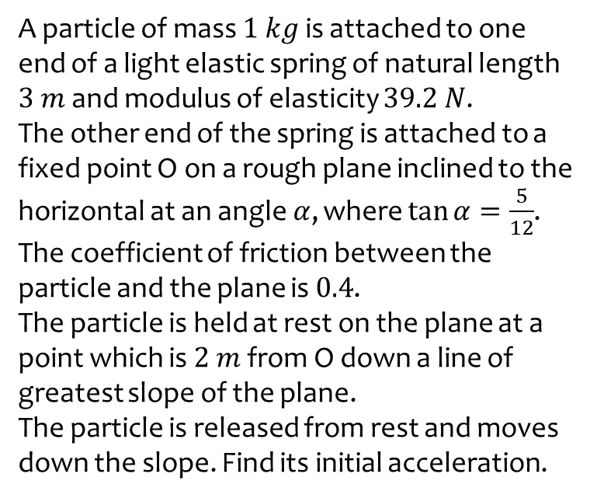

Worked example
Your turn
A particle of mass $1 kg$ is attached to one end of a light elastic spring of natural length $3 m$ and modulus of elasticity $39.2 N$.
The other end of the spring is attached to a fixed point O on a rough plane inclined to the horizontal at an angle $α$, where $\tan{α}=\frac{5}{12}$.
The coefficient of friction between the particle and the plane is $0.4$.
The particle is held at rest on the plane at a point which is $2 m$ from O down a line of greatest slope of the plane.
The particle is released from rest and moves down the slope. Find its initial acceleration.
A particle of mass $0.5 kg$ is attached to one end of a light elastic spring of natural length $1.5 m$ and modulus of elasticity $19.6 N$.
The other end of the spring is attached to a fixed point O on a rough plane inclined to the horizontal at an angle $α$, where $\tan{α}=\frac{3}{4}$.
The coefficient of friction between the particle and the plane is $0.2$.
The particle is held at rest on the plane at a point which is $1 m$ from O down a line of greatest slope of the plane.
The particle is released from rest and moves down the slope. Find its initial acceleration.
$17.4 ms^{−2}$ (3 sf)

Slide 4
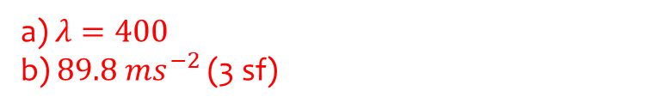
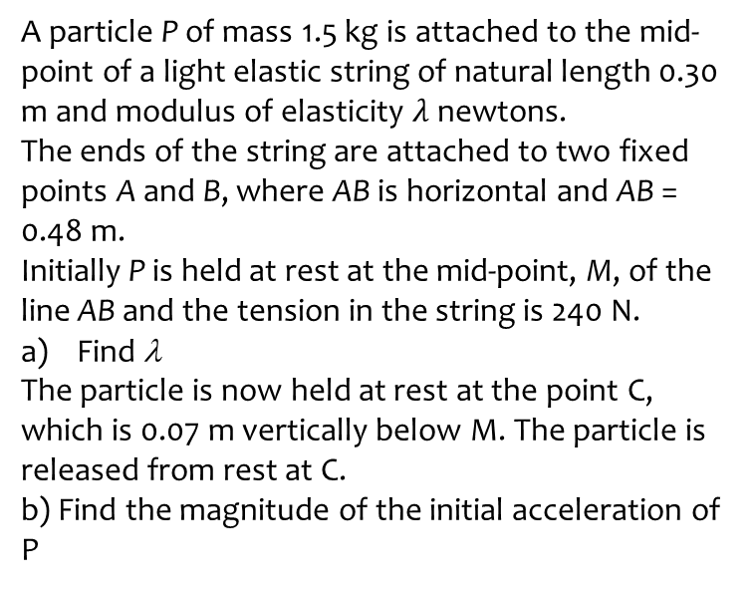
Worked example
Your turn
A particle P of mass 3 kg is attached to the mid-point of a light elastic string of natural length 0.60 m and modulus of elasticity λ newtons.
The ends of the string are attached to two fixed points A and B, where AB is horizontal and AB = 0.96 m.
Initially P is held at rest at the mid-point, M, of the line AB and the tension in the string is 480 N.
Find λ
The particle is now held at rest at the point C, which is 0.14 m vertically below M. The particle is released from rest at C.
b) Find the magnitude of the initial acceleration of P
A particle P of mass 1.5 kg is attached to the mid-point of a light elastic string of natural length 0.30 m and modulus of elasticity $λ$ newtons.
The ends of the string are attached to two fixed points A and B, where AB is horizontal and AB = 0.48 m.
Initially P is held at rest at the mid-point, M, of the line AB and the tension in the string is 240 N.
Find λ
The particle is now held at rest at the point C, which is 0.07 m vertically below M. The particle is released from rest at C.
b) Find the magnitude of the initial acceleration of P
a) $λ=400$
b) $89.8 ms^{−2}$ (3 sf)

