Slide 1
3.2) Finding probabilities for normal distributions

Slide 2
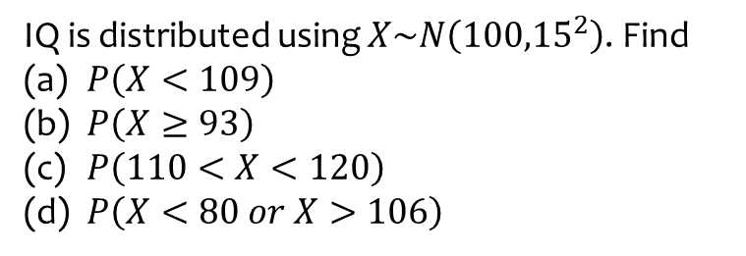
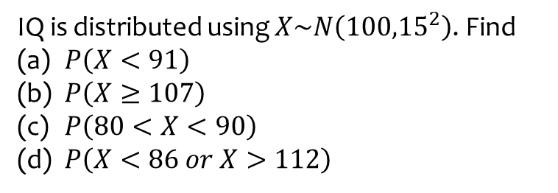
Worked example
Your turn
IQ is distributed using $X\sim N\left({100,15}^{2}\right)$. Find
$P\left(X<91\right)$
$P\left(X≥107\right)$
$P\left(80<X<90\right)$
$P\left(X<86 or X>112\right)$
IQ is distributed using $X\sim N\left({100,15}^{2}\right)$. Find
$P\left(X<109\right)$
$P\left(X≥93\right)$
$P\left(110<X<120\right)$
$P\left(X<80 or X>106\right)$
a) $0.7257$(4 dp)
b) $0.6796$ (4 dp)
c) $0.1613$ (4 dp)
d) $0.4358$ (4 dp)

Slide 3
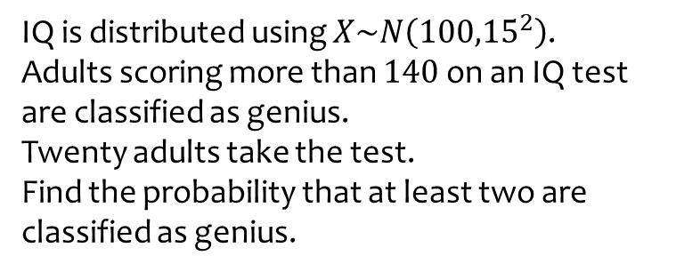
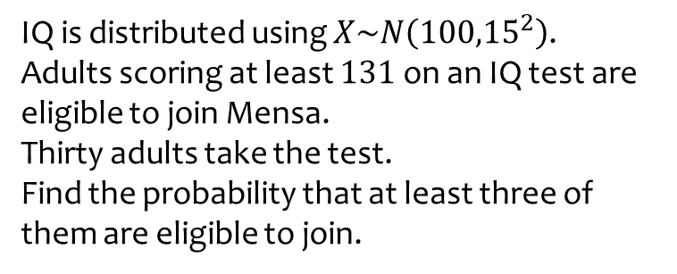
Worked example
Your turn
IQ is distributed using $X\sim N\left({100,15}^{2}\right)$.
Adults scoring at least $131$ on an IQ test are eligible to join Mensa.
Thirty adults take the test.
Find the probability that at least three of them are eligible to join.
IQ is distributed using $X\sim N\left({100,15}^{2}\right)$.
Adults scoring more than $140$ on an IQ test are classified as genius.
Twenty adults take the test.
Find the probability that at least two are classified as genius.
$0.00266$ (3 sf)

