Slide 1
3.2) Box plots

Slide 2
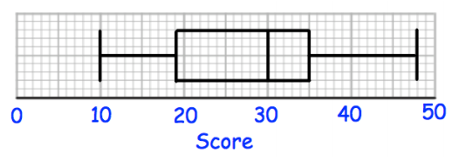
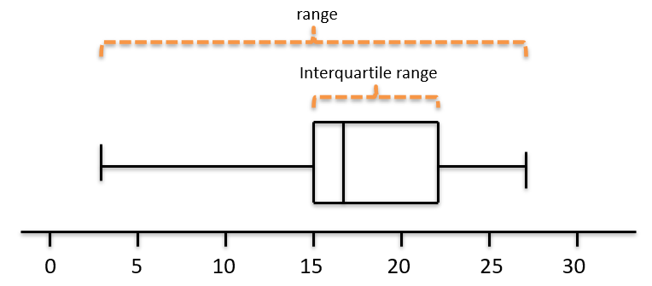
Worked example
Your turn
Using the box plot, write down:
The minimum
The lower quartile
The median
The upper quartile
The maximum
The range
The interquartile range
Using the box plot, write down:
The minimum
The lower quartile
The median
The upper quartile
The maximum
The range
The interquartile range
$$3$$
$$15$$
$$17$$
$$22$$
$$27$$
$$24$$
$$7$$
Questions used with permission from Corbettmaths (https://corbettmaths.com/) and Drfrostmaths (https://www.drfrostmaths.com/)

Slide 3
Worked example
Your turn
Sketch a box plot given the following data:
Sketch a box plot given the following data:
Minimum | Lower Quartile | Median | Upper Quartile | Maximum
2 | 11 | 18 | 20 | 29
Minimum | Lower Quartile | Median | Upper Quartile | Maximum
3 | 15 | 17 | 22 | 27
Diagrams/Graphs used with permission from DrFrostMaths: https://www.drfrostmaths.com/

Slide 4
Worked example
Your turn
An outlier is an observation that falls either $1.5×$interquartile range above the upper quartile or
$1.5×$interquartile range below the lower quartile.
Sketch a box plot for this data, marking any outliers.
An outlier is an observation that falls either $1.5×$interquartile range above the upper quartile or
$1.5×$interquartile range below the lower quartile.
Sketch a box plot for this data, marking the outlier boundaries
Smallest values | Largest values | Lower quartile | Median | Upper quartile
0, 4 | 22, 26 | 9 | 11 | 15
Smallest values | Largest values | Lower quartile | Median | Upper quartile
0, 3 | 21, 27 | 8 | 10 | 14
or
Diagrams/Graphs used with permission from DrFrostMaths: https://www.drfrostmaths.com/

Slide 5
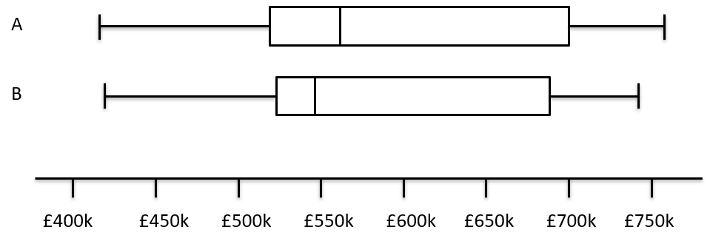
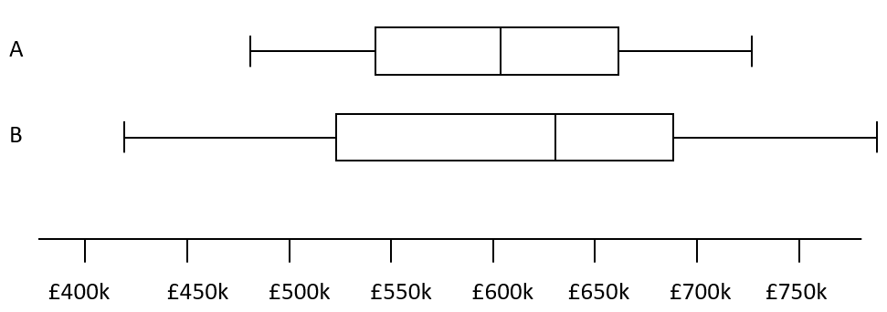
Worked example
Your turn
Compare the house prices of locations A and B
Compare the house prices of locations A and B
The interquartile range of house prices in B is greater than A.
The range of house prices in B is greater than A.
The median house price in Kingston was greater than that in Croydon
Diagrams/Graphs used with permission from DrFrostMaths: https://www.drfrostmaths.com/

