Slide 1
3.2) Arithmetic series

Slide 2
Worked example
Your turn
Find the sum of the first $50$ terms the sequence which begins:
$$7, 10, 13, 16,…$$
Find the sum of the first $80$ terms the sequence which begins:
$$2, 6, 10, 14, …$$
$$12800$$

Slide 3
Worked example
Your turn
Find the sum of the first $50$ terms the sequence which begins:
$$10, 7, 4, 1, −2, …$$
Find the sum of the first $80$ terms the sequence which begins:
$$18, 14, 10, 6, 2, …$$
$$−11200$$

Slide 4
Worked example
Your turn
Find the sum of the first $50$ terms the sequence which begins:
$$p, 3p, 5p, 7p, 9p, …$$
Find the sum of the first $80$ terms the sequence which begins:
$$k, 4k, 7k, 10k, 13k, …$$
$$9560k$$

Slide 5
Worked example
Your turn
Find the least number of terms for the sum of $6+11+16+…$ to exceed 2000.
Find the least number of terms for the sum of $4+9+14+…$ to exceed 2000.
$$28$$

Slide 6
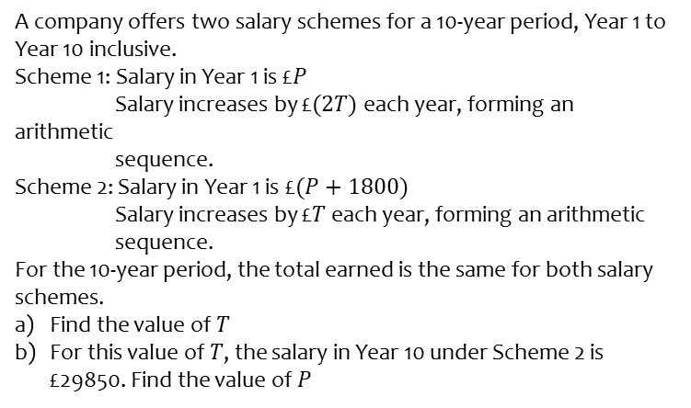
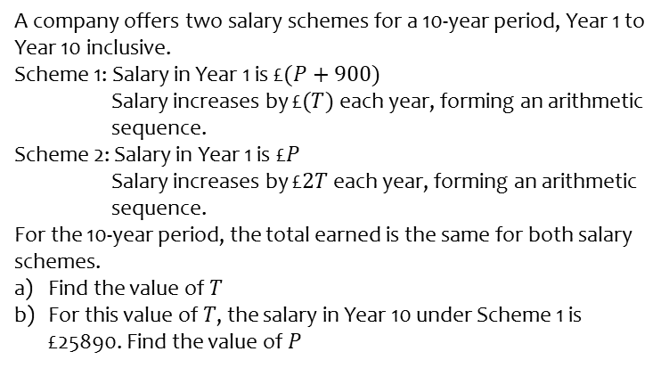
Worked example
Your turn
A company offers two salary schemes for a 10-year period, Year 1 to Year 10 inclusive.
Scheme 1: Salary in Year 1 is £$(P+900)$
Salary increases by £$(T)$ each year, forming an arithmetic
sequence.
Scheme 2: Salary in Year 1 is £$P$
Salary increases by £$2T$ each year, forming an arithmetic
sequence.
For the 10-year period, the total earned is the same for both salary schemes.
Find the value of $T$
For this value of $T$, the salary in Year 10 under Scheme 1 is £25890. Find the value of $P$
A company offers two salary schemes for a 10-year period, Year 1 to Year 10 inclusive.
Scheme 1: Salary in Year 1 is £$P$
Salary increases by £$(2T)$ each year, forming an arithmetic
sequence.
Scheme 2: Salary in Year 1 is £$(P+1800)$
Salary increases by £$T$ each year, forming an arithmetic
sequence.
For the 10-year period, the total earned is the same for both salary schemes.
Find the value of $T$
For this value of $T$, the salary in Year 10 under Scheme 2 is £29850. Find the value of $P$
$T=400$
$P=24450$

Slide 7
Worked example
Your turn
Prove that the sum of the first 200 natural numbers is 20100
Prove that the sum of the first 100 natural numbers is 5050
Proof

Slide 8
Worked example
Your turn
Find the sum of the first 50 odd numbers
Find the sum of the first 50 even numbers
$$2550$$

Slide 9
Worked example
Your turn
Prove that the sum of the first $n$ even numbers is $n^{2}+n$
Prove that the sum of the first $n$ odd numbers is $n^{2}$
Proof

Slide 10
Worked example
Your turn
An arithmetic series is given by $\left(k+1\right)+\left(2k+5\right)+\left(3k+9\right)+…+217$
Given that the sum of the series is $2250$, find the value of $k$
An arithmetic series is given by $\left(k+1\right)+\left(2k+3\right)+\left(3k+5\right)+…+303$
Given that the sum of the series is $2568$, find the value of $k$
$$k=17$$

Slide 11
Worked example
Your turn
The common difference of an arithmetic sequence is $4$. The sum of the first $60$ terms of this sequence is $7380$. Find the first term.
The common difference of an arithmetic sequence is $5$. The sum of the first $40$ terms of this sequence is $4020$. Find the first term.
$$3$$

Slide 12
Worked example
Your turn
The common difference of an arithmetic sequence is $4$. The sum of the first $60$ terms of this sequence is $−240$. Find the first term.
The common difference of an arithmetic sequence is $5$. The sum of the first $40$ terms of this sequence is $2620$. Find the first term.
$$−32$$

Slide 13
Worked example
Your turn
The first term of an arithmetic sequence is $3$. The sum of the first $50$ terms is $2600$. Work out the common difference of the sequence.
The first term of an arithmetic sequence is $4$. The sum of the first $40$ terms is $2500$. Work out the common difference of the sequence.
$$3$$

Slide 14
Worked example
Your turn
The eighth term of an arithmetic sequence is $11$. The fifth term of the same arithmetic sequence is $2$. Find the sum of the first $50$ terms of this arithmetic sequence.
The tenth term of an arithmetic sequence is $35$. The fourth term of the same arithmetic sequence is $17$. Find the sum of the first $50$ terms of this arithmetic sequence.
$$4075$$

