Slide 1
3.1) The normal distribution

Slide 2
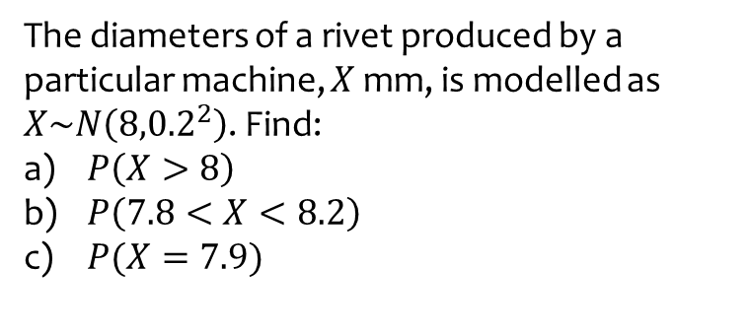
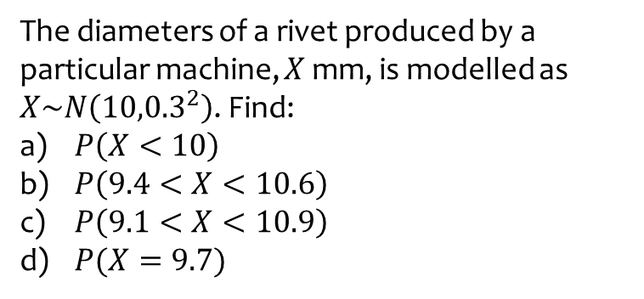
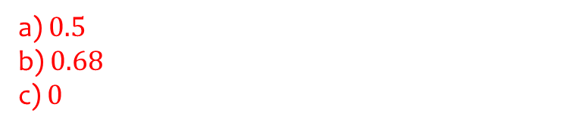
Worked example
Your turn
The diameters of a rivet produced by a particular machine, $X$ mm, is modelled as $X\sim N\left({10,0.3}^{2}\right)$. Find:
$P\left(X<10\right)$
$P\left(9.4<X<10.6\right)$
$P\left(9.1<X<10.9\right)$
$P(X=9.7)$
The diameters of a rivet produced by a particular machine, $X$ mm, is modelled as $X\sim N\left({8,0.2}^{2}\right)$. Find:
$P\left(X>8\right)$
$P\left(7.8<X<8.2\right)$
$P(X=7.9)$
a) $0.5$
b) $0.68$
c) $0$

Slide 3
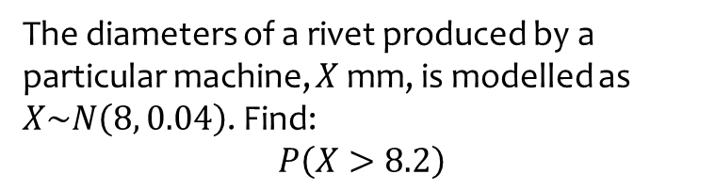
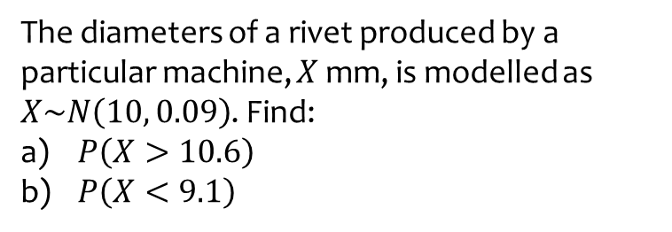
Worked example
Your turn
The diameters of a rivet produced by a particular machine, $X$ mm, is modelled as $X\sim N\left(10, 0.09\right)$. Find:
$P\left(X>10.6\right)$
$P\left(X<9.1\right)$
The diameters of a rivet produced by a particular machine, $X$ mm, is modelled as $X\sim N\left(8, 0.04\right)$. Find:
$$P\left(X>8.2\right)$$
$$0.16$$

Slide 4
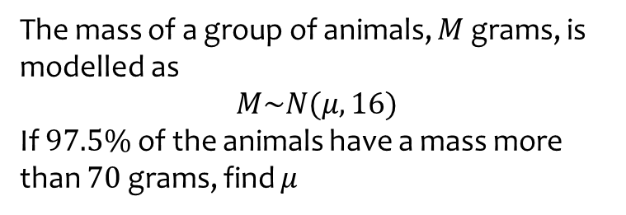
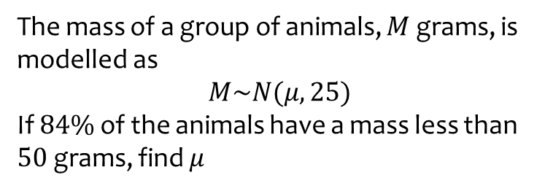
Worked example
Your turn
The mass of a group of animals, $M$ grams, is modelled as
$$M\sim N(μ, 25)$$
If $84\%$ of the animals have a mass less than $50$ grams, find $μ$
The mass of a group of animals, $M$ grams, is modelled as
$$M\sim N(μ, 16)$$
If $97.5\%$ of the animals have a mass more than $70$ grams, find $μ$
$$78$$

Slide 5
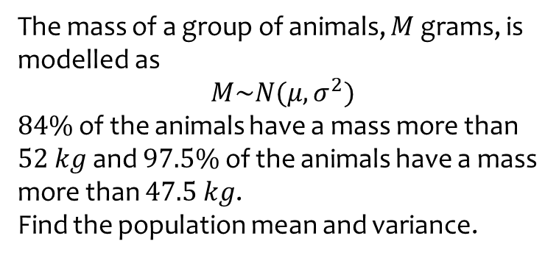
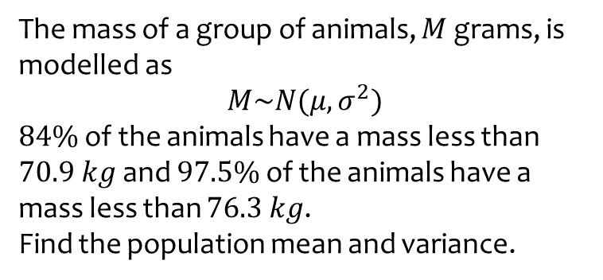

Worked example
Your turn
The mass of a group of animals, $M$ grams, is modelled as
$$M\sim N(μ, σ^{2})$$
$84\%$ of the animals have a mass less than $70.9 kg$ and $97.5\%$ of the animals have a mass less than $76.3 kg$.
Find the population mean and variance.
The mass of a group of animals, $M$ grams, is modelled as
$$M\sim N(μ, σ^{2})$$
$84\%$ of the animals have a mass more than $52 kg$ and $97.5\%$ of the animals have a mass more than $47.5 kg$.
Find the population mean and variance.
$$μ=56.5 kg$$
$$σ^{2}=20.25$$

