Slide 1
3.1) Linear simultaneous equations

Slide 2
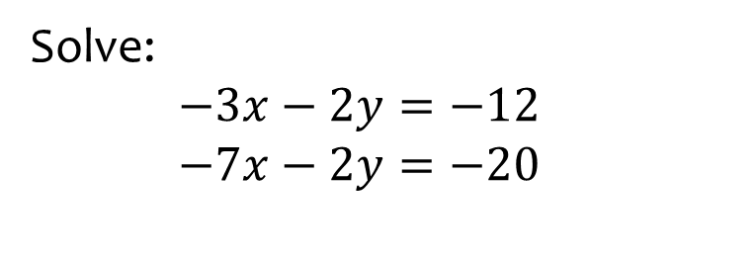

Worked example
Your turn
Solve:
$$−5x−2y=−26$$
$$−5x−4y=−32$$
$$−2x−3y=−17$$
$$−5x−3y=−20$$
Solve:
$−3x−2y=−12$
$−7x−2y=−20$
$$x=2, y=3$$

Slide 3
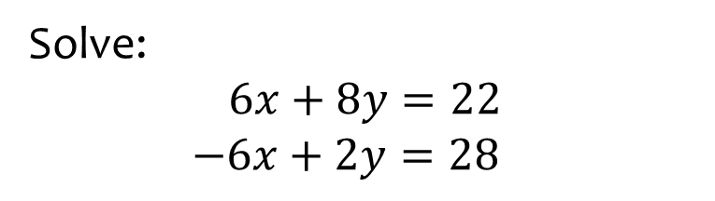

Worked example
Your turn
Solve:
$$5x+4y=23$$
$−5x+2y=19$
$$5x+3y=23$$
$2x−3y=5$
Solve:
$$6x+8y=22$$
$−6x+2y=28$
$$x=−3 , y=5$$

Slide 4
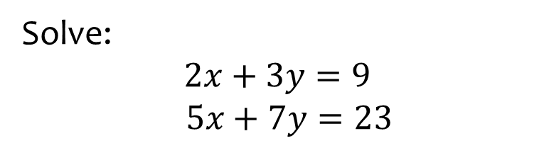

Worked example
Your turn
Solve:
$$2x+3y=11$$
$$3x+y=13$$
$$3x+2y=9$$
$$5x+7y=4$$
Solve:
$$2x+3y=9$$
$$5x+7y=23$$
$$x=6 , y=−1$$

Slide 5
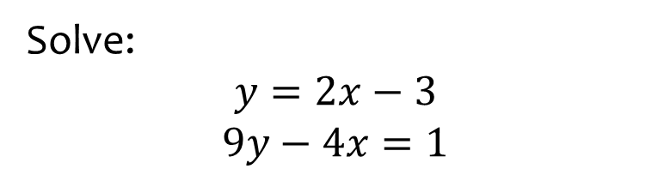
Worked example
Your turn
Solve:
$$y=4x−9$$
$$5y−3x=23$$
Solve:
$$y=2x−3$$
$$9y−4x=1$$
$$x=2, y=1$$

Slide 6
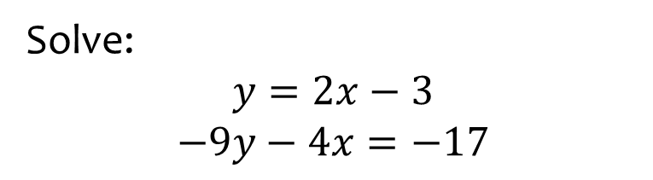
Worked example
Your turn
Solve:
$$y=4x−9$$
$$−5y−3x=−1$$
Solve:
$$y=2x−3$$
$$−9y−4x=−17$$
$$x=2, y=1$$

