Slide 1
3.1) Outliers

Slide 2
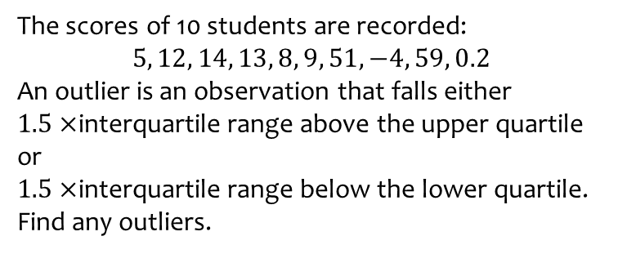
Worked example
Your turn
The scores of 10 students are recorded:
$$1, 8, 10, 9, −7, 21, 11, 10, 35, 0.3$$
An outlier is an observation that falls either $1.5×$interquartile range above the upper quartile or
$1.5×$interquartile range below the lower quartile.
Find any outliers.
The scores of 10 students are recorded:
$$5, 12, 14, 13, 8, 9, 51, −4, 59, 0.2$$
An outlier is an observation that falls either $1.5×$interquartile range above the upper quartile or
$1.5×$interquartile range below the lower quartile.
Find any outliers.
$$−4, 51, 59$$

Slide 3
Worked example
Your turn
The scores of 10 students are recorded:
$$1, 8, 10, 9, −7, 21, 11, 10, 35, 0.3$$
An outlier is an observation that falls outside $±2$ standard deviations from the mean.
Find any outliers.
The scores of 10 students are recorded:
$$5, 12, 14, 13, 8, 9, 51, −4, 59, 0.2$$
An outlier is an observation that falls either $1.5×$interquartile range above the upper quartile or
$1.5×$interquartile range below the lower quartile.
Find any outliers.
$$59$$

Slide 4
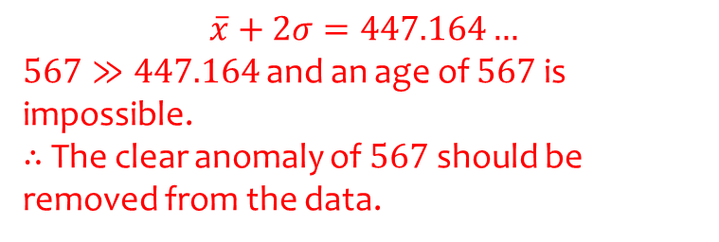
Worked example
Your turn
Clean this data on ages of people in a group:
$$12, 13, 14, 12, 13, 156$$
Clean this data on ages of people in a group:
$$5, 7, 6, 5, 5, 567, 7, 6$$
$$\overline{x}+2σ=447.164…$$
$567≫447.164$ and an age of $567$ is impossible.
$∴$ The clear anomaly of $567$ should be removed from the data.

