Slide 1
3.1) Hooke’s law and equilibrium problems

Slide 2

Worked example
Your turn
An elastic string of natural length 4m and modulus of elasticity 58.8N has one end fixed. A particle of mass 2kg is attached to the other end and hangs at rest. Find the extension of the string.
An elastic string of natural length 2m and modulus of elasticity 29.4N has one end fixed. A particle of mass 4kg is attached to the other end and hangs at rest. Find the extension of the string.
$2.67 m$ (3 sf)

Slide 3
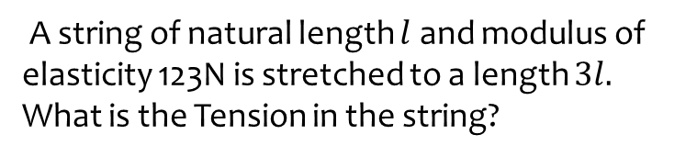
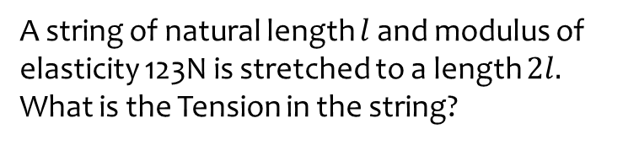
Worked example
Your turn
A string of natural length $l$ and modulus of elasticity 123N is stretched to a length $2l.$
What is the Tension in the string?
A string of natural length $l$ and modulus of elasticity 123N is stretched to a length $3l.$
What is the Tension in the string?
$$246 N$$

Slide 4
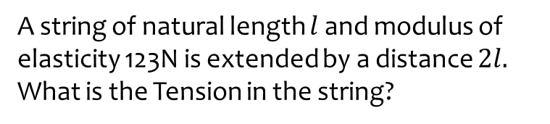
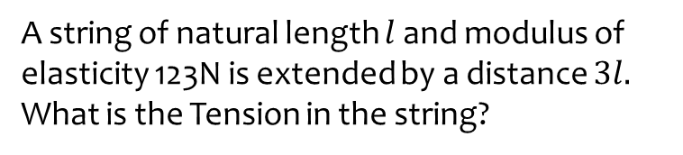
Worked example
Your turn
A string of natural length $l$ and modulus of elasticity 123N is extended by a distance $3l.$
What is the Tension in the string?
A string of natural length $l$ and modulus of elasticity 123N is extended by a distance $2l.$
What is the Tension in the string?
$$246 N$$

Slide 5
Worked example
Your turn
A spring of natural length 3m is stretched to a length of 12m by applying a force to both ends of 99N.
What is the modulus of elasticity of the spring?
A spring of natural length 3m is stretched to a length of 6m by applying a force to both ends of 99N.
What is the modulus of elasticity of the spring?
$$99 N$$

Slide 6

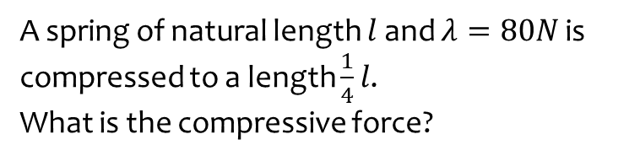

Worked example
Your turn
A spring of natural length $l$and $λ=80N$ is compressed to a length $\frac{1}{4}l$.
What is the compressive force?
A spring of natural length $l$and $λ=40N$ is compressed to a length $\frac{3}{4}l$.
What is the compressive force?
A string of natural length $l$and $λ=40N$ is compressed by a force of 10N. What is $x$?
$$10 N$$
Unknown – strings collapse under compression

Slide 7
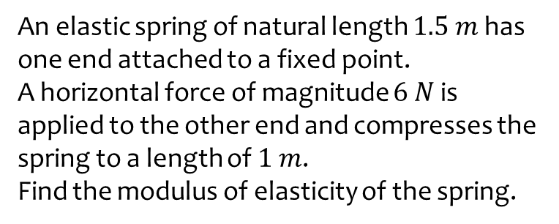
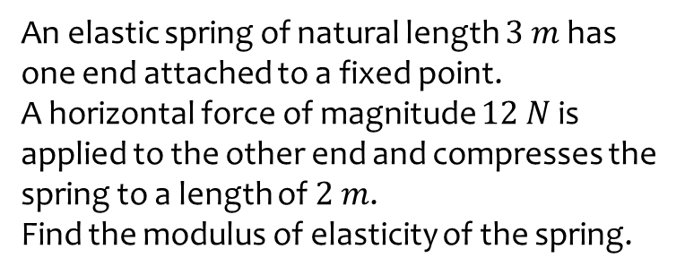
Worked example
Your turn
An elastic spring of natural length $3 m$ has one end attached to a fixed point.
A horizontal force of magnitude $12 N$ is applied to the other end and compresses the spring to a length of $2 m$.
Find the modulus of elasticity of the spring.
An elastic spring of natural length $1.5 m$ has one end attached to a fixed point.
A horizontal force of magnitude $6 N$ is applied to the other end and compresses the spring to a length of $1 m$.
Find the modulus of elasticity of the spring.
$$18 N$$

Slide 8

Worked example
Your turn
The elastic springs PQ and QR are joined together at Q to form one long spring.
The spring PQ has natural length 3.2 m and modulus of elasticity 40 N.
The spring QR has natural length 2.8 m and modulus of elasticity 56 N.
The ends P and R, of the long string are attached to two fixed points which are 8 m apart on the same horizontal plane.
[Assume Q is at rest and in equilibrium].
Find the Tension in the combined spring.
The elastic springs PQ and QR are joined together at Q to form one long spring.
The spring PQ has natural length 1.6 m and modulus of elasticity 20 N.
The spring QR has natural length 1.4 m and modulus of elasticity 28 N.
The ends P and R, of the long string are attached to two fixed points which are 4 m apart on the same horizontal plane.
[Assume Q is at rest and in equilibrium].
Find the Tension in the combined spring.
$7.69 N$ (3 sf)

Slide 9
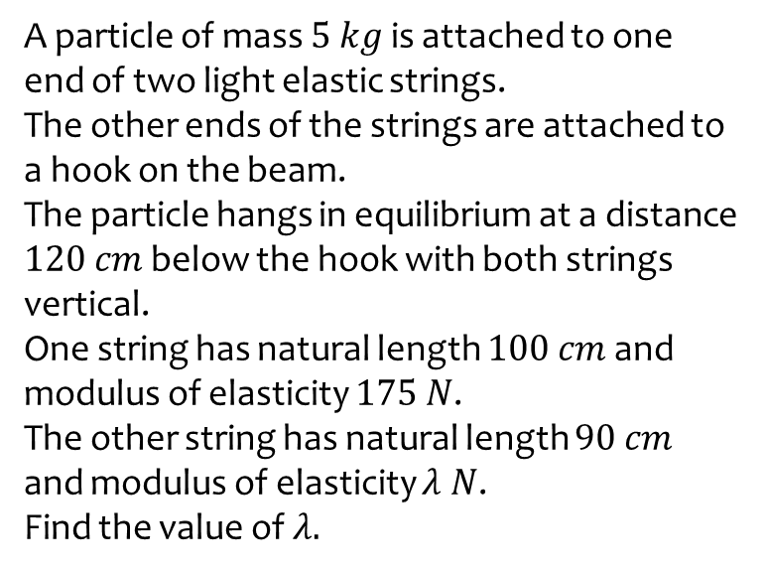
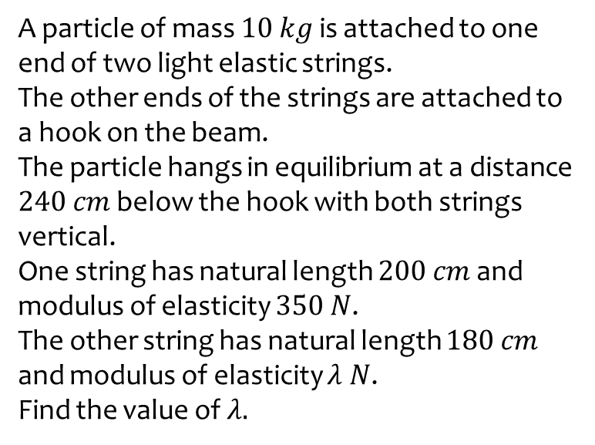
Worked example
Your turn
A particle of mass $10 kg$ is attached to one end of two light elastic strings.
The other ends of the strings are attached to a hook on the beam.
The particle hangs in equilibrium at a distance $240 cm$ below the hook with both strings vertical.
One string has natural length $200 cm$ and modulus of elasticity $350 N$.
The other string has natural length $180 cm$ and modulus of elasticity $λ N$.
Find the value of $λ.$
A particle of mass $5 kg$ is attached to one end of two light elastic strings.
The other ends of the strings are attached to a hook on the beam.
The particle hangs in equilibrium at a distance $120 cm$ below the hook with both strings vertical.
One string has natural length $100 cm$ and modulus of elasticity $175 N$.
The other string has natural length $90 cm$ and modulus of elasticity $λ N$.
Find the value of $λ.$
$$λ=42$$

Slide 10
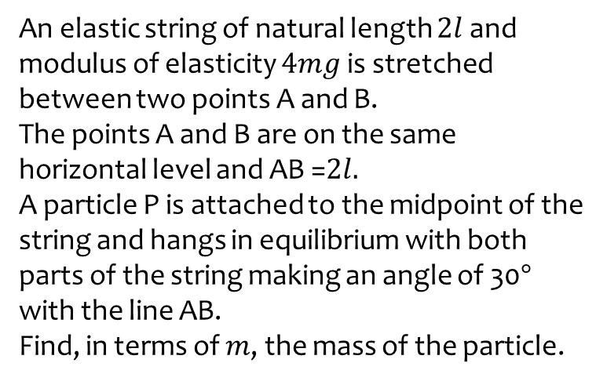
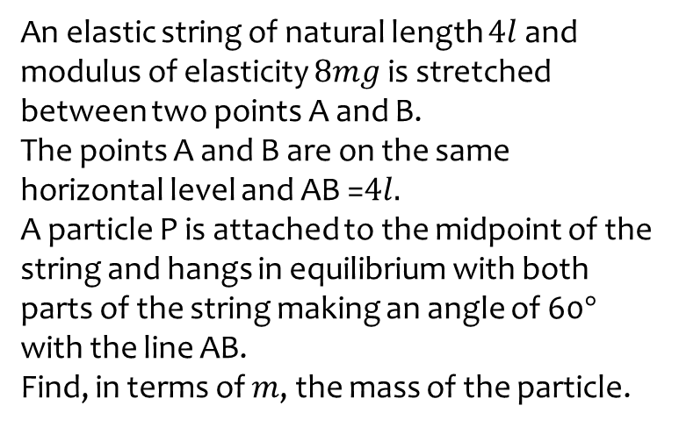

Worked example
Your turn
An elastic string of natural length $4l$ and modulus of elasticity $8mg$ is stretched between two points A and B.
The points A and B are on the same horizontal level and AB =$4l.$
A particle P is attached to the midpoint of the string and hangs in equilibrium with both parts of the string making an angle of 60$°$ with the line AB.
Find, in terms of $m$, the mass of the particle.
An elastic string of natural length $2l$ and modulus of elasticity $4mg$ is stretched between two points A and B.
The points A and B are on the same horizontal level and AB =$2l.$
A particle P is attached to the midpoint of the string and hangs in equilibrium with both parts of the string making an angle of 30$°$ with the line AB.
Find, in terms of $m$, the mass of the particle.
$0.619m$ kg (3 sf)

Slide 11
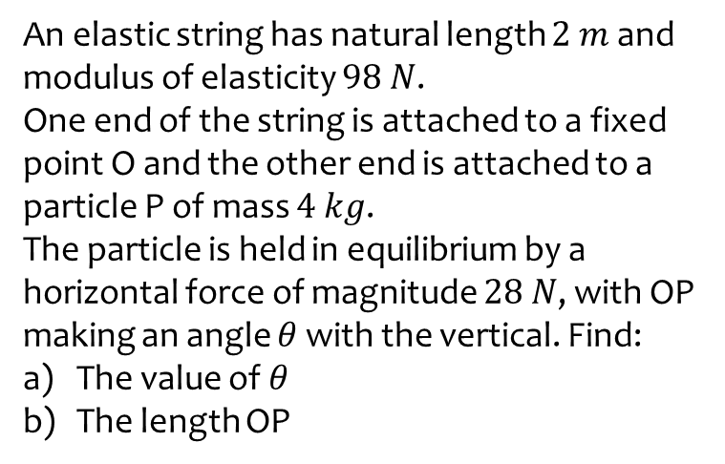
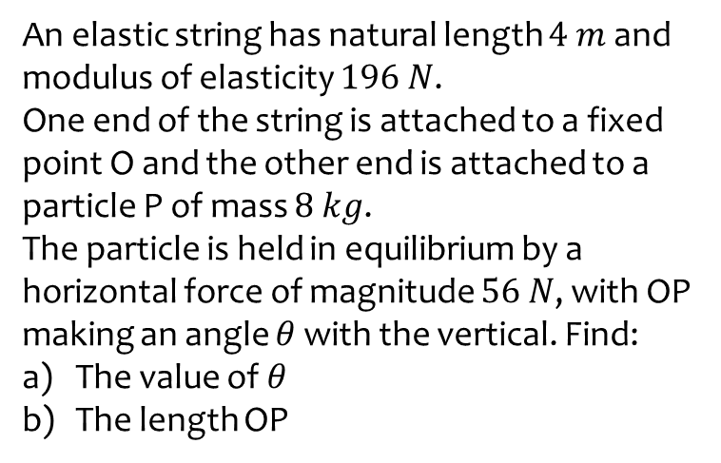
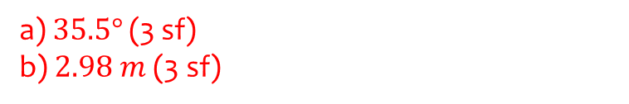
Worked example
Your turn
An elastic string has natural length $4 m$ and modulus of elasticity $196 N$.
One end of the string is attached to a fixed point O and the other end is attached to a particle P of mass $8 kg$.
The particle is held in equilibrium by a horizontal force of magnitude $56 N$, with OP making an angle $θ$ with the vertical. Find:
The value of $θ$
The length OP
An elastic string has natural length $2 m$ and modulus of elasticity $98 N$.
One end of the string is attached to a fixed point O and the other end is attached to a particle P of mass $4 kg$.
The particle is held in equilibrium by a horizontal force of magnitude $28 N$, with OP making an angle $θ$ with the vertical. Find:
The value of $θ$
The length OP
a) $35.5°$ (3 sf)
b) $2.98 m$ (3 sf)

Slide 12
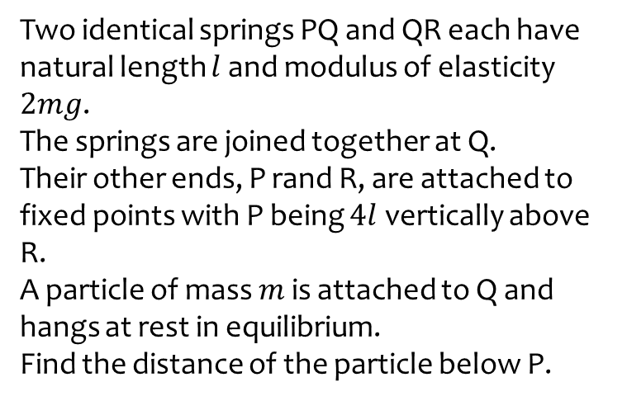
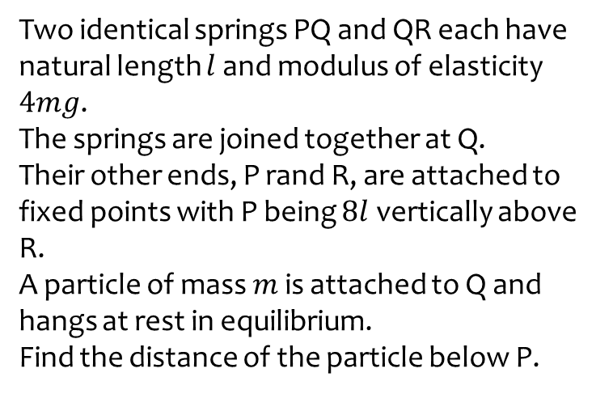

Worked example
Your turn
Two identical springs PQ and QR each have natural length $l$ and modulus of elasticity $4mg$.
The springs are joined together at Q.
Their other ends, P rand R, are attached to fixed points with P being $8l$ vertically above R.
A particle of mass $m$ is attached to Q and hangs at rest in equilibrium.
Find the distance of the particle below P.
Two identical springs PQ and QR each have natural length $l$ and modulus of elasticity $2mg$.
The springs are joined together at Q.
Their other ends, P rand R, are attached to fixed points with P being $4l$ vertically above R.
A particle of mass $m$ is attached to Q and hangs at rest in equilibrium.
Find the distance of the particle below P.
$$\frac{9l}{4}$$

Slide 13
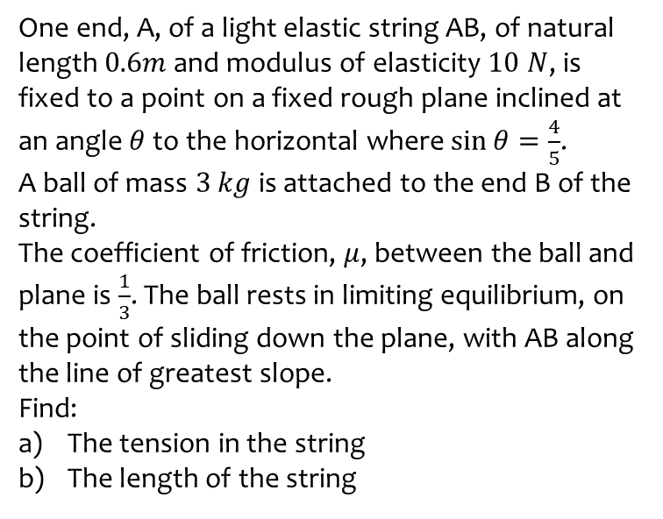
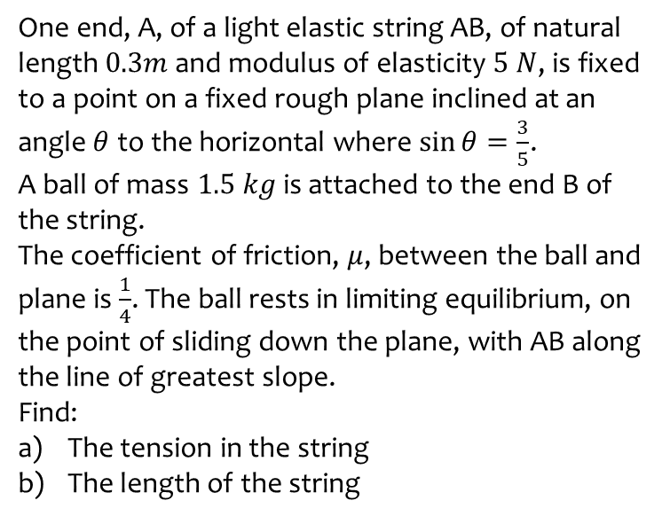
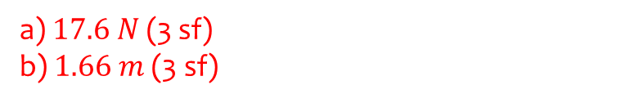
Worked example
Your turn
One end, A, of a light elastic string AB, of natural length $0.3m$ and modulus of elasticity $5 N$, is fixed to a point on a fixed rough plane inclined at an angle $θ$ to the horizontal where $\sin{θ}=\frac{3}{5}$.
A ball of mass $1.5 kg$ is attached to the end B of the string.
The coefficient of friction, $μ$, between the ball and plane is $\frac{1}{4}$. The ball rests in limiting equilibrium, on the point of sliding down the plane, with AB along the line of greatest slope.
Find:
The tension in the string
The length of the string
One end, A, of a light elastic string AB, of natural length $0.6m$ and modulus of elasticity $10 N$, is fixed to a point on a fixed rough plane inclined at an angle $θ$ to the horizontal where $\sin{θ}=\frac{4}{5}$.
A ball of mass $3 kg$ is attached to the end B of the string.
The coefficient of friction, $μ$, between the ball and plane is $\frac{1}{3}$. The ball rests in limiting equilibrium, on the point of sliding down the plane, with AB along the line of greatest slope.
Find:
The tension in the string
The length of the string
a) $17.6 N$ (3 sf)
b) $1.66 m$ (3 sf)

Slide 14
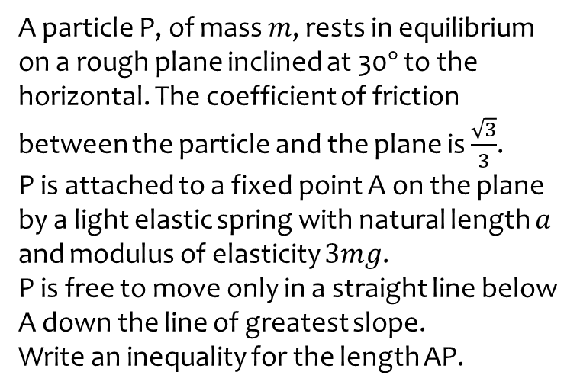
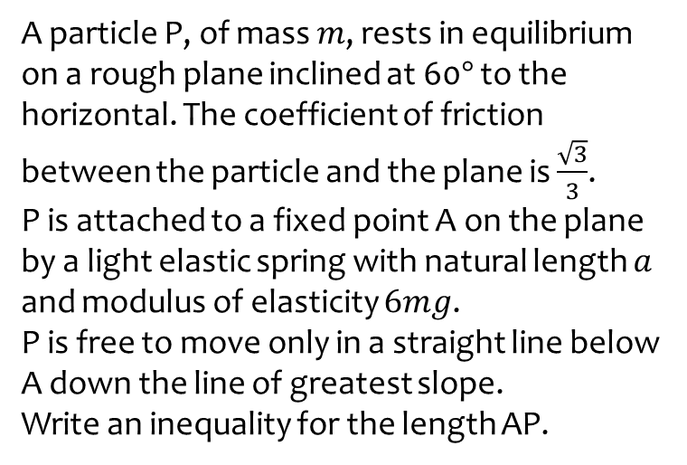

Worked example
Your turn
A particle P, of mass $m$, rests in equilibrium on a rough plane inclined at 60$°$ to the horizontal. The coefficient of friction between the particle and the plane is $\frac{\sqrt{3}}{3}$.
P is attached to a fixed point A on the plane by a light elastic spring with natural length $a$ and modulus of elasticity $6mg$.
P is free to move only in a straight line below A down the line of greatest slope.
Write an inequality for the length AP.
A particle P, of mass $m$, rests in equilibrium on a rough plane inclined at 30$°$ to the horizontal. The coefficient of friction between the particle and the plane is $\frac{\sqrt{3}}{3}$.
P is attached to a fixed point A on the plane by a light elastic spring with natural length $a$ and modulus of elasticity $3mg$.
P is free to move only in a straight line below A down the line of greatest slope.
Write an inequality for the length AP.
$$a≤AP≤\frac{4a}{3}$$

