Slide 1
3.1) Arithmetic sequences

Slide 2
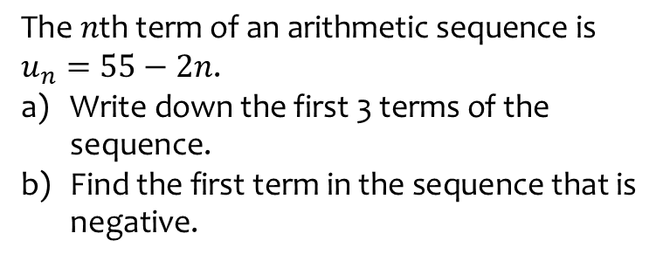
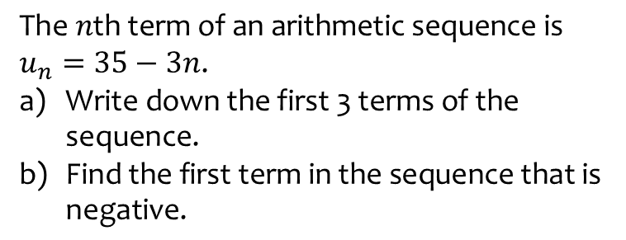
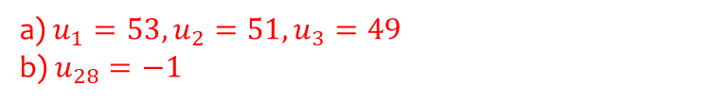
Worked example
Your turn
$$\text{The} n\text{th} \text{term} \text{of} \text{an} \text{arithmetic} \text{sequence} \text{is}$$
$$u_{n}=35−3n\text{.}$$
$\text{Write} \text{down} \text{the} \text{first}\text{ 3 }\text{terms} \text{of} \text{the} \text{sequence}\text{.}$
$\text{Find} \text{the} \text{first} \text{term} \text{in} \text{the} \text{sequence} \text{that} \text{is} \text{negative}\text{.}$
$$\text{The} n\text{th} \text{term} \text{of} \text{an} \text{arithmetic} \text{sequence} \text{is}$$
$$u_{n}=55−2n\text{.}$$
$\text{Write} \text{down} \text{the} \text{first}\text{ 3 }\text{terms} \text{of} \text{the} \text{sequence}\text{.}$
$\text{Find} \text{the} \text{first} \text{term} \text{in} \text{the} \text{sequence} \text{that} \text{is} \text{negative}\text{.}$
a) $u_{1}=53, u_{2}=51, u_{3}=49$
b) $u_{28}=−1$

Slide 3
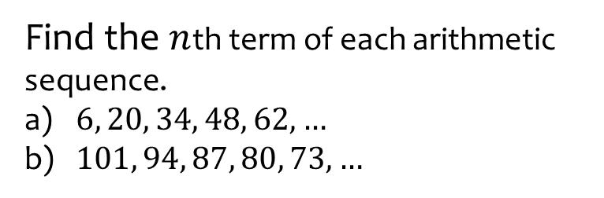

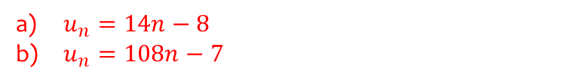
Worked example
Your turn
Find the $n$th term of each arithmetic sequence.
$−6, 2, 10, 18, 26, …$
$788, 785, 782, 779, 886, …$
Find the $n$th term of each arithmetic sequence.
$6, 20, 34, 48, 62, …$
$101, 94, 87, 80, 73, …$
$u_{n}=14n−8$
$u_{n}=108n−7$

Slide 4
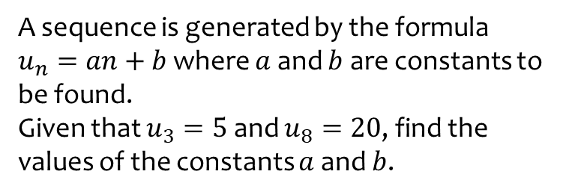
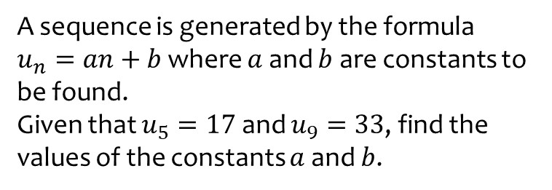
Worked example
Your turn
A sequence is generated by the formula
$u_{n}=an+b$ where $a$ and $b$ are constants to be found.
Given that $u_{5}=17$ and $u_{9}=33$, find the values of the constants $a$ and $b$.
A sequence is generated by the formula
$u_{n}=an+b$ where $a$ and $b$ are constants to be found.
Given that $u_{3}=5$ and $u_{8}=20$, find the values of the constants $a$ and $b$.
$$a=3, b=−4$$

Slide 5
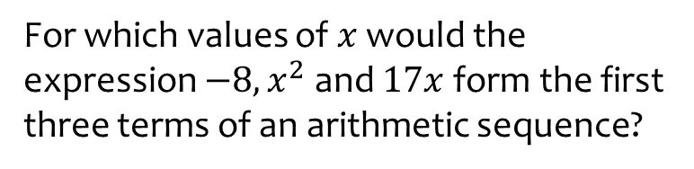
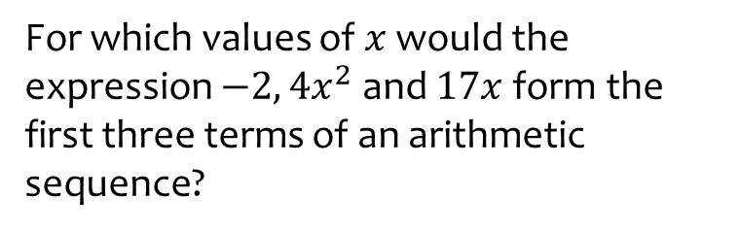

Worked example
Your turn
For which values of $x$ would the expression $−2, {4x}^{2}$ and $17x$ form the first three terms of an arithmetic sequence?
For which values of $x$ would the expression $−8, x^{2}$ and $17x$ form the first three terms of an arithmetic sequence?
$$x=\frac{1}{2}, x=8$$

Slide 6
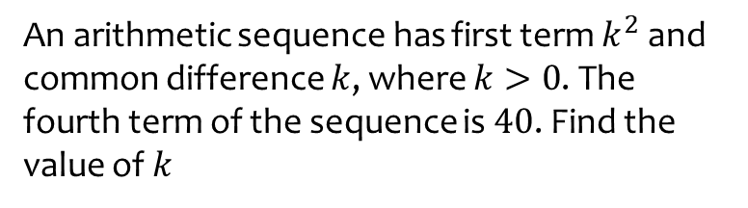
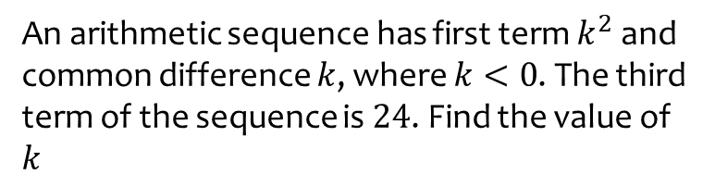
Worked example
Your turn
An arithmetic sequence has first term $k^{2}$ and common difference $k$, where $k<0$. The third term of the sequence is $24$. Find the value of $k$
An arithmetic sequence has first term $k^{2}$ and common difference $k$, where $k>0$. The fourth term of the sequence is $40$. Find the value of $k$
$$k=5$$

Slide 7
Worked example
Your turn
Is $100$ in the sequence:
$−3, 4, 11, 18,…$?
Is $10$ in the sequence:
$127 118, 109, 100,…$?
Is $100$ in the sequence:
$4, 7, 10, 13,…$ ?
Is $10$in the sequence:
$85, 78, 71, 64…$?
Yes – the 33rd term
No
$−7n+92=10$ solves to give $n=\frac{82}{7}$ which is not an integer.

Slide 8
Worked example
Your turn
The first five terms of each sequence are shown. Find two numbers which are in both sequences.
$$3, 10, 17, 24, 31,…$$
$$−4, −1, 2, 5, 8, …$$
The first five terms of each sequence are shown. Find two numbers which are in both sequences.
$$2, 7, 12, 17, 22,…$$
$$−4, −1, 2, 5, 8,…$$
$$2, 27$$

Slide 9
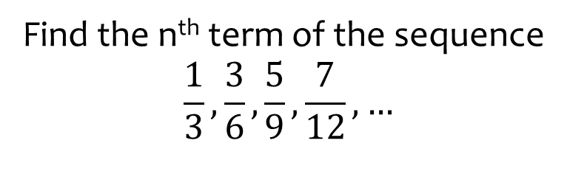
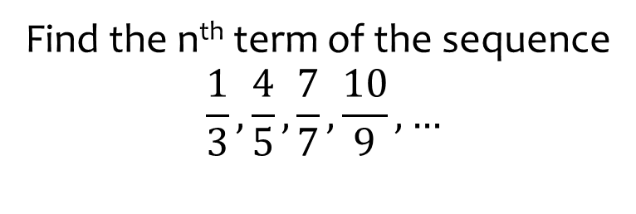
Worked example
Your turn
Find the n^{th} term of the sequence
$$\frac{1}{3},\frac{4}{5},\frac{7}{7},\frac{10}{9}, …$$
Find the n^{th} term of the sequence
$$\frac{1}{3},\frac{3}{6},\frac{5}{9},\frac{7}{12}, …$$
$$\frac{2n−1}{3n}$$

Slide 10
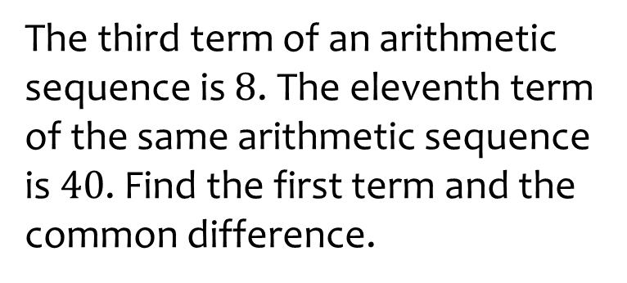

Worked example
Your turn
The fifth term of an arithmetic sequence is $9$. The twelfth term of the same arithmetic sequence is $23$. Find the first term and the common difference.
The third term of an arithmetic sequence is $8$. The eleventh term of the same arithmetic sequence is $40$. Find the first term and the common difference.
$$a=0, d=−4$$

