Slide 1
3) Sequences and series
3.1) Arithmetic sequences
3.2) Arithmetic series
3.3) Geometric sequences
3.4) Geometric series
3.5) Sum to infinity
3.6) Sigma notation
3.7) Recurrence relations
3.8) Modelling with series

Slide 2
3.1) Arithmetic sequences
Chapter CONTENTS

Slide 3
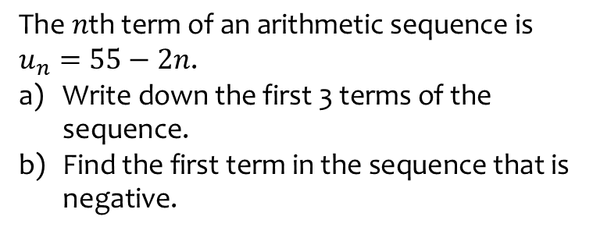
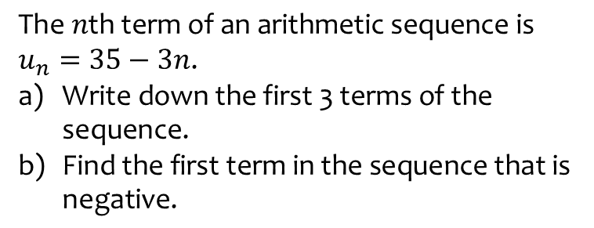
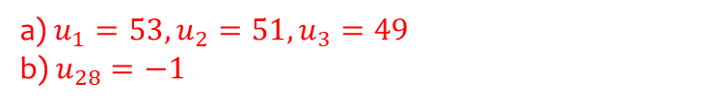
Worked example
Your turn
$$\text{The} n\text{th} \text{term} \text{of} \text{an} \text{arithmetic} \text{sequence} \text{is}$$
$$u_{n}=35−3n\text{.}$$
$\text{Write} \text{down} \text{the} \text{first}\text{ 3 }\text{terms} \text{of} \text{the} \text{sequence}\text{.}$
$\text{Find} \text{the} \text{first} \text{term} \text{in} \text{the} \text{sequence} \text{that} \text{is} \text{negative}\text{.}$
$$\text{The} n\text{th} \text{term} \text{of} \text{an} \text{arithmetic} \text{sequence} \text{is}$$
$$u_{n}=55−2n\text{.}$$
$\text{Write} \text{down} \text{the} \text{first}\text{ 3 }\text{terms} \text{of} \text{the} \text{sequence}\text{.}$
$\text{Find} \text{the} \text{first} \text{term} \text{in} \text{the} \text{sequence} \text{that} \text{is} \text{negative}\text{.}$
a) $u_{1}=53, u_{2}=51, u_{3}=49$
b) $u_{28}=−1$

Slide 4
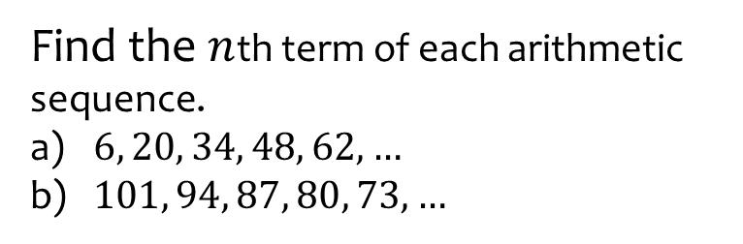

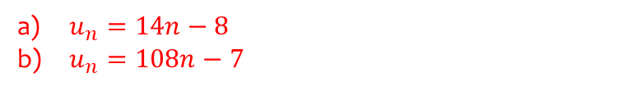
Worked example
Your turn
Find the $n$th term of each arithmetic sequence.
$−6, 2, 10, 18, 26, …$
$788, 785, 782, 779, 886, …$
Find the $n$th term of each arithmetic sequence.
$6, 20, 34, 48, 62, …$
$101, 94, 87, 80, 73, …$
$u_{n}=14n−8$
$u_{n}=108n−7$

Slide 5
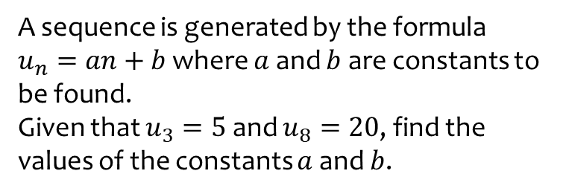
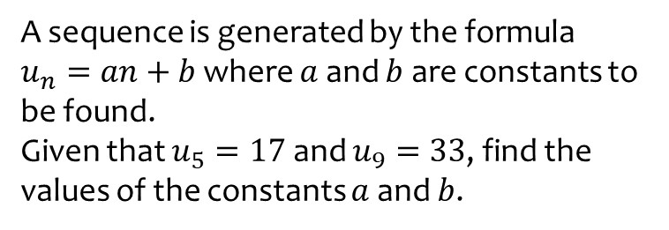
Worked example
Your turn
A sequence is generated by the formula
$u_{n}=an+b$ where $a$ and $b$ are constants to be found.
Given that $u_{5}=17$ and $u_{9}=33$, find the values of the constants $a$ and $b$.
A sequence is generated by the formula
$u_{n}=an+b$ where $a$ and $b$ are constants to be found.
Given that $u_{3}=5$ and $u_{8}=20$, find the values of the constants $a$ and $b$.
$$a=3, b=−4$$

Slide 6
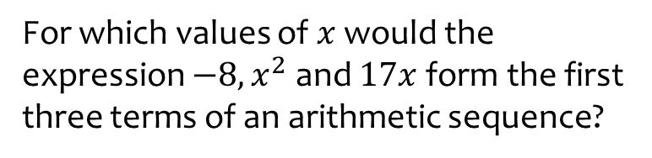
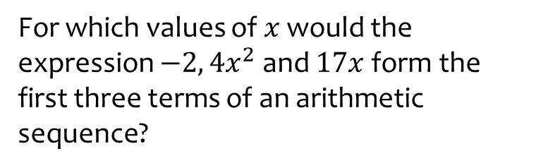

Worked example
Your turn
For which values of $x$ would the expression $−2, {4x}^{2}$ and $17x$ form the first three terms of an arithmetic sequence?
For which values of $x$ would the expression $−8, x^{2}$ and $17x$ form the first three terms of an arithmetic sequence?
$$x=\frac{1}{2}, x=8$$

Slide 7
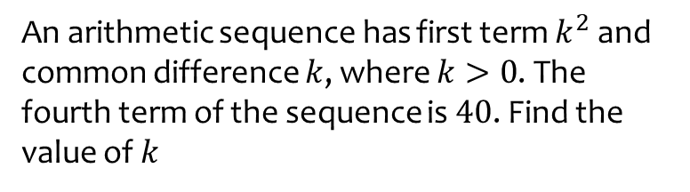
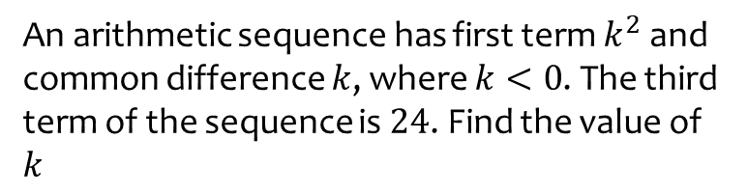
Worked example
Your turn
An arithmetic sequence has first term $k^{2}$ and common difference $k$, where $k<0$. The third term of the sequence is $24$. Find the value of $k$
An arithmetic sequence has first term $k^{2}$ and common difference $k$, where $k>0$. The fourth term of the sequence is $40$. Find the value of $k$
$$k=5$$

Slide 8
Worked example
Your turn
Is $100$ in the sequence:
$−3, 4, 11, 18,…$?
Is $10$ in the sequence:
$127 118, 109, 100,…$?
Is $100$ in the sequence:
$4, 7, 10, 13,…$ ?
Is $10$in the sequence:
$85, 78, 71, 64…$?
Yes – the 33rd term
No
$−7n+92=10$ solves to give $n=\frac{82}{7}$ which is not an integer.

Slide 9
Worked example
Your turn
The first five terms of each sequence are shown. Find two numbers which are in both sequences.
$$3, 10, 17, 24, 31,…$$
$$−4, −1, 2, 5, 8, …$$
The first five terms of each sequence are shown. Find two numbers which are in both sequences.
$$2, 7, 12, 17, 22,…$$
$$−4, −1, 2, 5, 8,…$$
$$2, 27$$

Slide 10
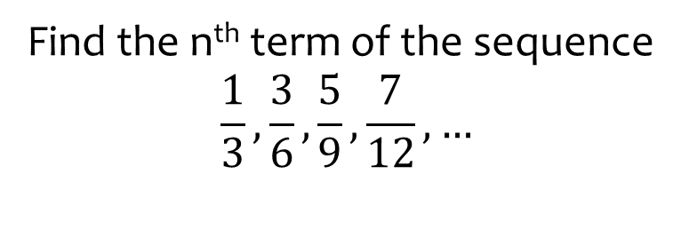
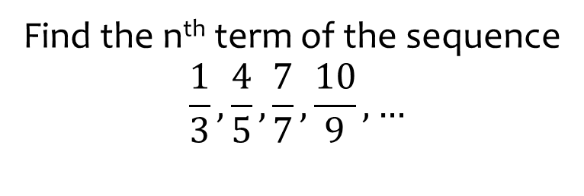
Worked example
Your turn
Find the n^{th} term of the sequence
$$\frac{1}{3},\frac{4}{5},\frac{7}{7},\frac{10}{9}, …$$
Find the n^{th} term of the sequence
$$\frac{1}{3},\frac{3}{6},\frac{5}{9},\frac{7}{12}, …$$
$$\frac{2n−1}{3n}$$

Slide 11
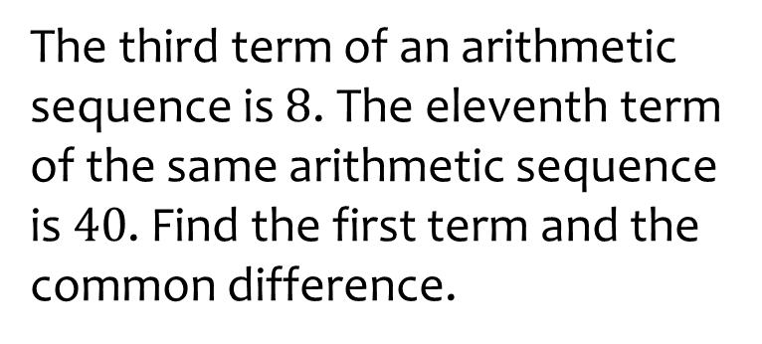

Worked example
Your turn
The fifth term of an arithmetic sequence is $9$. The twelfth term of the same arithmetic sequence is $23$. Find the first term and the common difference.
The third term of an arithmetic sequence is $8$. The eleventh term of the same arithmetic sequence is $40$. Find the first term and the common difference.
$$a=0, d=−4$$

Slide 12
3.2) Arithmetic series
Chapter CONTENTS

Slide 13
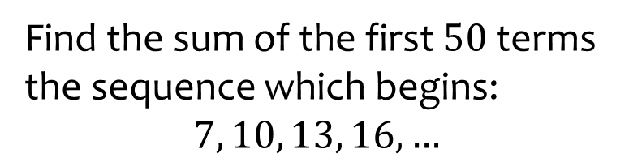
Worked example
Your turn
Find the sum of the first $50$ terms the sequence which begins:
$$7, 10, 13, 16,…$$
Find the sum of the first $80$ terms the sequence which begins:
$$2, 6, 10, 14, …$$
$$12800$$

Slide 14
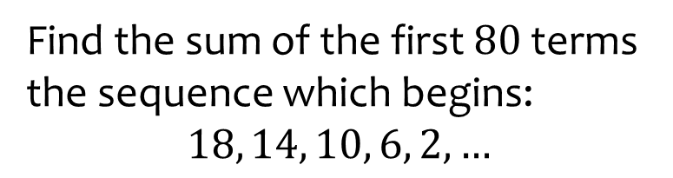
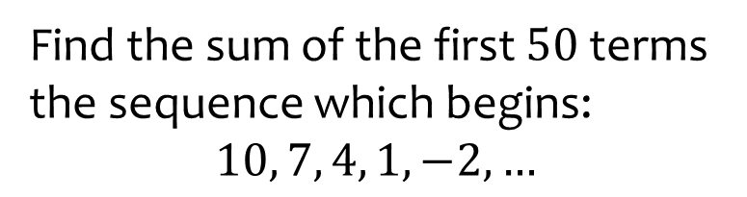
Worked example
Your turn
Find the sum of the first $50$ terms the sequence which begins:
$$10, 7, 4, 1, −2, …$$
Find the sum of the first $80$ terms the sequence which begins:
$$18, 14, 10, 6, 2, …$$
$$−11200$$

Slide 15
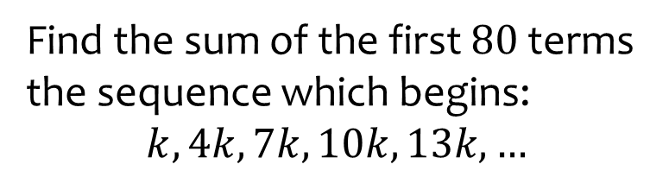
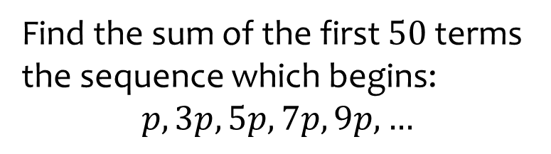

Worked example
Your turn
Find the sum of the first $50$ terms the sequence which begins:
$$p, 3p, 5p, 7p, 9p, …$$
Find the sum of the first $80$ terms the sequence which begins:
$$k, 4k, 7k, 10k, 13k, …$$
$$9560k$$

Slide 16
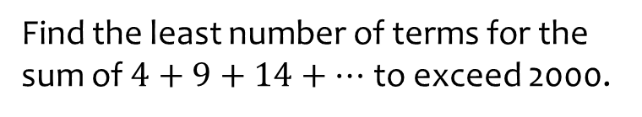
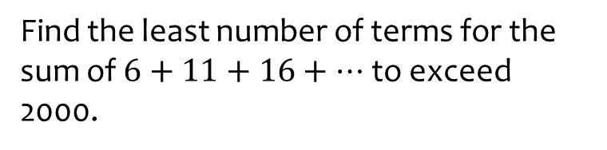

Worked example
Your turn
Find the least number of terms for the sum of $6+11+16+…$ to exceed 2000.
Find the least number of terms for the sum of $4+9+14+…$ to exceed 2000.
$$28$$

Slide 17
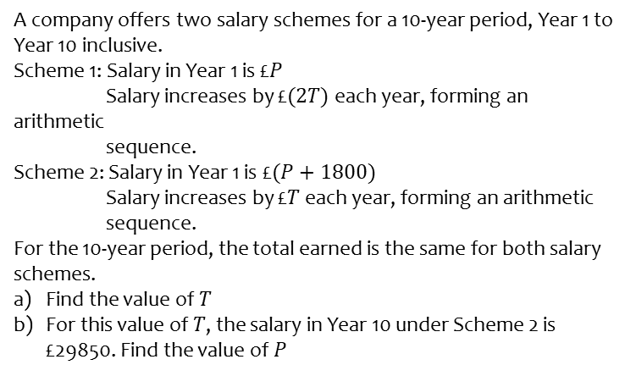
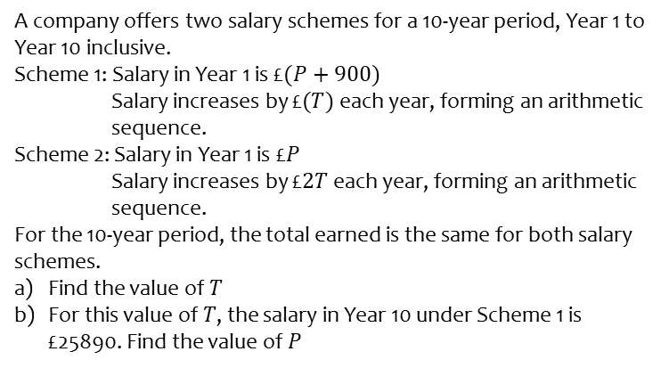
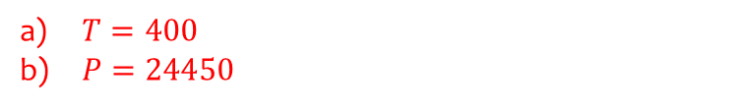
Worked example
Your turn
A company offers two salary schemes for a 10-year period, Year 1 to Year 10 inclusive.
Scheme 1: Salary in Year 1 is £$(P+900)$
Salary increases by £$(T)$ each year, forming an arithmetic
sequence.
Scheme 2: Salary in Year 1 is £$P$
Salary increases by £$2T$ each year, forming an arithmetic
sequence.
For the 10-year period, the total earned is the same for both salary schemes.
Find the value of $T$
For this value of $T$, the salary in Year 10 under Scheme 1 is £25890. Find the value of $P$
A company offers two salary schemes for a 10-year period, Year 1 to Year 10 inclusive.
Scheme 1: Salary in Year 1 is £$P$
Salary increases by £$(2T)$ each year, forming an arithmetic
sequence.
Scheme 2: Salary in Year 1 is £$(P+1800)$
Salary increases by £$T$ each year, forming an arithmetic
sequence.
For the 10-year period, the total earned is the same for both salary schemes.
Find the value of $T$
For this value of $T$, the salary in Year 10 under Scheme 2 is £29850. Find the value of $P$
$T=400$
$P=24450$

Slide 18
Worked example
Your turn
Prove that the sum of the first 200 natural numbers is 20100
Prove that the sum of the first 100 natural numbers is 5050
Proof

Slide 19
Worked example
Your turn
Find the sum of the first 50 odd numbers
Find the sum of the first 50 even numbers
$$2550$$

Slide 20
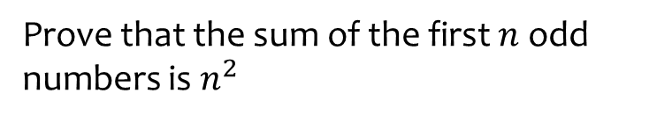
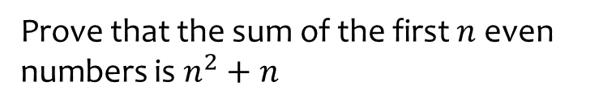
Worked example
Your turn
Prove that the sum of the first $n$ even numbers is $n^{2}+n$
Prove that the sum of the first $n$ odd numbers is $n^{2}$
Proof

Slide 21
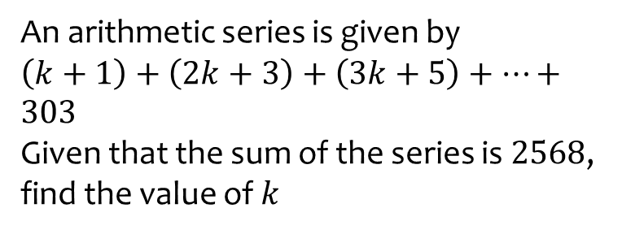
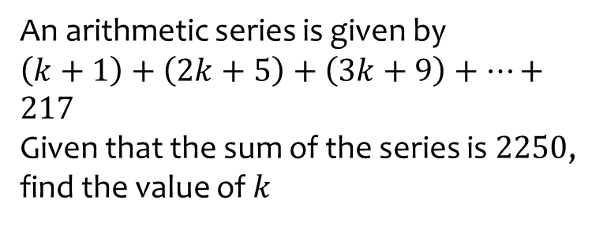
Worked example
Your turn
An arithmetic series is given by $\left(k+1\right)+\left(2k+5\right)+\left(3k+9\right)+…+217$
Given that the sum of the series is $2250$, find the value of $k$
An arithmetic series is given by $\left(k+1\right)+\left(2k+3\right)+\left(3k+5\right)+…+303$
Given that the sum of the series is $2568$, find the value of $k$
$$k=17$$

Slide 22
Worked example
Your turn
The common difference of an arithmetic sequence is $4$. The sum of the first $60$ terms of this sequence is $7380$. Find the first term.
The common difference of an arithmetic sequence is $5$. The sum of the first $40$ terms of this sequence is $4020$. Find the first term.
$$3$$

Slide 23
Worked example
Your turn
The common difference of an arithmetic sequence is $4$. The sum of the first $60$ terms of this sequence is $−240$. Find the first term.
The common difference of an arithmetic sequence is $5$. The sum of the first $40$ terms of this sequence is $2620$. Find the first term.
$$−32$$

Slide 24
Worked example
Your turn
The first term of an arithmetic sequence is $3$. The sum of the first $50$ terms is $2600$. Work out the common difference of the sequence.
The first term of an arithmetic sequence is $4$. The sum of the first $40$ terms is $2500$. Work out the common difference of the sequence.
$$3$$

Slide 25
Worked example
Your turn
The eighth term of an arithmetic sequence is $11$. The fifth term of the same arithmetic sequence is $2$. Find the sum of the first $50$ terms of this arithmetic sequence.
The tenth term of an arithmetic sequence is $35$. The fourth term of the same arithmetic sequence is $17$. Find the sum of the first $50$ terms of this arithmetic sequence.
$$4075$$

Slide 26
3.3) Geometric sequences
Chapter CONTENTS

Slide 27
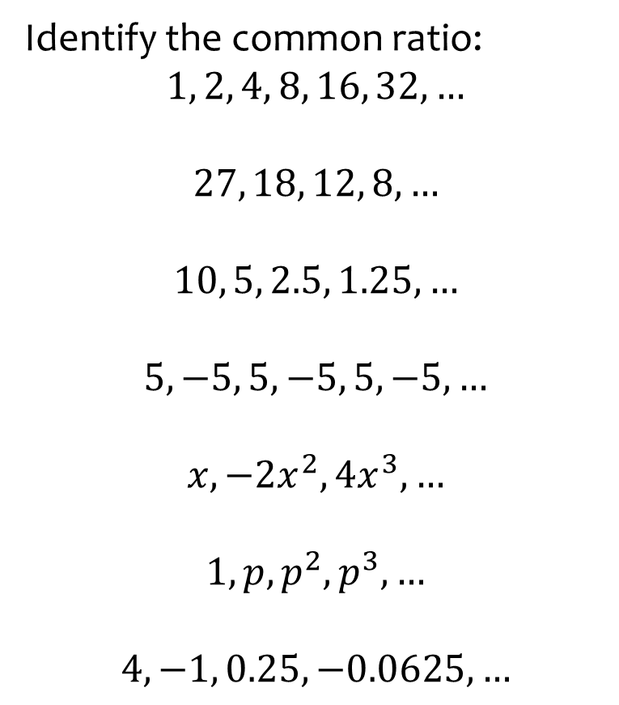
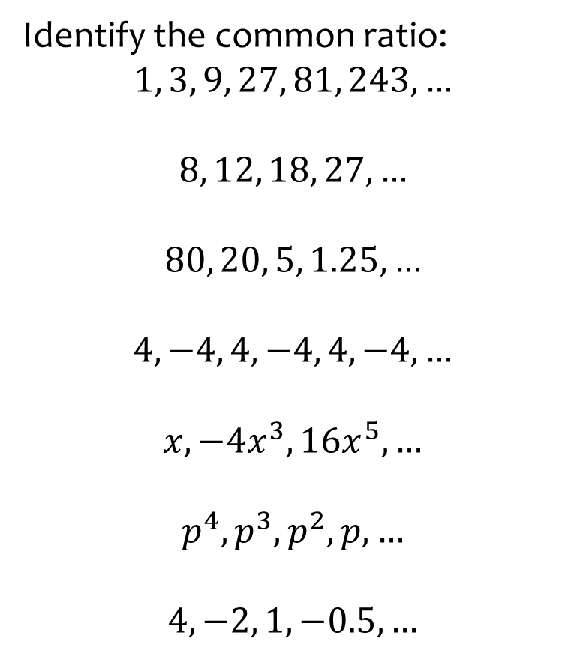

Worked example
Your turn
Identify the common ratio:
$$1, 3, 9, 27, 81, 243, …$$
$$8, 12, 18, 27, …$$
$$80, 20, 5, 1.25, …$$
$$4, −4, 4, −4, 4, −4, …$$
$$x, −4x^{3}, 16x^{5},…$$
$$p^{4}, p^{3}, p^{2}, p, …$$
$$4, −2, 1, −0.5, …$$
Identify the common ratio:
$$1, 2, 4, 8, 16, 32, …$$
$$27, 18, 12, 8, …$$
$$10, 5, 2.5, 1.25, …$$
$$5, −5, 5, −5, 5, −5, …$$
$$x, −2x^{2}, 4x^{3},…$$
$$1, p, p^{2}, p^{3}, …$$
$$4, −1, 0.25, −0.0625, …$$
$$r=2$$
$$r=\frac{2}{3}$$
$$r=\frac{1}{2}$$
$$r=−1$$
$$r=−2x$$
$$r=p$$
$$r=−\frac{1}{4}$$

Slide 28
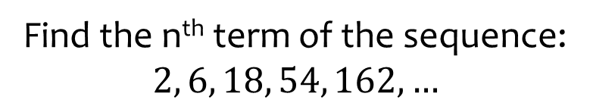


Worked example
Your turn
Find the n^{th} term of the sequence:
$$3, 6, 12, 24, 48,…$$
$$4, 20, 100, 500, 2500,…$$
Find the n^{th} term of the sequence:
$$2, 6, 18, 54, 162,…$$
$$u_{n}=2×3^{n−1}$$

Slide 29



Worked example
Your turn
Find the 10th term of the sequence:
$$3, 6, 12, 24, 48,…$$
$$4, 20, 100, 500, 2500,…$$
Find the 10th term of the sequence:
$$2, 6, 18, 54, 162,…$$
$$39366$$

Slide 30
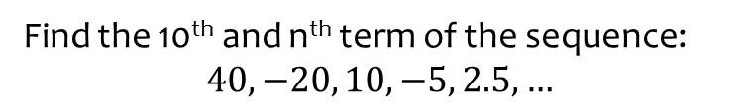
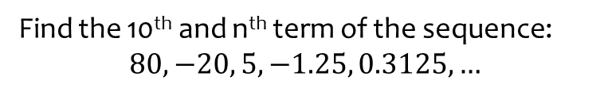
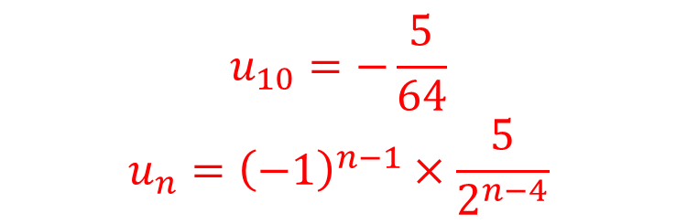
Worked example
Your turn
Find the 10th and n^{th} term of the sequence:
$$80, −20, 5, −1.25, 0.3125,…$$
Find the 10th and n^{th} term of the sequence:
$$40, −20, 10, −5, 2.5, …$$
$$u_{10}=−\frac{5}{64}$$
$$u_{n}={\left(−1\right)}^{n−1}×\frac{5}{2^{n−4}}$$

Slide 31
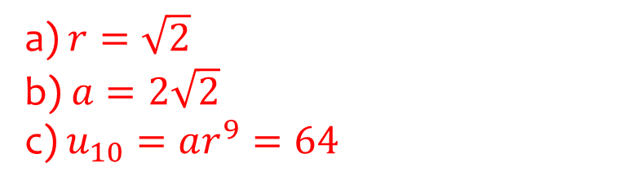
Worked example
Your turn
The second term of a geometric sequence is 6 and the 4th term is 18. The common ratio is positive. Find the exact values of:
The common ratio.
The first term.
The 20th term.
The second term of a geometric sequence is 4 and the 4th term is 8. The common ratio is positive. Find the exact values of:
The common ratio.
The first term.
The 10th term.
a) $r=\sqrt{2}$
b) $a=2\sqrt{2}$
c) $u_{10}=ar^{9}=64$

Slide 32
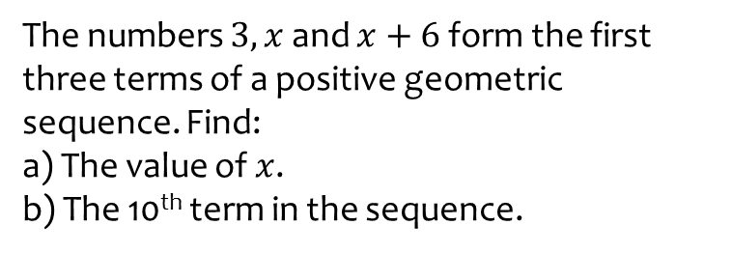
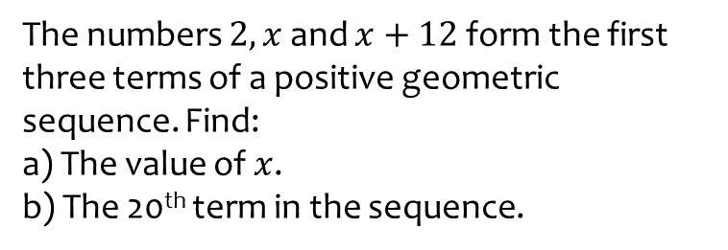
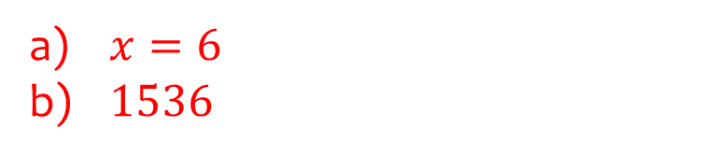
Worked example
Your turn
The numbers $2, x$ and $x+12$ form the first three terms of a positive geometric sequence. Find:
a) The value of $x$.
b) The 20th term in the sequence.
The numbers $3, x$ and $x+6$ form the first three terms of a positive geometric sequence. Find:
a) The value of $x$.
b) The 10th term in the sequence.
$x=6$
$1536$

Slide 33
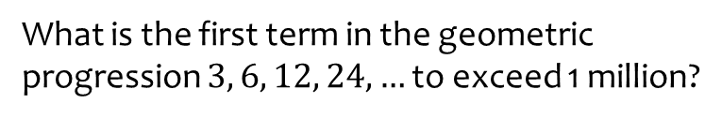
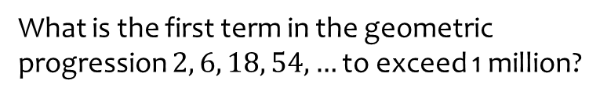

Worked example
Your turn
What is the first term in the geometric progression $2, 6, 18, 54, …$ to exceed 1 million?
What is the first term in the geometric progression $3, 6, 12, 24, …$ to exceed 1 million?
$n=20$ ; $u_{20}=1572864$

Slide 34
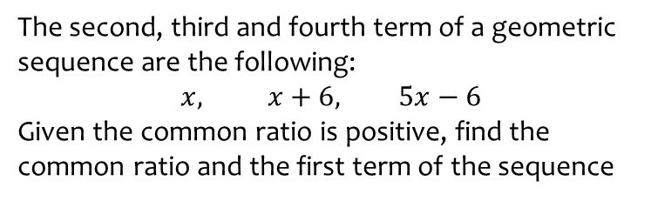
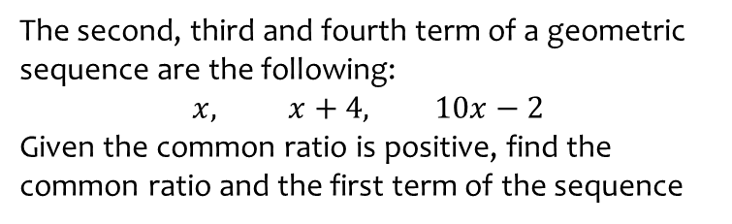

Worked example
Your turn
The second, third and fourth term of a geometric sequence are the following:
$$x, x+4, 10x−2$$
Given the common ratio is positive, find the common ratio and the first term of the sequence
The second, third and fourth term of a geometric sequence are the following:
$$x, x+6, 5x−6$$
Given the common ratio is positive, find the common ratio and the first term of the sequence
$$r=2$$
$$a=3$$

Slide 35
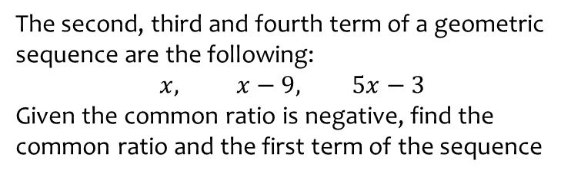
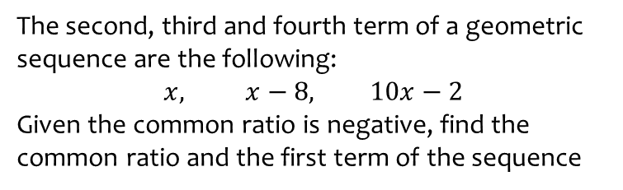

Worked example
Your turn
The second, third and fourth term of a geometric sequence are the following:
$$x, x−8, 10x−2$$
Given the common ratio is negative, find the common ratio and the first term of the sequence
The second, third and fourth term of a geometric sequence are the following:
$$x, x−9, 5x−3$$
Given the common ratio is negative, find the common ratio and the first term of the sequence
$$r=−2$$
$$a=3$$

Slide 36
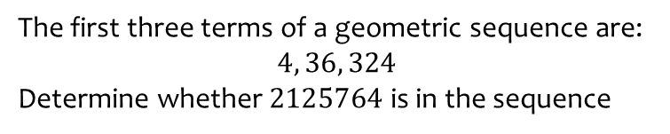
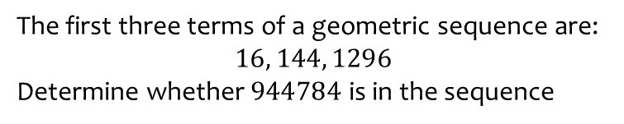

Worked example
Your turn
The first three terms of a geometric sequence are:
$$16, 144, 1296$$
Determine whether $944784$ is in the sequence
The first three terms of a geometric sequence are:
$$4, 36, 324$$
Determine whether $2125764$ is in the sequence
$$n=7$$
N is an integer
$2125764$ is in the sequence

Slide 37
3.4) Geometric series
Chapter CONTENTS

Slide 38



Worked example
Your turn
Find the sum of the first 10 terms:
$$2, 6, 18, 54, 162, …$$
$$4, 20, 100, 500, 2500, …$$
Find the sum of the first 10 terms:
$$3, 6, 12, 24, 48, …$$
$$3069$$

Slide 39



Worked example
Your turn
Find the sum of the first 10 terms:
$$2,\frac{1}{2},\frac{1}{8},\frac{1}{32},\frac{1}{128},…$$
$$243, −81, 27, −9, 3, …$$
Find the sum of the first 10 terms:
$$4, 2,1, \frac{1}{2},\frac{1}{4},\frac{1}{8}, …$$
$$\frac{1023}{128}$$

Slide 40



Worked example
Your turn
Find the least value of $n$ such that the sum of $1+3+9+27+…$ to $n$ terms would exceed 2 000 000.
Find the least value of $n$ such that the sum of $1+2+4+8+…$ to $n$ terms would exceed 2 000 000.
$$n=21$$

Slide 41



Worked example
Your turn
A geometric series has first term $a$ and common ratio $r$.
The sum of the first two terms of the series is $9$.
The sum of the first four terms of the series is $45$.
Find the two possible geometric sequences.
A geometric series has first term $a$ and common ratio $r$.
The sum of the first two terms of the series is $8$
The sum of the first four terms of the series is $80$
Find the two possible geometric sequences
$$u_{n}=2×3^{n−1}$$
$u_{n}=−4×{(−3)}^{n−1}$

Slide 42
3.5) Sum to infinity
Chapter CONTENTS

Slide 43



Worked example
Your turn
Comment on the sum of these series up to infinity:
$$1+2+4+8+16+32+…$$
$$1−2+3−4+5−6+7−8…$$
$$1+0.5+0.25+0.125+0.0625+…$$
Comment on the sum of these series up to infinity:
$$1+3+9+27+81+243+…$$
$$1−3+5−7+9−11+13…$$
$$1+0.25+0.0625+0.015625+0.00390625…$$
Divergent. The sum tends towards infinity
Divergent. The partial sum alternates between positive and negative but the magnitude gets further from 0
Convergent. The sum tends towards a fixed value, in this case $\frac{4}{3}$

Slide 44



Worked example
Your turn
Find the sum to infinity of the series:
$$1+\frac{1}{3}+\frac{1}{9}+\frac{1}{27}+\frac{1}{81}+…$$
$$32−16+8−4+2…$$
$$p+p^{3}+p^{5}+p^{7}+p^{9}+…$$
$$k+\frac{1}{k}+\frac{1}{k^{3}}+\frac{1}{k^{5}}+\frac{1}{k^{7}}+…$$
Find the sum to infinity of the series:
$$1+\frac{1}{2}+\frac{1}{4}+\frac{1}{8}+\frac{1}{16}+…$$
$$27−9+3−1+\frac{1}{3}…$$
$$k+k^{2}+k^{3}+k^{4}+k^{5}+…$$
$$p+1+\frac{1}{p}+\frac{1}{p^{2}}+\frac{1}{p^{3}}+…$$
$$2$$
$$\frac{81}{4}$$
$$\frac{k}{1−k}$$
$$\frac{p^{2}}{p−1}$$

Slide 45



Worked example
Your turn
Given that the geometric series
$1−4x+16x^{2}−64x^{3}+…$is convergent:
Find the range of possible values of $x$
Find an expression for $S_{∞}$
Given that the geometric series
$1−3x+9x^{2}−27x^{3}+…$is convergent:
Find the range of possible values of $x$
Find an expression for $S_{∞}$
a) $−\frac{1}{3}<x<\frac{1}{3}$
b) $S_{∞}=\frac{1}{1−3x}$

Slide 46



Worked example
Your turn
The third term of a geometric series is $1.5$ and the eighth term is $0.046875$.
Show that this series is convergent.
Find the sum to infinity of this series.
The fourth term of a geometric series is $1.08$ and the seventh term is $0.23328$.
Show that this series is convergent.
Find the sum to infinity of this series.
a) $\left|r\right|=0.6<1$
b) $12.5$

Slide 47



Worked example
Your turn
For a geometric series with first term $a$ and common ratio $r$, $S_{4}=12.75$ and $S_{∞}=12.8$.
a) Find the possible values of $r$.
b) Given that the terms in the series alternate between positive and negative values, find the value of $a$
For a geometric series with first term $a$ and common ratio $r$, $S_{4}=15$ and $S_{∞}=16$.
a) Find the possible values of $r$.
b) Given that all the terms in the series are positive, find the value of $a$.
a) $r=±\frac{1}{2}$
b) $8$

Slide 48
3.6) Sigma notation
Chapter CONTENTS

Slide 49


Worked example
Your turn
Write out the terms in the series:
$$\sum_{r=1}^{10}{(3r+5)}$$
$$\sum_{n=7}^{13}{(2−3n)}$$
Write out the terms in the series:
$$\sum_{k=4}^{8}{(2k+1)}$$
$$9+11+13+15+17=65$$

Slide 50


Worked example
Your turn
Find the value of $a, d$ and $n$:
$$\sum_{r=1}^{10}{(3r+5)}$$
$$\sum_{n=7}^{13}{(2−3n)}$$
Find the value of $a, d$ and $n$:
$$\sum_{k=4}^{8}{(2k+1)}$$
$$a=9, d=2, n=5$$

Slide 51



Worked example
Your turn
Write in sigma notation:
$$8+13+18+23+28+33+38+43+48+53$$
$$−11+−13+−15+−17+−19+ −21+−23$$
Write in sigma notation:
$$6+7+8+9+10$$
$$\sum_{k=4}^{8}{(k+2)}$$

Slide 52


Worked example
Your turn
Write out the terms in the series:
$$\sum_{r=1}^{10}{5×3^{r−1}}$$
$$\sum_{n=7}^{13}{2×5^{n−1}}$$
Write out the terms in the series:
$$\sum_{k=4}^{8}{3×2^{k−1}}$$
$$24+48+96+192+384=744$$

Slide 53


Worked example
Your turn
Find the value of $a, r$ and $n$:
$$\sum_{r=1}^{10}{5×3^{r−1}}$$
$$\sum_{n=7}^{13}{2×5^{n−1}}$$
Find the value of $a, r$ and $n$:
$$\sum_{k=4}^{8}{3×2^{k−1}}$$
$$a=24, r=2, n=5$$

Slide 54



Worked example
Your turn
Write in sigma notation:
$$3+15+75+375+1875+9375+46875+234375+1171876+5859375$$
$$320+640+1280+2560+5120+10240+20480$$
Write in sigma notation:
$$54+162+486+1458+4374$$
$$\sum_{k=4}^{8}{2×3^{k−1}}$$

Slide 55


Worked example
Your turn
Evaluate:
$$\sum_{n=9}^{30}{(2+7n)}$$
Evaluate:
$$\sum_{r=10}^{30}{(7+2r)}$$
$$987$$

Slide 56


Worked example
Your turn
Given that
$$\sum_{r=1}^{k}{3×2^{r}}=12282$$
Find the value of $k$
Given that
$$\sum_{r=1}^{k}{2×3^{r}}=59046$$
Find the value of $k$
$$k=9$$

Slide 57



Worked example
Your turn
A convergent geometric series is given by
$$1+2x+4x^{2}+8x^{3}$$
Find the range of possible values of $x$
Given that
$$\sum_{r=1}^{∞}{{\left(2x\right)}^{r−1}}=2$$
find the value of $x$
A convergent geometric series is given by
$$1+4x+16x^{2}+64x^{3}$$
Find the range of possible values of $x$
Given that
$$\sum_{r=1}^{∞}{{\left(4x\right)}^{r−1}}=2$$
find the value of $x$
a) $−\frac{1}{4}<x<\frac{1}{4}$
b) $x=\frac{1}{8}$

Slide 58
3.7) Recurrence relations
Chapter CONTENTS

Slide 59


Worked example
Your turn
Find the first five terms of the sequence:
$$u_{n+1}=2u_{n}+3, u_{1}=3$$
Find the first five terms of the sequence:
$$u_{n+1}=3u_{n}−2, u_{1}=4$$
$$4, 10, 28, 82, 244$$

Slide 60


Worked example
Your turn
A sequence $u_{1},u_{2},u_{3}, …$ is defined by
$$u_{1}=4$$
$u_{n+1}=pu_{n}+q, n≥1$
Given that $u_{2}=5$ and $u_{3}=7$, find the values of $p$ and $q$
A sequence $u_{1},u_{2},u_{3}, …$ is defined by
$$u_{1}=5$$
$u_{n+1}=pu_{n}+q, n≥1$
Given that $u_{2}=13$ and $u_{3}=37$, find the values of $p$ and $q$
$$p=3, q=−2$$

Slide 61


Worked example
Your turn
A sequence $a_{1},a_{2},a_{3}, …$ is defined by
$$a_{1}=1$$
$a_{n+1}={\left(a_{n}\right)}^{2}−ka_{n},n≥1$
where $k$ is a constant.
Given that $a_{3}=1$, find the value of:
$$\sum_{r=1}^{100}{a_{n}}$$
A sequence $a_{1},a_{2},a_{3}, …$ is defined by
$$a_{1}=1$$
$a_{n+1}=ka_{n}+5, n≥1$
where $a$ is a positive constant.
Given that $a_{3}=41$, find the value of:
$$\sum_{r=1}^{5}{a_{n}}$$
$$901$$

Slide 62



Worked example
Your turn
A sequence $a_{1},a_{2},a_{3}, …$ is defined by
$$a_{1}=2$$
$a_{n+1}={\left(a_{n}\right)}^{2}−2, n≥2$
where $p>0$
Find $a_{3}$
Given that $a_{2}=2$, find the value of $p$
Find the sum of the first 100 terms
Find $a_{199}$
A sequence $a_{1},a_{2},a_{3}, …$ is defined by
$$a_{1}=p$$
$a_{n+1}={\left(a_{n}\right)}^{2}−1, n≥1$
where $p>0$
Find $a_{3}$
Given that $a_{2}=0$, find the value of $p$
Find the sum of the first 100 terms
Find $a_{199}$
a) $p^{4}−2p^{2}$
b) $p=−1$
c) $−100$
d) $−1$

Slide 63



Worked example
Your turn
For each sequence:
State whether the sequence is increasing, decreasing or periodic.
If the sequence is periodic, write down its order.
$u_{n+1}=u_{n}−3, u_{1}=7$
$u_{n+1}={\left(u_{n}\right)}^{3}, u_{1}=2$
$u_{n+1}=\cos\left(45n°\right)$
For each sequence:
State whether the sequence is increasing, decreasing or periodic.
If the sequence is periodic, write down its order.
$u_{n+1}=u_{n}+3, u_{1}=7$
$u_{n+1}={\left(u_{n}\right)}^{2}, u_{1}=\frac{1}{2}$
$u_{n+1}=\sin\left(90n°\right)$
Increasing
Decreasing
Periodic, order $4$

Slide 64
3.8) Modelling with series
Chapter CONTENTS

Slide 65

Worked example
Your turn
Bruce starts a new company. In year 1 his profits will be £10 000. He predicts his profits to increase by £5000 each year, so that his profits in year 2 are modelled to be £15 000, in year 3, £20 000 and so on. He predicts this will continue until he reaches annual profits of £50 000. He then models his annual profits to remain at £50 000.
Calculate the profits for Bruce’s business in the first 20 years.
State one reason why this may not be a suitable model.
Bruce’s financial advisor says the yearly profits are likely to increase by 2.5% per annum. Using this model, calculate the profits for Bruce’s business in the first 20 years.
Jenny starts a new company. In year 1 her profits will be £20 000. She predicts her profits to increase by £5000 each year, so that her profits in year 2 are modelled to be £25 000, in year 3, £30 000 and so on. She predicts this will continue until she reaches annual profits of
£100 000. She then models her annual profits to remain at £100 000.
Calculate the profits for Jenny’s business in the first 20 years.
State one reason why this may not be a suitable model.
Jenny’s financial advisor says the yearly profits are likely to increase by 5% per annum. Using this model, calculate the profits for Jenny’s business in the first 20 years.
$£1 320 000$
It is unlikely that Bruce’s profits will
increase by exactly the same amount each
year.
c) $£ 661 319.08$

Slide 66

Worked example
Your turn
A company predicts a yearly profit of £210 000 in the year 2031. The company predicts that the yearly profit will rise each year by 4%.
Find the predicted profit in the year 2035
Find the first year in which the yearly predicted profit exceeds £300 000
Find the total predicted profit for the years 2031 to 2042 inclusive, giving your answer to the nearest pound.
A company predicts a yearly profit of £120 000 in the year 2013. The company predicts that the yearly profit will rise each year by 5%.
Find the predicted profit in the year 2016
Find the first year in which the yearly predicted profit exceeds £200 000
Find the total predicted profit for the years 2013 to 2023 inclusive, giving your answer to the nearest pound.
a) $£138915$
b) $2024$
c) $£1 704 814$

