Slide 1
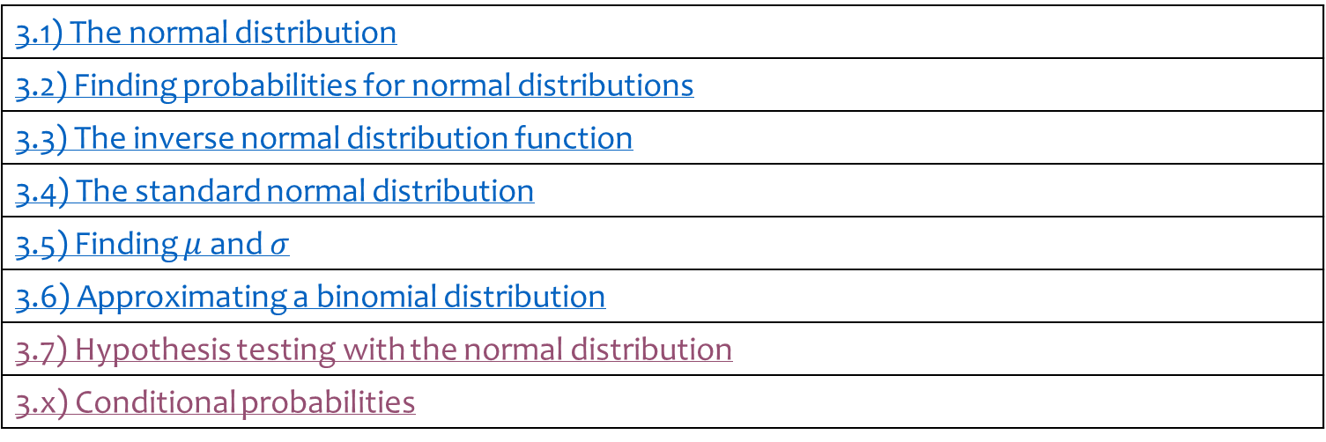
3) The normal distribution
3.1) The normal distribution
3.2) Finding probabilities for normal distributions
3.3) The inverse normal distribution function
3.4) The standard normal distribution
3.5) Finding $μ$ and $σ$
3.6) Approximating a binomial distribution
3.7) Hypothesis testing with the normal distribution
3.x) Conditional probabilities

Slide 2
3.1) The normal distribution
Chapter CONTENTS

Slide 3
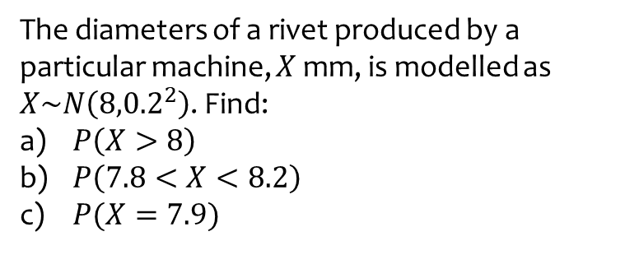
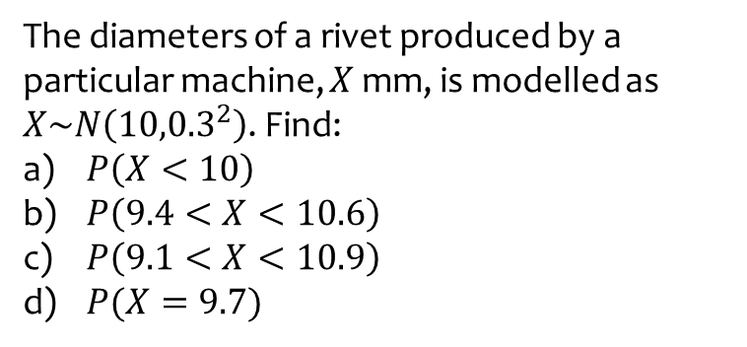
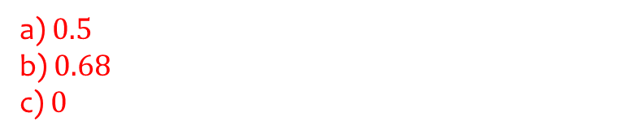
Worked example
Your turn
The diameters of a rivet produced by a particular machine, $X$ mm, is modelled as $X\sim N\left({10,0.3}^{2}\right)$. Find:
$P\left(X<10\right)$
$P\left(9.4<X<10.6\right)$
$P\left(9.1<X<10.9\right)$
$P(X=9.7)$
The diameters of a rivet produced by a particular machine, $X$ mm, is modelled as $X\sim N\left({8,0.2}^{2}\right)$. Find:
$P\left(X>8\right)$
$P\left(7.8<X<8.2\right)$
$P(X=7.9)$
a) $0.5$
b) $0.68$
c) $0$

Slide 4
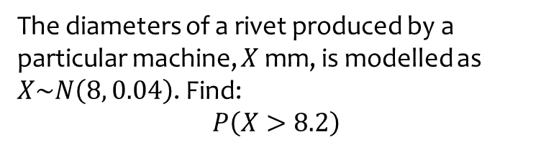
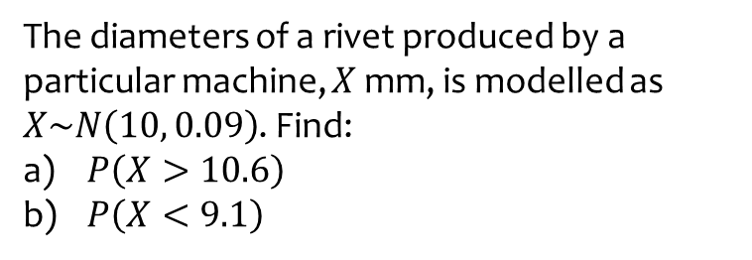
Worked example
Your turn
The diameters of a rivet produced by a particular machine, $X$ mm, is modelled as $X\sim N\left(10, 0.09\right)$. Find:
$P\left(X>10.6\right)$
$P\left(X<9.1\right)$
The diameters of a rivet produced by a particular machine, $X$ mm, is modelled as $X\sim N\left(8, 0.04\right)$. Find:
$$P\left(X>8.2\right)$$
$$0.16$$

Slide 5
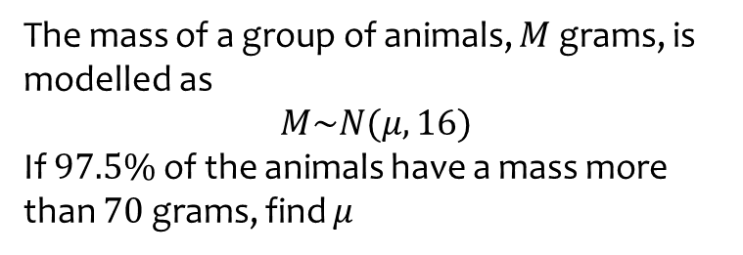
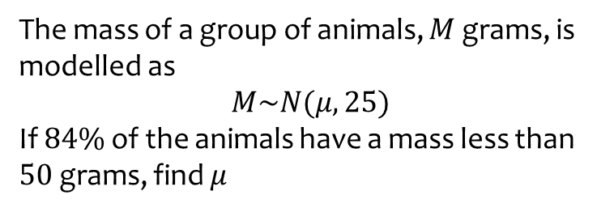
Worked example
Your turn
The mass of a group of animals, $M$ grams, is modelled as
$$M\sim N(μ, 25)$$
If $84\%$ of the animals have a mass less than $50$ grams, find $μ$
The mass of a group of animals, $M$ grams, is modelled as
$$M\sim N(μ, 16)$$
If $97.5\%$ of the animals have a mass more than $70$ grams, find $μ$
$$78$$

Slide 6
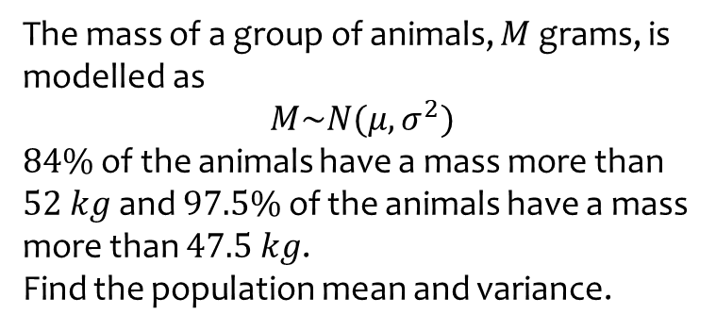
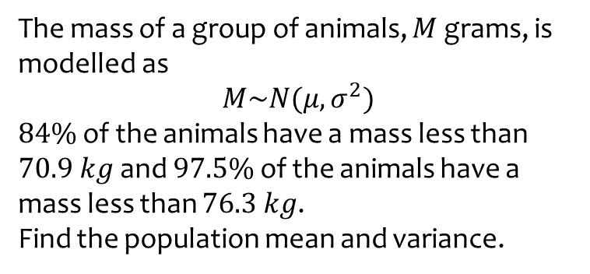

Worked example
Your turn
The mass of a group of animals, $M$ grams, is modelled as
$$M\sim N(μ, σ^{2})$$
$84\%$ of the animals have a mass less than $70.9 kg$ and $97.5\%$ of the animals have a mass less than $76.3 kg$.
Find the population mean and variance.
The mass of a group of animals, $M$ grams, is modelled as
$$M\sim N(μ, σ^{2})$$
$84\%$ of the animals have a mass more than $52 kg$ and $97.5\%$ of the animals have a mass more than $47.5 kg$.
Find the population mean and variance.
$$μ=56.5 kg$$
$$σ^{2}=20.25$$

Slide 7
3.2) Finding probabilities for normal distributions
Chapter CONTENTS

Slide 8
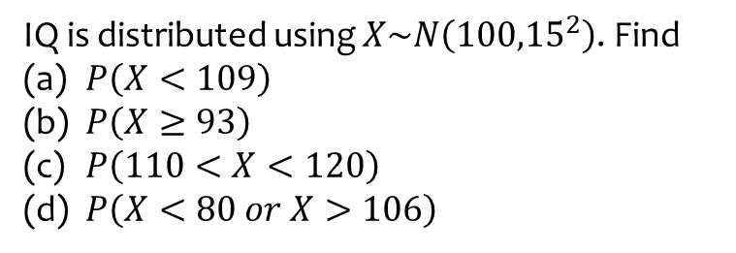
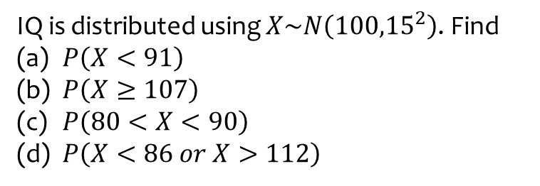
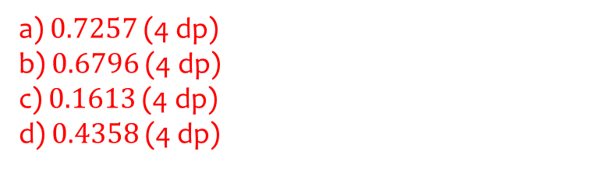
Worked example
Your turn
IQ is distributed using $X\sim N\left({100,15}^{2}\right)$. Find
$P\left(X<91\right)$
$P\left(X≥107\right)$
$P\left(80<X<90\right)$
$P\left(X<86 or X>112\right)$
IQ is distributed using $X\sim N\left({100,15}^{2}\right)$. Find
$P\left(X<109\right)$
$P\left(X≥93\right)$
$P\left(110<X<120\right)$
$P\left(X<80 or X>106\right)$
a) $0.7257$(4 dp)
b) $0.6796$ (4 dp)
c) $0.1613$ (4 dp)
d) $0.4358$ (4 dp)

Slide 9
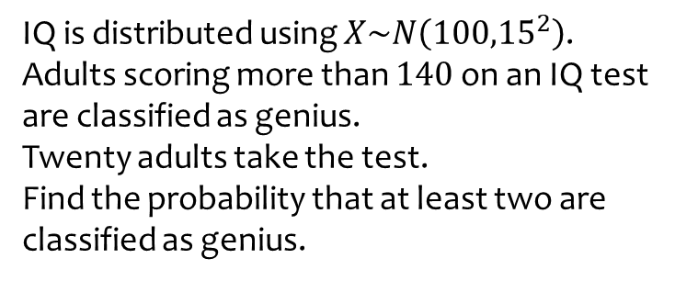
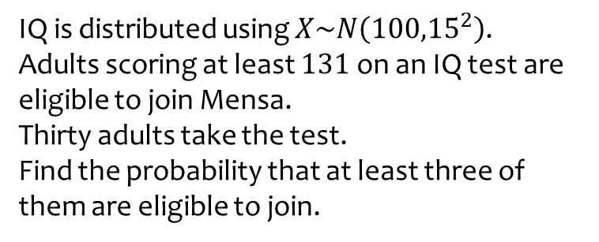

Worked example
Your turn
IQ is distributed using $X\sim N\left({100,15}^{2}\right)$.
Adults scoring at least $131$ on an IQ test are eligible to join Mensa.
Thirty adults take the test.
Find the probability that at least three of them are eligible to join.
IQ is distributed using $X\sim N\left({100,15}^{2}\right)$.
Adults scoring more than $140$ on an IQ test are classified as genius.
Twenty adults take the test.
Find the probability that at least two are classified as genius.
$0.00266$ (3 sf)

Slide 10
3.3) The inverse normal distribution function
Chapter CONTENTS

Slide 11
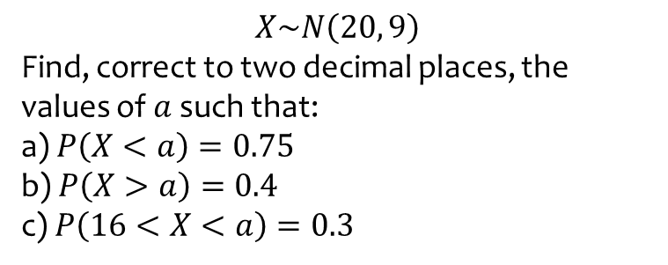
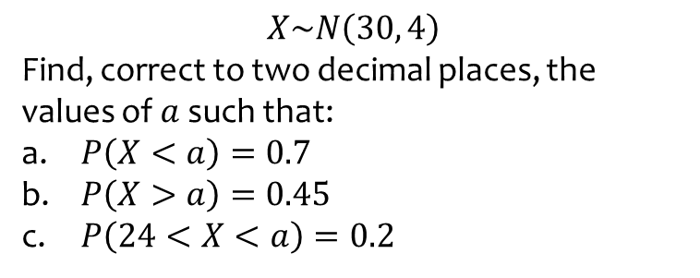
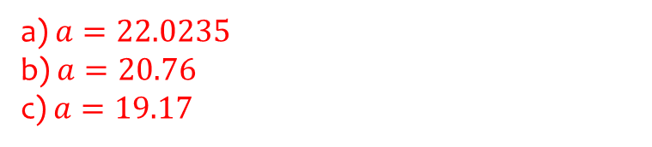
Worked example
Your turn
$$X\sim N\left(30, 4\right)$$
Find, correct to two decimal places, the values of $a$ such that:
$P\left(X<a\right)=0.7$
$P\left(X>a\right)=0.45$
$P\left(24<X<a\right)=0.2$
$$X\sim N\left(20, 9\right)$$
Find, correct to two decimal places, the values of $a$ such that:
a) $P\left(X<a\right)=0.75$
b) $P\left(X>a\right)=0.4$
c) $P\left(16<X<a\right)=0.3$
a) $a=22.0235$
b) $a=20.76$
c) $a=19.17$

Slide 12
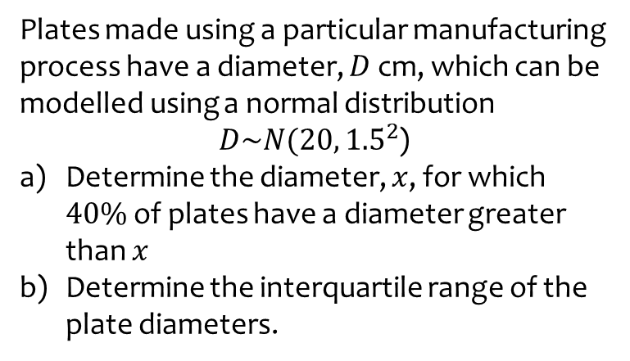
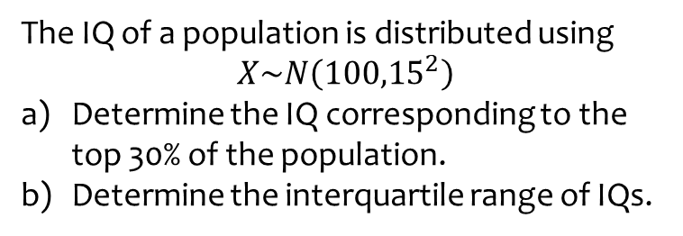
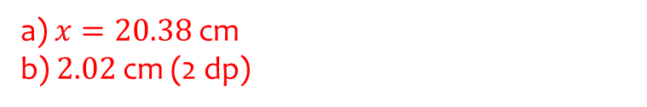
Worked example
Your turn
The IQ of a population is distributed using
$$X\sim N\left({100,15}^{2}\right)$$
Determine the IQ corresponding to the top 30% of the population.
Determine the interquartile range of IQs.
Plates made using a particular manufacturing process have a diameter, $D$ cm, which can be modelled using a normal distribution
$D\sim N(20, {1.5}^{2}$)
Determine the diameter, $x$, for which $40\%$ of plates have a diameter greater than $x$
Determine the interquartile range of the plate diameters.
a) $x=20.38$ cm
b) $2.02$ cm (2 dp)

Slide 13
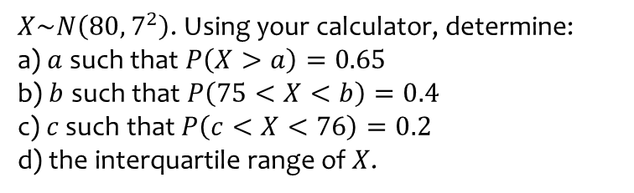
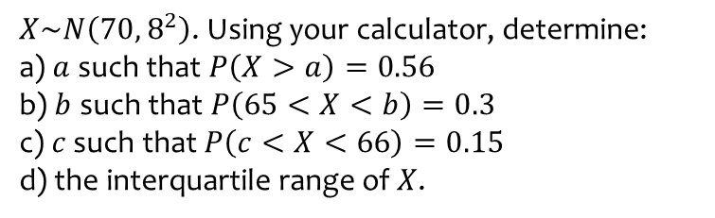
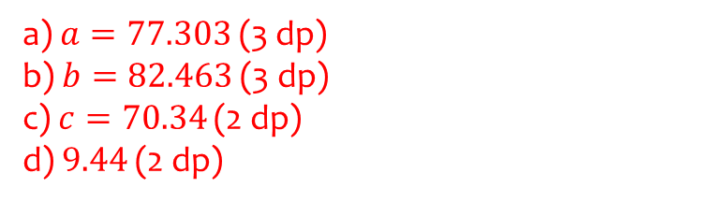
Worked example
Your turn
$X\sim N\left({70, 8}^{2}\right)$. Using your calculator, determine:
a) $a$ such that $P\left(X>a\right)=0.56$
b) $b$ such that $P\left(65<X<b\right)=0.3$
c) $c$ such that $P\left(c<X<66\right)=0.15$
d) the interquartile range of $X$.
$X\sim N\left({80, 7}^{2}\right)$. Using your calculator, determine:
a) $a$ such that $P\left(X>a\right)=0.65$
b) $b$ such that $P\left(75<X<b\right)=0.4$
c) $c$ such that $P\left(c<X<76\right)=0.2$
d) the interquartile range of $X$.
a) $a=77.303$ (3 dp)
b) $b=82.463$ (3 dp)
c) $c=70.34$ (2 dp)
d) $9.44$ (2 dp)

Slide 14
3.4) The standard normal distribution
Chapter CONTENTS

Slide 15



Worked example
Your turn
$Z$ is the number of standard deviations above the mean.
Assume $X\sim N\left({100,15}^{2}\right)$
Find $z$ if
$$X=100$$
$$X=130$$
$$X=62.5$$
$Z$ is the number of standard deviations above the mean.
Assume $X\sim N\left({100,15}^{2}\right)$
Find $Z$ if
$$X=85$$
$$X=165$$
$$Z=−1$$
$$Z=4.3333…$$

Slide 16
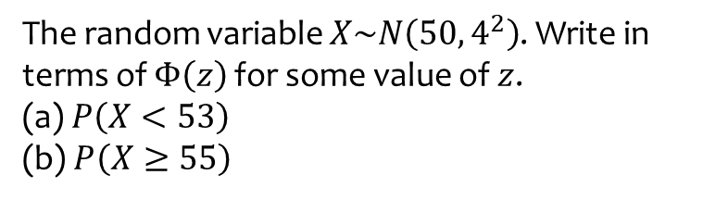

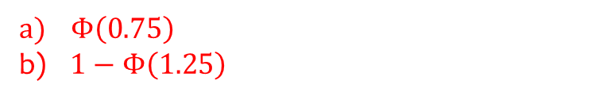
Worked example
Your turn
The random variable $X\sim N\left({40, 5}^{2}\right)$.
Write in terms of $Φ\left(z\right)$ for some value of $z$.
(a) $P\left(X≤45\right)$
(b) $P\left(X>43\right)$
The random variable $X\sim N\left({50, 4}^{2}\right)$. Write in terms of $Φ\left(z\right)$ for some value of $z$.
(a) $P\left(X<53\right)$
(b) $P\left(X≥55\right)$
$Φ\left(0.75\right)$
$1−Φ\left(1.25\right)$

Slide 17
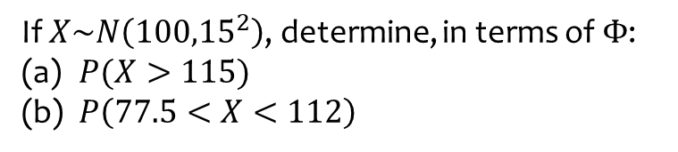
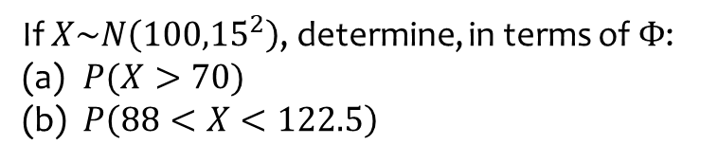
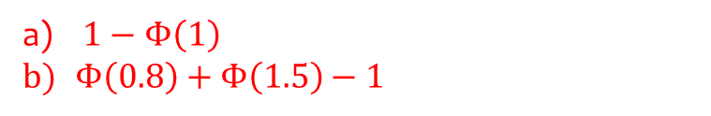
Worked example
Your turn
If $X\sim N\left({100,15}^{2}\right)$, determine, in terms of $Φ$:
$P(X>70)$
$P\left(88<X<122.5\right)$
If $X\sim N\left({100,15}^{2}\right)$, determine, in terms of $Φ$:
$P(X>115)$
$P\left(77.5<X<112\right)$
$1−Φ\left(1\right)$
$Φ\left(0.8\right)+Φ\left(1.5\right)−1$

Slide 18
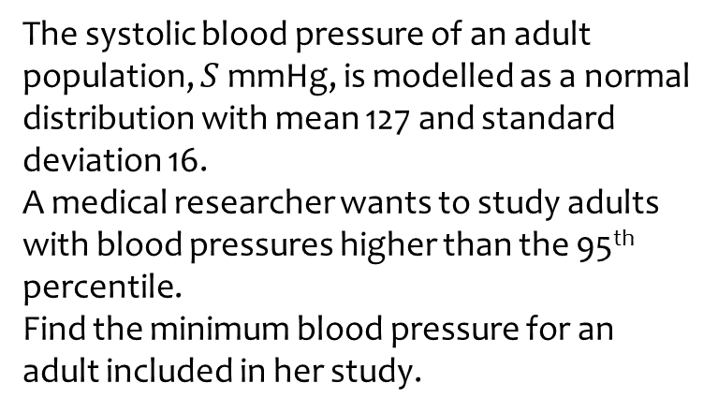
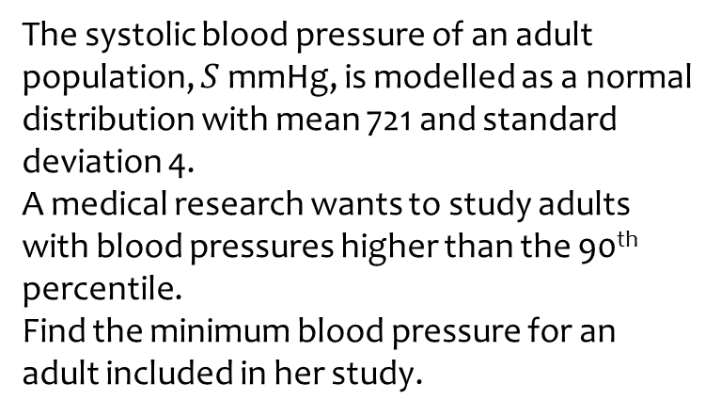

Worked example
Your turn
The systolic blood pressure of an adult population, $S$ mmHg, is modelled as a normal distribution with mean 721 and standard deviation 4.
A medical research wants to study adults with blood pressures higher than the 90th percentile.
Find the minimum blood pressure for an adult included in her study.
The systolic blood pressure of an adult population, $S$ mmHg, is modelled as a normal distribution with mean 127 and standard deviation 16.
A medical researcher wants to study adults with blood pressures higher than the 95th percentile.
Find the minimum blood pressure for an adult included in her study.
$s=153$ (3 sf)

Slide 19



Worked example
Your turn
Determine:
$$P(Z>−1.7)$$
$$P(Z≤−1.5)$$
Determine:
$$P(Z>−1.3)$$
$0.9032$ (4 dp)

Slide 20



Worked example
Your turn
Determine:
$$P\left(−1<Z<0\right)$$
$$P\left(−1.5<Z<0.5\right)$$
Determine:
$$P\left(−2<Z<1\right)$$
$0.8185$ (4 dp)

Slide 21



Worked example
Your turn
Determine $a$ such that:
$$P\left(Z>a\right)=0.3$$
$$P\left(Z<a\right)=0.4$$
Determine $a$ such that:
$$P\left(Z>a\right)=0.7$$
$a=−0.5244$ (4 dp)

Slide 22



Worked example
Your turn
Determine $a$ such that:
$$P\left(−a<Z<a\right)=0.4$$
$$P\left(−a<Z<a\right)=0.5$$
Determine $a$ such that:
$$P\left(−a<Z<a\right)=0.6$$
$a=−0.8416$ (4 dp)

Slide 23
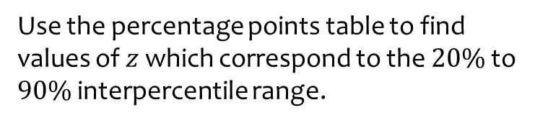
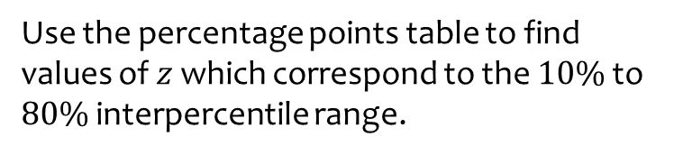
Worked example
Your turn
Use the percentage points table to find values of $z$ which correspond to the $10\%$ to $80\%$ interpercentile range.
Use the percentage points table to find values of $z$ which correspond to the $20\%$ to $90\%$ interpercentile range.
$$−0.8416<z<1.2816$$

Slide 24
3.5) Finding $μ$ and $σ$
Chapter CONTENTS

Slide 25


Worked example
Your turn
$$X\sim N\left(μ,4^{2}\right)$$
Given that $P\left(X>30\right)=0.1$, find the value of $μ$.
$$X\sim N\left(μ,3^{2}\right)$$
Given that $P\left(X>20\right)=0.2$, find the value of $μ$.
$$μ=17.5 (3sf)$$

Slide 26
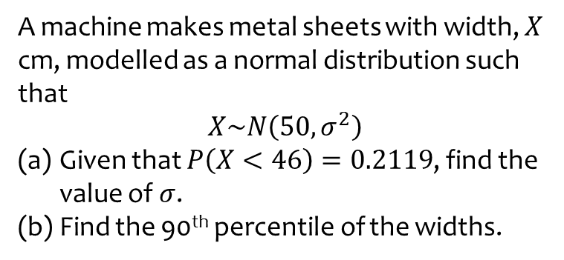
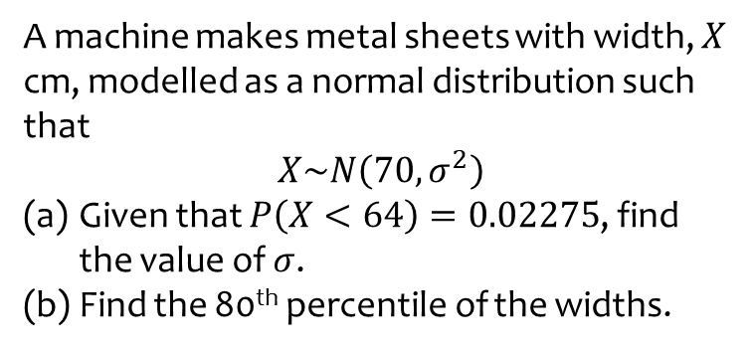
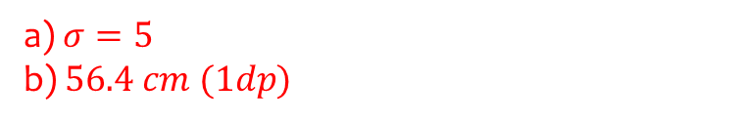
Worked example
Your turn
A machine makes metal sheets with width, $X$ cm, modelled as a normal distribution such that
$$X\sim N\left(70,σ^{2}\right)$$
Given that $P\left(X<64\right)=0.02275$, find the value of $σ$.
Find the 80th percentile of the widths.
A machine makes metal sheets with width, $X$ cm, modelled as a normal distribution such that
$$X\sim N\left(50,σ^{2}\right)$$
Given that $P\left(X<46\right)=0.2119$, find the value of $σ$.
Find the 90th percentile of the widths.
a) $σ=5$
b) $56.4 cm (1dp)$

Slide 27
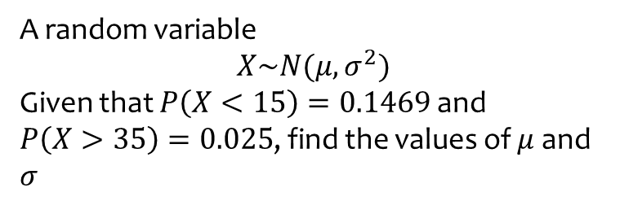
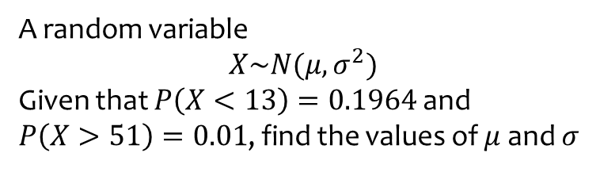

Worked example
Your turn
A random variable
$$X\sim N(μ,σ^{2})$$
Given that $P\left(X<13\right)=0.1964$ and
$P\left(X>51\right)=0.01$, find the values of $μ$ and $σ$
A random variable
$$X\sim N(μ,σ^{2})$$
Given that $P\left(X<15\right)=0.1469$ and
$P\left(X>35\right)=0.025$, find the values of $μ$ and $σ$
$σ=6.64, μ=22.0$ (3 sf)

Slide 28
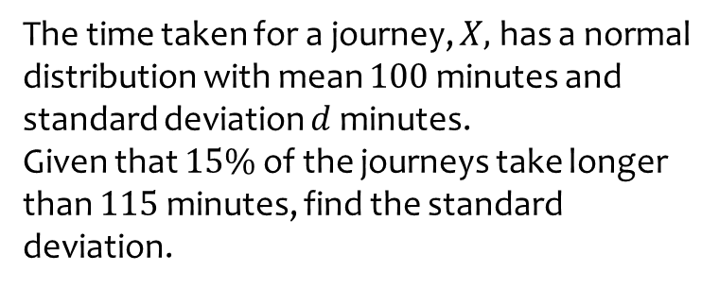
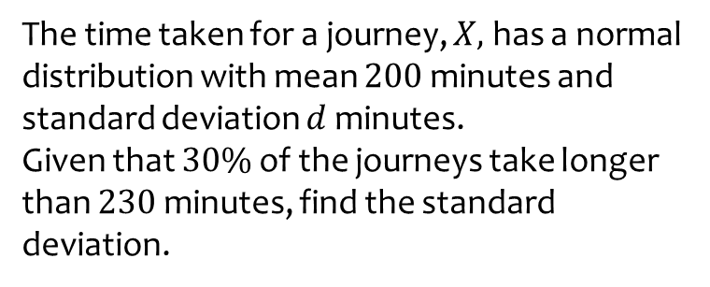
Worked example
Your turn
The time taken for a journey, $X,$ has a normal distribution with mean $200$ minutes and standard deviation $d$ minutes.
Given that $30\%$ of the journeys take longer than $230$ minutes, find the standard deviation.
The time taken for a journey, $X,$ has a normal distribution with mean $100$ minutes and standard deviation $d$ minutes.
Given that $15\%$ of the journeys take longer than $115$ minutes, find the standard deviation.
$$d=14.5$$

Slide 29
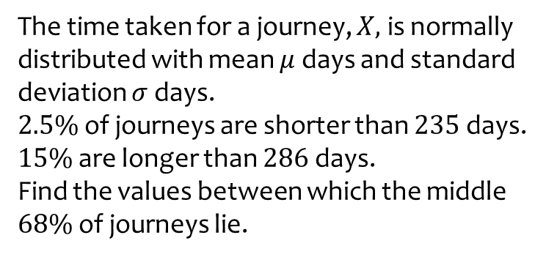
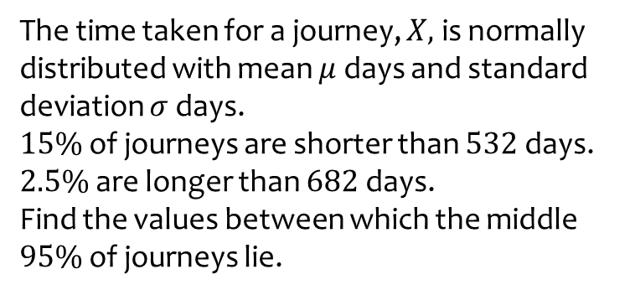

Worked example
Your turn
The time taken for a journey, $X,$ is normally distributed with mean $μ$ days and standard deviation $σ$ days.
$15\%$ of journeys are shorter than $532$ days.
$2.5\%$ are longer than $682$ days.
Find the values between which the middle $95\%$ of journeys lie.
The time taken for a journey, $X,$ is normally distributed with mean $μ$ days and standard deviation $σ$ days.
$2.5\%$ of journeys are shorter than $235$ days.
$15\%$ are longer than $286$ days.
Find the values between which the middle $68\%$ of journeys lie.
$251$ and $285$ (3 sf)

Slide 30



Worked example
Your turn
The mass of an animal is found to be normally distributed with mean $μ$ and standard deviation $σ$.
$10\%$ of the animals have a mass less than $9$ kg. $5\%$ of the animals have a mass greater than $60$ kg.
8 animals are chosen at random.
Find the probability that at least two of them have a mass greater than $50$ kg.
The mass of an animal is found to be normally distributed with mean $μ$ and standard deviation $σ$.
$5\%$ of the animals have a mass less than $18$ kg. $10\%$ of the animals have a mass greater than $30$ kg.
9 animals are chosen at random.
Find the probability that at least three of them have a mass greater than $25$ kg.
$0.8832$ (4 dp)

Slide 31
3.6) Approximating a binomial distribution
Chapter CONTENTS

Slide 32



Worked example
Your turn
A biased coin has $P\left(tails\right)=0.47$.
The coin is tossed $200$ times and the number of tails is recorded.
Write a binomial model for $X$
Show that $X$ can be approximated with a normal distribution $Y\sim N(μ, σ^{2})$ and find the values of $μ$ and $σ$
A biased coin has $P\left(tails\right)=0.53$.
The coin is tossed $100$ times and the number of tails is recorded.
Write a binomial model for $X$
Show that $X$ can be approximated with a normal distribution $Y\sim N(μ, σ^{2})$ and find the values of $μ$ and $σ$
a) $X\sim \left(100,0.53\right)$
b) $Y\sim N(53, {4.99}^{2})$

Slide 33


Worked example
Your turn
Convert these discrete probabilities, where
$$X\sim B\left(n, p\right)$$
to continuous probabilities, where
$$Y\sim N(np,np(1−p))$$
$$P(X=5)$$
$$P(X=4)$$
Convert these discrete probabilities, where
$$X\sim B\left(n, p\right)$$
to continuous probabilities, where
$$Y\sim N(np,np(1−p))$$
$$P(X=3)$$
$$≈P\left(2.5≤Y≤3.5\right)$$

Slide 34


Worked example
Your turn
Convert these discrete probabilities, where
$$X\sim B\left(n, p\right)$$
to continuous probabilities, where
$$Y\sim N(np,np(1−p))$$
$$P(X≤5)$$
$$P(X≤4)$$
Convert these discrete probabilities, where
$$X\sim B\left(n, p\right)$$
to continuous probabilities, where
$$Y\sim N(np,np(1−p))$$
$$P(X≤3)$$
$$≈P\left(Y≤3.5\right)$$

Slide 35


Worked example
Your turn
Convert these discrete probabilities, where
$$X\sim B\left(n, p\right)$$
to continuous probabilities, where
$$Y\sim N(np,np(1−p))$$
$$P(X<5)$$
$$P(X<4)$$
Convert these discrete probabilities, where
$$X\sim B\left(n, p\right)$$
to continuous probabilities, where
$$Y\sim N(np,np(1−p))$$
$$P(X<3)$$
$$≈P\left(Y≤2.5\right)$$

Slide 36


Worked example
Your turn
Convert these discrete probabilities, where
$$X\sim B\left(n, p\right)$$
to continuous probabilities, where
$$Y\sim N(np,np(1−p))$$
$$P(X≥5)$$
$$P(X≥4)$$
Convert these discrete probabilities, where
$$X\sim B\left(n, p\right)$$
to continuous probabilities, where
$$Y\sim N(np,np(1−p))$$
$$P(X≥3)$$
$$≈P\left(Y≥2.5\right)$$

Slide 37


Worked example
Your turn
Convert these discrete probabilities, where
$$X\sim B\left(n, p\right)$$
to continuous probabilities, where
$$Y\sim N(np,np(1−p))$$
$$P(X>5)$$
$$P(X>4)$$
Convert these discrete probabilities, where
$$X\sim B\left(n, p\right)$$
to continuous probabilities, where
$$Y\sim N(np,np(1−p))$$
$$P(X>3)$$
$$≈P\left(Y≥3.5\right)$$

Slide 38


Worked example
Your turn
Convert these discrete probabilities, where
$$X\sim B\left(n, p\right)$$
to continuous probabilities, where
$$Y\sim N(np,np(1−p))$$
$$P(5≤X≤8)$$
$$P(4<X<7)$$
Convert these discrete probabilities, where
$$X\sim B\left(n, p\right)$$
to continuous probabilities, where
$$Y\sim N(np,np(1−p))$$
$$P(3<X<6)$$
$$≈P\left(3.5≤Y≤5.5\right)$$

Slide 39


Worked example
Your turn
Convert these discrete probabilities, where
$$X\sim B\left(n, p\right)$$
to continuous probabilities, where
$$Y\sim N(np,np(1−p))$$
$$P(5<X≤8)$$
$$P(4≤X<7)$$
Convert these discrete probabilities, where
$$X\sim B\left(n, p\right)$$
to continuous probabilities, where
$$Y\sim N(np,np(1−p))$$
$$P(3<X≤6)$$
$$≈P\left(3.5≤Y≤6.5\right)$$

Slide 40

Worked example
Your turn
For a particular type of flower bulbs, 44% will produce red flowers. A random sample of 160 bulbs is planted.
Calculate the actual probability that there are exactly 70 red flowers.
Use a normal approximation to find a estimate that there are exactly 70 red flowers.
Hence determine the percentage error of the normal approximation for 70 red flowers.
For a particular type of flower bulbs, 55% will produce yellow flowers. A random sample of 80 bulbs is planted.
Calculate the actual probability that there are exactly 50 yellow flowers.
Use a normal approximation to find a estimate that there are exactly 50 yellow flowers.
Hence determine the percentage error of the normal approximation for 50 yellow flowers.
a) $0.0365$
b) $0.0362 (4dp)$
c) $0.82\%$ (2 dp)

Slide 41



Worked example
Your turn
The random variable
$$X\sim B(100, 0.51)$$
Use a suitable approximation to estimate:
$$P(X=45)$$
$$P(X>54)$$
$$P(X≤43)$$
$$P(47<X≤51)$$
The random variable
$$X\sim B(200, 0.47)$$
Use a suitable approximation to estimate:
$$P(X=87)$$
$$P(X>102)$$
$$P(X≤91)$$
$$P(89≤X<98)$$
$0.0346$ (4 dp)
$0.1142$ (4 dp)
$0.3616$ (4 dp)
$0.4721$ (4 dp)

Slide 42
3.7) Hypothesis testing with the normal distribution
Chapter CONTENTS

Slide 43



Worked example
Your turn
A random sample of size $n$ is taken from a population $X$ having a normal distribution with mean $μ$ and variance $σ^{2}$. Conduct a hypothesis test on the population mean, given:
Sample size $n=40$
Sample mean $\overline{x}=49$
Population standard deviation $σ=4$
5% significance level
$$H_{0}: μ=50$$
$$H_{1}: μ<50$$
A random sample of size $n$ is taken from a population $X$ having a normal distribution with mean $μ$ and variance $σ^{2}$. Conduct a hypothesis test on the population mean, given:
Sample size $n=30$
Sample mean $\overline{x}=49$
Population standard deviation $σ=4$
10% significance level
$$H_{0}: μ=50$$
$$H_{1}: μ<50$$
Assume $H_{0}$ true: $X\sim N\left({50,4}^{2} \right)$
$$\overline{X}\sim N(50,\frac{4^{2}}{30})$$
$$\overline{X}\sim N(50,{\left(\frac{4}{\sqrt{30}}\right)}^{2})$$
Reject $H_{0}$ if $P\left(\overline{X}≤49\right)<0.1$
$$P\left(\overline{X}≤49\right)=0.0854…<0.1$$
The result is significant.
Sufficient evidence to reject $H_{0}$.
Sufficient evidence to suggest $μ<50$

Slide 44



Worked example
Your turn
A random sample of size $n$ is taken from a population $X$ having a normal distribution with mean $μ$ and variance $σ^{2}$. Conduct a hypothesis test on the population mean, given:
Sample size $n=30$
Sample mean $\overline{x}=51$
Population standard deviation $σ=4$
10% significance level
$$H_{0}: μ=50$$
$$H_{1}: μ>50$$
A random sample of size $n$ is taken from a population $X$ having a normal distribution with mean $μ$ and variance $σ^{2}$. Conduct a hypothesis test on the population mean, given:
Sample size $n=40$
Sample mean $\overline{x}=51$
Population standard deviation $σ=4$
5% significance level
$$H_{0}: μ=50$$
$$H_{1}: μ>50$$
Assume $H_{0}$ true: $X\sim N\left({50,4}^{2} \right)$
$$\overline{X}\sim N(50,\frac{4^{2}}{40})$$
$$\overline{X}\sim N(50,{\left(\frac{4}{\sqrt{40}}\right)}^{2})$$
Reject $H_{0}$ if $P\left(\overline{X}≥51\right)<0.05$
$$P\left(\overline{X}≥51\right)=0.0569…>0.05$$
The result is not significant.
Insufficient evidence to reject $H_{0}$.
Insufficient evidence to suggest $μ>50$

Slide 45



Worked example
Your turn
A random sample of size $n$ is taken from a population $X$ having a normal distribution with mean $μ$ and variance $σ^{2}$. Conduct a hypothesis test on the population mean, given:
Sample size $n=61$
Sample mean $\overline{x}=51$
Population standard deviation $σ=4$
10% significance level
$$H_{0}: μ=50$$
$$H_{1}: μ≠50$$
A random sample of size $n$ is taken from a population $X$ having a normal distribution with mean $μ$ and variance $σ^{2}$. Conduct a hypothesis test on the population mean, given:
Sample size $n=62$
Sample mean $\overline{x}=51$
Population standard deviation $σ=4$
5% significance level
$$H_{0}: μ=50$$
$$H_{1}: μ≠50$$
Assume $H_{0}$ true: $X\sim N\left({50,4}^{2} \right)$
$$\overline{X}\sim N(50,\frac{4^{2}}{62})$$
$$\overline{X}\sim N(50,{\left(\frac{4}{\sqrt{62}}\right)}^{2})$$
Reject $H_{0}$ if $P\left(\overline{X}≥51\right)<0.025$
$$P\left(\overline{X}≥51\right)=0.0245…<0.025$$
The result is significant.
Sufficient evidence to reject $H_{0}$.
Sufficient evidence to suggest $μ≠50$

Slide 46



Worked example
Your turn
A random sample of size $n$ is taken from a population $X$ having a normal distribution with mean $μ$ and variance $σ^{2}$. Conduct a hypothesis test on the population mean, given:
Sample size $n=62$
Sample mean $\overline{x}=49$
Population standard deviation $σ=4$
2% significance level
$$H_{0}: μ=50$$
$$H_{1}: μ≠50$$
A random sample of size $n$ is taken from a population $X$ having a normal distribution with mean $μ$ and variance $σ^{2}$. Conduct a hypothesis test on the population mean, given:
Sample size $n=61$
Sample mean $\overline{x}=49$
Population standard deviation $σ=4$
1% significance level
$$H_{0}: μ=50$$
$$H_{1}: μ≠50$$
Assume $H_{0}$ true: $X\sim N\left({50,4}^{2} \right)$
$$\overline{X}\sim N(50,\frac{4^{2}}{61})$$
$$\overline{X}\sim N(50,{\left(\frac{4}{\sqrt{61}}\right)}^{2})$$
Reject $H_{0}$ if $P\left(\overline{X}≤49\right)<0.005$
$$P\left(\overline{X}≤49\right)=0.0254…>0.005$$
The result is not significant.
Insufficient evidence to reject $H_{0}$.
Insufficient evidence to suggest $μ≠50$

Slide 47



Worked example
Your turn
A random sample of size $n$ is taken from a population $X$ having a normal distribution with mean $μ$ and variance $σ^{2}$. Find the critical region for the test statistic $\overline{X}$ in a hypothesis test on the population mean, given:
Sample size $n=30$
Population standard deviation $σ=4$
5% significance level
$$H_{0}: μ=50$$
$$H_{1}: μ<50$$
A random sample of size $n$ is taken from a population $X$ having a normal distribution with mean $μ$ and variance $σ^{2}$. Find the critical region for the test statistic $\overline{X}$ in a hypothesis test on the population mean, given:
Sample size $n=40$
Population standard deviation $σ=4$
10% significance level
$$H_{0}: μ=50$$
$$H_{1}: μ<50$$
Assume $H_{0}$ true: $X\sim N\left({50,4}^{2} \right)$
$\overline{X}\sim N(50,\frac{4^{2}}{40})$
$\overline{X}\sim N(50,{\left(\frac{4}{\sqrt{40}}\right)}^{2})$
$$Z=\frac{\overline{X}−50}{\frac{4}{\sqrt{40}}}$$
$P\left(Z<z\right)=0.1$ -> $z=−1.28155…$
$$−1.28155…=\frac{\overline{X}−50}{\frac{4}{\sqrt{40}}}$$
$$\overline{X}=−1.28155…×\frac{4}{\sqrt{40}}+50=49.189…$$
Critical region is $\overline{X}<49.19$ (2 dp)

Slide 48



Worked example
Your turn
A random sample of size $n$ is taken from a population $X$ having a normal distribution with mean $μ$ and variance $σ^{2}$.
a) Find the critical region for the test statistic $\overline{X}$ in a hypothesis test on the population mean, given:
Sample size $n=30$
Population standard deviation $σ=4$
5% significance level
$$H_{0}: μ=50$$
$$H_{1}: μ<50$$
b) The mean of the sample of $50$ was found to be
$48.9$. Comment on this observation in light of
the critical region.
A random sample of size $n$ is taken from a population $X$ having a normal distribution with mean $μ$ and variance $σ^{2}$.
a) Find the critical region for the test statistic $\overline{X}$ in a hypothesis test on the population mean, given:
Sample size $n=40$
Population standard deviation $σ=4$
10% significance level
$$H_{0}: μ=50$$
$$H_{1}: μ<50$$
b) The mean of the sample of $50$ was found to be
$48.9$. Comment on this observation in light of
the critical region.
Assume $H_{0}$ true: $X\sim N\left({50,4}^{2} \right)$
$\overline{X}\sim N(50,\frac{4^{2}}{40})$
$\overline{X}\sim N(50,{\left(\frac{4}{\sqrt{40}}\right)}^{2})$
$$Z=\frac{\overline{X}−50}{\frac{4}{\sqrt{40}}}$$
$P\left(Z<z\right)=0.1$ -> $z=−1.28155…$
$$−1.28155…=\frac{\overline{X}−50}{\frac{4}{\sqrt{40}}}$$
$$\overline{X}=−1.28155…×\frac{4}{\sqrt{40}}+50=49.189…$$
Critical region is $\overline{X}<49.19$ (2 dp)
b) $48.9$ is in the critical region.
The result is significant.
Sufficient evidence to reject $H_{0}$.
Sufficient evidence to suggest $μ<50$

Slide 49



Worked example
Your turn
A random sample of size $n$ is taken from a population $X$ having a normal distribution with mean $μ$ and variance $σ^{2}$. Find the critical region for the test statistic $\overline{X}$ in a hypothesis test on the population mean, given:
Sample size $n=40$
Population standard deviation $σ=4$
10% significance level
$$H_{0}: μ=50$$
$$H_{1}: μ>50$$
A random sample of size $n$ is taken from a population $X$ having a normal distribution with mean $μ$ and variance $σ^{2}$. Find the critical region for the test statistic $\overline{X}$ in a hypothesis test on the population mean, given:
Sample size $n=30$
Population standard deviation $σ=4$
5% significance level
$$H_{0}: μ=50$$
$$H_{1}: μ>50$$
Assume $H_{0}$ true: $X\sim N\left({50,4}^{2} \right)$
$\overline{X}\sim N(50,\frac{4^{2}}{30})$
$\overline{X}\sim N(50,{\left(\frac{4}{\sqrt{30}}\right)}^{2})$
$$Z=\frac{\overline{X}−50}{\frac{4}{\sqrt{30}}}$$
$P\left(Z>z\right)=0.05$ -> $z=1.64485…$
$$1.64485…=\frac{\overline{X}−50}{\frac{4}{\sqrt{30}}}$$
$$\overline{X}=1.64485…×\frac{4}{\sqrt{30}}+50=51.201…$$
Critical region is $\overline{X}>51.20$ (2 dp)

Slide 50



Worked example
Your turn
A random sample of size $n$ is taken from a population $X$ having a normal distribution with mean $μ$ and variance $σ^{2}$.
a) Find the critical region for the test statistic $\overline{X}$ in a hypothesis test on the population mean, given:
Sample size $n=40$
Population standard deviation $σ=4$
10% significance level
$$H_{0}: μ=50$$
$$H_{1}: μ>50$$
b) The mean of the sample of $50$ was found to be
$50.9$. Comment on this observation in light of
the critical region.
A random sample of size $n$ is taken from a population $X$ having a normal distribution with mean $μ$ and variance $σ^{2}$.
a) Find the critical region for the test statistic $\overline{X}$ in a hypothesis test on the population mean, given:
Sample size $n=30$
Population standard deviation $σ=4$
5% significance level
$$H_{0}: μ=50$$
$$H_{1}: μ>50$$
b) The mean of the sample of $50$ was found to be
$50.9$. Comment on this observation in light of
the critical region.
Assume $H_{0}$ true: $X\sim N\left({50,4}^{2} \right)$
$\overline{X}\sim N(50,\frac{4^{2}}{30})$
$\overline{X}\sim N(50,{\left(\frac{4}{\sqrt{30}}\right)}^{2})$
$$Z=\frac{\overline{X}−50}{\frac{4}{\sqrt{30}}}$$
$P\left(Z>z\right)=0.05$ -> $z=1.64485…$
$$1.64485…=\frac{\overline{X}−50}{\frac{4}{\sqrt{30}}}$$
$$\overline{X}=1.64485…×\frac{4}{\sqrt{30}}+50=51.201…$$
Critical region is $\overline{X}>51.20$ (2 dp)
b) $50.9$ is not in the critical region.
The result is not significant.
Insufficient evidence to reject $H_{0}$.
Insufficient evidence to suggest $μ>50$

Slide 51



Worked example
Your turn
A random sample of size $n$ is taken from a population $X$ having a normal distribution with mean $μ$ and variance $σ^{2}$. Find the critical regions for the test statistic $\overline{X}$ in a hypothesis test on the population mean, given:
Sample size $n=40$
Population standard deviation $σ=4$
1% significance level
$$H_{0}: μ=50$$
$$H_{1}: μ≠50$$
A random sample of size $n$ is taken from a population $X$ having a normal distribution with mean $μ$ and variance $σ^{2}$. Find the critical regions for the test statistic $\overline{X}$ in a hypothesis test on the population mean, given:
Sample size $n=30$
Population standard deviation $σ=4$
5% significance level
$$H_{0}: μ=50$$
$$H_{1}: μ≠50$$
Assume $H_{0}$ true: $X\sim N\left({50,4}^{2} \right)$
$\overline{X}\sim N(50,\frac{4^{2}}{30})$
$\overline{X}\sim N(50,{\left(\frac{4}{\sqrt{30}}\right)}^{2})$
$$Z=\frac{\overline{X}−50}{\frac{4}{\sqrt{30}}}$$
$$z=±1.95996…$$
$−1.95996…=\frac{\overline{X}−50}{\frac{4}{\sqrt{30}}}$ $1.95996…=\frac{\overline{X}−50}{\frac{4}{\sqrt{30}}}$
$\overline{X}=−1.95996…×\frac{4}{\sqrt{30}}+50$ $\overline{X}=1.95996…×\frac{4}{\sqrt{30}}+50$
$=48.568…$ $=51.431….$
Critical region is $\overline{X}<48.57$ or $\overline{X}>51.43$ (2 dp)

Slide 52



Worked example
Your turn
A random sample of size $n$ is taken from a population $X$ having a normal distribution with mean $μ$ and variance $σ^{2}$.
a) Find the critical regions for the test statistic $\overline{X}$ in a hypothesis test on the population mean, given:
Sample size $n=40$
Population standard deviation $σ=4$
1% significance level
$$H_{0}: μ=50$$
$$H_{1}: μ≠50$$
b) The mean of the sample of $50$ was found to be
$48.38$. Comment on this observation in light of
the critical region.
A random sample of size $n$ is taken from a population $X$ having a normal distribution with mean $μ$ and variance $σ^{2}$.
a) Find the critical regions for the test statistic $\overline{X}$ in a hypothesis test on the population mean, given:
Sample size $n=30$
Population standard deviation $σ=4$
5% significance level
$$H_{0}: μ=50$$
$$H_{1}: μ≠50$$
b) The mean of the sample of $50$ was found to be
$48.38$. Comment on this observation in light of
the critical region.
a) Assume $H_{0}$ true: $X\sim N\left({50,4}^{2} \right)$
$\overline{X}\sim N(50,\frac{4^{2}}{30})$
$\overline{X}\sim N(50,{\left(\frac{4}{\sqrt{30}}\right)}^{2})$
$$Z=\frac{\overline{X}−50}{\frac{4}{\sqrt{30}}}$$
$$z=±1.95996…$$
$−1.95996…=\frac{\overline{X}−50}{\frac{4}{\sqrt{30}}}$ $1.95996…=\frac{\overline{X}−50}{\frac{4}{\sqrt{30}}}$
$\overline{X}=−1.95996…×\frac{4}{\sqrt{30}}+50$ $\overline{X}=1.95996…×\frac{4}{\sqrt{30}}+50$
$=48.568…$ $=51.431….$
Critical region is $\overline{X}<48.57$ or $\overline{X}>51.43$ (2 dp)
b) $48.38$ is in the critical region.
The result is significant.
Sufficient evidence to reject $H_{0}$.
Sufficient evidence to suggest $μ≠50$

Slide 53



Worked example
Your turn
A random sample of size $n$ is taken from a population $X$ having a normal distribution with mean $μ$ and variance $σ^{2}$.
a) Find the critical regions for the test statistic $\overline{X}$ in a hypothesis test on the population mean, given:
Sample size $n=40$
Population standard deviation $σ=4$
1% significance level
$$H_{0}: μ=50$$
$$H_{1}: μ≠50$$
b) The mean of the sample of $50$ was found to be
$51.64$. Comment on this observation in light of
the critical region.
A random sample of size $n$ is taken from a population $X$ having a normal distribution with mean $μ$ and variance $σ^{2}$.
a) Find the critical regions for the test statistic $\overline{X}$ in a hypothesis test on the population mean, given:
Sample size $n=30$
Population standard deviation $σ=4$
5% significance level
$$H_{0}: μ=50$$
$$H_{1}: μ≠50$$
b) The mean of the sample of $50$ was found to be
$51.64$. Comment on this observation in light of
the critical region.
a) Assume $H_{0}$ true: $X\sim N\left({50,4}^{2} \right)$
$\overline{X}\sim N(50,\frac{4^{2}}{30})$
$\overline{X}\sim N(50,{\left(\frac{4}{\sqrt{30}}\right)}^{2})$
$$Z=\frac{\overline{X}−50}{\frac{4}{\sqrt{30}}}$$
$$z=±1.95996…$$
$−1.95996…=\frac{\overline{X}−50}{\frac{4}{\sqrt{30}}}$ $1.95996…=\frac{\overline{X}−50}{\frac{4}{\sqrt{30}}}$
$\overline{X}=−1.95996…×\frac{4}{\sqrt{30}}+50$ $\overline{X}=1.95996…×\frac{4}{\sqrt{30}}+50$
$=48.568…$ $=51.431….$
Critical region is $\overline{X}<48.57$ or $\overline{X}>51.43$ (2 dp)
b) $51.64$ is in the critical region.
The result is significant.
Sufficient evidence to reject $H_{0}$.
Sufficient evidence to suggest $μ≠50$

Slide 54



Worked example
Your turn
A certain company sells fruit juice in cartons.
The amount of juice in a carton has a normal distribution with a standard deviation of 5ml.
The company claims that the mean amount of juice per carton, $μ$, is 40ml.
A trading inspector has received complaints that the company is overstating the mean amount of juice per carton and wishes to investigate this complaint. The trading inspector takes a random sample of 36 cartons and finds that the mean amount of juice per carton is 38.9ml.
Using a 5% level of significance, and stating your hypotheses clearly, test whether or not there is evidence to uphold this complaint.
A certain company sells fruit juice in cartons.
The amount of juice in a carton has a normal distribution with a standard deviation of 3ml.
The company claims that the mean amount of juice per carton, $μ$, is 60ml.
A trading inspector has received complaints that the company is overstating the mean amount of juice per carton and wishes to investigate this complaint. The trading inspector takes a random sample of 16 cartons and finds that the mean amount of juice per carton is 59.1ml.
Using a 5% level of significance, and stating your hypotheses clearly, test whether or not there is evidence to uphold this complaint.
$X=$ amount of juice per carton
$$H_{0}: μ=60$$
$$H_{1}: μ<60$$
Assume $H_{0}$ true: $X\sim N\left({60,3}^{2} \right)$
$\overline{X}\sim N(60,\frac{3^{2}}{16})$
$\overline{X}\sim N(50,{\left(\frac{3}{4}\right)}^{2})$
Reject $H_{0}$ if $P\left(\overline{X}≤59.1\right)<0.05$
$$P\left(\overline{X}≥59.1\right)=0.1151…≮0.05$$
The result is not significant.
Insufficient evidence to reject $H_{0}$.
Insufficient evidence to suggest the company is overstating the mean amount of juice per carton.

Slide 55



Worked example
Your turn
A machine products bolts of diameter $D$ where $D$ has a normal distribution with mean 0.580 cm and standard deviation 0.015 cm. The machine is serviced and after the service a random sample of 50 bolts from the next production run is taken to see if the mean diameter of the bolts has changed from 0.580 cm. The distribution of the diameters of bolts after the service is still normal with a standard deviation of 0.015 cm.
Find, at the 1% level, the critical region for this test, stating your hypotheses clearly.
The mean diameter of the sample of 50 bolts is calculated to be 0.587 cm.
(b) Comment on this observation in light of the critical region.
A machine products bolts of diameter $D$ where $D$ has a normal distribution with mean 0.580 cm and standard deviation 0.015 cm. The machine is serviced and after the service a random sample of 50 bolts from the next production run is taken to see if the mean diameter of the bolts has changed from 0.580 cm. The distribution of the diameters of bolts after the service is still normal with a standard deviation of 0.015 cm.
Find, at the 1% level, the critical region for this test, stating your hypotheses clearly.
The mean diameter of the sample of 50 bolts is calculated to be 0.587 cm.
(b) Comment on this observation in light of the critical region.
a) $H_{0}:μ=0.580$
$H_{1}:μ≠0.580$
Assume $H_{0}$ true: $D\sim N\left({0.580, 0.015}^{2} \right)$
$\overline{D}\sim N(0.0580,\frac{{0.015}^{2}}{50})$
$\overline{D}\sim N\left(0.580, {\left(\frac{0.015}{\sqrt{50}}\right)}^{2}\right)$
$Z=\frac{\overline{D}−0.580}{\frac{0.015}{\sqrt{50}}}$
$$z=±2.5758…$$
$−2.5758…=\frac{\overline{D}−0.580}{\frac{0.015}{\sqrt{50}}} 2.5758…=\frac{\overline{D}−0.580}{\frac{0.015}{\sqrt{50}}}$
$\overline{D}=−2.5758…×\frac{0.015}{\sqrt{50}}+0.580$ $\overline{D}=2.5758…×\frac{0.015}{\sqrt{50}}+0.580$
Critical region is $\overline{D}<0.575$ or $\overline{D}>0.585 (3sf)$
b) $0.587$ is in the critical region.
The result is significant.
Sufficient evidence to reject $H_{0}$.
Sufficient evidence to suggest the mean diameter of bolts has changed.

Slide 56
3.x) Conditional probabilities
Chapter CONTENTS

Slide 57



Worked example
Your turn
The time taken, $X$ minutes, for a flight has a normal distribution with mean $μ$ minutes.
Given that $P\left(X<μ−25\right)=0.45$,
Find $P\left(X>μ+25 \right| X>μ−25)$
The time taken, $X$ minutes, for a flight has a normal distribution with mean $μ$ minutes.
Given that $P\left(X<μ−15\right)=0.35$,
Find $P\left(X>μ+15 \right| X>μ−15)$
$$\frac{7}{13}$$

Slide 58



Worked example
Your turn
The length of time, $L$ hours, that a phone will work before it needs charging is normally distributed with a mean of $20$ hours and a standard deviation of $3$ hours.
A person is about to go on a $2$ hour journey.
Given that it is $25$ hours since they last charged their phone, find the probability that their phone will not need charging before the journey is completed.
The length of time, $L$ hours, that a phone will work before it needs charging is normally distributed with a mean of $100$ hours and a standard deviation of $15$ hours.
A person is about to go on a $6$ hour journey.
Given that it is $127$ hours since they last charged their phone, find the probability that their phone will not need charging before the journey is completed.
$0.39$ (2 sf)

