Slide 1
3) Representations of data
3.1) Outliers
3.2) Box plots
3.3) Cumulative frequency
3.4) Histograms
3.5) Comparing data

Slide 2
3.1) Outliers
Chapter CONTENTS

Slide 3
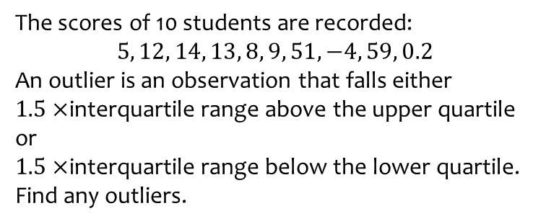
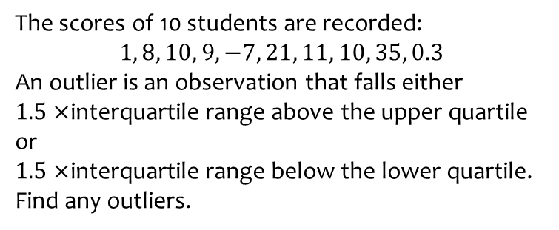
Worked example
Your turn
The scores of 10 students are recorded:
$$1, 8, 10, 9, −7, 21, 11, 10, 35, 0.3$$
An outlier is an observation that falls either $1.5×$interquartile range above the upper quartile or
$1.5×$interquartile range below the lower quartile.
Find any outliers.
The scores of 10 students are recorded:
$$5, 12, 14, 13, 8, 9, 51, −4, 59, 0.2$$
An outlier is an observation that falls either $1.5×$interquartile range above the upper quartile or
$1.5×$interquartile range below the lower quartile.
Find any outliers.
$$−4, 51, 59$$

Slide 4
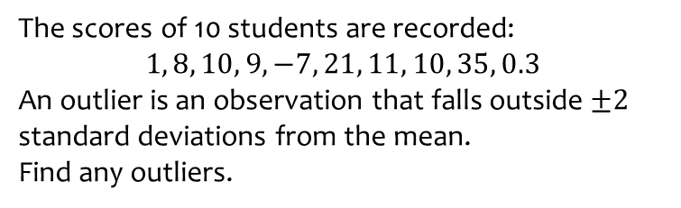
Worked example
Your turn
The scores of 10 students are recorded:
$$1, 8, 10, 9, −7, 21, 11, 10, 35, 0.3$$
An outlier is an observation that falls outside $±2$ standard deviations from the mean.
Find any outliers.
The scores of 10 students are recorded:
$$5, 12, 14, 13, 8, 9, 51, −4, 59, 0.2$$
An outlier is an observation that falls either $1.5×$interquartile range above the upper quartile or
$1.5×$interquartile range below the lower quartile.
Find any outliers.
$$59$$

Slide 5


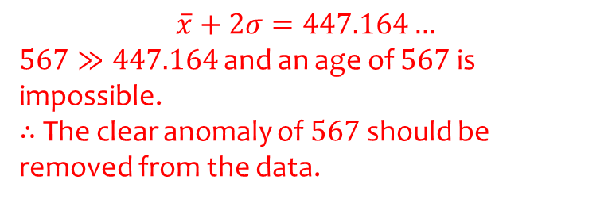
Worked example
Your turn
Clean this data on ages of people in a group:
$$12, 13, 14, 12, 13, 156$$
Clean this data on ages of people in a group:
$$5, 7, 6, 5, 5, 567, 7, 6$$
$$\overline{x}+2σ=447.164…$$
$567≫447.164$ and an age of $567$ is impossible.
$∴$ The clear anomaly of $567$ should be removed from the data.

Slide 6
3.2) Box plots
Chapter CONTENTS

Slide 7
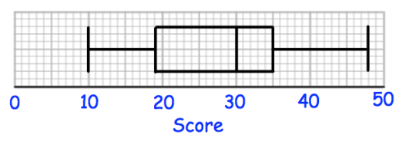
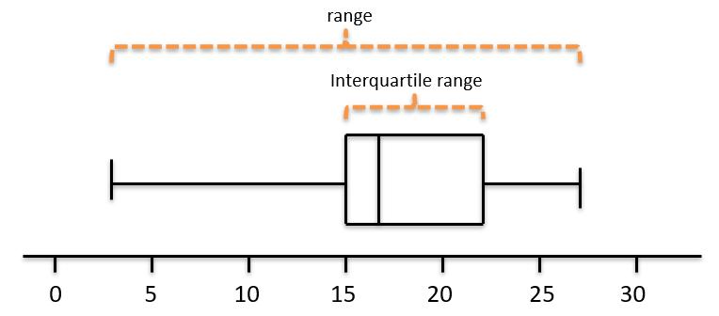

Worked example
Your turn
Using the box plot, write down:
The minimum
The lower quartile
The median
The upper quartile
The maximum
The range
The interquartile range
Using the box plot, write down:
The minimum
The lower quartile
The median
The upper quartile
The maximum
The range
The interquartile range
$$3$$
$$15$$
$$17$$
$$22$$
$$27$$
$$24$$
$$7$$
Questions used with permission from Corbettmaths (https://corbettmaths.com/) and Drfrostmaths (https://www.drfrostmaths.com/)

Slide 8
Worked example
Your turn
Sketch a box plot given the following data:
Sketch a box plot given the following data:
Minimum | Lower Quartile | Median | Upper Quartile | Maximum
2 | 11 | 18 | 20 | 29
Minimum | Lower Quartile | Median | Upper Quartile | Maximum
3 | 15 | 17 | 22 | 27
Diagrams/Graphs used with permission from DrFrostMaths: https://www.drfrostmaths.com/

Slide 9
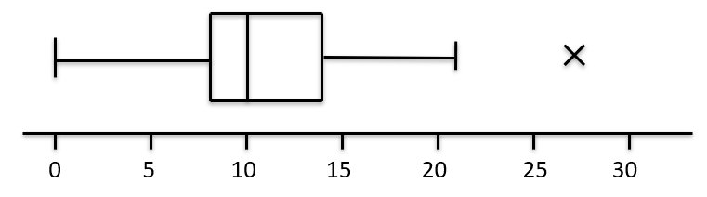
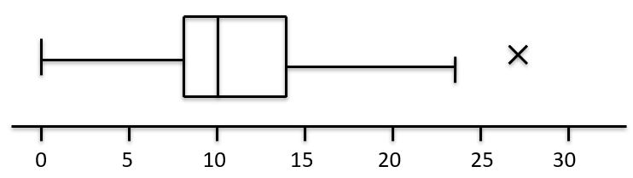
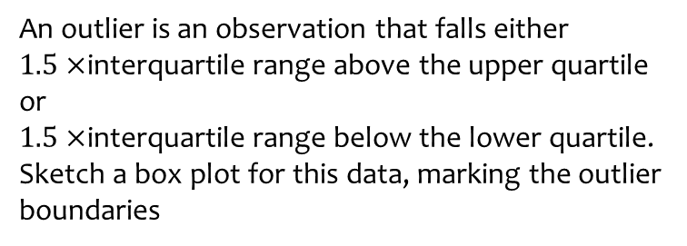
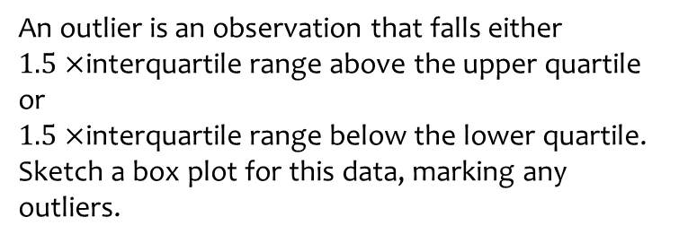
Worked example
Your turn
An outlier is an observation that falls either $1.5×$interquartile range above the upper quartile or
$1.5×$interquartile range below the lower quartile.
Sketch a box plot for this data, marking any outliers.
An outlier is an observation that falls either $1.5×$interquartile range above the upper quartile or
$1.5×$interquartile range below the lower quartile.
Sketch a box plot for this data, marking the outlier boundaries
Smallest values | Largest values | Lower quartile | Median | Upper quartile
0, 4 | 22, 26 | 9 | 11 | 15
Smallest values | Largest values | Lower quartile | Median | Upper quartile
0, 3 | 21, 27 | 8 | 10 | 14
or
Diagrams/Graphs used with permission from DrFrostMaths: https://www.drfrostmaths.com/

Slide 10
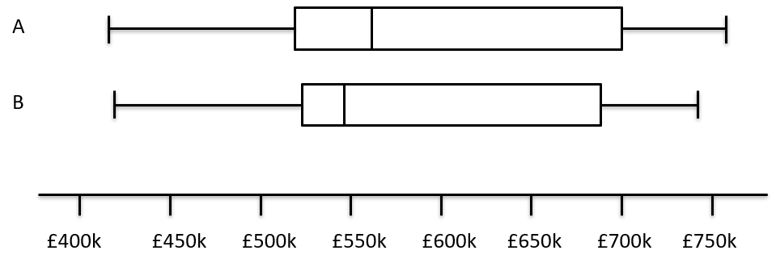
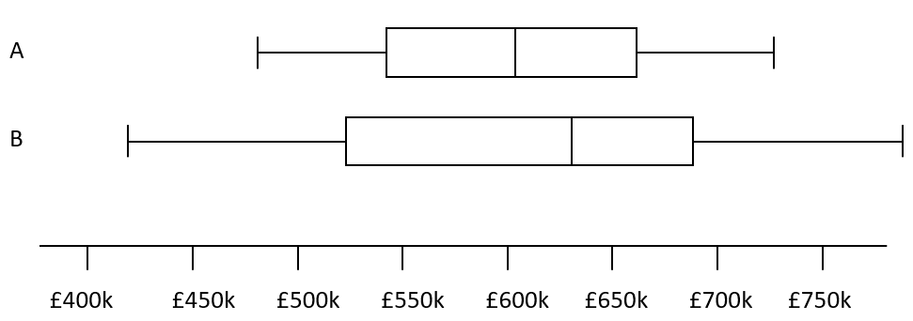
Worked example
Your turn
Compare the house prices of locations A and B
Compare the house prices of locations A and B
The interquartile range of house prices in B is greater than A.
The range of house prices in B is greater than A.
The median house price in Kingston was greater than that in Croydon
Diagrams/Graphs used with permission from DrFrostMaths: https://www.drfrostmaths.com/

Slide 11
3.3) Cumulative frequency
Chapter CONTENTS

Slide 12
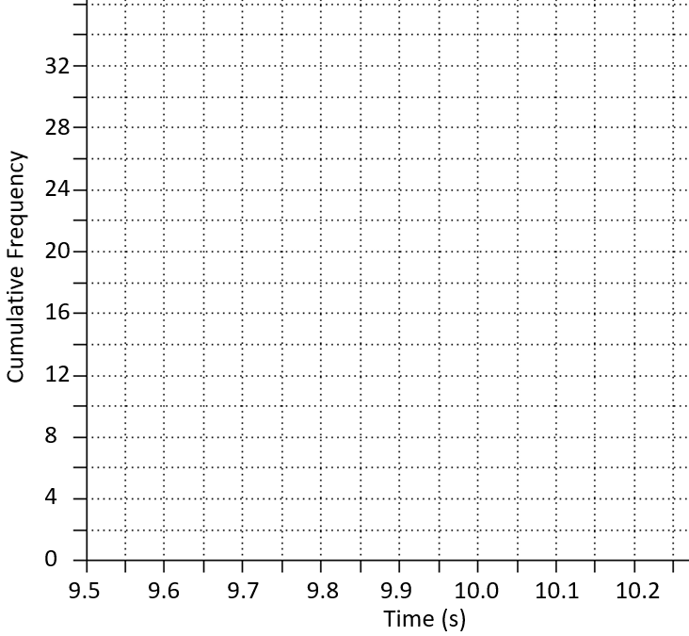
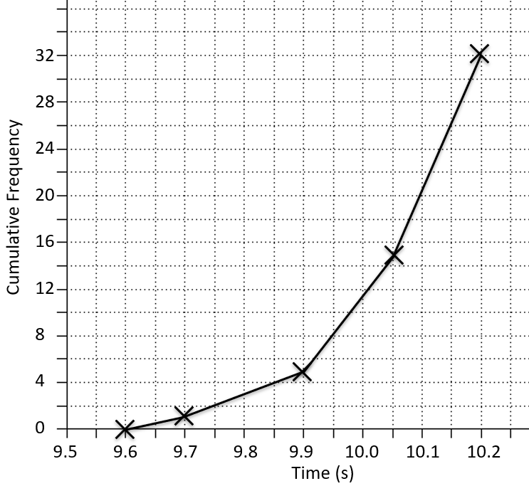
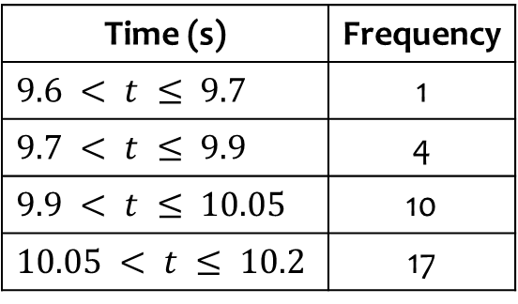
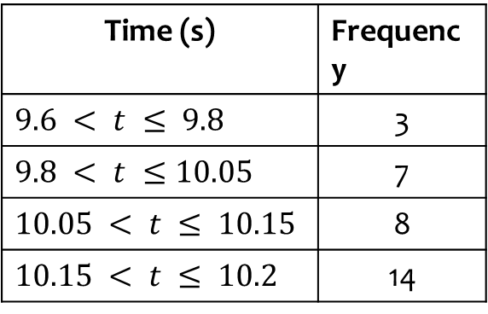
Worked example
Your turn
Draw a cumulative frequency diagram for the data:
Draw a cumulative frequency diagram for the data:
Time (s) | Frequency
$$9.6 < t ≤ 9.8$$ | 3
$$9.8 < t ≤10.05$$ | 7
$$10.05 < t ≤ 10.15$$ | 8
$$10.15 < t ≤ 10.2$$ | 14
Time (s) | Frequency
$$9.6 < t ≤ 9.7$$ | 1
$$9.7 < t ≤ 9.9$$ | 4
$$9.9 < t ≤ 10.05$$ | 10
$$10.05 < t ≤ 10.2$$ | 17
Diagrams/Graphs used with permission from DrFrostMaths: https://www.drfrostmaths.com/

Slide 13
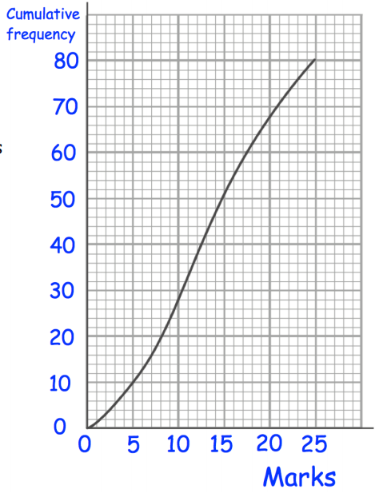
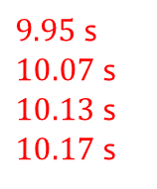
Worked example
Your turn
Use the cumulative frequency diagram to estimate the:
Lower quartile
Median
Upper quartile
60th percentile
Use the cumulative frequency diagram to estimate the:
Lower quartile
Median
Upper quartile
90th percentile
$9.95$ s
$10.07$ s
$10.13$ s
$10.17$ s
Questions used with permission from Corbettmaths (https://corbettmaths.com/) and Drfrostmaths (https://www.drfrostmaths.com/)

Slide 14
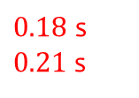
Worked example
Your turn
Use the cumulative frequency diagram to estimate the:
Interquartile range
10th – 90th interpercentile range
Use the cumulative frequency diagram to estimate the:
Interquartile range
20th – 80th interpercentile range
$0.18$s
$0.21$ s
Questions used with permission from Corbettmaths (https://corbettmaths.com/) and Drfrostmaths (https://www.drfrostmaths.com/)

Slide 15
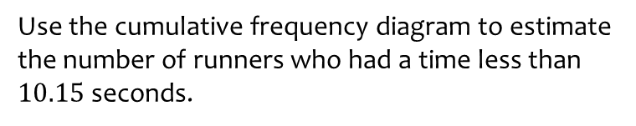
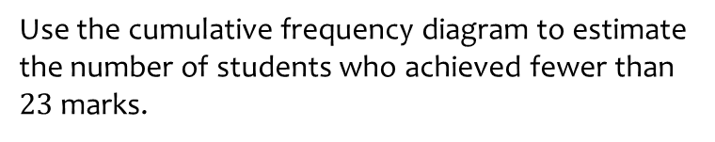
Worked example
Your turn
Use the cumulative frequency diagram to estimate the number of students who achieved fewer than $23$ marks.
Use the cumulative frequency diagram to estimate the number of runners who had a time less than $10.15$ seconds.
$$26$$
Questions used with permission from Corbettmaths (https://corbettmaths.com/) and Drfrostmaths (https://www.drfrostmaths.com/)

Slide 16
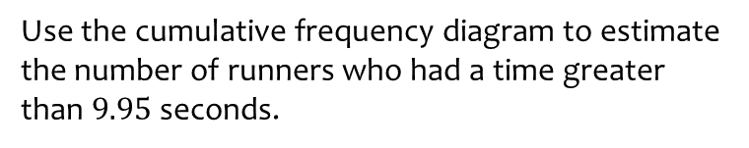
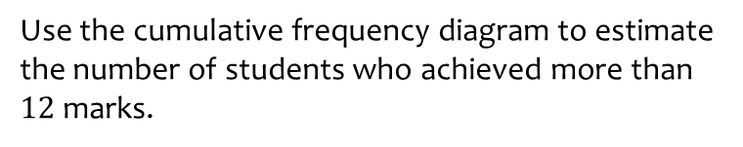
Worked example
Your turn
Use the cumulative frequency diagram to estimate the number of students who achieved more than $12$ marks.
Use the cumulative frequency diagram to estimate the number of runners who had a time greater than $9.95$ seconds.
$$24$$
Questions used with permission from Corbettmaths (https://corbettmaths.com/) and Drfrostmaths (https://www.drfrostmaths.com/)

Slide 17
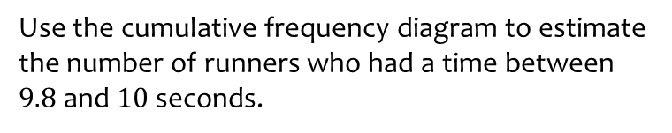
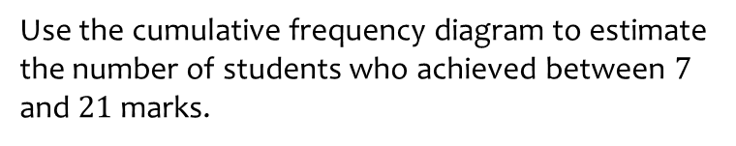
Worked example
Your turn
Use the cumulative frequency diagram to estimate the number of students who achieved between $7$ and $21$ marks.
Use the cumulative frequency diagram to estimate the number of runners who had a time between $9.8$ and $10$ seconds.
$$8$$
Questions used with permission from Corbettmaths (https://corbettmaths.com/) and Drfrostmaths (https://www.drfrostmaths.com/)

Slide 18
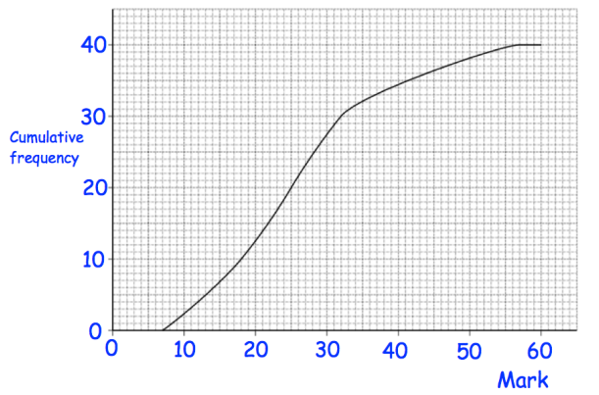
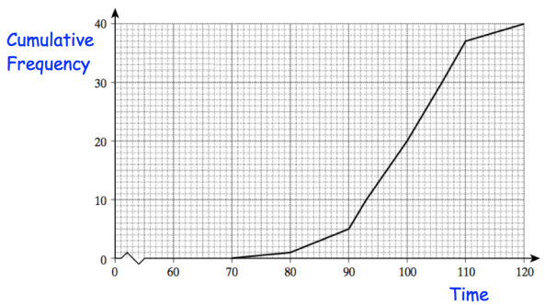
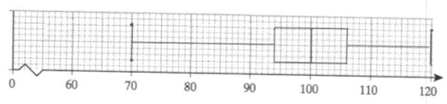
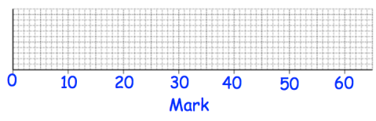
Worked example
Your turn
Use the cumulative frequency diagram to draw a box plot:
Use the cumulative frequency diagram to draw a box plot:
Questions used with permission from Corbettmaths: https://corbettmaths.com/

Slide 19
3.4) Histograms
Chapter CONTENTS

Slide 20
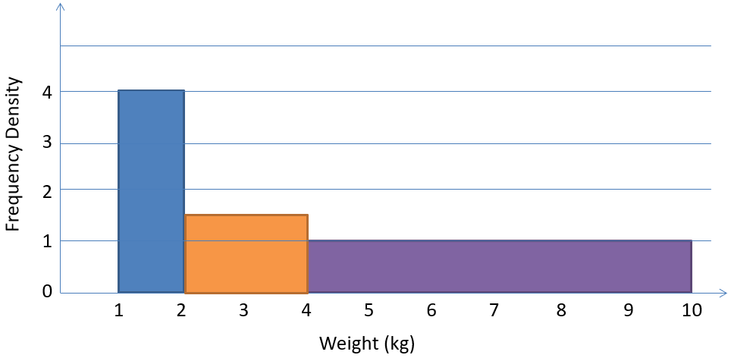
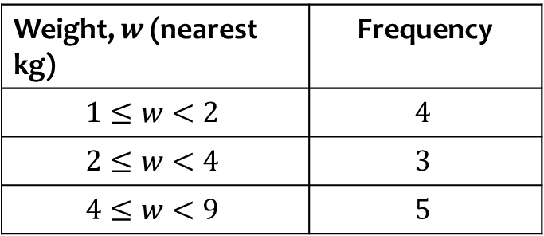
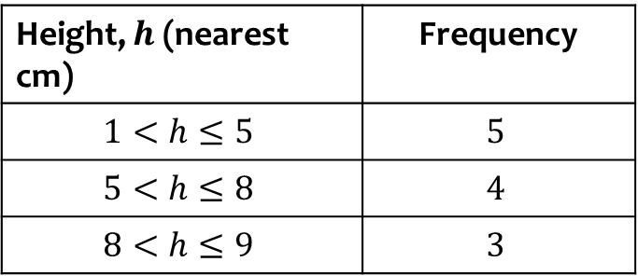
Worked example
Your turn
Plot a histogram for the data:
Plot a histogram for the data:
Height, $h$ (nearest cm) | Frequency
$$1<h≤5$$ | $$5$$
$$5<h≤8$$ | $$4$$
$$8<h≤9$$ | $$3$$
Weight, $w$ (nearest kg) | Frequency
$$1≤w<2$$ | $$4$$
$$2≤w<4$$ | $$3$$
$$4≤w<9$$ | $$5$$

Slide 21
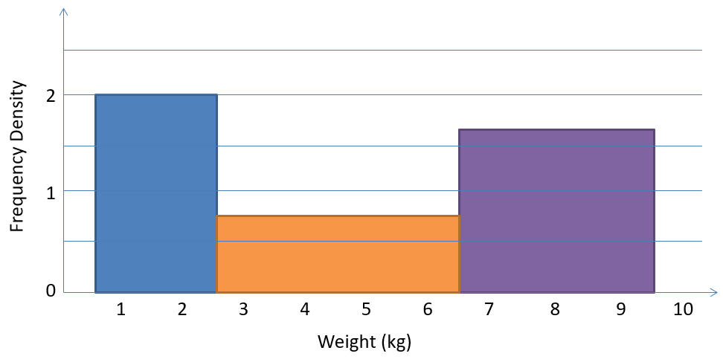
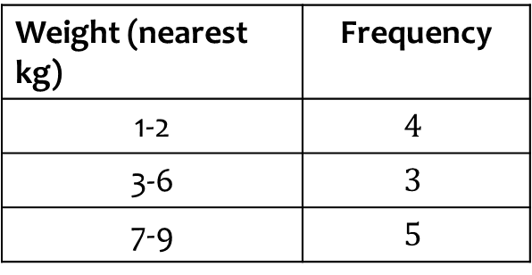
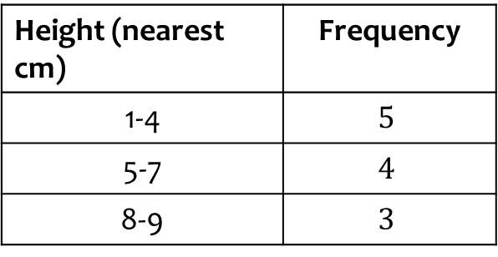
Worked example
Your turn
Plot a histogram for the data:
Plot a histogram for the data:
Height (nearest cm) | Frequency
1-4 | $$5$$
5-7 | $$4$$
8-9 | $$3$$
Weight (nearest kg) | Frequency
1-2 | $$4$$
3-6 | $$3$$
7-9 | $$5$$

Slide 22
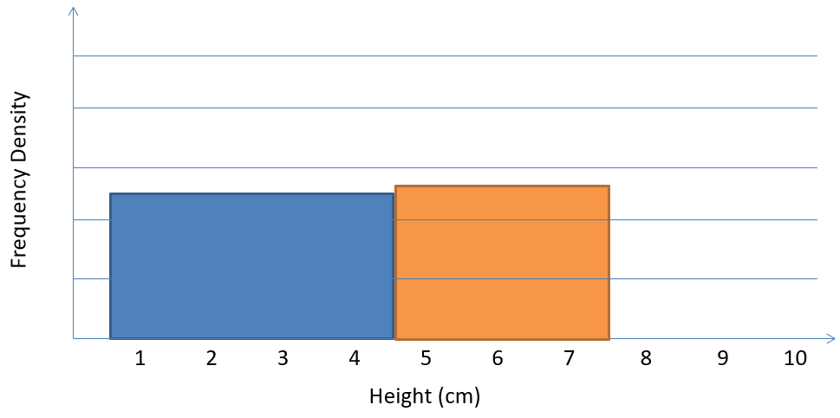
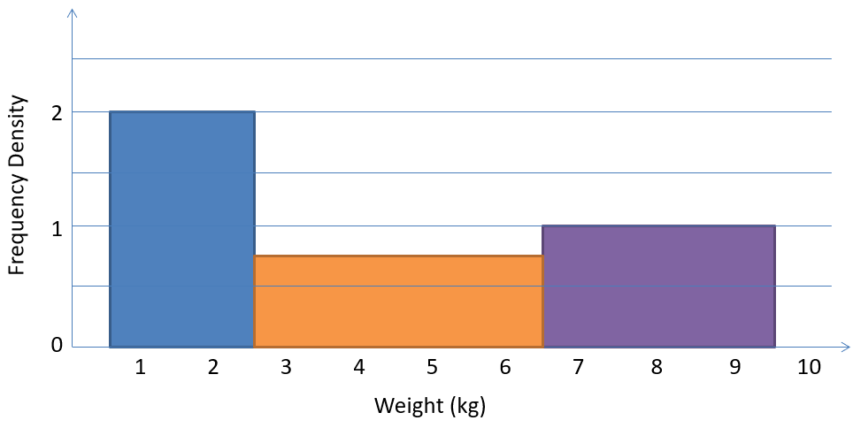
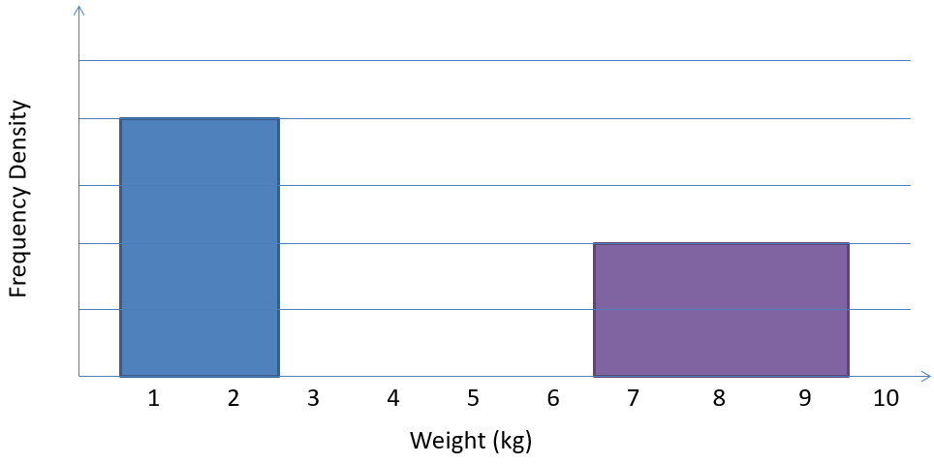
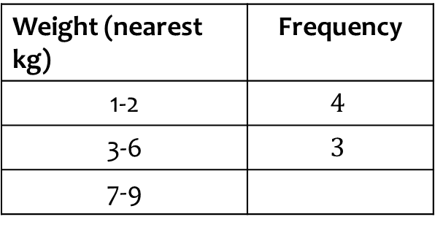

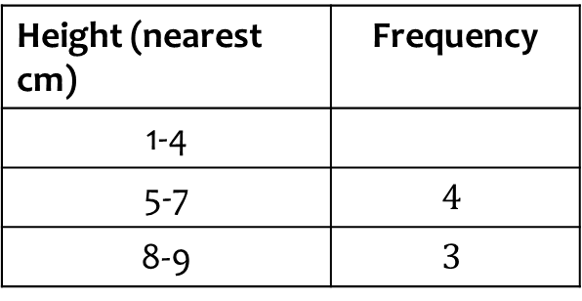
Worked example
Your turn
Complete the table and histogram:
Complete the table and histogram:
Height (nearest cm) | Frequency
1-4
5-7 | $$4$$
8-9 | $$3$$
Weight (nearest kg) | Frequency
1-2 | $$4$$
3-6 | $$3$$
7-9
$$3$$

Slide 23
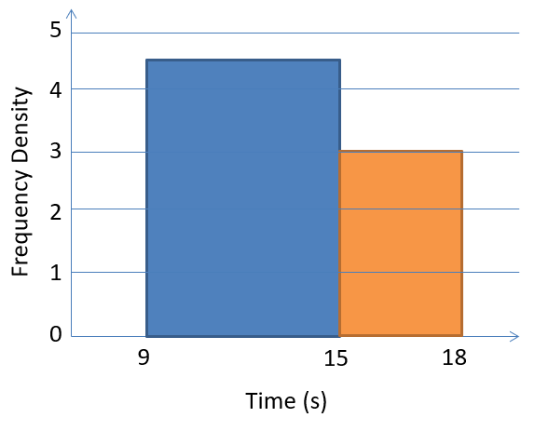
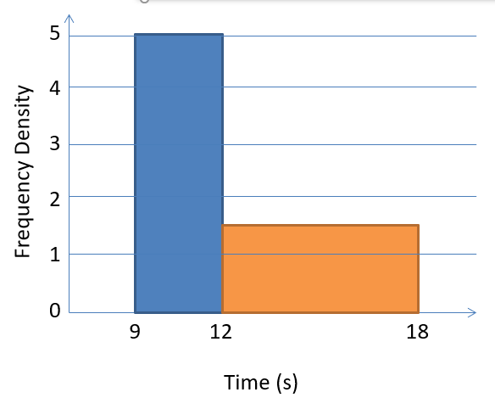
Worked example
Your turn
There were 54 runners in a 100m race.
The following histogram represents their times. Determine the number of runners with times below 13 seconds.
There were 60 runners in a 100m race.
The following histogram represents their times. Determine the number of runners with times above 14 seconds.
$$15$$

Slide 24
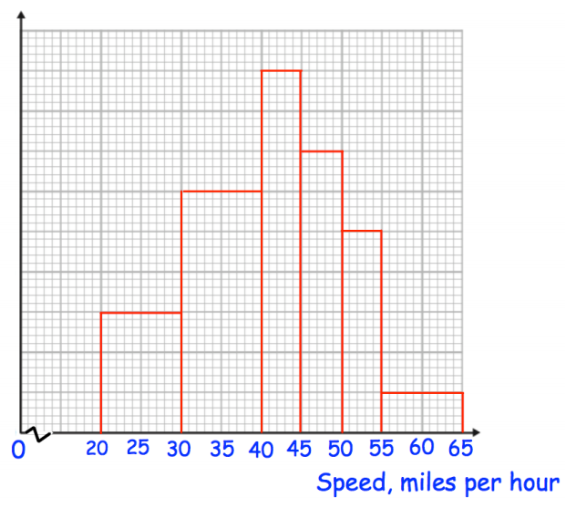
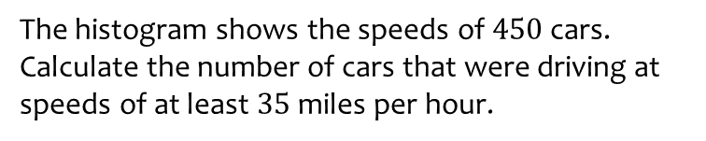
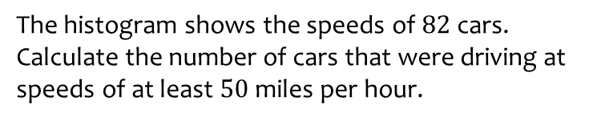
Worked example
Your turn
The histogram shows the speeds of $82$ cars.
Calculate the number of cars that were driving at speeds of at least $50$ miles per hour.
The histogram shows the speeds of $450$ cars.
Calculate the number of cars that were driving at speeds of at least $35$ miles per hour.
$$90$$
Questions used with permission from Corbettmaths (https://corbettmaths.com/) and Drfrostmaths (https://www.drfrostmaths.com/)

Slide 25
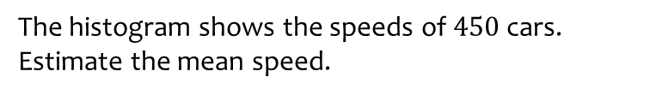
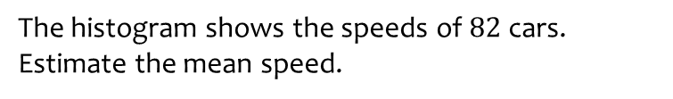

Worked example
Your turn
The histogram shows the speeds of $82$ cars.
Estimate the mean speed.
The histogram shows the speeds of $450$ cars.
Estimate the mean speed.
$28.8$mph
Questions used with permission from Corbettmaths (https://corbettmaths.com/) and Drfrostmaths (https://www.drfrostmaths.com/)

Slide 26
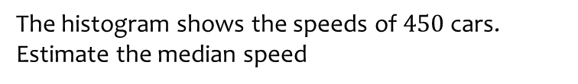
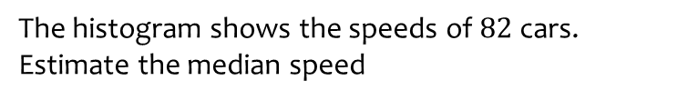

Worked example
Your turn
The histogram shows the speeds of $82$ cars.
Estimate the median speed
The histogram shows the speeds of $450$ cars.
Estimate the median speed
$28.1$ mph (3 sf)
Questions used with permission from Corbettmaths (https://corbettmaths.com/) and Drfrostmaths (https://www.drfrostmaths.com/)

Slide 27



Worked example
Your turn
The frequency table shows some running times.
On a histogram the bar for 0-2 seconds is drawn with width 8cm and height 12cm.
Find the width and height of the bar for 2-6 seconds.
The frequency table shows some running times. On a histogram the bar for 0-4 seconds is drawn with width 6cm and height 8cm. Find the width and height of the bar for 4-6 seconds.
Time (seconds) | Frequency
$$0≤t<2$$ | $$12$$
$$2≤t<6$$ | $$3$$
Time (seconds) | Frequency
$$0≤t<4$$ | $$8$$
$$4≤t<6$$ | $$9$$
Width $=3$ cm
Height $=18$ cm

Slide 28





Worked example
Your turn
The variable $x$ was measured to the nearest whole number.
On a histogram the bar representing the $2−7$ class has a width of $4$ cm and a height of $12$ cm.
Find the width and height of the $8−10$ class
The variable $x$ was measured to the nearest whole number.
On a histogram the bar representing the $10−15$ class has a width of $2$ cm and a height of $5$ cm.
Find the width and height of the $16−18$ class
$$x$$ | Frequency
$$2−7$$ | $$18$$
$$8−10$$ | $$6$$
$$12−$$ | $$4$$
$$x$$ | Frequency
$$10−15$$ | $$15$$
$$16−18$$ | $$9$$
$$19−$$ | $$16$$
Width $=1$ cm
Height $=6$ cm

Slide 29


Worked example
Your turn
Draw a frequency polygon.
Draw a frequency polygon.
Questions used with permission from Corbettmaths (https://corbettmaths.com/) and Drfrostmaths (https://www.drfrostmaths.com/)

Slide 30



Worked example
Your turn
Plot a histogram
Plot a histogram
Height, $x$ (cm) | Frequency
$$140<x≤155$$ | $$6$$
$$155<x≤175$$ | $$14$$
$$175<x≤185$$ | $$6$$
$$185<x≤190$$ | $$21$$
Price, $y$ (£) | Frequency
$$0<y≤10$$ | $$4$$
$$10<y≤20$$ | $$9$$
$$20<y≤25$$ | $$8$$
$$25<y≤35$$ | $$10$$
$$35<y≤50$$ | $$12$$
Frequency Density
Price (£)
Diagrams/Graphs used with permission from DrFrostMaths: https://www.drfrostmaths.com/

Slide 31



Worked example
Your turn
Draw a frequency table from the histogram
Draw a frequency table from the histogram
Height, $y$(cm) | Frequency
$$120<y≤130$$ | $$25$$
$$130<y≤145$$ | $$15$$
$$145<y≤155$$ | $$20$$
$$155<y≤160$$ | $$20$$
$$160<y≤180$$ | $$20$$

Slide 32



Worked example
Your turn
Estimate the number of pilots who have flown under 350 hours.
Estimate the number of students who took less than 60 seconds to complete the puzzle
$$120$$
Questions used with permission from Corbettmaths: https://corbettmaths.com/

Slide 33




Worked example
Your turn
Work out the percentage of pilots who have flown under 250 hours.
Work out the percentage of cars that were under the speed limit of $60 mph$
$$96\%$$
Questions used with permission from Corbettmaths: https://corbettmaths.com/

Slide 34






Worked example
Your turn
There were 82 cars on the road.
14 cars were travelling over $50 mph$.
Estimate the number of cars that were travelling between $40$ and $49$ mph.
There were 504 athletes measured.
45 athletes weigh under $60 kg$.
Estimate the number of athletes between $70$ and $95 kg$.
$$243$$
Questions used with permission from Corbettmaths: https://corbettmaths.com/

Slide 35



Worked example
Your turn
Estimate the median time
Estimate the median weight
$14.84$(2 dp)
Questions used with permission from Corbettmaths: https://corbettmaths.com/

Slide 36


Worked example
Your turn
A participant is chosen at random.
What is the probability they took longer than 60 seconds?
A participant is chosen at random.
What is the probability they weigh more than $14 kg$?
$\frac{14}{25}=0.56$
Questions used with permission from Corbettmaths: https://corbettmaths.com/

Slide 37
3.5) Comparing data
Chapter CONTENTS

Slide 38



Worked example
Your turn
From the large data set, the daily mean temperature during June 1987 is recorded at Camborne and Leuchars.
For Camborne, $\sum{x}=377.1$ and $\sum{x^{2}}=4939.45$
For Leuchars, the mean temperature was $10.9 °C$ with a standard deviation of $2.10 °C$.
Compare the data for the two locations.
From the large data set, the daily mean temperature during August 2015 is recorded at Heathrow and Leeming.
For Heathrow, $\sum{x}=562.0$ and $\sum{x^{2}}=10301.2$
For Leeming, the mean temperature was $15.6 °C$ with a standard deviation of $2.01 °C$.
Compare the data for the two locations.
Mean daily temperature in Heathrow $=18.1 °C$
Standard deviation in Heathrow $=1.91 °C$ (3 sf)
The mean daily temperature in Leeming is lower than in Heathrow.
The spread of temperatures is greater in Leeming than in Heathrow.

Slide 39
Worked example
Your turn
Compare the house prices of locations A and B
Compare the house prices of locations A and B
The interquartile range of house prices in B is greater than A.
The range of house prices in B is greater than A.
The median house price in Kingston was greater than that in Croydon
Diagrams/Graphs used with permission from DrFrostMaths: https://www.drfrostmaths.com/

